Slide 1
Organizing MAC frame formats in 802.15.13
Date: 2018-7-10
Authors:

Slide 2
Abstract
In this contribution we summarize the MAC frame types in draft 2 of 15.13
The way forward is proposed for discussion

Slide 3
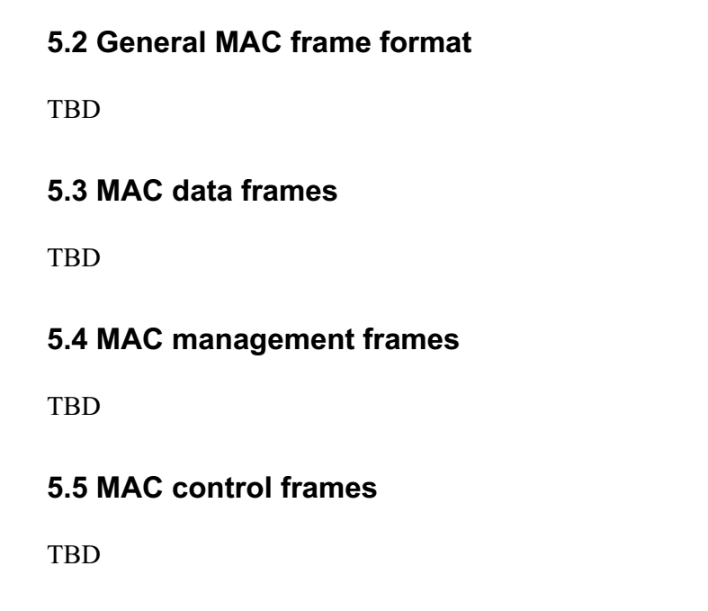
Draft 2 MAC frame types
In current draft, four sections are kept blank
Text for 5.2 is now available and may be integrated into D3 [1]
Next step
5.3 MAC data frames
5.4 MAC management frames
5.5 MAC control frames

Slide 4
Current frame types
Type value b3 b2 | Type description | Subtype value b7 b6 b5 b4 | Subtype description
00 | Management | 0000 | Association request
00 | Management | 0001 | Association response
00 | Management | 0010 | Reassociation request
00 | Management | 0011 | Reassociation response
00 | Management | 0100 | Probe request
00 | Management | 0101 | Probe response
00 | Management | 0110-0111 | Reserved
00 | Management | 1000 | Beacon
00 | Management | 1001 | Disassociation notification
00 | Management | 1010 | Authentication
00 | Management | 1011 | Deauthentication
 | Management |  | Clock rate change notification
 | Management |  | Beacon request
 | Management |  | Additional beacon request
 | Management |  | Coordinator realignment
 | Management |  | Data request
 | Management |  | GTS request
 | Management |  | GTS response
 | Management |  | Neighboring OWPAN report request
 | Management |  | Neighboring OWPAN report indication
 | Management |  | OWPAN ID conflict notification
 | Management |  | Scan-over-backhaul request
 | Management |  | Scan-over-backhaul confirmation
00 | Management | 1100-1111 | Reserved
01 | Control | 0000 | Waveform Control
01 | Control | 0001 | Advanced Modulation Control
01 | Control | 0010 | CSI Control
01 | Control | 0011 | High reliability control
01 | Control | 0100 | Acknowledgement
 | Control |  | RTS
 | Control |  | CTS
01 | Control | 0100-1111 | Reserved
10 | Data | 0000 | Data
10 | Data | 0001 | Null (no data)
10 | Data | 0010-1111 | Reserved
11 | Reserved | 0000-1111 | Reserved
The current MAC frame types were summarized in [1]

Slide 5
Suggested organization
Type value b3 b2 | Type description | Subtype value b7 b6 b5 b4 | Subtype description | Text
00 | Management | 0000 | Association request | Annex I.1
00 | Management | 0001 | Association response | Annex I.2
00 | Management | 0010 | Reassociation request | Annex I.3
00 | Management | 0011 | Reassociation response | Not available
00 | Management | 0100 | Probe request | Page 270, Need revision to follow agreed frame structure
00 | Management | 0101 | Probe response | Page 270, Need revision to follow agreed frame structure
00 | Management | 0110 | Beacon | G.2.1
00 | Management | 0111 | Disassociation notification | I.4
00 | Management | 1000 | Authentication | Page 270, Need revision to follow agreed frame structure
00 | Management | 1001 | Deauthentication | Page 271, Need revision to follow agreed frame structure
00 | Management | 1010 | Clock rate change notification | I.17
00 | Management | 1011 | Beacon request | I.11
00 | Management | 1100 | Additional beacon request | I.12
00 | Management | 1101 | Coordinator realignment | I.13
00 | Management | 1110 | Data request | I.5
00 | Management | 1111 | GTS request | I.14
01 | Management | 0000 | GTS response | I.16
01 | Management | 0001 | Neighboring OWPAN report request | I.9
01 | Management | 0010 | Neighboring OWPAN report indication | I.10
01 | Management | 0011 | OWPAN ID conflict notification | I.8
01 | Management | 0100 | Scan-over-backhaul request | I.6
01 | Management | 0101 | Scan-over-backhaul confirmation | I.7
01 | Management | 0110-1111 | Reserved
10 | Control | 0000 | Waveform Control | Not available
10 | Control | 0001 | Advanced Modulation Control | H 4.3.1 Need revision to follow agreed frame structure
10 | Control | 0010 | CSI Control | P280 Need revision to follow agreed frame structure
10 | Control | 0011 | High reliability control | Not available
10 | Control | 0100 | Acknowledgement | G.2.3
10 | Control | 0101 | RTS / CTS | G.2.5
10 | Control | 0110 -1111 | Reserved
11 | Data | 0000 | Data | G.2.2
11 | Data | 0001 | Null (no data) | G.2.6
11 | Data | 0010-1111 | Reserved

Slide 6
Next step
Agree on the frame type table
Q1: does the table in the previous page cover all the frames types that need to be specified?
Q2: are there any frame types included in the previous page unnecessary in the future draft?
Comment collection (until next round of comment resolution)
For frame types with text available, provide your comment
If no comment received, the text in current draft will be moved from annex into the specification
For frame types that text is not available, provide the text if you want to.
If no text received by September meeting, the group may need to consider deleting the frame type and the associated MAC procedures

Slide 7
Next step
After comments are resolved, the text will be merged into
5.3 MAC data frames
5.4 MAC management frames
5.5 MAC control frames

Slide 8
Reference
Chong Han, Nikola Serafimovski，John Li, “15-18/270 r3 Text proposal of general MAC format”

