Slide 1
Organizing MAC frame formats in 802.15.13
Date: 2017-11-01
Authors:

Slide 2
Abstract
In draft 1 of 15.13, there are two different designs of MAC
  MAC inherited from 802.15.7-2011 (hence 802.15.4)
  MAC proposed in [1]
Both MACs define a set of MAC frames types, yet there are a lot of overlaps
In this contribution we suggest to unify MAC designs. As the first step, we try to organize the MAC frame types.

Slide 3
Overview
In draft 1 of 15.13, there are still two MAC frameworks
  MAC inherited from 802.15.7-2011 (hence 802.15.4)
  MAC proposed in [1] (which follows 802.11 MAC principle)
Eventually these two MAC frameworks should be merged into one
Four aspects to work in order to unify MAC
  MAC functionalities: (already merged)
  MAC frame structure
  MAC frame types
  Primitives
As the first step, this contribution provides review of MAC frame types and propose a unified classification

Slide 4
Frame types
IEEE 802.15.7: frame types
  Beacon frame
  Data frame
  Acknowledgement frame
  Command frame
  CVD frame
  Control frame
Frame types proposed in [1]
  Management frame
  Data frame
  Control frame

Slide 5
Frame type | Subtype
Beacon frame | Beacon frame
Data frame | Data frame
Acknowledgement frame | Acknowledgement frame
Command frame | Association request
 | Association response
 | Re-association request
 | Disassociation notification
 | Data request
 | Scan-over-backhaul request
 | Scan-over-backhaul confirmation
 | OWPAN ID conflict notification
 | Neighboring OWPAN report request
 | Neighboring OWPAN report indication
 | Beacon request
 | Additional Beacon request
 | Coordinator alignment
 | GTS request
 | Blinking notification
 | Fast link recovery
 | Mobility notification command
 | GTS response
 | Clock rate change notification
 | Multiple channel assignment
 | CVD disable
 | CSI control
CVD frame | CVD frame
Control frame | RTS
 | CTS
Frame type | Subtype
Management | Association request
 | Association response
 | Reassociation request
 | Reassociation response
 | Probe request
 | Probe response
 | Beacon
 | ATIM
 | Disassociation
 | Authentication
 | Deauthentication
 | Action
Data | Data
 | Null (no data)
Control | Waveform control
 | Advanced modulation control
 | CSI control
Observation: classification of frames types are different
Yet, a large number for frame types are common, such as beacon, association request, data, etc.
It is suggested to unify the frame types in the specification.

Slide 6
CVD frames
CVD frames are specified for color function, visibility, dimming.
As discussed in our companion contribution [2],
  Color function and dimming are no longer specified in the normative part of 15.13
  Visibility pattern may be specified as a PHY signal rather than MAC frame
Proposal 1:
  CVD frame is removed. Visibility pattern, (if specified) should be specified in PHY.

Slide 7
Frame type | Subtype
Management | Action
 | Additional Beacon request
 | Association request
 | Association response
 | ATIM
 | Authentication
 | Beacon
 | Beacon request
 | Blinking notification
 | Clock rate change notification
 | CVD disable
 | Coordinator alignment
 | Data request
 | Deauthentication
 | Disassociation notification
 | Fast link recovery
 | GTS request
 | GTS response
 | Mobility notification command
 | Multiple channel assignment
 | Neighboring OWPAN report request
 | Neighboring OWPAN report indication
 | OWPAN ID conflict notification
 | Probe request
 | Probe response
 | Re-association request
 | Re-association response
 | Scan-over-backhaul request
 | Scan-over-backhaul confirmation
Frame type | Subtype
Data | Data
 | Null (no data)
Control frame | Acknowledgement
 | Advanced modulation control
 | CSI control
 | CTS
 | RTS
 | Waveform control
Proposal 2: 15.13 MAC frame types are classified into management frame; data frame; control frame
  Data frame: for data transmission
  Management frame: for OWPAN management
  Control frame: Control Frames assist with the delivery of Data & Management frames

Slide 8
Potential unnecessary frame types
Control frame -> waveform control
  Observation: no specification of the format of “waveform control frame” and there is no explanation why “waveform control frame” is needed
  Proposal 3: “waveform control frame type” is removed

Slide 9
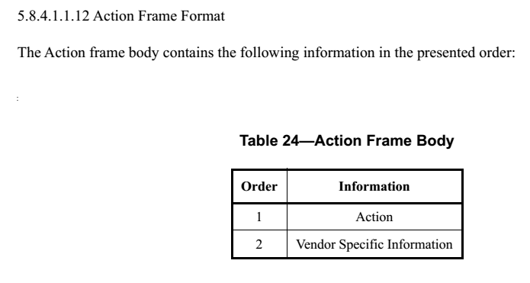
Potential unnecessary frame types
Management -> Action
  Observation: action frame format is specified. Yet there is no MAC functional description for which action frame is used.
  Proposal 4: clarify whether action frame is needed in 15.13

Slide 10

Potential unnecessary frame types
Management -> ATIM
  Observation: ATIM frame format is specified. Yet there is no MAC functional description for which ATIM frame is used.
  Proposal 5: clarify whether ATIM frame is needed in 15.13

Slide 11
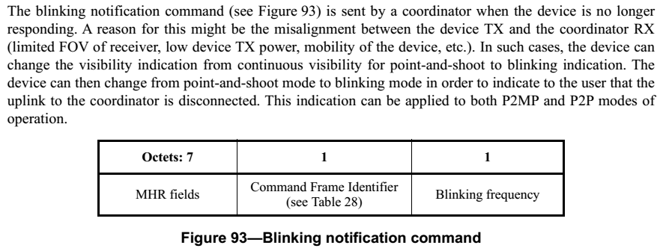
Potential unnecessary frame types
Management -> blinking notification command
  Observation: it is an implementation issues and does not need standard support.
  Proposal 6: remove blinking notification command and related text

Slide 12
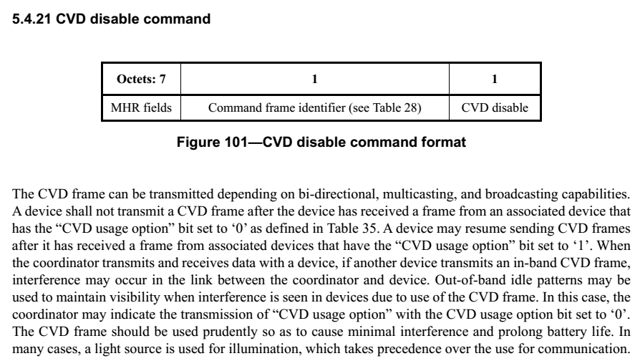
Potential unnecessary frame types
Management -> CVD disable
  Observation: CVD disable frame is used in conjunction with CVD frame. If it is agreed to remove CVD frame from 15.13, then CVD disable frame does not need to be specified.
  Proposal 7: CVD disable frame type is removed

Slide 13
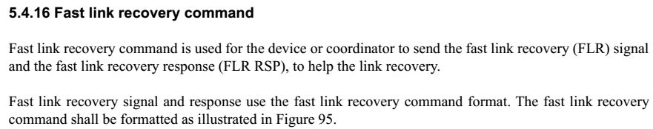
Potential unnecessary frame types
Management -> fast link recovery command
  As discussed in our companion contribution [2], the necessity for a dedicated fast link recovery is not clear
  Proposal 8: fast link recovery command frame is removed

Slide 14
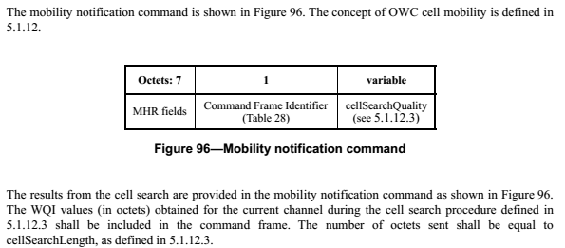
Potential unnecessary frame types
Management -> Mobility notification command
  As discussed in our companion contribution [2], the necessity for cell reconfiguration is unnecessary as MIMO is introduced.
  Proposal 9: mobility notification command frame is removed

Slide 15
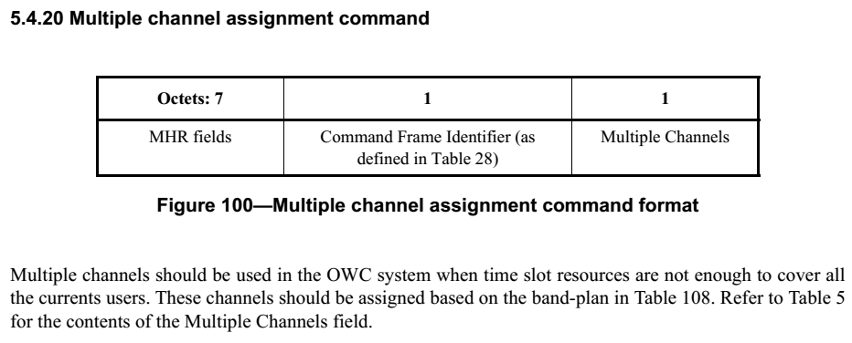
Potential unnecessary frame types
Management -> Multiple channel assignment
  Observation: multiple logical channel operations were deleted in draft 1
  Proposal 10: multiple channel assignment command is removed

Slide 16

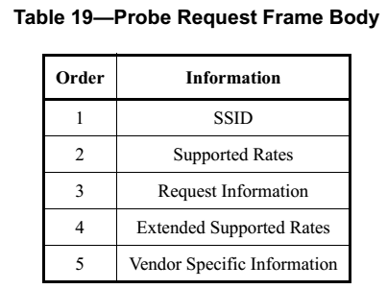
Potential unnecessary frame types
Management -> Probe request
  Observation: Probe request frame format was specified as above. Yet there is no MAC functional description for where probe request frame is used.
  Proposal 11: clarify whether probe request frame is needed.

Slide 17

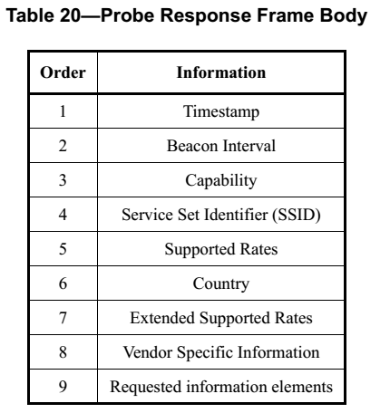
Potential unnecessary frame types
Management -> Probe response
  Observation: Probe request frame format was specified as above. Yet there is no MAC functional description for where probe request frame is used.
  Proposal 12: clarify whether probe request frame is needed.

Slide 18
Summary
As the first step, this contribution provides review of MAC frame types and propose a unified classification. It is proposed that
  Proposal 1: CVD frame is removed. Visibility pattern, (if specified) should be specified in PHY.
  Proposal 2: 15.13 MAC frame types are classified into management frame; data frame; control frame
  Proposal 3: “waveform control frame type” is removed
    Proposal rejected
  Proposal 4: clarify whether action frame is needed in 15.13
  Proposal 5: clarify whether ATIM frame is needed in 15.13
  Proposal 6: remove blinking notification command and related text

Slide 19
Summary
Proposal
  Proposal 7: CVD disable frame type is removed
  Proposal 8: fast link recovery command frame is removed
  Proposal 9: mobility notification command frame is removed
  Proposal 10: multiple channel assignment command is removed
  Proposal 11: clarify whether probe request frame is needed.
    Probe request frame is kept in the draft 3
  Proposal 12: clarify whether probe request frame is needed.
    Probe request frame is kept in the draft 3

Slide 20
Summary
Frame type | Subtype
Management | Action
 | Additional Beacon request
 | Association request
 | Association response
 | ATIM
 | Authentication
 | Beacon
 | Beacon request
 | Blinking notification
 | Clock rate change notification
 | CVD disable
 | Coordinator alignment
 | Data request
 | Deauthentication
 | Disassociation notification
 | Fast link recovery
 | GTS request
 | GTS response
 | Mobility notification command
 | Multiple channel assignment
 | Neighboring OWPAN report request
 | Neighboring OWPAN report indication
 | OWPAN ID conflict notification
 | Probe request
 | Probe response
 | Re-association request
 | Re-association response
 | Scan-over-backhaul request
 | Scan-over-backhaul confirmation
It is proposed to adopt the following frame type classification
Frame type | Subtype
Data | Data
 | Null (no data)
Control frame | Acknowledgement
 | Advanced modulation control
 | CSI control
 | CTS
 | RTS
 | Waveform control

Slide 21
Reference
Dobroslav Tsonev (pureLiFi), Nikola Serafimovski (pureLiFi), et. al. “15-16-0363-00-007a text input lifi low bandwidth phy and mac d0”, May, 2016
John Li (Huawei), “15-17-0578-00-0013 considerations on some MAC functionalities”, November, 2017

