Slide 1
Considerations on some MAC functionalities
Date: 2017-11-01
Authors:

Slide 2
Abstract
Draft 1 of 802.15.13 was released in October 2017
Some MAC functionalities were analysed in this contribution. These functionalities are mainly vestiges from 802.15.7-2011 and potentially non-essential for 802.15.13
Fast link recovery
Intra PAN Cell (re)configuration
Intra PAN mobility
CVD MAC frame
It is proposed to remove these MAC functionalities in future drafts

Slide 3
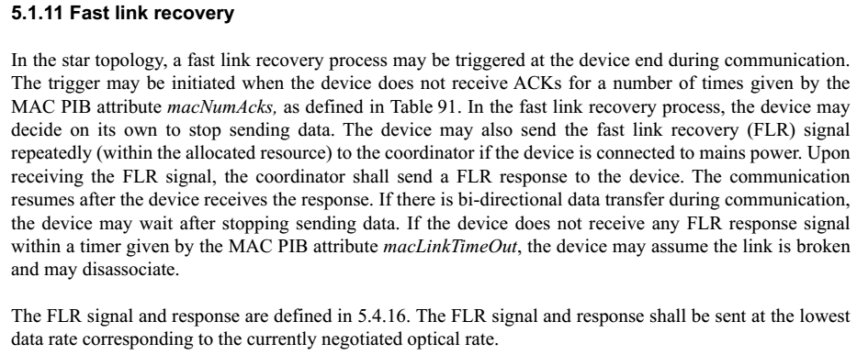
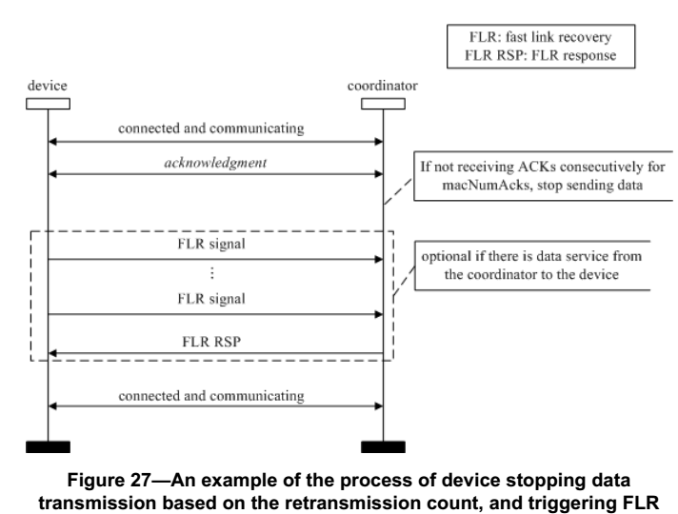
Fast link recovery

Slide 4
Fast link recovery
Considerations on fast link recovery
Fast link recovery is leftover from IEEE 802.15.7-2011
Observation 1: fast link recovery can be achieved through other approaches. For example the device can send data with the lowest MCS level. If even the lowest MCS level can not be successfully received, there is no point to recover the link.
Observation 2: the necessity for a dedicated fast link recovery is not clear. Yet it brought significant complexity to the specification.
Proposal 1: Remove fast link recovery and related signaling from future draft.

Slide 5
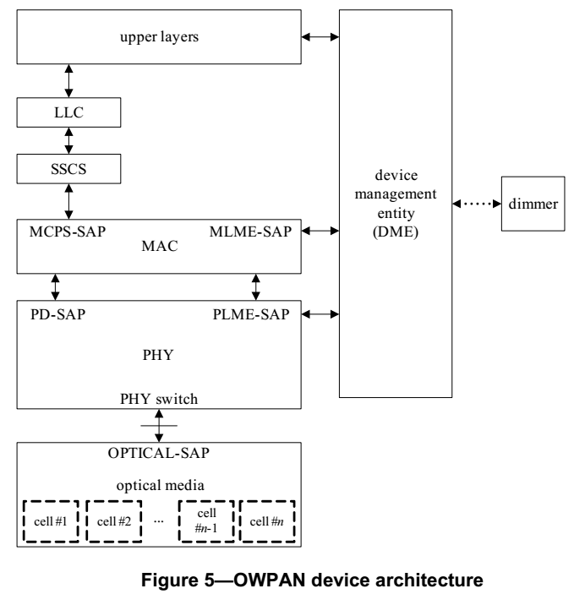
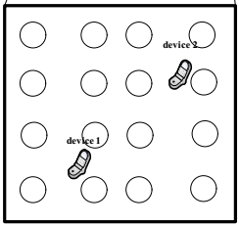
Cell configuration
In 802.15.7-2011, each OWPAN can be further divided into multiple “cells”
One coordinator can connect to multiple optical sources (LED bulbs).
The coordinator can divide multiple LED bulbs into several cells.
Cell 1
Cell 2
Cell 3
Cell 4

Slide 6
Cell configuration
DME can choose which cell is used for transmission
DME use PHY switch to select the cell for transmission

Slide 7
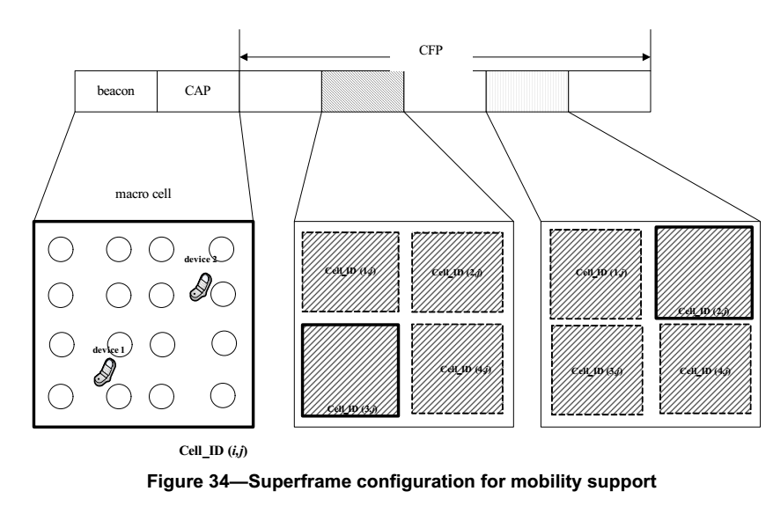
Cell configuration
During beacon and CAP, all LED bulbs transmit the same signal to form a macro cell
During CFP, the coordinator can choose different cells to serve difference device

Slide 8
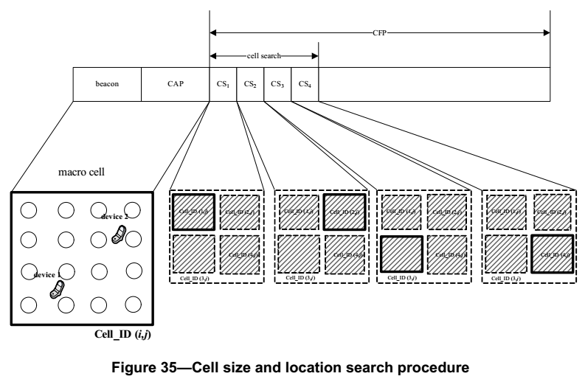
Cell configuration
For each device, which cell is optimal for service can be selected based on measurements.

Slide 9
Cell configuration
Observation: the introduction of MIMO makes the current mechanism unnecessary. Such scheme is just one special case of MIMO antenna selection.
Proposal 2: in 15.13, one OWPAN is not further divided into cells.
Proposal 3: the mechanism for cell (re)configuration is removed from 15.13

Slide 10
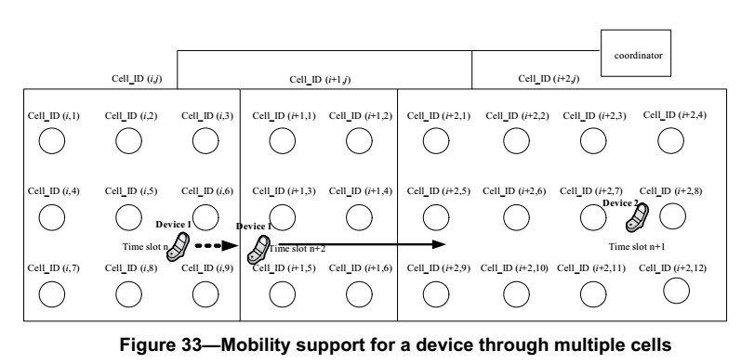
Intra-OWPAN mobility
In 802.15.7-2011, the mobility support for a device move from one cell to another is specified

Slide 11
Intra-OWPAN mobility
Observation: the introduction of MIMO makes the current mechanism unnecessary. It can be considered as antenna switching.
Proposal 4: the mechanism for inter-cell mobility is removed.

Slide 12
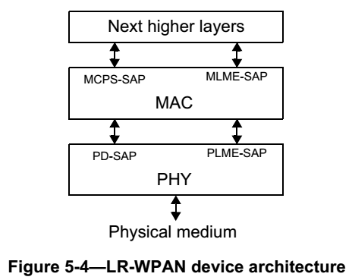
Device architecture
If the previous proposals were accepted
DME’s function: 1) dimming support 2) cell management are all not specified
There is no necessity to specify DME for 15.13
Proposal 5: adopt the simple device architecture used by 15.4 where there is no DME

Slide 13
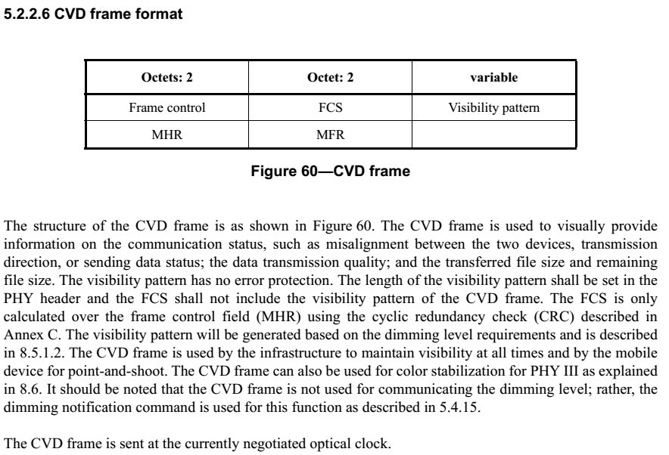
CVD frame
CVD frame is classified as one MAC frame type, used for
Color function
Visibility
Dimming support

Slide 14
CVD frame
Observation:
Dimming support and color function are no longer specified by 15.13
Visibility patterns may still be needed for inter-frame visibility support. However, it may be considered as PHY signal rather than MAC frame.
Proposal 6:
CVD frame is removed. Visibility pattern, (if specified) should be specified in PHY.

Slide 15
Summary
In this contribution, several MAC functionalities are analyzed. It is proposed that:
Proposal 1: Remove fast link recovery and related signaling from future draft.
Proposal 2: in 15.13, one OWPAN is not further divided into cells.
Proposal 3: the mechanism for cell (re)configuration is removed from 15.13
Proposal 4: the mechanism for inter-cell mobility is removed.
Proposal 5: adopt the simple device architecture used by 15.4 where there is no DME
Proposal 6: CVD frame is removed. Visibility pattern, (if specified) should be specified in PHY.

