Slide 1
Project: IEEE P802.15 Working Group for Wireless Personal Area Networks (WPANs)
Submission Title: [Proposal for Recommendation to WG 15]
Date Submitted: [14 September 2017]
Source: [Joerg ROBERT] Company [Friedrich-Alexander University Erlangen-Nuernberg]
Address [Am Wolfsmantel 33, 91058 Erlangen, Germany]
Voice:[+49 9131 8525373], FAX: [+49 9131 8525102], E-Mail:[joerg.robert@fau.de]
Re: []
Abstract: [This document contains a proposal how to proceed after the end of the IG LPWA]
Purpose: [Discussion with IG LPWA]
Notice: This document has been prepared to assist the IEEE P802.15. It is offered as a basis for discussion and is not binding on the contributing individual(s) or organization(s). The material in this document is subject to change in form and content after further study. The contributor(s) reserve(s) the right to add, amend or withdraw material contained herein.
Release: The contributor acknowledges and accepts that this contribution becomes the property of IEEE and may be made publicly available by P802.15.

Slide 2
Proposal for Recommendation to WG 802.15
Joerg Robert (University Erlangen-Nuernberg)

Slide 3
Motivation
A list of proprietary LPWAN system is already available on the market, but many applications require open standards for long lasting operation
Also existing IEEE 802.15.4 networks may use low-bitrate links for long range communication
However: Low bit-rates are significantly more sensitive wrt. interference (17/15-478)
Improve performance of 802.15.4 for low-bitrates in highly interfered channels allows for significant gains

Slide 4
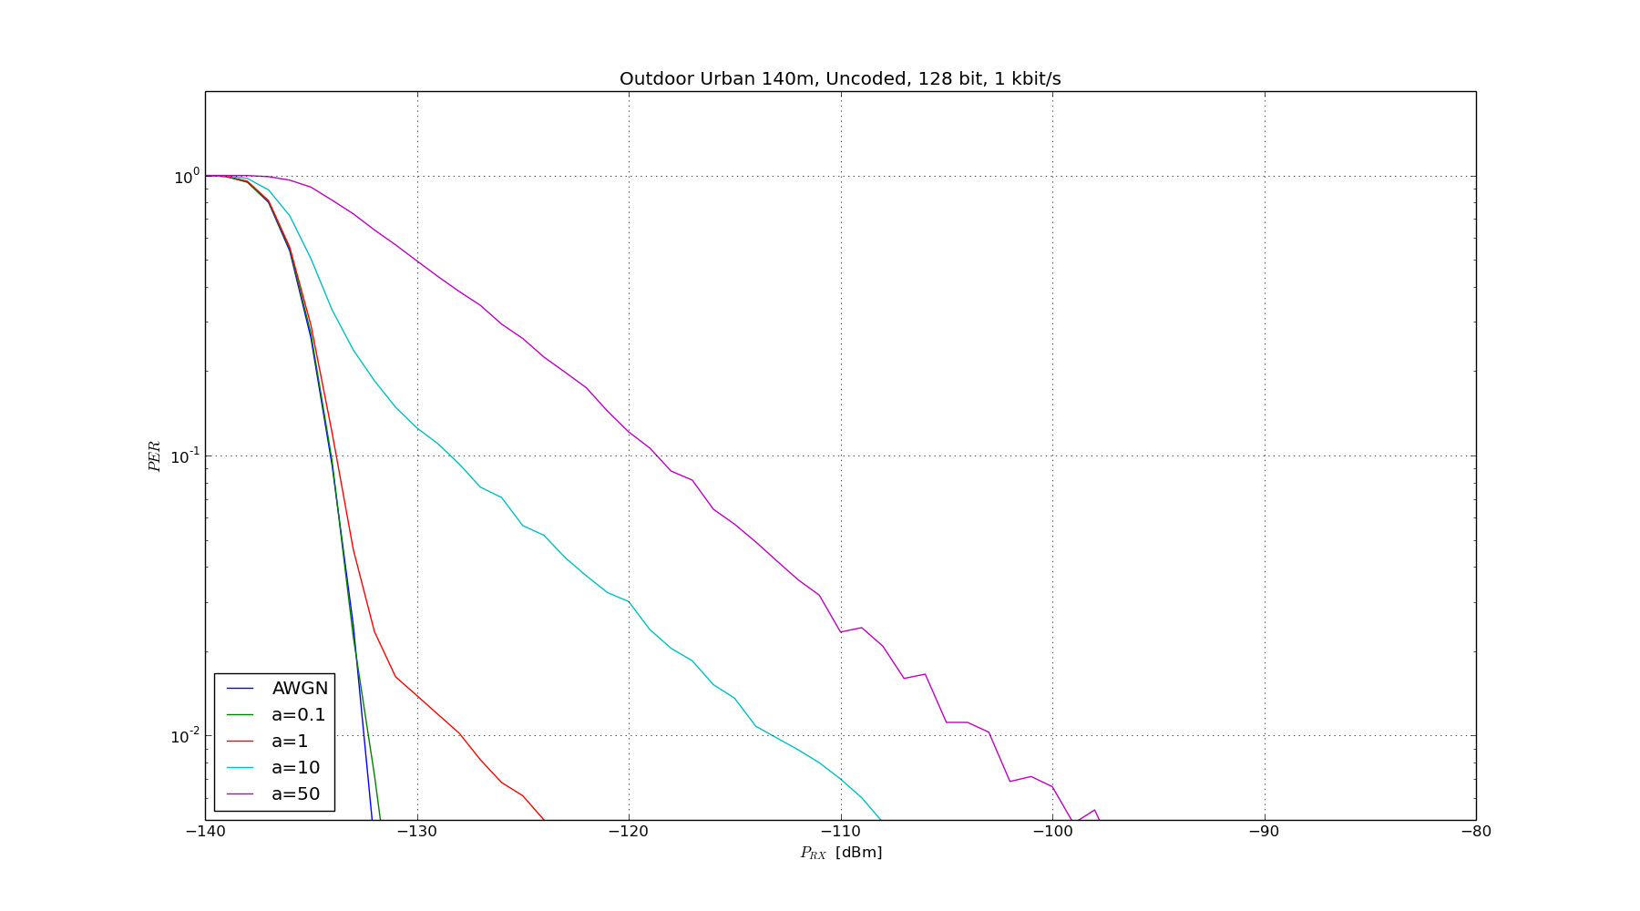
Impact of Interference
No Interference
1kbit/s
Dense Interference
Medium Interference
>30dB loss
The interference model dense reduces the sensitivity (1% PER) in interfered channels by more than 30dB
→ Significantly reduced transmit range (e.g. 1/10 of transmit range)

Slide 5
How to Improve the Robustness in Interfered Channels for Low Bit-Rates?
Use a powerful FEC code
Use narrow-band modulation, e.g. FSK or MSK
Use FEC code-word interleaving over multiple channels

Slide 6
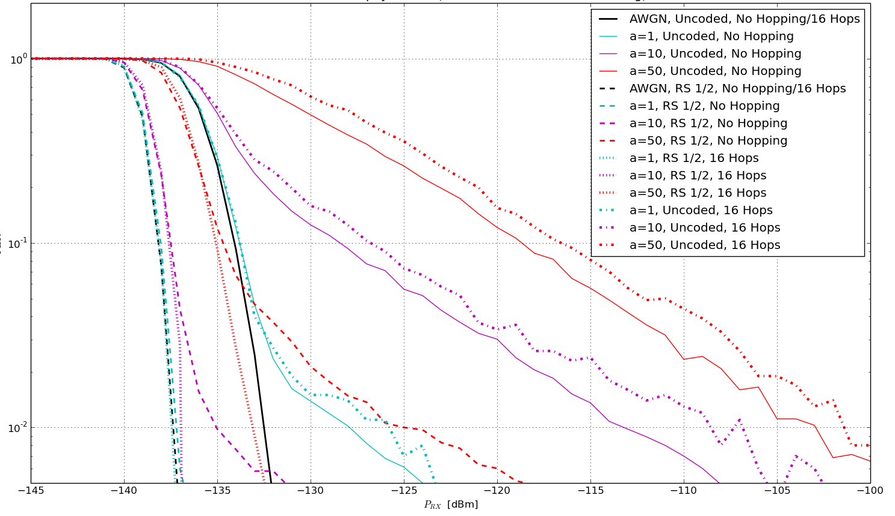
Gain using Frequency Hopping
Dense Interference
No Interference
30dB gain
FHSS offers a gain of more than 30dB @ 1% PER
Densely interfered channel almost as good as non-interfered one

Slide 7
What does IEEE 802.15.4 Offer?
Powerful FEC code
Narrow-band modulation, e.g. FSK or MSK
FEC code-word interleaving over multiple channels

Slide 8
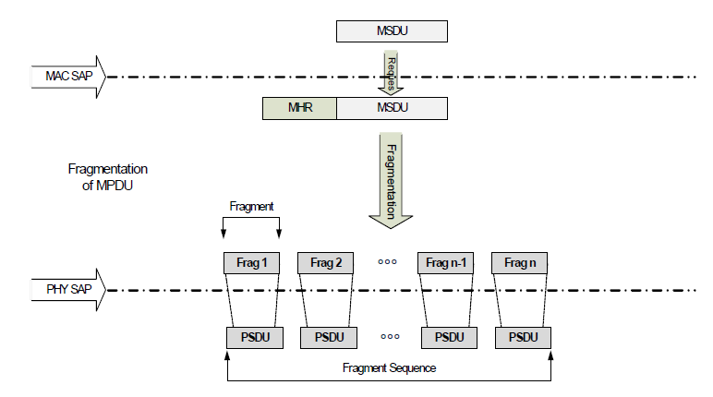
How to Improve: Necessary Modification to IEEE 802.15.4k FSK
Position of FEC encoder
IEEE 802.15.4 already offers everything
Only the position of the FEC encoder has to be adjusted

Slide 9
Proposal for Future Work
Improve IEEE 802.15.4 by amending the FEC: Change the position of the FEC encoder
No introduction of new modulation schemes
Practically no modifications to the MAC
All modifications should be realizable with existing silicon
Very limited scope for PAR and CSD that offers significant performance improvements in interfered channels for low payload bit-rates

Slide 10
Benefits of the Approach
Significantly increased robustness for lower bit-rates in channels with medium and strong interference
Reliable communication even if the sub-GHz channel use increases significantly, e.g. due to IEEE 802.11ah
Competitive IEEE LPWAN standard based on existing IEEE 802.15.4 framework
➔ Potential for new markets potentially not covered yet
All proposed optimizations can be achieved in software
Improved performance based on software updates!
Hardware can be “sold twice”, as improved functionality can be integrated into already shipped devices by software updates

Slide 11
Proposed Next Steps
Presentation of the results during the November WNG and decision to create new SG
Development of focused PAR and CSD
Official approval of SG/TG during March plenary

Slide 12
Thank You for Your Interest!
Any Questions?

