Slide 1
Project: IEEE P802.15 Working Group for Wireless Personal Area Networks (WPANs)
Submission Title: [L2R operation]
Date Submitted: [11 September 2017]
Source: [Noriyuki Sato, Kiyoshi Fukui] Company [Oki Electric Industry Co., Ltd.]
Address [2-6-8, Bingo-machi, Chuo-ku, Osaka, Japan]
Voice:[+81-6-6260-0700], E-Mail:[sato652@oki.com]
Re: [L2R operation]
Abstract: [Explaining L2R operations with ULI management box]
Purpose: [To discuss]
Notice: This document has been prepared to assist the IEEE P802.15. It is offered as a basis for discussion and is not binding on the contributing individual(s) or organization(s). The material in this document is subject to change in form and content after further study. The contributor(s) reserve(s) the right to add, amend or withdraw material contained herein.
Release: The contributor acknowledges and accepts that this contribution becomes the property of IEEE and may be made publicly available by P802.15.

Slide 2
L2R Operations
Configuration
Device types
PAN Coordinator, Mesh root, L2R router, End device
Operation mode
PAN Coordinator decides PAN type – SSPAN, Regular PAN,TMCTP
Mesh root decides operation options
Address mode, Non-store/Store/Adhoc-P2P/etc…
Joining device to be configured – allowed options
Ex. I can join to the mesh operates in either non-storing mode or storing.
L2R PIBs
Operations
Bootstrap procedure
Process the procedure as configured – (Management box does?)
Security setting
Need a detailed procedure of KMP to set key parameters to L2R PIBs
Interaction with higher layer (see following pages)

Slide 3
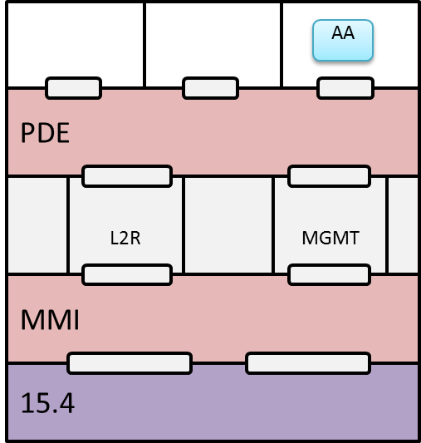
Short address assignment
Device
L2R Router
Mesh root

Slide 4
Short address assignment
PANCDC
Device
L2R Router
Mesh root
Only PAN Coordinator has short address assignment function.
If the mesh root is also PAN coordinator, it has a function to assign a short address.
If the mesh root is not PAN coordinator, mesh root play a role of proxy using PAN coordinator direct connection (PANCDC)
PANCDC also manages the inter mesh flooding
A mesh root forwards flooding data using PANCDC to PAN Coordinator and PAN Coordinator forwards all the mesh roots.

Slide 5
Short address request on a joining device
Device requesting a short address
L2R
Protocols sublayer
MMI
sublayer
IEEE802.15.4
MMI-DATA.request
MCPS-DATA.request
PDE
MMI
AA-RQ IE
MCPS-DATA.confirm
MMI-DATA.confirm
L2R
MCPS-DATA.indication
AA-RP IE
MMI-DATA.indication
15.4
AA-RP IE
AA-RQ IE
L2R invokes MMI-DATA.request to invoke MCPS-DATA.request.

Slide 6
Short address assignment on a mesh root (Option 1 – APL does)
PANC DC
Mesh root on PAN coordinator
Mesh root with PANC DC
AA
Alternate AA
PDE
MMI
PDE
MMI
L2R
L2R
PAN coordinator
15.4
15.4

Slide 7
Short address assignment on a mesh root (Option 1)
MMI
sublayer
L2R
Protocols sublayer
PDE
sublayer
AA MGT App.
IEEE802.15.4
AA-RQ IE
MCPS-DATA.indication
MMI-DATA.indication
L2RLME-AA-RQ.indication
PDE-MGMT.indication
L2RLME-AA-RP.request
PDE-MGMT.request
PANC DC
MCPS-DATA.request
MMI-DATA.request
AA-RP IE
MCPS-DATA.confirm
MMI-DATA.confirm
L2RLME-AA-RP.confirm
PDE-MGMT.confirm

Slide 8
Short address assignment on a mesh root (Option 2 – Management box does)
PANC DC
Mesh root on PAN coordinator
Mesh root with PANC DC
PANC comm.
PDE
MMI
PDE
MMI
L2R
MGMT
L2R
MGMT
AA
Alt. AA
PAN coordinator
15.4
15.4

Slide 9
L2R short address assignment (Option 2)
MMI
sublayer
L2R
Protocols sublayer
Management
Protocols sublayer
PDE
sublayer
NHL
NHL
PDE
sublayer
Management
Protocols sublayer
IEEE802.15.4
AA-RQ IE
MCPS-DATA.
indication
MMI-DATA.
indication
L2RLME-AA-RQ.indication
MGMT-MGMET.
indication
PDE-MGMT.
indication
PDE-MGMT.
request
MGMT-MGMET.
request
PANC DC
PDE-MGMT.
confirm
MGMT-MGMT.
confirm
MGMT-MGMT.
response
PDE-MGMT.
response
L2RLME-AA-RP.request
MCPS-DATA.
request
MMI-DATA.
request
PANC DC
AA-RP IE
MCPS-DATA.
confirm
MMI-DATA.
confirm
L2RLME-AA-RP.confirm

Slide 10
Short address assignment on a mesh root (Option 3 APL does & MGMT pass the messages)
PANC DC
Mesh root on PAN coordinator
Mesh root with PANC DC
AA
Alternate AA
PDE
MMI
PDE
MMI
L2R
L2R
MGMT
L2R
L2R
MGMT
PAN coordinator
15.4
15.4

Slide 11
Short address assignment on a mesh root (Option 3)
MMI
sublayer
L2R
Protocols sublayer
Management
Protocols sublayer
PDE
sublayer
AA MGT App.
IEEE802.15.4
AA-RQ IE
MCPS-DATA.indication
MMI-DATA.indication
L2RLME-AA-RQ.indication
MGMTMGMT.
indication
PDE-MGMT.indication
PDE-MGMT.request
PANC DC
MGMT-MGMT.
request
L2RLME-AA-RP.request
MCPS-DATA.request
MMI-DATA.request
AA-RP IE
MCPS-DATA.confirm
MMI-DATA.confirm
L2RLME-AA-RP.confirm
MGMT-MGMT.
confirm
PDE-MGMT.confirm

Slide 12
Source routing
It depends on how to fix inconsistency on source routing error in IEEE802.15.10.
NHL manages source routing
L2R layer manages source routing

Slide 13
Source routing
APL manages source routing. APL needs to manages the mode in which L2R operates and need to invoke L2R-DATA.request with appropriate parameters.
L2R mesh root
L2R Router
DST node
Source route
APL
APL
APL

Slide 14
Source routing
L2R mesh root
L2R Router
DST node
APL
APL
APL
Source route
Management Box manages source routing.
It manages mode in which L2R operates and it also manages data transmission.

Slide 15
Source routing
L2R mesh root
L2R Router
DST node
APL
APL
APL
Source route
If the source routing is managed in L2R. APL just send a data using Data-SAP

Slide 16
Source routing P2P communication on no-Storing mode
SRC node
L2R mesh root
DST node
Source route
APL
APL
APL
Hop by Hop routing
Source routing
APL handles source routing – Call L2R primitives directly?
Or PDE handles indication and notify to APL?
It can be that MGMT handles first and then invokes appropriate primitives

Slide 17
Source routing P2P communication on no-Storing mode
SRC node
L2R mesh root
DST node
APL
APL
APL
Source route

Slide 18
Source routing P2P communication on no-Storing mode
SRC node
L2R mesh root
DST node
APL
APL
APL
Source route
L2R Layer manages source routing. Nothing to do with management box or APL.

