Slide 1
Project: IEEE P802.15 Working Group for Wireless Personal Area Networks (WPANs)
Submission Title: [Address adaption between 48-bit address and 64-bit address in ULI]
Date Submitted: [12 Sep 2017]
Source: [Xiaojing Fan, Hao Wang, Su Yi and Ryuichi Matsukura] Company [Fujitsu]
Address [Beijing, China]
Voice:[+86-010-5969-1000], E-Mail:[fanxiaojing, wangh, yisu@cn.fujitsu.com; r.matsukura@jp.fujitsu.com]
Re: []
Abstract: [State the issues on 802.15.12 network management, propose an adaption procedure between 48-bit address and 64-bit address in ULI]
Purpose: [Discussion and approval]
Notice: This document has been prepared to assist the IEEE P802.15. It is offered as a basis for discussion and is not binding on the contributing individual(s) or organization(s). The material in this document is subject to change in form and content after further study. The contributor(s) reserve(s) the right to add, amend or withdraw material contained herein.
Release: The contributor acknowledges and accepts that this contribution becomes the property of IEEE and may be made publicly available by P802.15.

Slide 2
Background
Vast number of 802.15.4 devices have been/will be deployed, especially in IoT applications, will dominate the market by 2020 [1]
  Massive legacy 802.15.4 devices without IP support are still in use in various cases
OAM (Operation, Administration, and Management) functionalities will be essential to deliver services through 802.15.4 networks
  Nowadays, relies on IETF management protocols for IP-capable networks and proprietary protocols for non-IP networks,
  Sometimes, they are high cost, low efficiency, inconsistent, and have compatibility issues.
Source: 16-05-27 IHST iot-connectivity-market-tracker-q1-2016

Slide 3
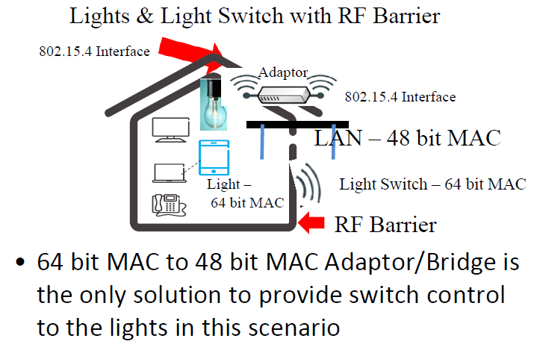
Use Case 1: Bridging
Related Contributions in 802.1 [3]
[3] foresees the benefits from connecting different 802 networks and identifies the gaps for ‘802.15.4 to 802.3 Adaptation or Bridging’ as
  Address bridging
  MPDU bridging
  Avoiding control
  frame loops
Use case provided by [3], describing the urgent demand for such technology

Slide 4
Use Case 2: Enable L2 OAM Functionalities
Unified management interface supported by native L2 management protocols developed by 802
  802.1AB (LLDP), 802.1Q (CFM) have been developed and widely used for years for easy use of 802 access networks
  EAPoL for 802.1X authentication
802.15.12
802.15.12
802.15.12
A
B
C
Application
Application
L2 mngt., e.g. LLDP
L2 mngt., e.g. LLDP
L2 mngt, e.g LLDP
ULI
ULI
ULI
MAC
MAC
MAC
PHY
PHY
PHY
LLDP: Link Layer Discovery Protocol
CFM: Connectivity Fault Management

Slide 5
ULI could Make Things Much Easier
Advanced functionalities have been considered in scope of ULI
  Ethertype support
  Fragmentation/assembly schemes
  L2R interfaces
  Mandatory management modules
  NWK-SAP & App-SAP
Re-identified gaps based on
the definitions of ULI
  48bit to 64bit/16bit adaptation
  at point “1”
  Identify request of 48bit or
  64/16bit at point “2”
2
1

Slide 6
Potential Implementation with LLDP
Service procedure
  LLDP agent triggers PDE-DATA request service with (48-bit source addr, 48-bit destination addr, 0x88CC, LLDPDU)
  PDE dispatches the request of EPD = 0x88CC to address adaption module
LLDP agent
  Address adaption module converts 48-bit to 64bit/16bit 802.15.4 MAC address
  Address adaption module triggers MMI data request service
LLDP agent may initiates the ‘get’ primitive to obtain information from local PIB
EPD= 0x88CC
48 bit Address
Addr.
Adap.
Fragmentation
e.g SRM information
64 bit Address
PIB

Slide 7
Conceptual Reference Model
Advantages and comparison with the previous proposal [3],
  No change requirements for 802.1 specifications (802.1Q, etc.)
  No change requirements for 802.15.4 (assembly required by [3])
  Support 802.1 management protocols (not only bridging as in [3])
  802c local address applicable
  Enable data forwarding to legacy 802.15.4 devices as well
802 LLC Functionalities
LLDP
EAPOL
802.1x
Bridge
802.1Q
802c local
address
…
service primitive
Support 48-bit addr
ULI
LAN
(802.3
MAC/PHY)
WLAN
(802.11
MAC/PHY)
Address adaption
802.15.4
PAN
service primitive
Support 64-bit addr
802.15.4 MAC/PHY

Slide 8
Reference
[1] https://mentor.ieee.org/802.11/dcn/17/11-17-1036-00-0wng-wlan-iot-low-complexity-constrained-peak-power-consumption-wlan.pptx
[2] https://standards.ieee.org/findstds/standard/802-2014.html
[3] http://www.ieee802.org/1/files/public/docs2016/new-64bitto48bitMACAdapting-sarikaya-0116-v00-xtn.pdf
[4] 802c, http://www.ieee802.org/1/pages/802c.html
[5] 802.1AB (LLDP), http://www.ieee802.org/1/pages/802.1AB-2009.html

Slide 9
Question?

