Slide 1
doc.: IEEE 15-17-0527-00-0vat
Project: IEEE P802.15 Working Group for Wireless Personal Area Networks (WPANs)
Submission Title: Consideration Issues for Long Range High Speed OCC for Vehicular Communications
Date Submitted: September 2017
Source: Yeong Min Jang [Kookmin University].
Contact: +82-2-910-5068 E-Mail: yjang@kookmin.ac.kr
Re:
Abstract: This document contains the output of the Vehicular Assistant Technology (VAT) Interest Group, intended to describe the use cases, requirements, and technical feasibility of Optical Wireless Communications in 802.15.
Purpose: Press release announcing confirmation of VAT IG
Notice: This document has been prepared to assist the IEEE P802.15. It is offered as a basis for discussion and is not binding on the contributing individual(s) or organization(s). The material in this document is subject to change in form and content after further study. The contributor(s) reserve(s) the right to add, amend or withdraw material contained herein.
Release: The contributor acknowledges and accepts that this contribution becomes the property of IEEE and may be made publicly available by P802.15.
Submission

Slide 2
IEEE P802.15 VAT Study Group
doc.: IEEE 15-17-0527-00-0vat
Scenario Topology
Vehicle to Vehicle
Infrastructure to Vehicle
MAC mode
Broadcasting

Slide 3
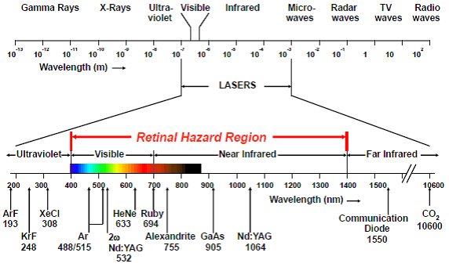
IEEE P802.15 VAT Study Group
doc.: IEEE 15-17-0527-00-0vat
Optical wavelength for Communication channel
Visible Light band
IR band
Near IR band
Laser technology (for eye safety: Class 1, 1M, 2, 2M)
http://noirlaser.com/laser-standards

Slide 4
IEEE P802.15 VAT Study Group
doc.: IEEE 15-17-0527-00-0vat
Technical requirement
High mobility
High data rate (up to 100Mbps)
Different environment conditions
Communication range (up to 100m)
Low overhead protocol
Coexisting with RF system ( Bluetooth, WiFi, 3GPP)
Flicker free on optical channel
MIMO technique( For multiple link connection)

Slide 5
IEEE P802.15 VAT Study Group
doc.: IEEE 15-17-0527-00-0vat
Standard coexisting
IEEE 802.15.4
IEEE 802.15.7
IEEE 802.15.7m
IEEE 802.15.11

