Slide 1
September 2017
doc.: IEEE 802.15-17-0521-00-007a
Project: IEEE P802.15 Working Group for Wireless Personal Area Networks (WPANs)
Submission Title: Issues of DCT Technique for Invisible Watermarking
Date Submitted: September 2017
Source: Nam Tuan Le and Yeong Min Jang (Kookmin University)
Contact: +82-2-910-5068 E-Mail: yjang@kookmin.ac.kr
Re:
Abstract: Discussion on D4 Comments and Resolution
Purpose: targeting D4
Notice: This document has been prepared to assist the IEEE P802.15. It is offered as a basis for discussion and is not binding on the contributing individual(s) or organization(s). The material in this document is subject to change in form and content after further study. The contributor(s) reserve(s) the right to add, amend or withdraw material contained herein.
Release: The contributor acknowledges and accepts that this contribution becomes the property of IEEE and may be made publicly available by P802.15.

Slide 2
Issues of DCT Technique for Invisible Watermarking

Slide 3
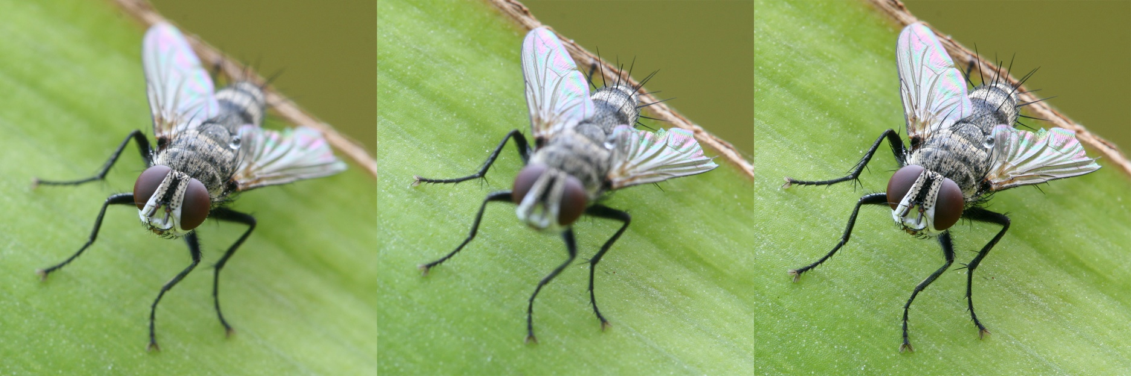
Focus point
https://en.wikipedia.org/wiki/Focus_stacking

Slide 4
Environment ambient light
https://www.fonepaw.com/solution/take-great-photos-with-your-android-phone.html

Slide 5
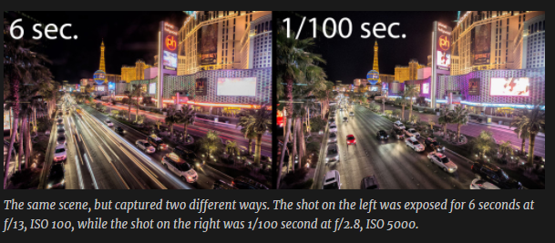
Exposure time
http://picture.guide/2016/01/11/three-tips-better-shot-playing-in-traffic/

Slide 6
Brightness Level

Slide 7
Pixel Information

Slide 8
DCT Result

Slide 9
Quantization

Slide 10
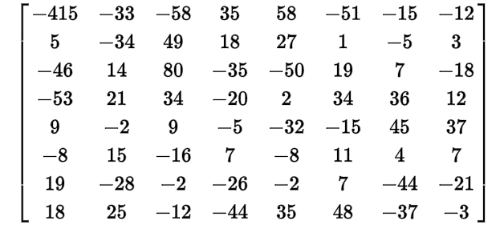
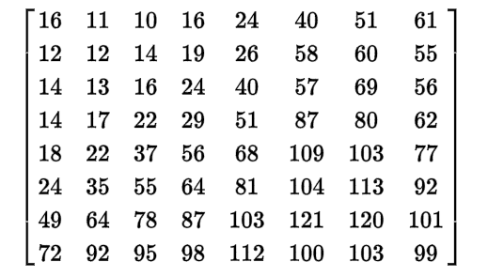
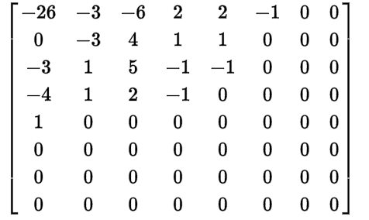
Quantization method

Slide 12
MPEG1 default quantization matrix
{8,16,19,22,26,27,29,34 },
{16,16,22,24,27,29,34,37},
{19,22,26,27,29,34,34,38},
{22,22,26,27,29,34,37,40},
{22,26,27,29,32,35,40,48},
{26,27,29,32,35,40,48,58},
{26,27,29,34,38,46,56,69},
{27,29,35,38,46,56,69,83}

Slide 13
