Slide 1
Project: IEEE P802.15 Working Group for Wireless Personal Area Networks (WPANs)
Submission Title: [Qualitative Use-Case Evaluation]
Date Submitted: [11. Sept, 2017]
Source: [Joerg ROBERT] Company [Friedrich-Alexander University Erlangen-Nuernberg]
Address [Am Wolfsmantel 33, 91058 Erlangen, Germany]
Voice:[+49 9131 8525373], FAX: [+49 9131 8525102], E-Mail:[joerg.robert@fau.de]
Re: []
Abstract: [This document presents the first version of the qualitative use-case evaluation]
Purpose: [Prensentation in IG LPWA]
Notice: This document has been prepared to assist the IEEE P802.15. It is offered as a basis for discussion and is not binding on the contributing individual(s) or organization(s). The material in this document is subject to change in form and content after further study. The contributor(s) reserve(s) the right to add, amend or withdraw material contained herein.
Release: The contributor acknowledges and accepts that this contribution becomes the property of IEEE and may be made publicly available by P802.15.

Slide 2
Qualitative Use-Case Evaluation
Joerg Robert (FAU Erlangen-Nuernberg)

Slide 3
General Evaluation Procedure
Suitability
Analysis the general suitability of a candidate technology
Qualitative Evaluation
Analysis pros and cons, and dependency on other technologies
Quantitative Evaluation
Exact performance (only for selected technologies)
This document

Slide 4
Motivation
Analyze the remaining use-cases
Derive a set of combined technology options that are able to cover the requirements according to the suitability evaluation documents in an optimal way
Figure out whether existing IEEE standards offer the combined technology options
Analyze the communalities between the reaming uncovered use-cases

Slide 5
Remaining Use-Cases with Potential for a new LPWAN Standard
Domain | Use-Case
Agriculture and Environmental
Consumer/Medical | Pet Tracking
Industrial | Industrial Plant Condition Monitoring
Infrastructure | Pipeline Monitoring – Terrestrial, Smart Grid - Fault Monitoring, Smart Grid - Load Control, Smart Metering, Structural Health Monitoring
Logistics | Global Tracking, Fast Asset Tracking
Smart Building
Smart City | Public Lighting, Smart Parking, Vending Machines – general, Vending Machines - Point of Sale, Waste Management

Slide 6
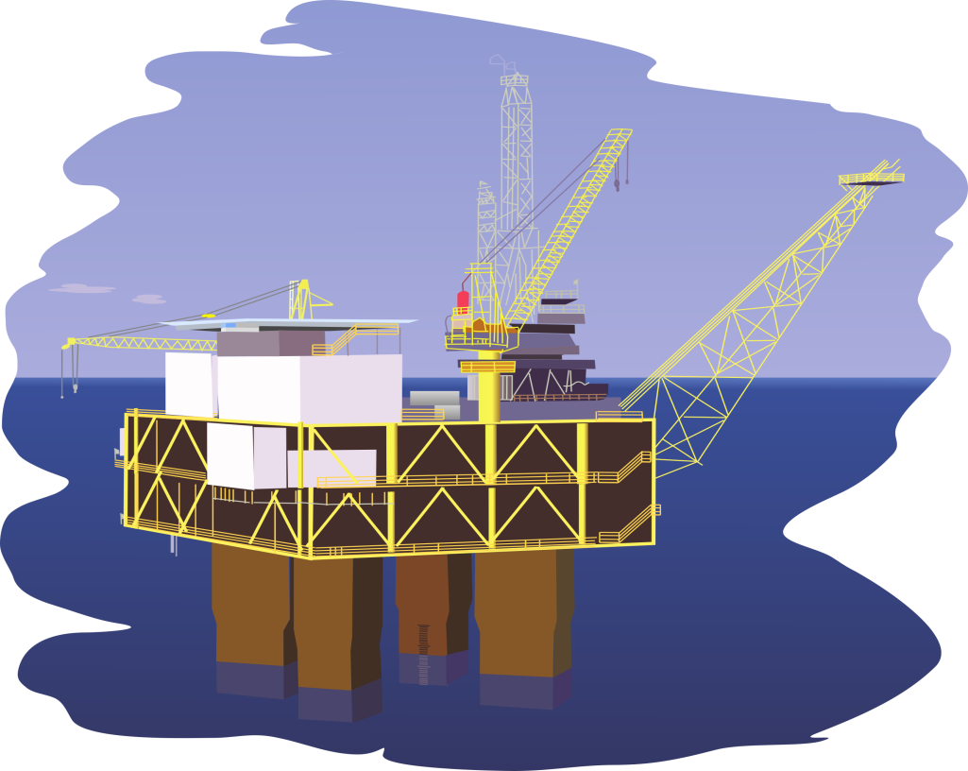
Industrial Plant Condition Monitoring
Monitoring of large industrial plants (e.g. oil refinery/platform) using distributed sensor-nodes, use of licensed frequency bands

Slide 7
Industrial Plant Condition Monitoring
Channel Model | Parameter
Channel Model | Outdoor Urban
Interference Model | None
Active Interfering Users | Medium
Communication Mode | Uplink/Broadcast Downlink
Data Period | Occasionally 1/hour
Data Length (Uplink) | <=16bytes
Availability | High
Latency | <10s
LP-WAN Localization Precision | <10m
Typical Power Supply | Energy Harvesting
Frequency Regulation | NA
Cell Radius | <50km
Data Security | Layer-3

Slide 8
Industrial Plant Condition Monitoring
Modulation:
Precise localization requires broadband signals
No interference (licensed spectrum) and low number of users
→ Spreading modulation
Coding:
Long distance requires good coding
Data length <= 16 bytes
Convolutional code
MAC:
Low number of users
Latency < 10s
→ Fully synchronized network / extended star / multi-hop

Slide 9
Industrial Plant Condition Monitoring
Connectivity
Use of IPv6 with header compression or transparent
Network topology
Medium number of active users
Latency < 10s
Fully synchronized network / extended star / multi-hop
The optimum parameter configuration exactly matches the existing IEEE 802.15.4 standard. Therefore, a new LPWAN standard would not offer significant benefits.

Slide 10
Pipeline Monitoring – Terrestrial
Channel Model | Parameter
Channel Model | Outdoor Rural
Interference Model | None
Active Interfering Users | Low
Communication Mode | Uplink
Data Period | Occasionally 1/day
Data Length (Uplink) | <=16bytes
Availability | High
Latency | <1min
LP-WAN Localization Precision | <100m
Typical Power Supply | Energy Harvesting
Frequency Regulation | NA
Cell Radius | <50km
Data Security | Layer-2

Slide 11
Pipeline Monitoring – Terrestrial
Modulation:
Precise localization requires broadband signal
No interference (licensed spectrum) and low number of users
→ spreading modulation
Coding:
Long distance requires good coding
Data length <= 16 bytes
convolutional code
MAC:
Low number of users
Latency < 10s
→ Fully synchronized network

Slide 12
Pipeline Monitoring – Terrestrial
Connectivity
Use of IPv6 with header compression or transparent
Network topology
Low number of active users
Latency < 1min
Extended star or mesh
The optimum parameter configuration exactly matches the existing IEEE 802.15.4 standard. Therefore, a new LPWAN standard does not offer significant benefits.

Slide 13
Fault Monitoring in the Medium Voltage Distribution Network
Use-case description: Detection and indication of faults in the medium voltage distribution network.
Assumptions
No suitable 110/220V power supply to power the sensor node → powered by battery
Devices only transmit in case of error or one alive message per day → low traffic
Only uplink data, no downlink required
But, in case of a major network failure many devices may report an error at the same time → dense traffic
System may be operated in populated areas → strong interference
The distance between different sensor nodes may be multiple km

Slide 14
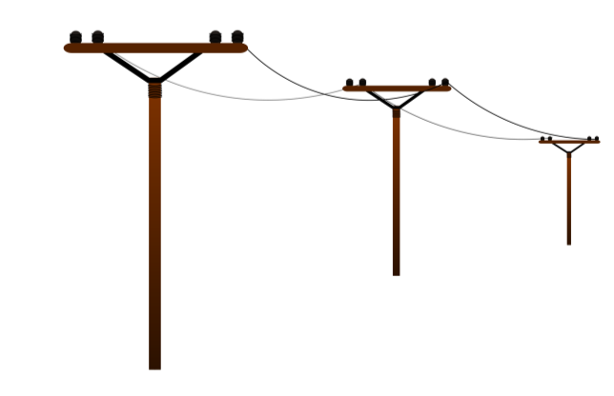
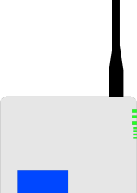
Fault Monitoring in the Medium Voltage Distribution Network
The large spacing between different measurement nodes requires low payload bit-rates
Measurement locations may be separated by multiple km

Slide 15
Fault Monitoring in the Medium Voltage Distribution Network
Channel Model | Parameter
Channel Model | Outdoor Urban
Interference Model | Dense
Active Interfering Users | Very high
Communication Mode | Uplink
Data Period | Occasionally 1/day
Data Length (Uplink) | <=16bytes
Availability | High
Latency | <1min
LP-WAN Localization Precision | <100m
Typical Power Supply | 2xAA
Frequency Regulation | ETSI/FCC
Cell Radius | <50km
Data Security | Layer-2

Slide 16
Fault Monitoring in the Medium Voltage Distribution Network
Modulation: The
Localization precision <100m
Strong interference and many users
→ FHSS
Coding:
Long distance requires good coding
Data length <= 16 bytes
Convolutional code
MAC:
High number of users, strong interference
Uplink only
Latency < 1min
→ Only ALOHA may work due to pure uplink mode

Slide 17
Fault Monitoring in the Medium Voltage Distribution Network
Connectivity
Use of IPv6 with header compression or transparent
Network topology
High number of active users with interference
Latency < 1min
Extended star (e.g. with mesh backhaul)
Potential use-case for new LPWAN standard

Slide 18
Smart Grid - Load Control
Control of the load of the smart grid with focus on private homes. May also be combined with smart electricity meters.
Assumptions:
External power supply available
High interference and density as used in highly populated areas
Significant amount of payload data also on the downlink, also software updates

Slide 19
Smart Grid - Load Control
Channel Model | Parameter
Channel Model | Outdoor Urban
Interference Model | None
Active Interfering Users | Very high
Communication Mode | Uplink/Downlink
Data Period | Occasionally, more than 1/hour
Data Length (Uplink) | <=16bytes
Availability | High
Latency | <1s
LP-WAN Localization Precision | Not required
Typical Power Supply | External
Frequency Regulation | NA
Cell Radius | <10km
Data Security | Secure Authentication

Slide 20
Smart Grid - Load Control
Existing systems are already on the market (e.g. based on IEEE 802.15.4g)
These systems employ mesh structures with antennas that are typically not highly exposed →even dense cell traffic can be handled efficiently
The mesh structure also allow for significant downlink bit-rates that would not be possible in
However, LPWAN may be used to connect remote houses (last mile) that may currently not be well covered by mesh structures

Slide 21
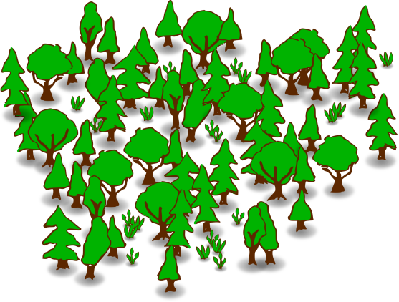
Smart Grid - Load Control with LPWAN Extension
Long-Range LPWAN Link
Mesh Network (e.g. 802.15.4g)
for normal users
Remote User

Slide 22
Smart Grid - Load Control: LPWAN Extension Part
Modulation:
Long-range transmission with potential interference
→ FHSS
Coding:
Long distance requires good coding
Data length <= 16 bytes
Convolutional code
MAC:
Low number of users
Uplink and downlink
Latency < 1s
→ Fully synchronized network

Slide 23
Smart Grid - Load Control with LPWAN Extension
Connectivity
Use of IPv6 with header compression or transparent
Network topology
Low number of active users
Latency < 1min
Point to point for last mile
Potential LPWAN use-case to extend mesh network to remote users

Slide 24
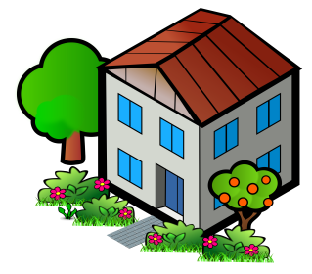
Smart Metering (Water / Gas)
Gas and water meters are equipped with LPWAN
No power supply available, data transmission required only once per day, backhaul network can also be mesh
LPWAN
Mesh

Slide 25
Smart Metering (Water / Gas)
Channel Model | Parameter
Channel Model | Outdoor Urban
Interference Model | Dense
Active Interfering Users | Very high
Communication Mode | Uplink/Broadcast Downlink
Data Period | Periodically 1/day
Data Length (Uplink) | <=16bytes
Availability | Medium
Latency | <1day
LP-WAN Localization Precision | Not required
Typical Power Supply | 2xAA
Frequency Regulation | ETSI/FCC
Cell Radius | <10km
Data Security | End-to-end

Slide 26
Smart Metering (Water / Gas)
Modulation:
Localization not required an high interference
High interference and many users
→ FHSS
Coding:
Long distance requires good coding
Data length <= 16 bytes
Convolutional code
MAC:
Very high number of users, strong interference
Uplink and broadcast downlink
Latency < 1day
→ ALOHA network

Slide 27
Smart Metering (Water / Gas)
Connectivity
Use of IPv6 with header compression or transparent
Network topology
Very high number of active users and dense interference
Latency < 1day
Star or extended star (e.g. based on mesh network)
Potential for new LPWAN standard also for increasing the range of mesh networks

Slide 28
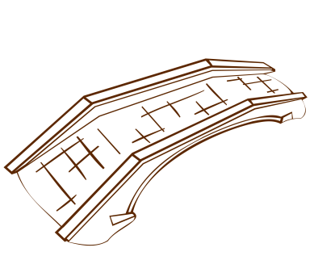
Structural Health Monitoring
Monitoring of the structural health of bridges, etc.
Stations may be separated by multiple km
LPWAN
5km
5km

Slide 29
Structural Health Monitoring
Channel Model | Parameter
Channel Model | Outdoor Urban
Interference Model | Dense
Active Interfering Users | Very high
Communication Mode | Uplink
Data Period | Occasionally 1/day
Data Length (Uplink) | <=16bytes
Availability | High
Latency | <1min
LP-WAN Localization Precision | Not required
Typical Power Supply | 2xAA
Frequency Regulation | ETSI/FCC
Cell Radius | <5km
Data Security | Layer-2

Slide 30
Structural Health Monitoring
Modulation:
Localization not required an high interference
High interference and many users
→ FHSS
Coding:
Long distance requires good coding
Data length <= 16 bytes
convolutional code
MAC:
Very high number of users, strong interference
Uplink only
Latency < 1min
→ Only ALOHA may work

Slide 31
Structural Health Monitoring
Connectivity
Use of IPv6 with header compression or transparent
Network topology
Very high number of active users and dense interference
Latency < 1min
Pure mesh not useful due to low traffic per sensor node
Star or extended star
Potential for new LPWAN standard

Slide 32
Logistics: Global Tracking
Channel Model | Parameter
Channel Model | Outdoor Urban
Interference Model | Dense
Active Interfering Users | Very high
Communication Mode | Uplink
Data Period | Periodically 1/hour
Data Length (Uplink) | <=16bytes
Availability | Best effort
Latency | <10min
LP-WAN Localization Precision | <100m
Typical Power Supply | 2xAA
Frequency Regulation | ETSI/FCC
Cell Radius | <5km
Data Security | Layer-3

Slide 33
Logistics: Global Tracking
Modulation:
High interference and many users
Localization < 100m
→ FHSS
Coding:
Long distance requires good coding
Data length <= 16 bytes
convolutional code
MAC:
Very high number of users, strong interference
Uplink only
Latency < 10min
→ Only ALOHA may work

Slide 34
Logistics: Global Tracking
Connectivity
Use of IPv6 with header compression or transparent
Network topology
Very high number of active users and dense interference
Latency < 10min
Extended star (e.g. with mesh backhaul)
The optimum parameter configuration exactly matches the existing IEEE 802.15.4 standard. Therefore, a new LPWAN standard does not offer significant benefits.

Slide 35
Logistics: Fast Asset Tracking
Channel Model | Parameter
Channel Model | Outdoor Urban
Interference Model | Dense
Active Interfering Users | High
Communication Mode | Uplink
Data Period | more than 1/hour
Data Length (Uplink) | <=16bytes
Availability | High
Latency | <1 min
LP-WAN Localization Precision | <10m
Typical Power Supply | 2xAA
Frequency Regulation | ETSI/FCC
Cell Radius | <5km
Data Security | Layer-2

Slide 36
Logistics: Fast Asset Tracking
Modulation:
High interference and many users
Localization < 10m
→ Spreading modulation, but only if many base stations are used
Coding:
Long distance requires good coding
Data length <= 16 bytes
convolutional code
MAC:
High number of users, strong interference
Uplink only
Latency < 1min
→ Only ALOHA may work

Slide 37
Logistics: Fast Asset Tracking
Connectivity
Use of IPv6 with header compression or transparent
Network topology
Very high number of active users and dense interference
Precise localization
Latency < 1min
Extended star (e.g. with mesh backhaul)
The optimum parameter configuration exactly matches the existing IEEE 802.15.4 standard. Therefore, a new LPWAN standard does not offer significant benefits.

Slide 38
Smart City: Public Lighting
Switch on and off of public street lights
Short distance between street lights
Significant downlink communication

Slide 39
Smart City: Public Lighting
Channel Model | Parameter
Channel Model | Outdoor Urban
Interference Model | Dense
Active Interfering Users | Very high
Communication Mode | Uplink/Downlink
Data Period | Occasionally 1/hour
Data Length (Uplink) | <=16bytes
Availability | Medium
Latency | <1min
LP-WAN Localization Precision | Not required
Typical Power Supply | External
Frequency Regulation | ETSI/FCC
Cell Radius | <10km
Data Security | Secure Authentication

Slide 40
Smart City: Public Lighting
The system requirements are perfectly met by existing standards (e.g. IEEE 802.15.4g) that are already in commercial use
A new LPWAN standard would not provide benefits and may not work due to the required downlink traffic

Slide 41
Smart City: Smart Parking
Parking spaces along the street that are spread over large areas

Slide 42
Smart City: Smart Parking
Channel Model | Parameter
Channel Model | Outdoor Urban
Interference Model | Dense
Active Interfering Users | Very high
Communication Mode | Uplink
Data Period | Occasionally, more than 1/hour
Data Length (Uplink) | <=16bytes
Availability | High
Latency | <1min
LP-WAN Localization Precision | Not required
Typical Power Supply | 2xAA
Frequency Regulation | ETSI/FCC
Cell Radius | <10km
Data Security | Layer-2

Slide 43
Smart City: Smart Parking
Modulation:
High interference and many users
Localization not required
→ FHSS
Coding:
Long distance requires good coding
Data length <= 16 bytes
Convolutional code
MAC:
High number of users, strong interference
Uplink only
Latency < 1min
→ Only ALOHA may work

Slide 44
Smart City: Smart Parking
Connectivity
Use of IPv6 with header compression or transparent
Network topology
Very high number of active users and dense interference
Different sensor nodes may be highly separated
Latency < 1min
Star or extended star (e.g with mesh as backhaul)
Potential for new LPWAN standard

Slide 45
Smart City: Vending Machines – general
Vending machines indicate whether the are running out of products
Distance between vending machines may be several km

Slide 46
Smart City: Vending Machines – general
Channel Model | Parameter
Channel Model | Outdoor Urban
Interference Model | Dense
Active Interfering Users | Very high
Communication Mode | Uplink
Data Period | Occasionally 1/day
Data Length (Uplink) | <=64bytes
Availability | Medium
Latency | <60min
LP-WAN Localization Precision | Not required
Typical Power Supply | Energy Harvesting
Frequency Regulation | ETSI/FCC
Cell Radius | <10km
Data Security | Layer-3

Slide 47
Smart City: Vending Machines – general
Modulation:
High interference and many users
Localization not required
→ FHSS
Coding:
Long distance requires good coding
Data length <= 64 bytes
Convolutional code or Turbo or Polar codes
MAC:
High number of users, strong interference
Uplink only
Latency < 1h
→ Only ALOHA may work

Slide 48
Smart City: Vending Machines – general
Connectivity
Use of IPv6 with header compression or transparent
Network topology
Very high number of active users and dense interference
Machines may be placed in high distance
Latency < 60min
Star or extended star (e.g. with mesh backhaul)
Potential for new LPWAN standard

Slide 49
Smart City: Vending Machines - Point of Sale
Secure authorization (e.g. credit card) for vending machines

Slide 50
Smart City: Vending Machines - Point of Sale
Channel Model | Parameter
Channel Model | Outdoor Urban
Interference Model | Dense
Active Interfering Users | Very high
Communication Mode | Uplink/Downlink
Data Period | Occasionally, more than 1/hour
Data Length (Uplink) | >256bytes
Availability | High
Latency | <10s
LP-WAN Localization Precision | Not required
Typical Power Supply | External
Frequency Regulation | ETSI/FCC
Cell Radius | <10km
Data Security | Secure Authentication

Slide 51
Smart City: Vending Machines - Point of Sale
A significant amount of downlink traffic is required (e.g. certificates, etc.), which cannot be delivered by LPWAN systems in the license exempt frequency bands
➔ No use-case for LPWAN

Slide 52
Smart City: Waste Management
Trash cans transmit their whether they have to be emptied
Use case very similar to water/gas metering

Slide 53
Smart City: Waste Management
Channel Model | Parameter
Channel Model | Outdoor Urban
Interference Model | Dense
Active Interfering Users | Very high
Communication Mode | Uplink
Data Period | Occasionally 1/day
Data Length (Uplink) | <=16bytes
Availability | Best effort
Latency | <60min
LP-WAN Localization Precision | Not required
Typical Power Supply | Energy Harvesting
Frequency Regulation | ETSI/FCC
Cell Radius | <10km
Data Security | Layer-2

Slide 54
Smart City: Waste Management
Modulation:
High interference and many users
Localization not required
→ FHSS
Coding:
Long distance requires good coding
Data length <= 16 bytes
convolutional code
MAC:
High number of users, strong interference
Uplink only
Latency < 1h
→ Only ALOHA may work

Slide 55
Smart City: Waste Management
Connectivity
Use of IPv6 with header compression or transparent
Network topology
Very high number of active users and dense interference
Low amount of packets not the first option for mesh
Latency < 60min
Star or extended star (e.g. with mesh backhaul)
Potential for new LPWAN standard

Slide 56
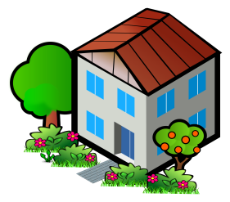
Consumer/Medial: Pet Tracking
Localization of cat in the neighborhood

Slide 57
Consumer/Medial: Pet Tracking
Channel Model | Parameter
Interference Model | Dense
Active Interfering Users | Very high
Communication Mode | Uplink/Downlink
Data Period | Periodically, more than 1/hour
Data Length (Uplink) | <=64bytes
Availability | Best effort
Latency | <1min
LP-WAN Localization Precision | <100m
Typical Power Supply | CR2025
Frequency Regulation | ETSI/FCC
Cell Radius | <5km
Data Security | Layer-2
Node Velocity | 3km/h

Slide 58
Consumer/Medial: Pet Tracking
Modulation:
High interference and many users
Localization <100m required
→ FHSS
Coding:
Long distance requires good coding
Data length <= 64 bytes
Convolutional code or Turbo or Polar code
MAC:
High number of users, strong interference
Uplink only/downlink
Latency < 1min
→ Fully synchronized

Slide 59
Consumer/Medial: Pet Tracking
Connectivity
Use of IPv6 with header compression or transparent
Network topology
Very high number of active users and dense interference
Latency < 1min
LPWAN localization would require multiple distributed base-stations → not useful for personal use → GPS tracking
Star topology
Potential use-case for LPWAN if GPS localization is used

Slide 60
Potentially Relevant Use-Cases
Domain | Use-Cases
Agriculture and Environmental
Consumer/Medical | Pet Tracking
Industrial
Infrastructure | Smart Grid - Fault Monitoring, Smart Grid - Load Control with LPWAN Extension, Smart Metering, Structural Health Monitoring
Logistics
Smart Building
Smart City | Smart Parking, Vending Machines – general, Waste Management

Slide 61
Communalities of Uncovered Use-Cases
Communalities:
Mainly focusing on uplink communication with highly limited downlink traffic
Require large cells
Are operated outdoors
Have to support many users
Suffer from interference
Typically require LPWAN localization < 100m
Require data length <= 16 bytes
Have a latency requirement <1min
LPWAN is highly interesting to offer connectivity to remote users

Slide 62
Thank You for Your Interest!

