Slide 1
Considerations for Comments Resolution against D0
Date: 2017-09-10
Authors:

Slide 2
Abstract
170 technical comments against D0 were received
Several principle issues may be discussed first before resolving comments one-by-one

Slide 3
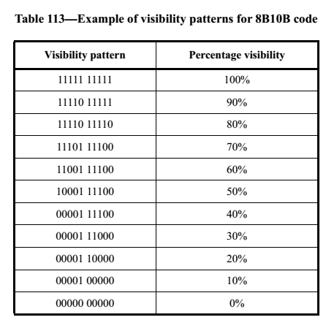
Should Dimming be the Normative Part of the Specification?
Question1: is the claim "The receiver is not required to know what dimming level is used while communication is ongoing." true for VPPM?
Question2: should RPO-OFDM be supported?
Question3: Should the visibility pattern dimming specified in 8.5.1.2 be supported?

Slide 4
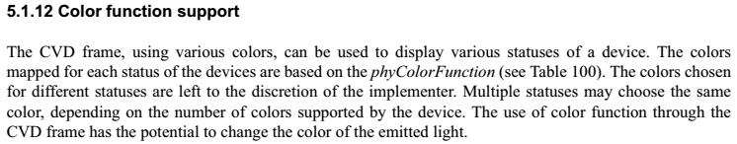
Should Color Function be Brought Back?
Color function was part of 15.7r1
It was agreed in May by comment 85 of https://mentor.ieee.org/802.15/dcn/17/15-17-0297-02-0013-comment-against-7m-d1.xlsx to move relevant part of color function support to the Annex H.
Several comments for September meeting suggest to re-open the discussion.
Should color function be brought back?

Slide 5
Should the Text for Pulsed PHY be Accepted?
Text for Pulsed PHY were generated in 454/r3 during and after Berlin Ad-Hoc meeting.
Question 1: is the proposal to delete current PHY II, and replace with the proposed text?
Question 2: no text for VPPM can be found in the proposed text, will the specification support VPPM?
Question 3: should we review it step by step? The structure, line code, modulation, etc…

Slide 6
Optical Clock Rate
Definition of optical clock rate for OOK
How to define optical clock rate for OFDM PHYs?
Which optical clock rate are supported for Pulsed PHY?
T =1/clock_rate

Slide 7
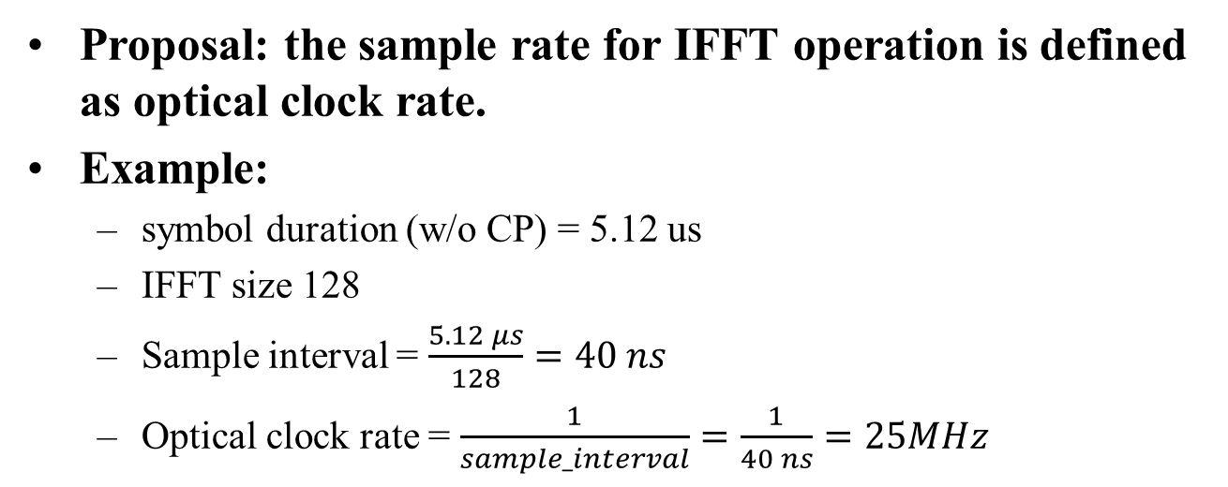
How to define optical clock rate for OFDM PHYs?
Proposal: the sample rate for IFFT operation is defined as optical clock rate.
Example:
  symbol duration (w/o CP) = 5.12 us
  IFFT size 128
  Sample interval = $\frac{5.12 μs}{128}=40 ns$
  Optical clock rate = $\frac{1}{sample_interval}=\frac{1}{40 ns}=25MHz$

