Slide 1
Project: IEEE P802.15 Working Group for Wireless Personal Area Networks (WPANs)
Submission Title: [Simulation Results for Interfered Channels]
Date Submitted: [31 August, 2017]
Source: [Joerg ROBERT] Company [Friedrich-Alexander University Erlangen-Nuernberg]
Address [Am Wolfsmantel 33, 91058 Erlangen, Germany]
Voice:[+49 9131 8525373], FAX: [+49 9131 8525102], E-Mail:[joerg.robert@fau.de]
Re: []
Abstract: [This document provides simulation results for different parameter conigurations in interfered channels]
Purpose: [Information to IG LPWA]
Notice: This document has been prepared to assist the IEEE P802.15. It is offered as a basis for discussion and is not binding on the contributing individual(s) or organization(s). The material in this document is subject to change in form and content after further study. The contributor(s) reserve(s) the right to add, amend or withdraw material contained herein.
Release: The contributor acknowledges and accepts that this contribution becomes the property of IEEE and may be made publicly available by P802.15.

Slide 2
Simulation Results for Interfered Channels
Joerg Robert (University Erlangen-Nuernberg)

Slide 3
Motivation
In the IG LPWA the effect of coding in interference channels has been extensively discussed, but without the availability of detailed simulation results
This presented provides simulation results for different parameter configurations in interference channels with and without coding
The simulations base on Minimum Shift Keying (MSK) which is a FSK variant that allows for coherent decoding
The Forward Error Correction (FEC) simulations use a Reed Solomon code, but codes with significantly higher performance are available and used in practical systems
These simulations only consider the interference of other systems, not the interference from other users using the same system

Slide 4
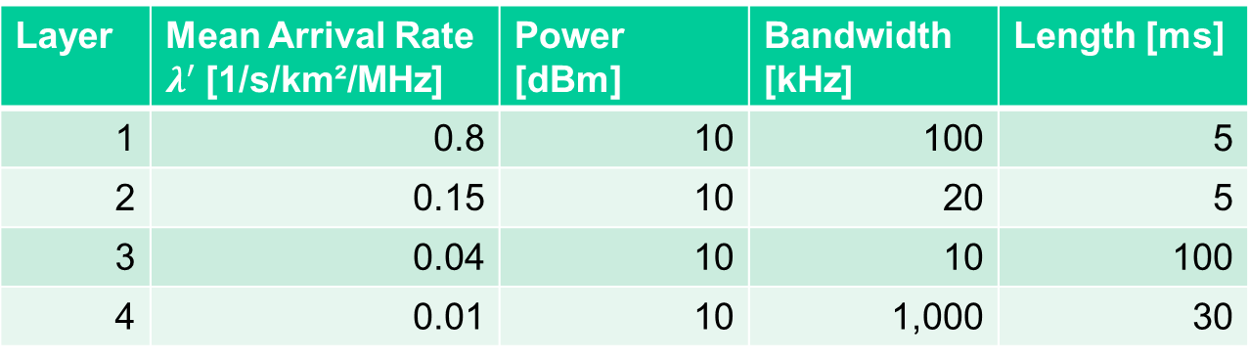
Definition of Interference Model (I / II)
Simulations are based on interference model defined in 15-17/37r1
Four different interferer types are present:
Mean arrival rate of is 1 interferer per second per km² per MHz
Additional multiplier A is used to scale rate for different scenarios
Layer | Mean Arrival Rate $λ^{′}$[1/s/km²/MHz] | Power [dBm] | Bandwidth [kHz] | Length [ms]
1 | 0.8 | 10 | 100 | 5
2 | 0.15 | 10 | 20 | 5
3 | 0.04 | 10 | 10 | 100
4 | 0.01 | 10 | 1,000 | 30

Slide 5
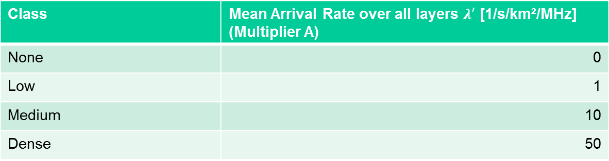
Definition of Interference Model (II / II)
Class | Mean Arrival Rate over all layers $λ′$ [1/s/km²/MHz] (Multiplier A)
None | 0
Low | 1
Medium | 10
Dense | 50
For interference class “dense” we obtain 50 signals per s per km² per MHz
The overall area is given by the propagation model, here we use the “Outdoor Urban 140m” as defined in 15-17/36
Results in thousands of interferers in the given playground size of 2 s and 2 MHz bandwidth
Field strength of the individual signals depends on the distance between receiver node and the interferer

Slide 6
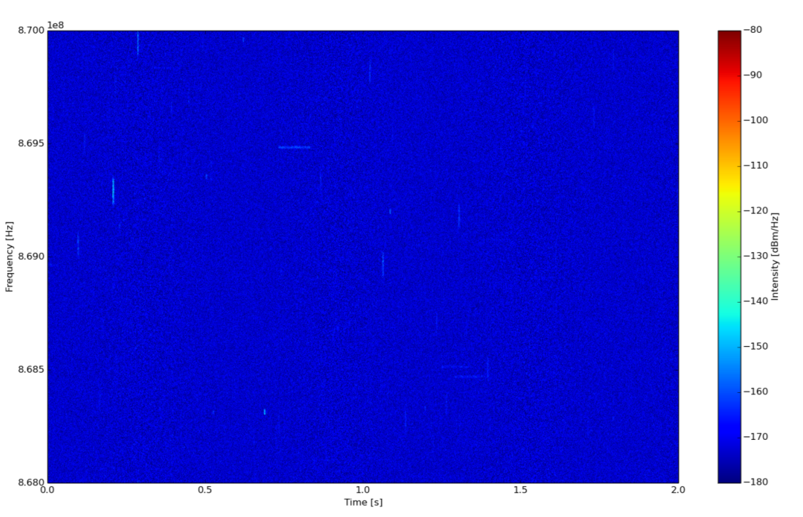
Example Playground of Interference Class “Low” (A=1)
Only few interferers visible in case of interference class ”low“

Slide 7
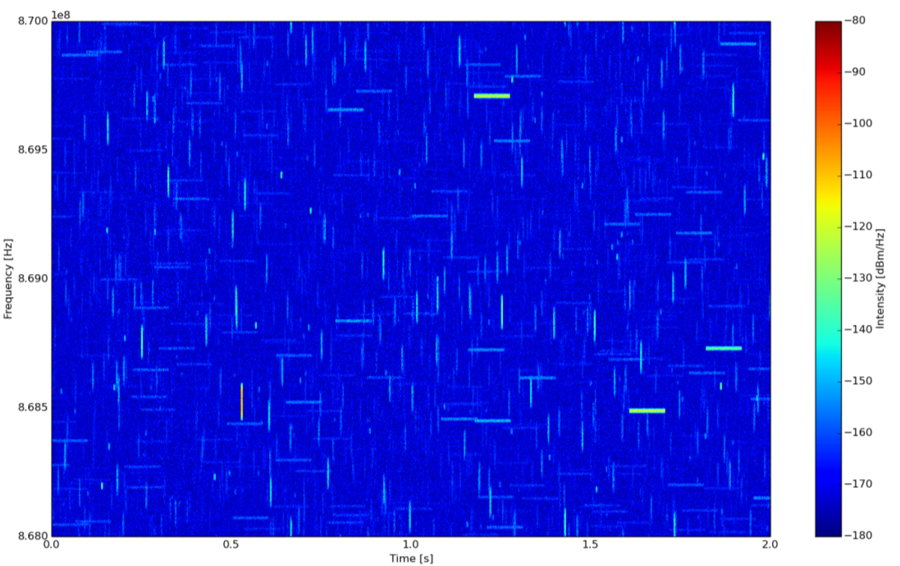
Example Playground of Interference Class “Dense” (A=50)
Thousands of interferers visible in case of interference class ”dense“

Slide 8
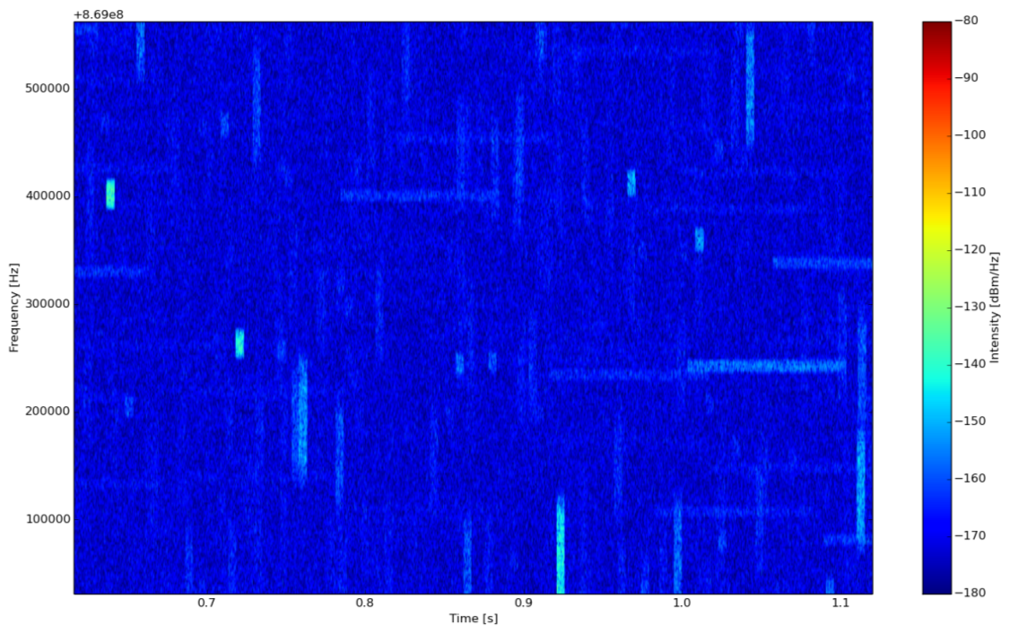
Example Playground of Interference Class “Dense” (A=50) – Zoomed
Zoomed version shows that the playground consists of many thousands of interferers. However, most
interferes have a high distance to the receiver and are therefore received with low level.

Slide 9
Comment on the Interference Class
The number of relevant interferers depends on the number of the density of the potential interference AND the propagation conditions
The “Outdoor Urban 140m” defines a typical LPWAN scenario with a base-station antenna mounted on a high tower in a height of 140m → collects many interferers due to exposed antenna
In case of indoor scenarios and point-to-point transmission without exposed antennas a significantly lower interference level can be expected

Slide 10
Simulation Results AWGN (I / III)
These simulations indicate the performance of un-coded data in the AWGN channel (no interference)
The results indicate the packet error rate (PER) as a function of the received signal level P_{RX} [dBm]
According to 15-17/36 a noise figure of 3 dB is assumed
The modulation uses coherently demodulated MSK (minimum shift keying)
Perfect synchronization is assumed
The payload data length is 128 bits
The bit-rate varies between 200 bit/s and 100 kbit/s
10000 snapshots (playgrounds) have been used for the simulations

Slide 11
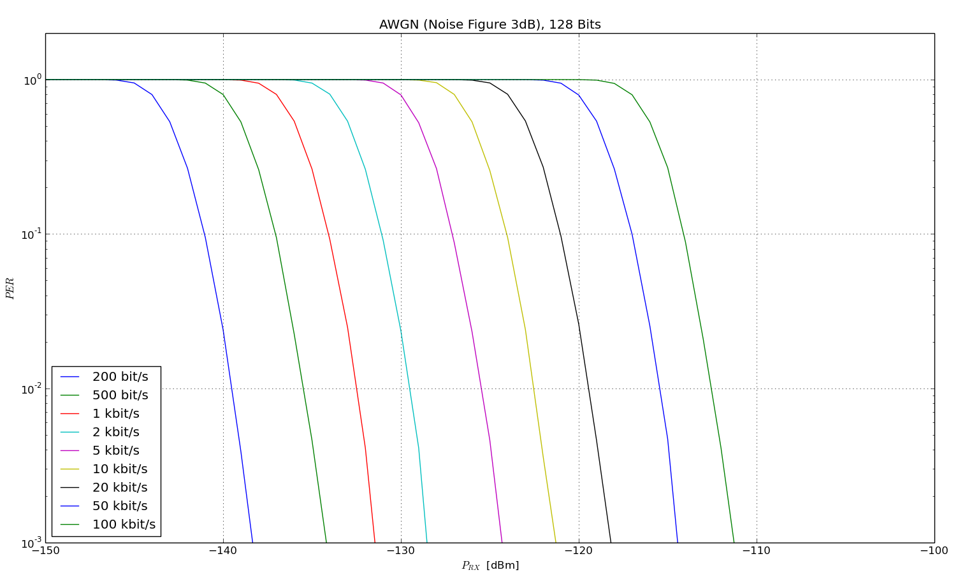
Simulation Results AWGN (II / III)

Slide 12
Simulation Results AWGN (III / III)
The simulation results match the performance presented in 15-17/346r1
A reduction of the payload bit-rate by a factor of 10 increases the robustness by 10 dB
The curves a not very steep due to the missing FEC
The 200 bit/s is almost able to reach the -140dBm criterion with a PER of 1%

Slide 13
Simulation Results with
Interference (I / II)
The following results show the performance of un-coded transmission with additional interference
Identical assumptions compared to AWGN results
Interference classes dense (A=50) and medium (A=10) with propagation model outdoor urban with 140m antenna height

Slide 14
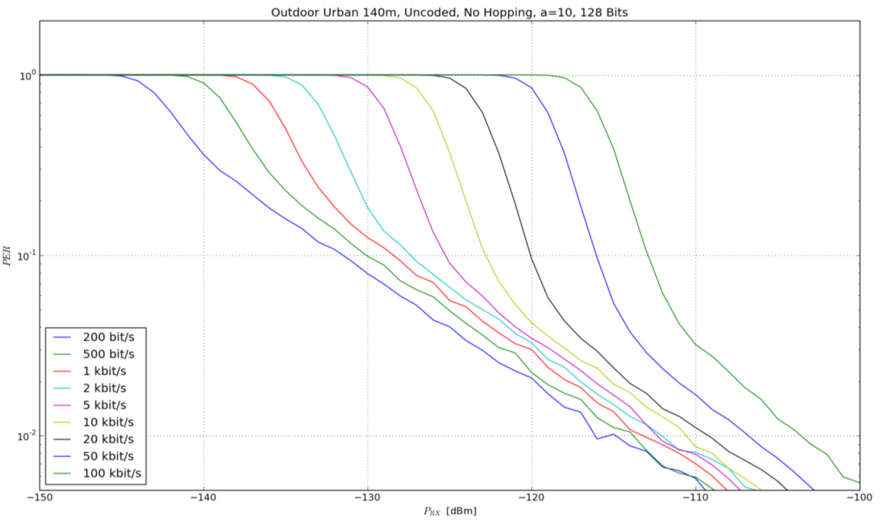
Simulation Results with Interference – Medium (A=10)

Slide 15
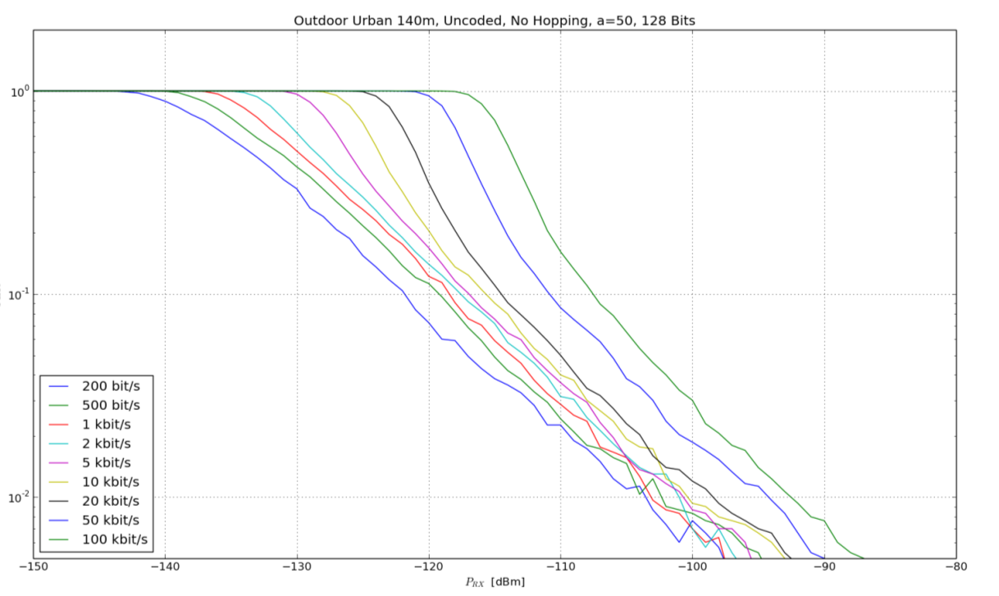
Simulation Results with Interference – Dense (A=50)

Slide 16
Simulation Results with
Interference (II / II)
Significantly reduced performance in case of interference for both interference classes
  Loss of more than 40 dB for 200 bit/s
  Loss of approx. 20 dB for 100 kbit/s
The improved robustness of low bit-rates in the AWGN channel does not hold in the interference channel
Long packets (e.g. 0.64 s for 200 bit/s) lead to a significant foot-print, and hence, a high probability that the signal is hit by an interferer
Short packets (e.g. high bit-rates) have a significantly smaller foot-print, and hence, a lower probability to be hit by an interferer
Low bit-rates without coding do not provide the expected gain in case of interference

Slide 17
Simulation Results with Interference – PER as function of the Class ( I / V )
Similar assumptions as previous simulations (e.g. un-coded transmission)
Now we compare the PER for a given bit-rate with different interference classes
  AWGN: No interference
  A = 0.1 (very low interference)
  A = 1: Class “Low”
  A = 10: Class “Medium”
  A = 50: Class “Dense”

Slide 18
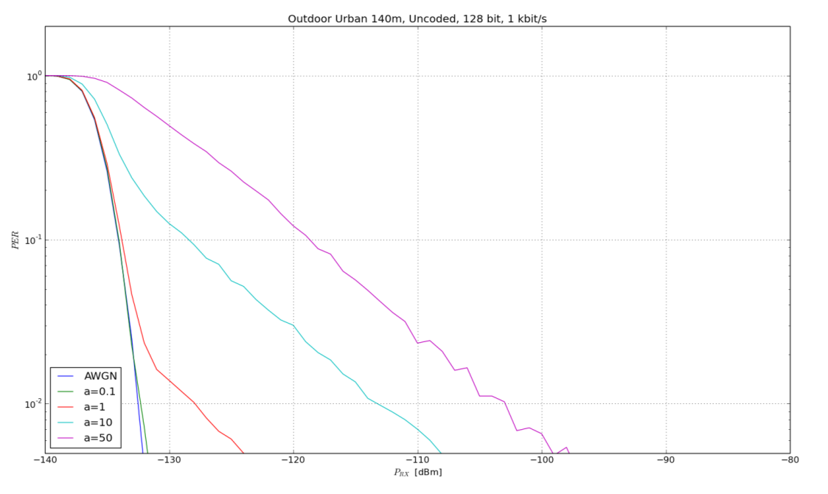
Simulation Results with Interference – PER as function of the Class ( II / V )
1 kbit/s

Slide 19
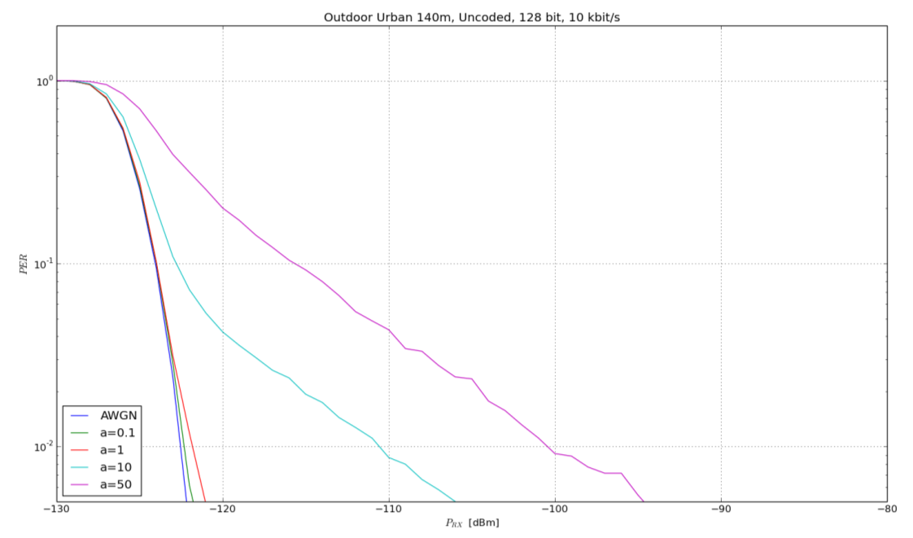
Simulation Results with Interference – PER as function of the Class ( III / V )
10 kbit/s

Slide 20
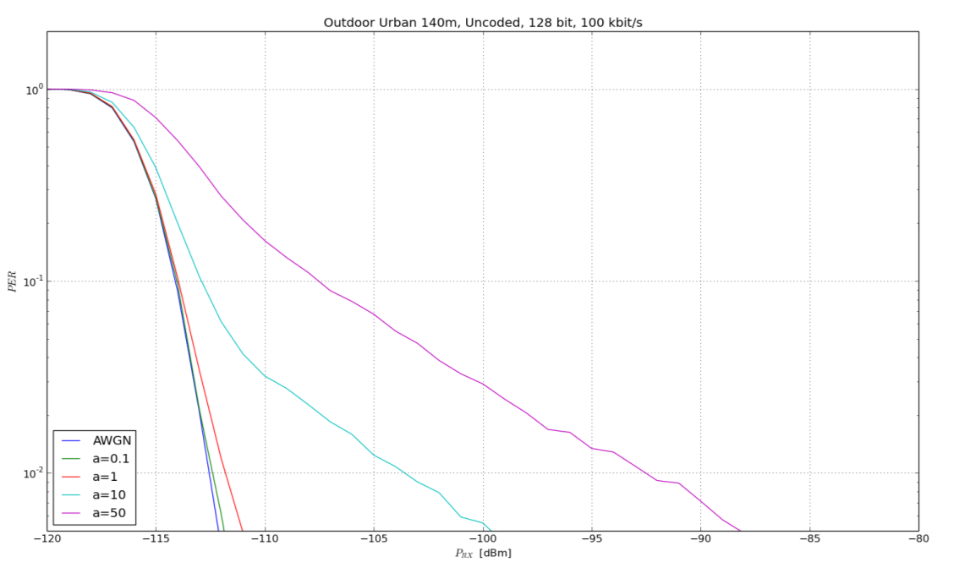
Simulation Results with Interference – PER as function of the Class ( IV / V )
100 kbit/s

Slide 21
Simulation Results with Interference – PER as function of the Class ( V / V )
Low bit-rates are more sensitive wrt. interference due to the larger foot-print

Slide 22
Simulation Results with Frequency Hopping (I/V)
Now we add frequency hopping
Number of payload bits is still 128
Data is spread over 16 hops → 2 bytes per hop
Results give an indication on the behavior of 802.15.4k with fragmentation, i.e. the probability that all hops are received correctly

Slide 23
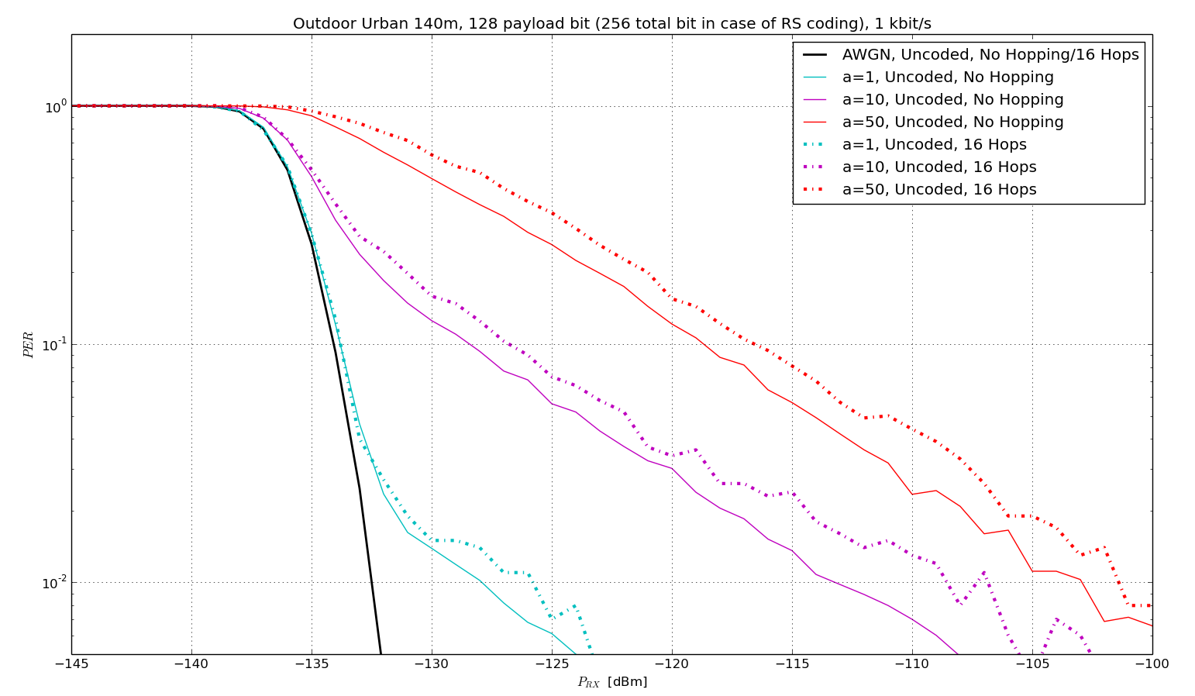
Simulation Results with Frequency Hopping (II/V)
1kbit/s

Slide 24
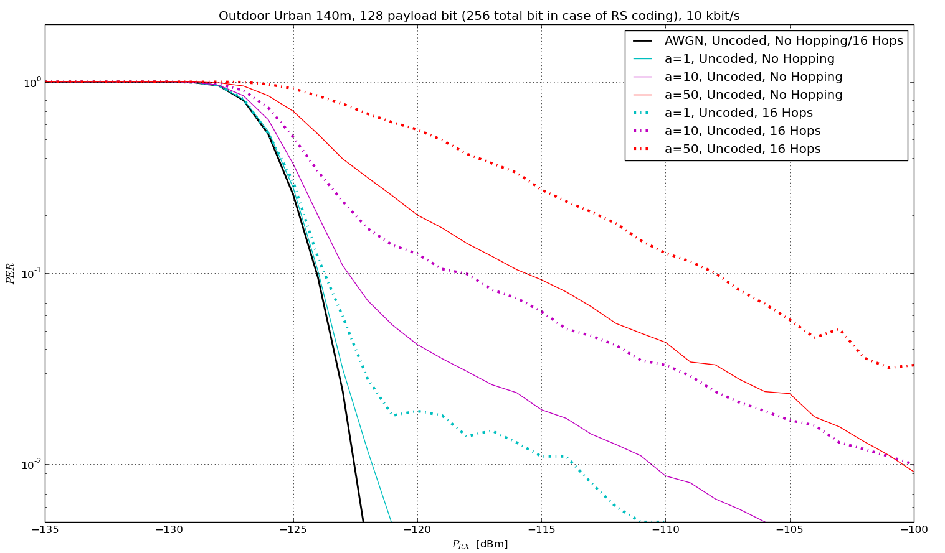
Simulation Results with Frequency Hopping (III/V)
10kbit/s

Slide 25
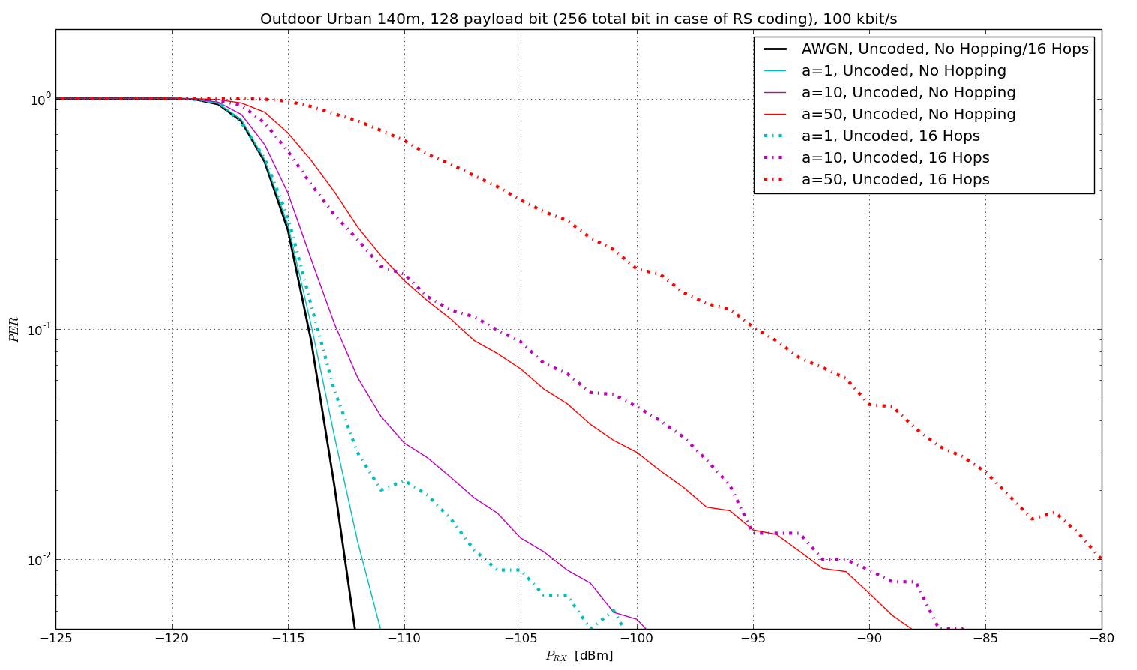
Simulation Results with Frequency Hopping (IV/V)
100kbit/s

Slide 26
Simulation Results with Frequency Hopping (V/V)
As expected, the use of hopping increases the probability that at least one hop is destroyed by interference
For low data rates this effect is not fully visible, as the fragments are much longer than the interferers, which may not be presented in real systems → decorrelation

Slide 27
Simulation Results AWGN with
RS Coding (I / III)
Now we add a very simple Reed Solomon (RS) Code to compare the performance (much better codes exist), all other parameters are identical to the AWGN case
We assume a code-rate of ½
A packet with 128 bits results in a coded packet with 256 bits, as we do not change the transmit rate
A packet with have twice the duration compared to an un-coded packet
In order to compare the actual transmit energy, a coded packet has a penalty of 3dB for the sample P_{RX}
We assume a shortened RS (255, 239) Code of GF(2^8) ➔ the code operates on bytes and is able to correct up to 8 bytes errors
We can assume that the data can be corrected if we have 8 or less bytes errors in a coded packet of 32 bytes (i.e. 256 bits)

Slide 28
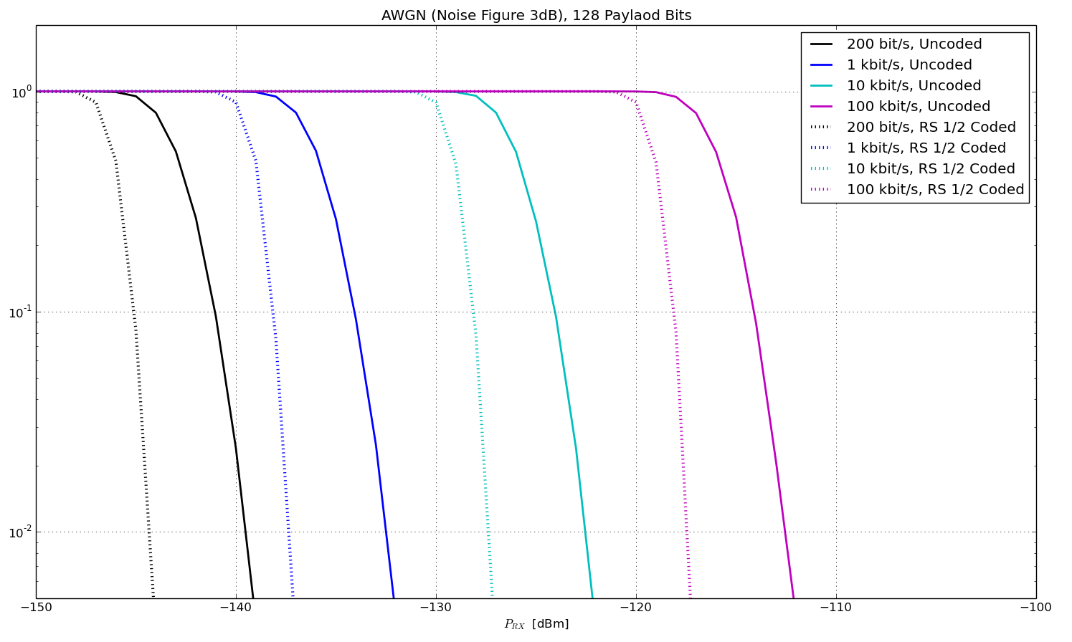
Simulation Results AWGN with
RS Coding (II / III)

Slide 29
Simulation Results AWGN with
RS Coding (III / III)
Reed Solomon Code obtains a gain of 5.5 dB wrt. P_{RX}
Results in a gain of 2.5 dB if the energy consumption is considered (as the coded transmission has twice the duration)
BUT: The RS code is not really suitable for decoding bit-errors, a convolutional code would result in a significantly higher gain!

Slide 30
Simulation Results with
Interference and Coding ( I / II )
We now use the Reed Solomon Code with the parameters used for the AWGN simulations in different interference channels for different bit-rates
We now use the interference classes
  AWGN: No interference
  A = 1: Class “Low”
  A = 10: Class “Medium”
  A = 50: Class “Dense”

Slide 31
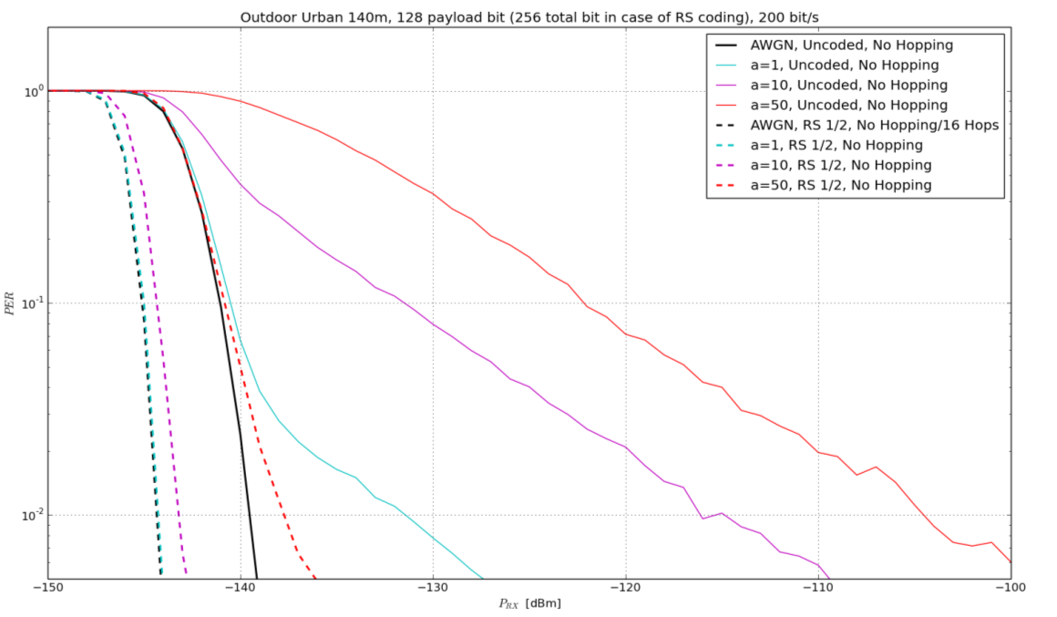
Simulation Results with
Interference and Coding – 200 bit/s

Slide 32
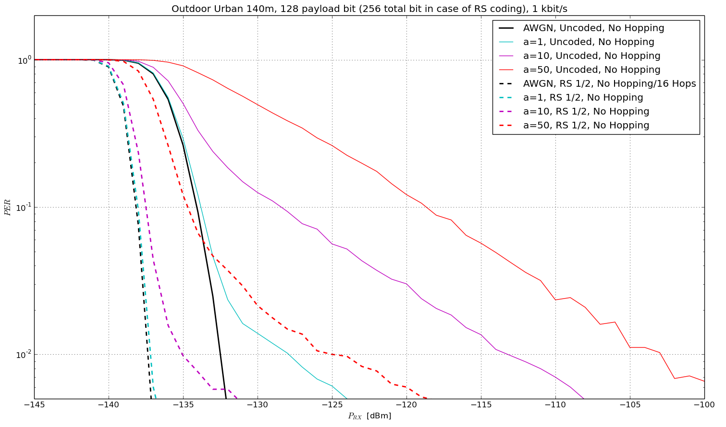
Simulation Results with
Interference and Coding – 1 kbit/s

Slide 33
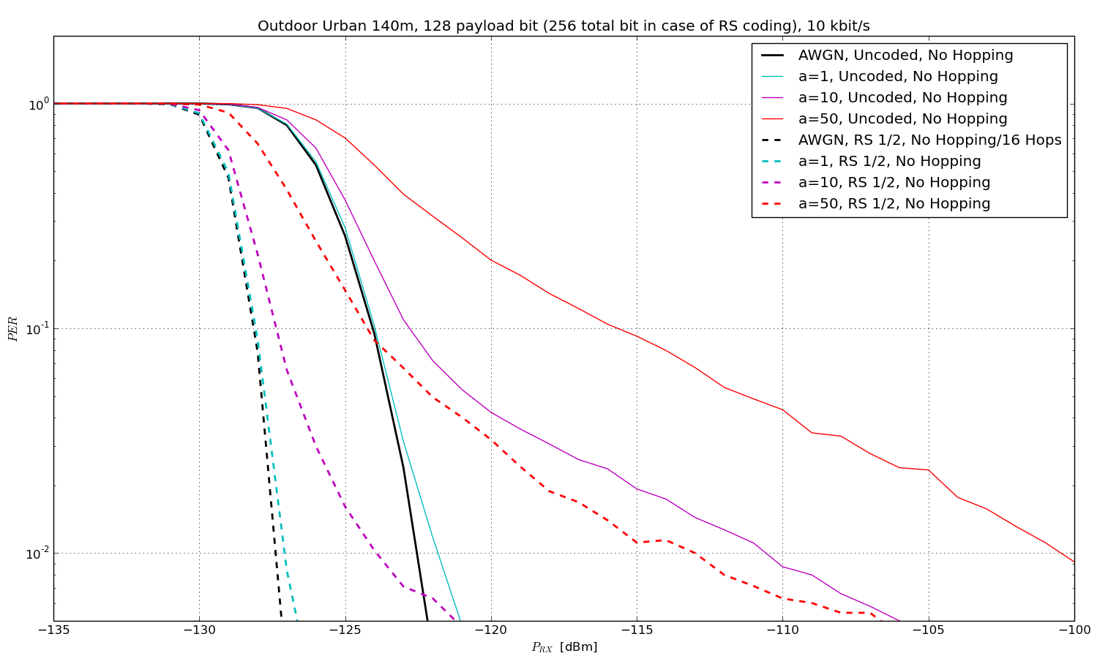
Simulation Results with
Interference and Coding – 10 kbit/s

Slide 34
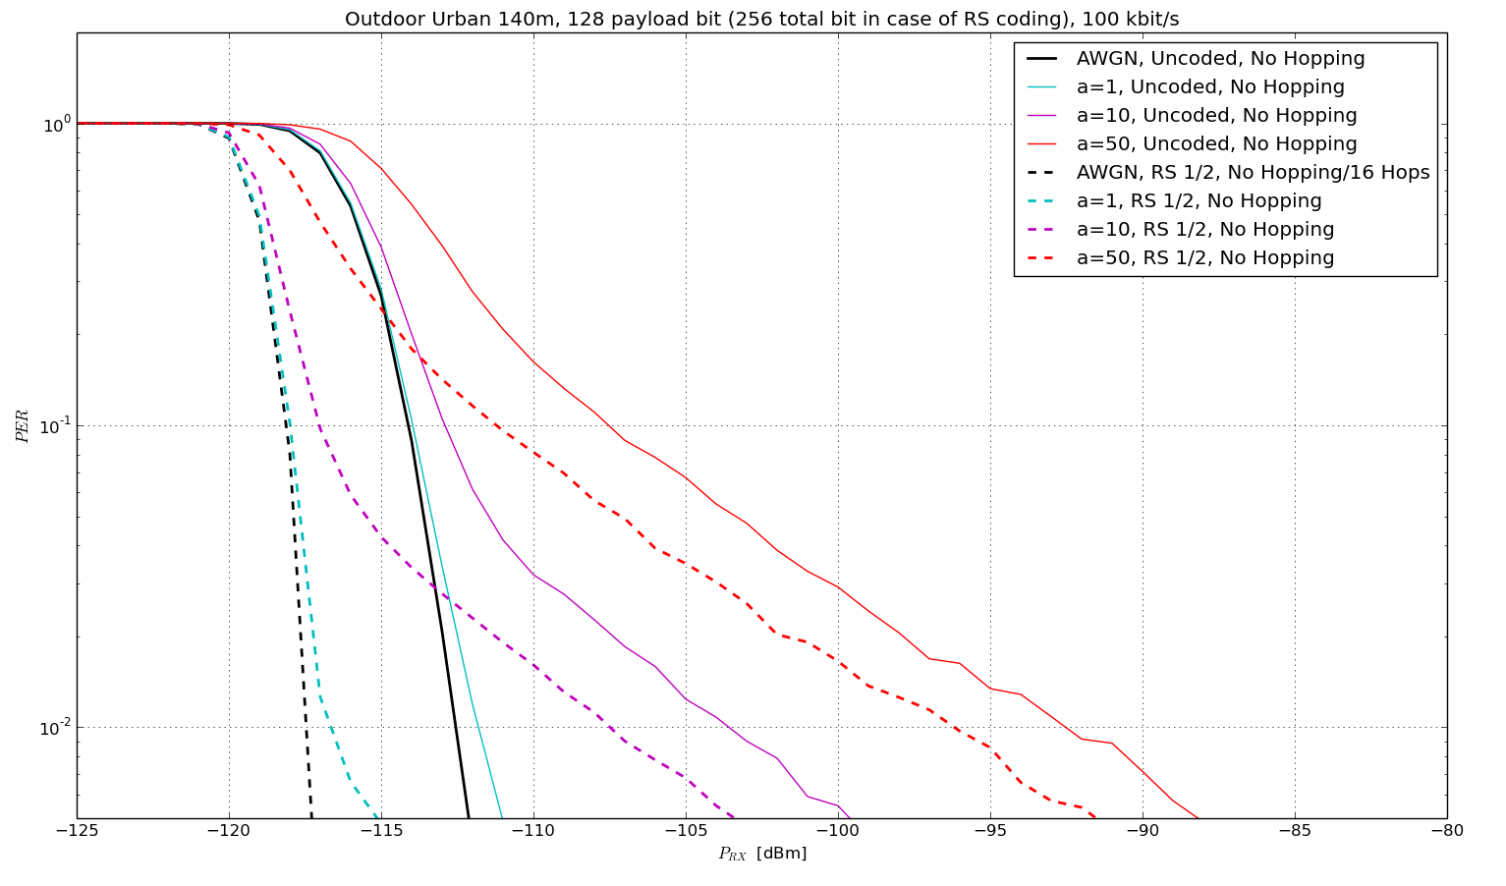
Simulation Results with
Interference and Coding – 100 kbit/s

Slide 35
Simulation Results with
Interference and Coding ( II / II )
Coding is able to provide a really significant gain in case of coding
However: The coding is not able to remove the long tail in case of stronger interference
... with one exception: For the low bit-rates the long tail is removed. This is caused by the long duration of the coded data (e.g. 1.28s for 200 bit/s) which is much longer than the longest interferer defined in the interference model (100ms)
Potentially unrealistic and does not consider self-interference
Interleaving should be stimulated also for higher rates ➔ hopping

Slide 36
Simulation Results with Additional Hopping (I / II)
Similar assumptions as previous slides
Additional hopping is used: Packets are split into 16 fragments of identical length with are then transmitted with frequency hopping ➔ decorrelation of the interferers
Requirement: All fragments have to be FEC encoded jointly!
No-Hopping and 16 Hops gives similar results in AWGN channel

Slide 37
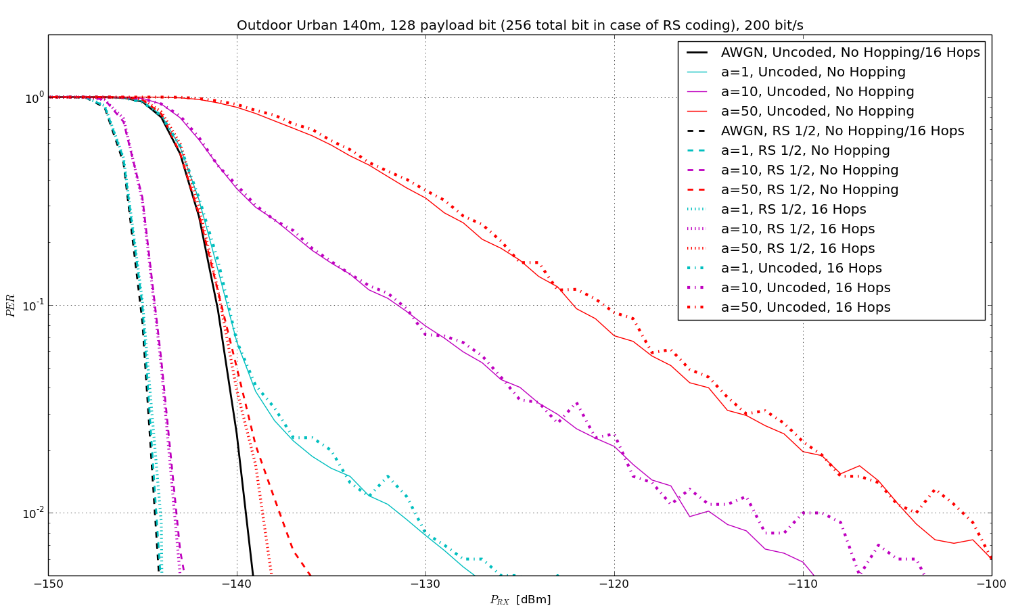
Simulation Results with
Hopping – 200 bit/s

Slide 38
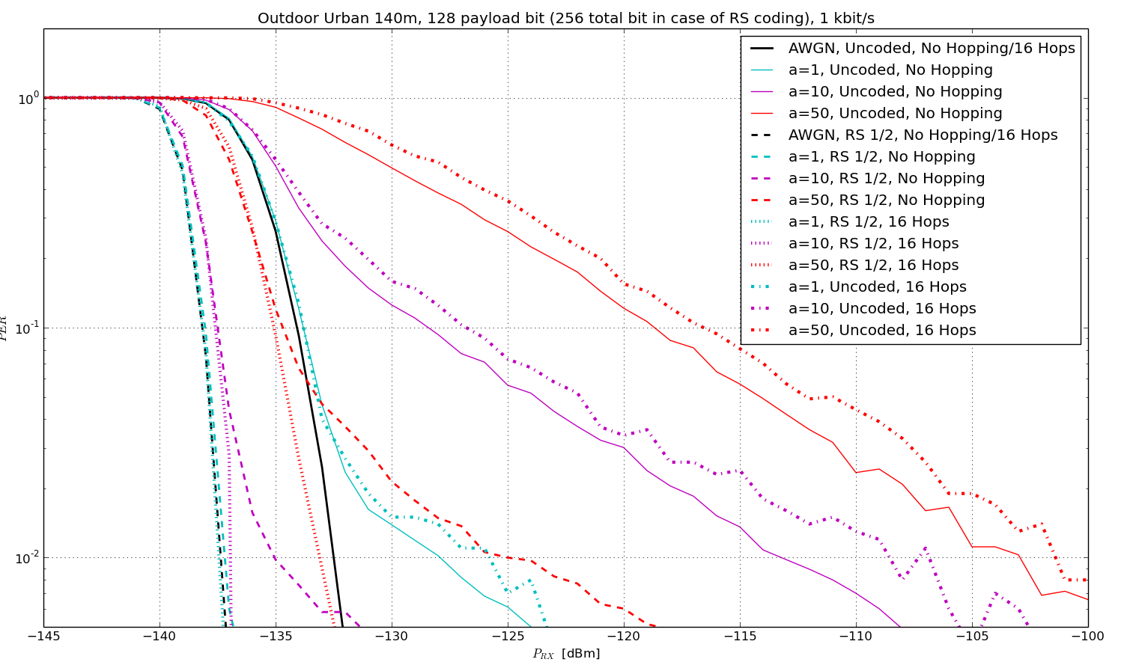
Simulation Results with
Hopping – 1 kbit/s

Slide 39
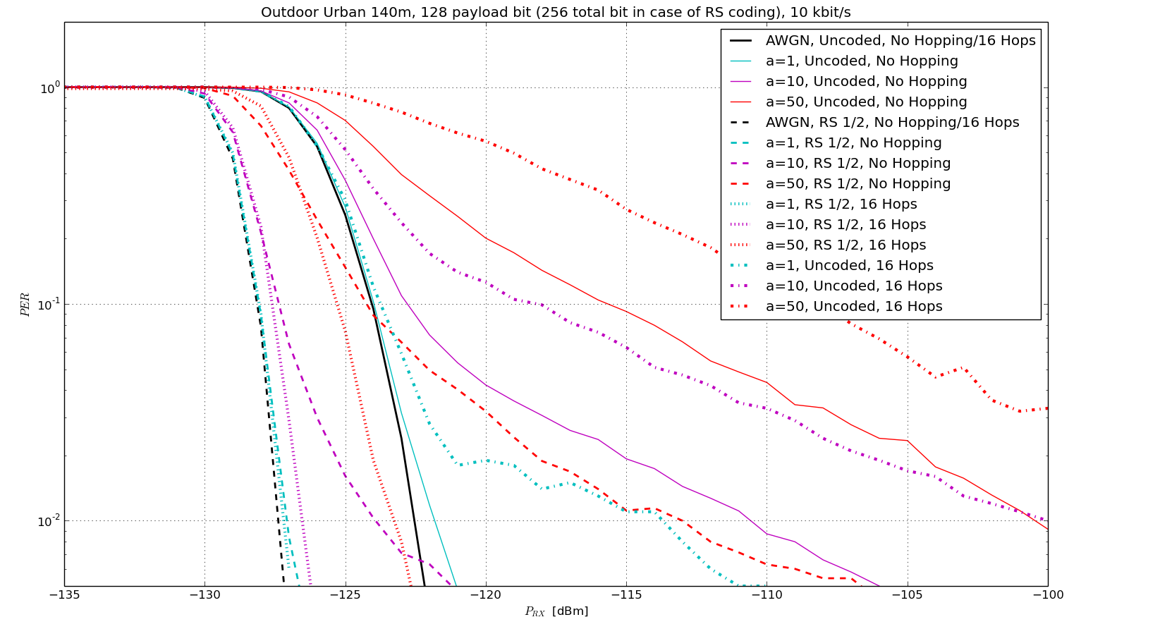
Simulation Results with
Hopping – 10 kbit/s

Slide 40
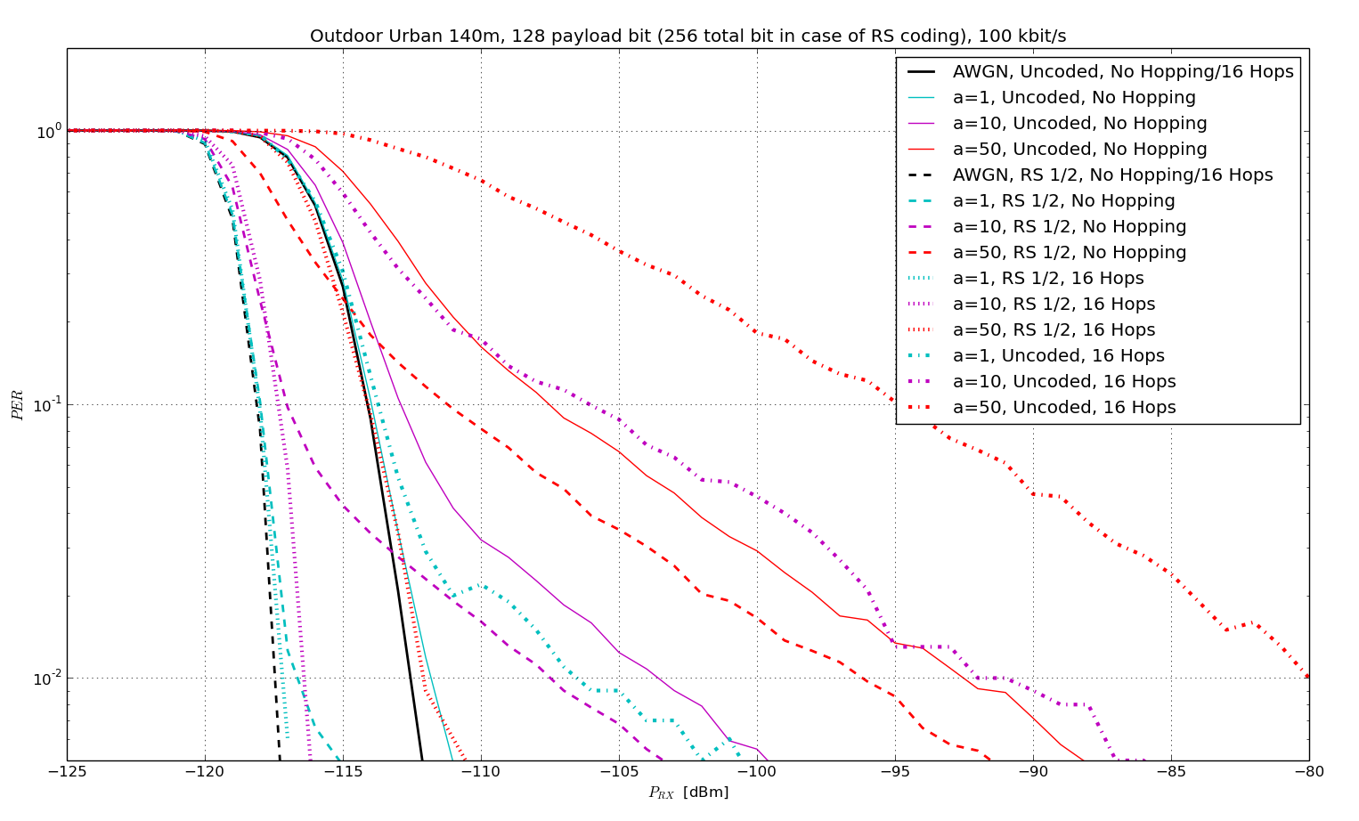
Simulation Results with
Hopping – 100 kbit/s

Slide 41
Simulation Results with Additional Hopping (II / II)
The use of frequency hopping de-correlates the interference
Losses of some fragments are compensated by means of the used Reed Solomon Code
Hopping almost approaches the performance of the AWGN channel even in dense interference scenarios with simple codes
Significantly better results may be achieved using convolutional codes and further optimization

Slide 42
Conclusions
Coding improved the performance in the AWGN channel
Interference has a significant impact on the reception quality, especially in case of un-coded transmission and ultra-low payload bit-rates
The use of coding only shows limited improvement in case of interfered channels
Combined channel hopping and coding significantly improves the performance and almost reaches the AWGN performance, even in highly interfered channels

Slide 43
Thank You for Your Interest!

