Slide 1
doc.: IEEE 802.15-17- 0471 -00-007a
Project: IEEE P802.15 Working Group for Wireless Personal Area Networks (WPANs)
Submission Title: Ad-hoc meeting Kookmin and SNUST
Date Submitted: August 19, 2017
Source: Trang Nguyen, Thanh Luan Vu, Yeong Min Jang (Kookmin University)
Vinayagam Mariappan, Jaesang Cha (SNUST)
Contact: +82-2-910-5068 E-Mail: yjang@kookmin.ac.kr
Re: July-2017 TG7m comments resolution, Screen modulation PHYs
Abstract: Ad-hoc meeting Kookmin and SNUST
Purpose: Meeting minutes
Notice: This document has been prepared to assist the IEEE P802.15. It is offered as a basis for discussion and is not binding on the contributing individual(s) or organization(s). The material in this document is subject to change in form and content after further study. The contributor(s) reserve(s) the right to add, amend or withdraw material contained herein.
Release: The contributor acknowledges and accepts that this contribution becomes the property of IEEE and may be made publicly available by P802.15.
Submission

Slide 2
doc.: IEEE 802.15-17- 0471 -00-007a
Ad-hoc meeting Participants
Kookmin University Attendees: Yeong Min Jang, Trang Nguyen, Thanh Luan Vu | SNUST Attendees Jaesang Cha, Vinayagam Mariappan
Start time: 8:30AM August 19, 2017
Finish time: 11:30AM August 19, 2017
Submission

Slide 3
doc.: IEEE 802.15-17- 0471 -00-007a
Timeline
1 | Saturday AM1
1.1 | MEETING CALLED TO ORDER | Yeong Min Jang | 0
 | Open Discussion The feasibility of PHY modes The restructure of PHY 6 |  | 30
1.2 | Presentation by Kookmin | Trang | 30
1.3 | Presentation by SNUST | Vinay | 30
1.4 | Q&A |  | 30
1.5 | Meeting Objectives and Minutes Approval |  | 20
Submission

Slide 4
doc.: IEEE 802.15-17- 0471 -00-007a
Open discussion
Submission

Slide 5
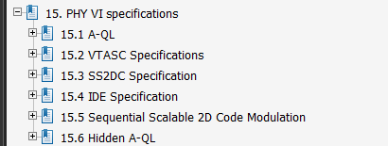
doc.: IEEE 802.15-17- 0471 -00-007a
Restructure of PHY 6
Trang’s comments
Can be merged VTASC / Sequential Scalable 2D-code
Shape modulation seems to be difficult/ its communication performance is not efficient
Vinay’s comments
Firstly, SNUST will rewrite the text for a clear description. Keep the two sections. Later, the merging can be discussed
By using 32x32 cells, shape modulation has 8 bit/Hz. This is feasible and already implemented.
Submission

Slide 6
doc.: IEEE 802.15-17- 0471 -00-007a
Restructure of PHY 6
SNUST is going to have these three sections in PHY 6
15.2 VTASC
15.3 IDE
15.4 SS2DC (MIMO case of above codes)
Kookmin is going the have these two sections in PHY 6
15.1 A-QL
15.5 HA-QL
Submission

Slide 7
doc.: IEEE 802.15-17- 0471 -00-007a
Kookmin presentation
Submission

Slide 8
doc.: IEEE 802.15-17- 0471 -00-007a
Kookmin presents
show 16x16 A-QL demo with BER 10^-5 using Reed Solomon and Convolutional Code as FEC
show 32x32 A-QL demo with BER 10^-3 using Reed Solomon and Convolutional Code as FEC
show 16x16 HA-QL demo using RS and CC as FEC
Re-call the need of redistribution of PHY 6 Section (Screen modulation modes)
Submission

Slide 9
doc.: IEEE 802.15-17- 0471 -00-007a
Kookmin presentation: Q&A
Vinay’s comments:
Change the figure title into “Illustration of HA-QL channel encoder output” because the output is imperceptible by human eyes.
Illustration of …
Submission

Slide 10
doc.: IEEE 802.15-17- 0471 -00-007a
SNUST presentation
Submission

Slide 11
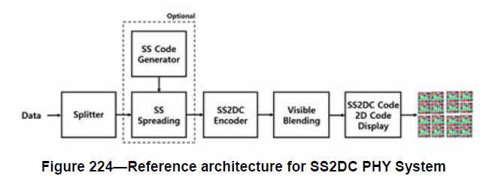
doc.: IEEE 802.15-17- 0471 -00-007a
SNUST presentation: VTASC and SS2DC
For VTASC only
Screen
SNUST presents
The difference between VTASC and SS2DC.
SS2DC Encoder shall use to existing encoder (such as VTASC, IDE, A-QL, QR code).
There may have one or multiple encoders inside the SS2DC encoder. The SS2DC encoder section shall link to the implementation of other encoders.
Submission

Slide 12
doc.: IEEE 802.15-17- 0471 -00-007a
SNUST presentation: VTASC
Modulation and Coding
Rx
TX (MIMO)
Encoder
SS
Outer FEC
Inner protection
Outer protection:
Reed Solomon
Trang’s comments about VTASC:
Rotation Limit:
Reference cells may needed
Vinay’s thinking about VTASC:
Insert Ab bits like Kookmin/ reference bits/ PHY sequential number to support rotation
Agree that Reference cells may needed
Trang’s comments about VTASC:
SNUST uses SS code that has similar purpose as an inner FEC.
Instead of SS, Kookmin uses CC as inner FEC
Vinay’s thinking about VTASC:
SS is for two purposes:
asynchronous communication
Reliable communication
Submission

Slide 13
doc.: IEEE 802.15-17- 0471 -00-007a
SNUST presentation: Shape modulation
20% tolerance
BER
Performance 8 bits/ block of 32x32
SNUST presents
The demo of shape modulation
Using 4 shapes and levels of size, 8 bits/ block of 32x32 cells is transmitted
Submission

Slide 14
doc.: IEEE 802.15-17- 0471 -00-007a
SNUST presentation: IDE mode
SNUST presents:
The feasibility of implementation/ Simulated results - IDE
Conclusion
IDE has two methods: water marking and waveform blending
Kookmin agrees the feasibility of DCT based water marking
HA-QL has similar concept with data blending (alpha channel) but using different waveforms. SNUST uses M-FSK/M-PSK and the FFT block at the Rx, while Kookmin uses reference image to extract the embedded signal (time domain).
--->remaining question is how Rx can extract the blended signal
Submission

Slide 15
doc.: IEEE 802.15-17- 0471 -00-007a
Summary
The restructure of PHY 6 has been discussed
15.1 A-QL
15.2 VTASC
15.3 IDE
15.4 SS2DC (MiMo use case of above codes)
15.5 HA-QL
The technical details on PHY 6 modes are discussed
Performance of A-QL, HA-QL, VTASC, IDE
Feasibility of SS2DC
Similarity and difference between PHY modes:
VTASC, SS2DC, A-QL
IDE and HA-QL
Further technical discussion on and ad-hoc meetings needed
Submission

