Slide 1
Project: IEEE P802.15 Working Group for Wireless Personal Area Networks (WPANs)
Submission Title: [Comment Resolutions for #345, #347, #348, and #349]
Date Submitted: [July 2017]
Source: [Huan-Bang Li [NICT], Marco Hernandez [Consultant], and Fumihide Kojima [NICT] ]
Address [3-4 Hikarino-oka, Yokosuka, Kanagawa, Japan]
Voice:[+81 468475104], FAX: [:[+81 468475431], E-Mail:[lee@nict.go.jp]
Re: [Contribution to 15.8 PAC draft]
Abstract: [Comment Resolutions for #309, #310, and #314]
Purpose: [This document is to provide comment resolution in Sponsor Ballot]
Notice: This document has been prepared to assist the IEEE P802.15. It is offered as a basis for discussion and is not binding on the contributing individual(s) or organization(s). The material in this document is subject to change in form and content after further study. The contributor(s) reserve(s) the right to add, amend or withdraw material contained herein.
Release: The contributor acknowledges and accepts that this contribution becomes the property of IEEE and may be made publicly available by P802.15.

Slide 2
Comment Resolutions for
#345, #347, #348, and #349
July, 2017

Slide 3
    Comment #345 : Page 57, Line 14
      Comment
      Should also indicate the peering type as part of the MLME-PEERING.request invocation.
Suggestion
add appropriate text to say with the peering type of many-2-many

Slide 4
    Proposed Solutions for #345
(changed text = blue)
a)
The I-PD’s higher layer triggers the many-to-many peering procedure by issuing the MLME-PEERING.request primitive to its MAC layer with the selected multicast group address and the list of targeted R-PDs selected from the list of qualified R-PDs obtained during the many-to-many discovery.
a)
The I-PD’s higher layer triggers the many-to-many peering procedure by issuing the MLME-PEERING.request primitive, with the content of the Request Type parameter set to MULTICAST, to its MAC layer with the selected multicast group address and the list of targeted R-PDs selected from the list of qualified R-PDs obtained during the many-to-many discovery.

Slide 5
    Comment #347 : Page 58, Line 21
      Comment
      "or reaching the macMaxFrameRetries", may be mis-interpreted because it is not clear what the criteria is. I reckon that it is not necessary, since the mechanisms described will naturally remove any remaining non responding PD to give an empty targeted list.
Suggestion
delete "or reaching the macMaxFrameRetries"

Slide 6
    Proposed Solutions for #347
(changed text = blue)
g)
The I-PD broadcasts additional Peering Request command frame with the updated list of targeted R-PDs and the updated list of accepted R-PDs, repeating steps d) to g), until the updated targeted R-PDs list is empty, or reaching the macMaxFrameRetries.
g)
The I-PD broadcasts additional Peering Request command frame with the updated list of targeted R-PDs and the updated list of accepted R-PDs, repeating steps d) to g), until the updated targeted R-PDs list is empty, or reaching the macPeeringResponseTimeout.

Slide 7
    Comment #348 : Page 58, Line 22
      Comment
      Maybe cleaner for (h), (i) and (j) to be merged and done by the MAC without any upper layer activity.
Suggestion
Replace (h), (i) and (j) with single step (h) : the MAC shall multicast a final many-to-many Peering Request command frame with the final list of accepted R-PDs using the multicast group address provided at step (a) and then issues the MLME-PEERING.confirm to its next higher layer with the final list of accepted R-PDs.

Slide 8
    Proposed Solutions for #348
(changed text = blue)
h)
i)
j)
The I-PD’s MAC layer shall issue the MLME-PEERING.confirm to its next higher layer with the final list of accepted R-PDs.
The next higher layer of I-PD issues a final MLME-PEERING.request primitive to its MAC layer with an empty list of targeted R-PDs and the final list of accepted R-PDs.
Upon reception of the MLME-PEERING.request primitive, the I-PD’s MAC layer shall multicast a final many-to-many Peering Request command frame with the final list of accepted R-PDs using the multicast group address selected in step a).
h)
The MAC layer shall multicast a final many-to-many Peering Request command frame with the final list of accepted R-PDs using the multicast group address provided at step (a) and then issues the MLME-PEERING.confirm to its next higher layer with the final list of accepted R-PDs.

Slide 9
    Corresponding Bullet Number Changes
old | new
h), i), and j) | h)
k) | i)
l) | j)

Slide 10
    Comment #349: Page 59, Line 2
      Comment
      if the previously proposed change to simplify and merge steps (h), (i) and (j) then Figure 32 will need updating accordingly.
Suggestion
update the figure

Slide 11
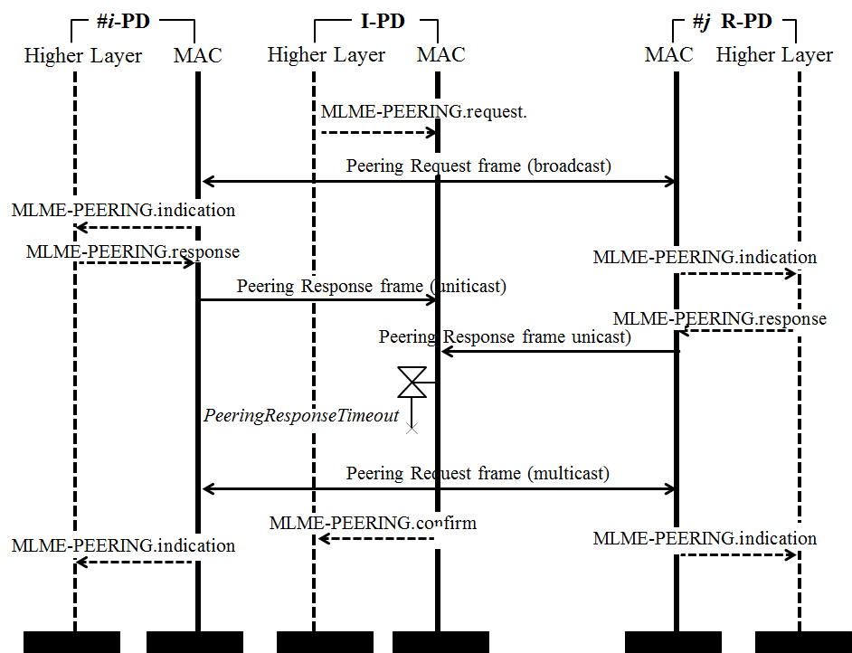
    Proposed Solutions for #349 (Figure 32)

Slide 12
    Other related Changes
      Page 58, line 2
      many-to-many → MULTICAST
      Page 58, line 6
      MANY2MANY → MULTICAST

Slide 13
    Reference Slides

Slide 14
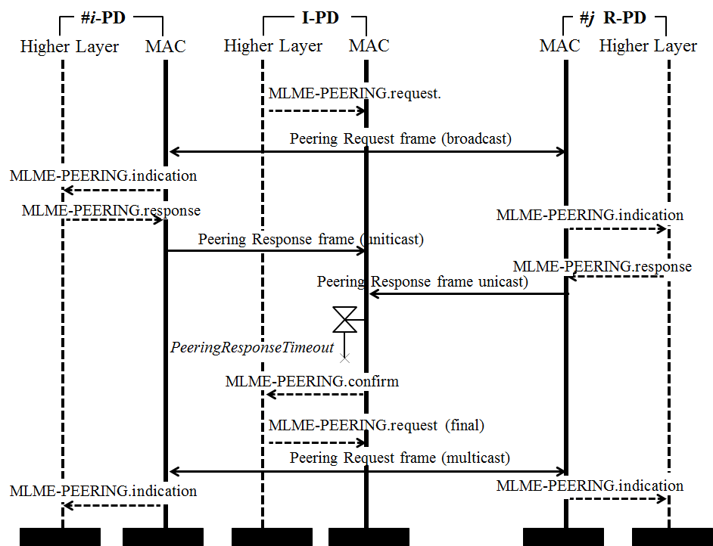
    Figure 32 Before Change

