Slide 1
Evaluation on blind detection for 802.15
Doc.: IEEE 15-17-0449-00-lpwa
Date: 2017-7-10
Authors:
Name | Affiliations | Address | Phone | Email
Ningbo Zhang | Beijing University of Posts and Telecommunications | Beijing, China |  | nbzhang@bupt.edu.cn
Tingting Ding | Beijing University of Posts and Telecommunications | Beijing, China |  | ttding@bupt.edu.cn
BUPT

Slide 2
Motivation
Doc.: IEEE 15-17-0449-00-lpwa
In NOMA random access, SIC receiver is required to cancel inter-user interferences at STA[1-2]
  SIC receiver requires diverse arrived power to distinguish multiplexing users.
  To obtain the diverse arrived power, a power back-off scheme is proposed for uplink NOMA transmission.
BUPT

Slide 3
  NOMA RA
Doc.: IEEE 15-17-0449-00-lpwa
Step 1: Peer discovery: This step is to discover neighbor paired STAs.
Step 2: NOMA group establishment: Select a group center and allocate the power back-off index.
Step 3: Channel detection: The group center sends preamble to detect the channel on behalf of NOMA group.
Step 4: Detection response: AP sends back the detection response to NOMA group STAs.
Step 5: Power back-off: NOMA group STA power back-off to guarantee diverse received power at AP.
Step6: SIC reception and ACK: AP performs SIC receiver to cancel multi-STA interferences and sends back ACK/NACK.
BUPT

Slide 4
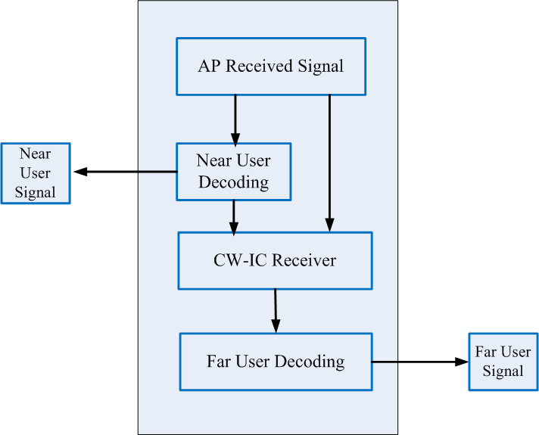
  Multiple User Decoding at STA
Doc.: IEEE 15-17-0449-00-lpwa
Two Users are multiplexed
  Near User: baseline arrived power
  Far User: dB lower than near user
AP decoding
  For near user, AP direct decodes the
  message since the interference from
  far user is neglected.
  For far user, AP first cancels the near
  user’s message and then decodes the
  far user’s message.
Fig.1 SIC receiver at STA
BUPT

Slide 5
Performance of NOMA
Doc.: IEEE xxxx-xx
(MMSE-SIC) receiver is performed at AP
  The performance of NOMA degrades compared to OMA
  There exists SNR threshold between the OMA RA and the NOMA RA for a target BLER. Taking as the target BLER, the SNR threshold is about 6.3dB
Fig.2 Performance of SIC receiver at STA
Transport block size (TBS) :100 bits
Modulation order: QPSK
The number of STAs in Group A: Two
The number of STAs in Group B: Three
Channel model: Extended pedestrian A (EPA)
Difference of received power : 5dB

Slide 6
  Power Control for Uplink NOMA
Doc.: IEEE 15-17-0449-00-lpwa
The transmit power of the i-th User in a NOMA set is:
Where is the maximum transmit power, is the target arrived power and is the path loss including distance-dependent path loss and lognormal shadowing. is the assigned resource unit.
Near user
  Far User
BUPT

Slide 7
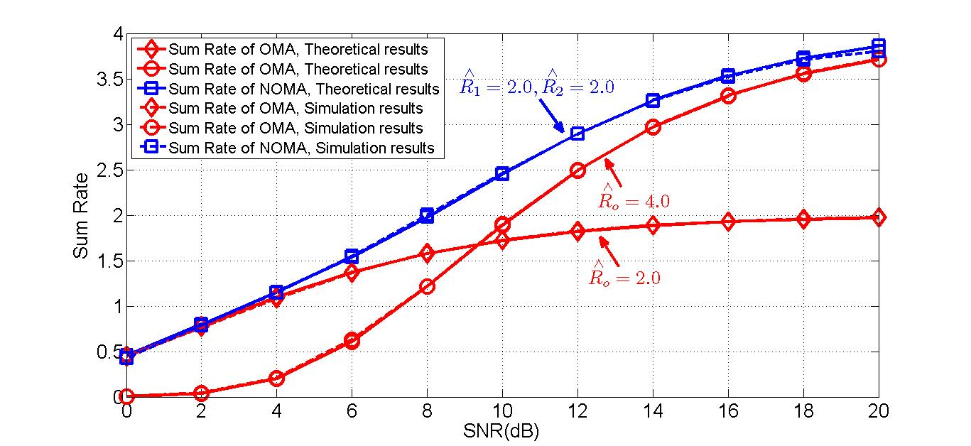
  Simulation Results
Doc.: IEEE 15-17-0449-00-lpwa
Assumptions:
  -
Parameter | Value
Carrier | 2.4GHz
 | 23dBm
Distance between near user and AP | 10 meters
Distance between far user and AP | 30 meters
Distance between OMA user and AP | 10 meters
Tb size | 100bits
Modulation order | QPSK
 | 5dB
Target data rate for near user and far user
Target data rate for OMA user
Fig.3 Sum rate simulation between OMA and NOMA
NOMA achieves signiﬁcant gain at lower SNR region when the target data rate of OMA equals the sum of NOMA’s target data rate.
NOMA achieves almost double sum data rate more than OMA at higher SNR region when the target data rate of OMA is the same as NOMA UE.
BUPT

Slide 8
Hybrid RA for 802.15
Doc.: IEEE xxxx-xx
Access mode selection
  Received SNR at AP
  where is the variance of noise and is the received power at AP.
Fig.4 Hybrid RA scheme

Slide 9
  Simulation Results
Doc.: IEEE 15-17-0449-00-lpwa
Assumptions:
  -
Parameter | Value
Carrier | 2.4GHz
 | 23dBm
Distance between near user and AP | 10 meters
Distance between far user and AP | 30 meters
Distance between OMA user and AP | 10 meters
Tb size | 100bits
Modulation order | QPSK
 | 5dB
Target data rate for near user and far user
Target data rate for OMA user
Fig.5 Number of access between hybrid access and OMA/NOMA access
The hybrid RA procedure increases the total number of successful UEs from 140 in the OMA RA procedure to 218 within a RA cycle.
Hybrid RA can significantly improve the access capacity.
BUPT

Slide 10
  Conclusions
Doc.: IEEE 15-17-0449-00-lpwa
  SIC receiver is required to cancel inter-user interferences in NOMA random access
  NOMA transmission outperforms OMA transmission in all cases.
  Hybrid RA can significantly improve the access capacity.
BUPT

Slide 11
References
Doc.: IEEE 15-16-0851-00-004t
[1] Z. Ding, Z. Yang, P. Fan, and H. V. Poor, “On the performance of nonorthogonalmultipleaccessin5Gsystemswithrandomlydeployedusers,” IEEE Signal Process. Lett., vol. 21, no. 12, pp. 1501–1505, Dec. 2014.
[2] N. Zhang, J. Wang, G. Kang and Y. Liu, “Uplink Nonorthogonal Multiple Access in 5G Systems,” IEEE Communications. Lett, vol. 20, no. 3, Mar. 2016.
BUPT

Slide 12
Doc.: IEEE 15-17-0449-00-lpwa
Thanks!
BUPT

