Slide 1
Project: IEEE P802.15 Working Group for Wireless Personal Area Networks (WPANs)
Submission Title: Dimming support solutions of PHYs in IEEE802.15.7
Date Submitted: 15 July 2017
Source: Sang-Kyu Lim and Tae-Gyu Kang [ETRI]
Address:
Voice:[+82-42-860-1573], FAX: [+82-42-860-5218], E-Mail:[sklim@etri.re.kr]
Re:
Abstract:
Purpose: Contribution to IEEE 802.15.13
Notice: This document has been prepared to assist the IEEE P802.15. It is offered as a basis for discussion and is not binding on the contributing individual(s) or organization(s). The material in this document is subject to change in form and content after further study. The contributor(s) reserve(s) the right to add, amend or withdraw material contained herein.
Release: The contributor acknowledges and accepts that this contribution becomes the property of IEEE and may be made publicly available by P802.15.

Slide 2
Dimming Support Solutions
of PHYs in IEEE802.15.7
Sang-Kyu Lim and Tae-Gyu Kang
ETRI

Slide 3
Dimming Requirements in IEEE 802.15.7
The dimming technologies on data transmission time depend on the PHY modulation schemes and are designed to avoid flicker.
All devices shall honor dimming requests but a device shall not be required to support communication for any dimming request.
Due to non-linear human eye response to light, dimming levels as low as 0.1% shall be supported (square law phenomenon).
→ Please find the document, IEEE 802.15-09-0369-00-0007.

Slide 4
Dimming Solutions in IEEE 802.15.7
Idle pattern & Compensation time
Dimming
during idle time
Visibility pattern
Dimming during data transmission time
CSK-mode dimming
OOK-mode dimming
VPPM-mode dimming

Slide 5
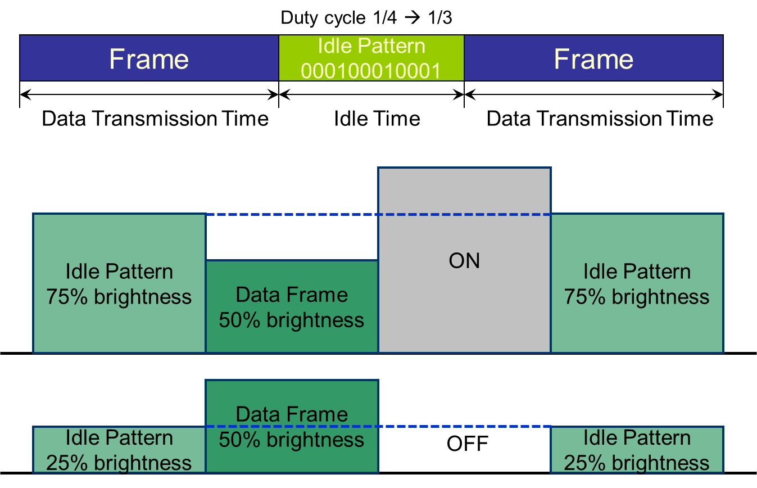
Dimming Control and Flicker Mitigation
by Idle Pattern & Compensation Time

Slide 6
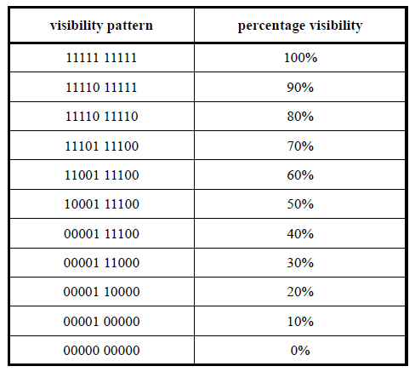
Dimming Control and Flicker Mitigation
by Visibility Pattern
Example of visibility patterns for 8B10B code

Slide 7
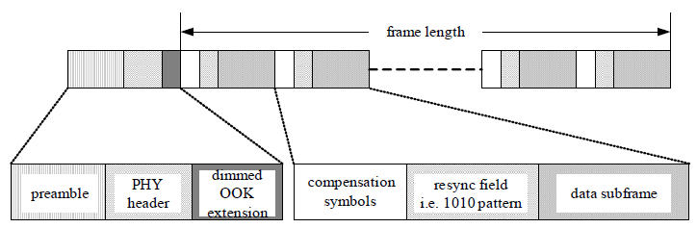
OOK-mode dimming
Since the average intensity of data frame in OOK-mode is 50%, compensation time may need to be inserted into the data frame to adjust the average intensity.
The data frame is fragmented into sub-frames of the appropriate length.
The OOK-mode dimming is supported by using the dimmed OOK bit field set in the PHY header.
If the dimmed OOK bit is set in the PHY header for dimming support, additional fields indicating the compensation symbol length, the resync field length and the subframe length are transmitted after the PHY header.

Slide 8
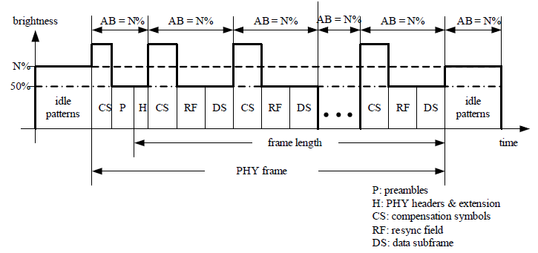
An Example of OOK-mode dimming

Slide 9
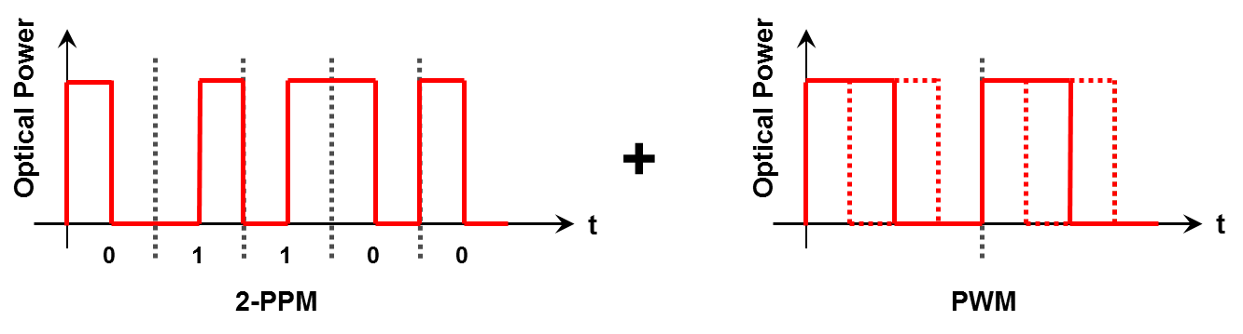
VPPM Modulation Scheme
Variable-PPM = PWM + 2-PPM
  2-PPM for communication and flicker mitigation
  PWM (duty cycle control) for brightness control
  Brightness of bit “0” = Brightness of bit “1”
  Constant amplitude level

Slide 10
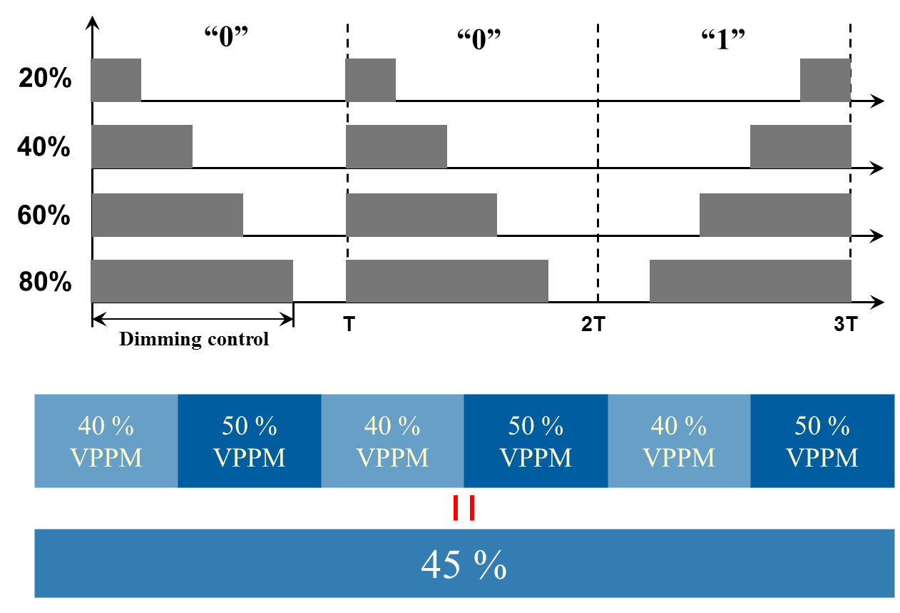
VPPM-mode dimming

Slide 11
Summary
Dimming Support & Intra-frame Flicker Mitigation
- VPPM modulation scheme
Dimming Support & Inter-frame Flicker Mitigation
- Idle pattern, Compensation time, Visibility pattern
OOK-mode Dimming
- Dimmed OOK bit field in the PHY header
- Idle pattern, Compensation symbols, Visibility pattern
VPPM-mode Dimming
- VPPM modulation scheme
- Algorithm for higher dimming resolution

