Slide 1
Project: IEEE P802.15 Working Group for Wireless Personal Area Networks (WPANs)
Submission Title: Flicker mitigation solutions of PHYs in IEEE802.15.7
Date Submitted: 15 July 2017
Source: Sang-Kyu Lim and Tae-Gyu Kang [ETRI]
Address:
Voice:[+82-42-860-1573], FAX: [+82-42-860-5218], E-Mail:[sklim@etri.re.kr]
Re:
Abstract:
Purpose: Contribution to IEEE 802.15.13
Notice: This document has been prepared to assist the IEEE P802.15. It is offered as a basis for discussion and is not binding on the contributing individual(s) or organization(s). The material in this document is subject to change in form and content after further study. The contributor(s) reserve(s) the right to add, amend or withdraw material contained herein.
Release: The contributor acknowledges and accepts that this contribution becomes the property of IEEE and may be made publicly available by P802.15.

Slide 2
Flicker Mitigation Solutions
of PHYs in IEEE802.15.7
Sang-Kyu Lim and Tae-Gyu Kang
ETRI

Slide 3
VLC Characteristics distinguished
from Other Communication System
Flicker Mitigation Schemes
Dimming Support

Slide 4
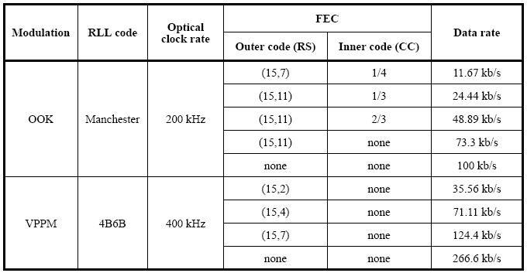
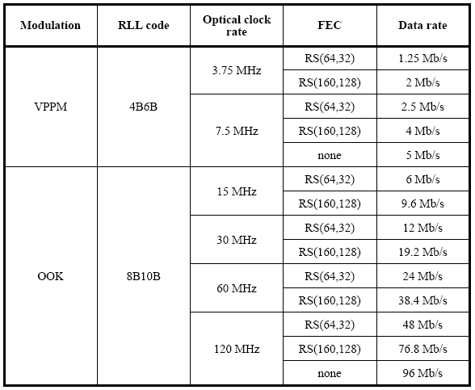
PHY Types in IEEE 802.15.7
< PHY I >
< PHY II >
< PHY III >

Slide 5
Flicker Issue
Flicker is defined as the fluctuation of the brightness of light that can cause noticeable physiological changes in humans.
Intra-frame Flicker
Inter-frame Flicker
Data Frame
Data Frame
Data Transmission Time
Idle Time
Data Transmission Time

Slide 6
Solutions for Flicker Mitigation
RLL Codes
Manchester
4B6B
Intra-Frame Flicker
8B10B
Dimming Support Solutions
Modulation Scheme
Variable-PPM
Inter-Frame Flicker
Idle Pattern & Compensation Time
Visibility Pattern

Slide 7

Manchester Code
Expands each bit into 2-bit symbols
Same average brightness
Flicker mitigation effect
DC balancing code
Strong clock spectral line
Optical Power
= 50 % =
Optical Power
t
t
bit “1”
T
bit “0”
T
Manchester - OOK

Slide 8
4B6B Code
 | 4B | 6B
0 | 0000 | 001110
1 | 0001 | 001101
2 | 0010 | 010011
3 | 0011 | 010110
4 | 0100 | 010101
5 | 0101 | 100011
6 | 0110 | 100110
7 | 0111 | 100101
8 | 1000 | 011001
9 | 1001 | 011010
A | 1010 | 011100
B | 1011 | 110001
C | 1100 | 110010
D | 1101 | 101001
E | 1110 | 101010
F | 1111 | 101100
Expands 4-bits to 6-bits symbols
Counts of 1 and 0 = 3
Same average brightness
Flicker mitigation effect
DC balancing code
Strong clock spectral line

Slide 9
Simulation Results of 4B6B Code
DC Balancing Code: YES DC residual: -infinity (perfect balance)
Spectrum at 0.05 Hz: -12 dBr Clock Strength: +21 dBr @ 2/3 Hz
(Reference : IEEE 802.15-09-0766-00-0007)

Slide 10
8B10B Code
The low 5 bits of data are encoded into a 6-bit group
The top 3 bits are encoded into a 4-bit group
The long-term ratio of 1s and 0s transmitted is exactly 50%.
DC balancing code
Strong clock spectral line
(Reference : IEEE 802.15-09-0637-00-0007 and IEEE 802.15-09-0766-00-0007)

