Slide 1
Project: IEEE P802.15 Working Group for Wireless Personal Area Networks (WPANs)
Submission Title: [On IETF LPWAN]
Date Submitted: [10 July , 2017]
Source: [Pascal Thubert] Company [Cisco Systems]
Address [Building D (Regus) 45 Allée des Ormes - BP1200 06254 MOUGINS cedex France]
Voice:[+33 4 97 23 26 34], FAX: :[+33 4 97 23 26 26], E-Mail:[pthubert@cisco.com]
Re: [N/A]
[If this is a response to a Call for Contributions, cite the name and date of the Call for Contributions to which this document responds, as well as the relevant item number in the Call for Contributions.]
[Note: Contributions that are not responsive to this section of the template, and contributions which do
not address the topic under which they are submitted, may be refused or consigned to the “General Contributions” area.]
Abstract: [Introduces the IETF LPWAN WG]
Purpose: [Informational]
Notice: This document has been prepared to assist the IEEE P802.15. It is offered as a basis for discussion and is not binding on the contributing individual(s) or organization(s). The material in this document is subject to change in form and content after further study. The contributor(s) reserve(s) the right to add, amend or withdraw material contained herein.
Release: The contributor acknowledges and accepts that this contribution becomes the property of IEEE and may be made publicly available by P802.15.
NOTE: Update all red fields replacing with your information; they are required. This is a manual update in appropriate
fields. All Blue fields are informational and are to be deleted. Black stays. After updating delete this box/paragraph.

Slide 2
On IETF LPWAN
IPv6 over Low Power Wide-Area Networks

Slide 3
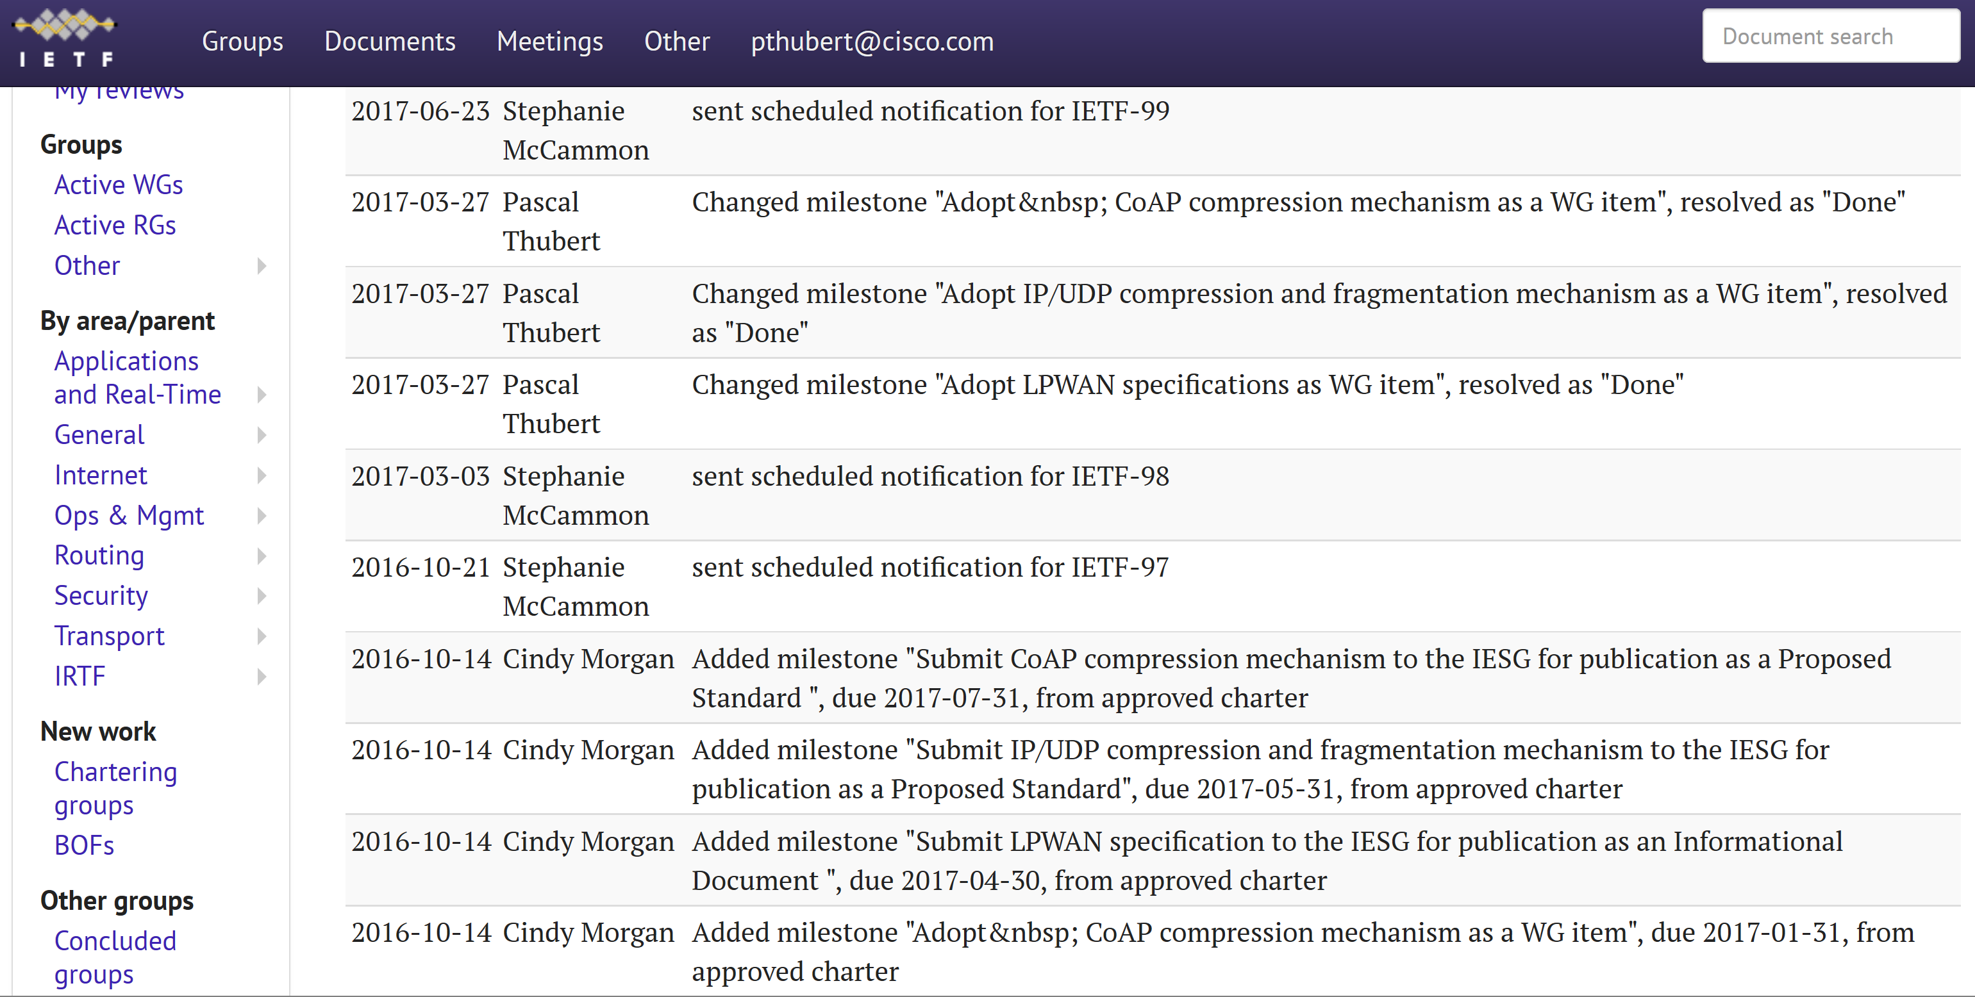
IPv6 over Low Power Wide-Area Networks

Slide 4
Charter and Deliverables
WG formed October 14^{th,} 2016
Charter item #1 (Informational document)
  Baseline technology description
Charter item #2 (Standards track document(s))
  Enable the compression and fragmentation of a CoAP/UDP/IPv6 packet over LPWA networks

Slide 5
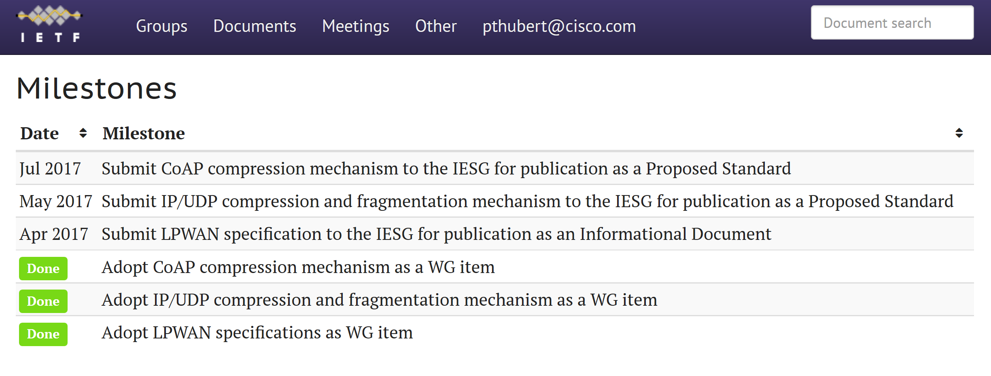
Milestones
Milestones

Slide 6
LPWAN Overview
Introduces the 4 selected technologies
  LoRa
  SIGFOX
  NB-IOT
  Wi-SUN
Provides a Gap Analysis, to be discussed at IETF 99 for rechartering
In WG Last Call

Slide 7
Static Context Header Compression
(SCHC)
Pronouced Chic
Defines Compression of IPv6 stack over LPWANs
draft-ietf-lpwan-ipv6-static-context-hc
  Has the basic mechanism
  Provides IPv6 and UDP compression
  Provides recoverable fragments (and profiles)
draft-ietf-lpwan-coap-static-context-hc
  Adds CoAP
draft-lagos-lpwan-icmpv6-static-context-hc
  Adds support for ICMPv6

Slide 8
SCHC (Static Context Header Compression)
July 2017
July 2017
July 2017
July 2017
draft-ietf-lpwan-ipv6-static-context-hc
Pascal Thubert, Cisco Systems
Pascal Thubert, Cisco Systems
Pascal Thubert, Cisco Systems
Pascal Thubert, Cisco Systems
Notes:
Here you show the SCHC functionality.
When an uncompressed packet arrives to the SCHC the first thing to do is to search the correct rule that match all the header values. When a rule matches, the Rule ID will be used and sent in order that the other side can decompress the correct values. Following the rule_ID you will find the values that need to be sent with this rule and the data.
When the compressed packet arrives to the SCHC destination then it will search device ID and the rule id in order to get the correct header values.

Slide 9
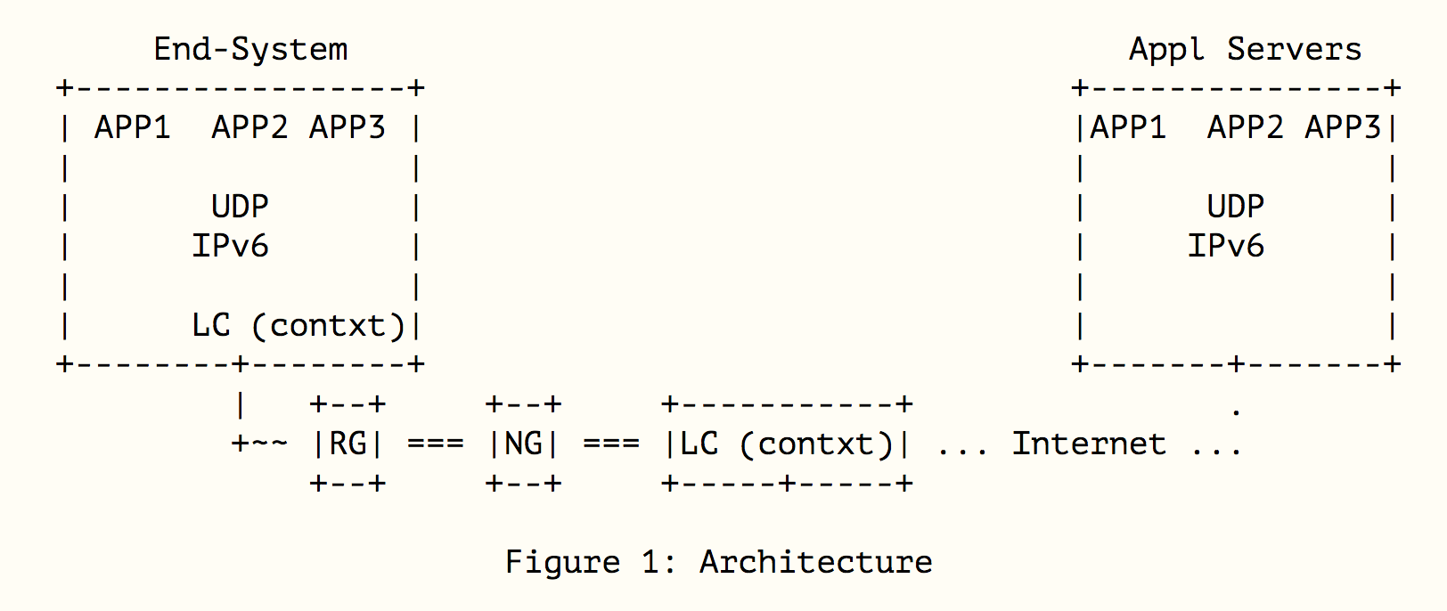
SCHC Compressor/Decompressor architecture
Application
(CoAP)
UDP
IPv6
SCHC
L2
draft-ietf-lpwan-ipv6-static-context-hc
Slide 9
Notes:
This figures show the place where the SCHC compressor/decompressor may be implemented. Both sides of the header compression are the End-System which is represented by the host or thing and the network side where the SCHC compressor/decompressor may be implemented after the network gateway (NG) as an independent element or inside the NG as part of it.
At left just to remind the protocol stack, where SCHC is between layer 2 and 3 because here we know the complete header of the stack

Slide 10
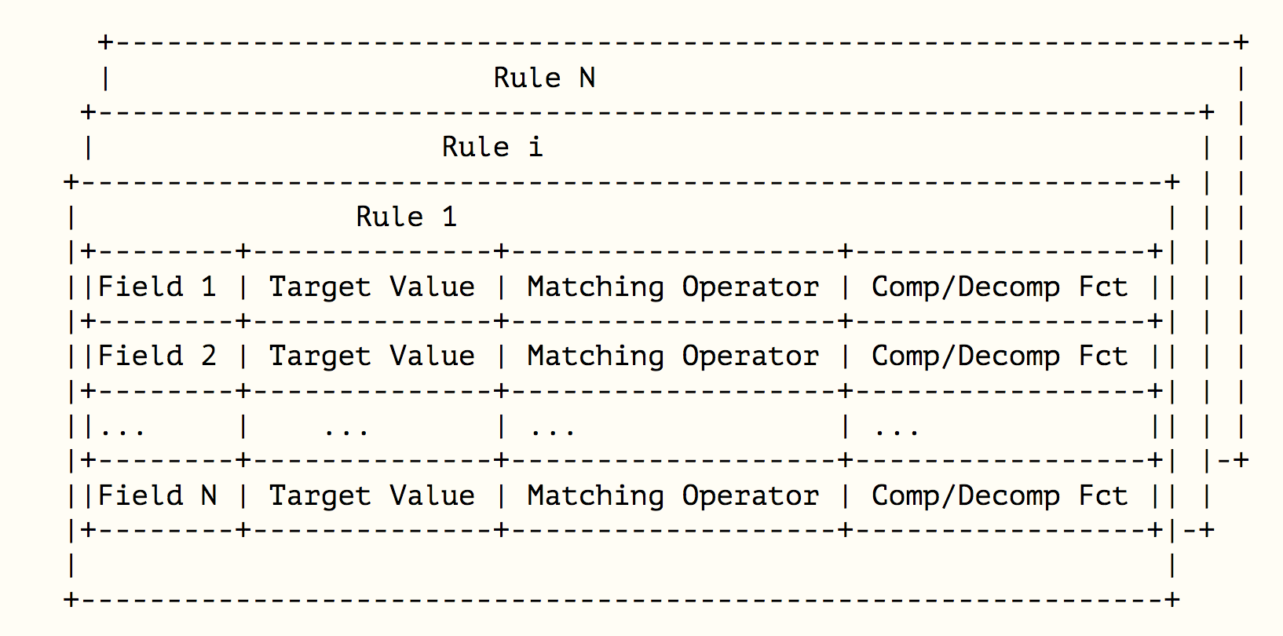
Context
July 2017
draft-ietf-lpwan-ipv6-static-context-hc
Slide 10
Pascal Thubert, Cisco Systems
Notes:
The context contains all the rules that can be used. Each rule (context) has a rule ID to be identified.
In the Rule you have the description of the header fields.
You will find a table with the name of the field, its value and the MO to select the rule and the CDF to compress decompress
What it is new in this version is that each header field has a field id, and the headers are in order of the header format. So the order is known

Slide 11
Compression Decompression Functions
Add mapping-sent (from CoAP draft)
  Index is sent corresponding to the FV
  { 0: 2001:db8:1:1,
  1: 2001:db8:2:3
  2 : 2001:db8:3:7}
Rename compute-length and compute-checksum
  More generic (IPv6, UDP, …)
draft-ietf-lpwan-ipv6-static-context-hc
Slide 11
Notes:
So the CDF will only send the index of the list in order to identify the value used.
We have also changed the name of the compute*, we have put the name of the field that have to be computed as:
Compute-length or compute-checksum, etc. It is more generic and easily identified for IPv6 and UDP.

Slide 12
More in article in IEEE Communications Standards Magazine, April 2017

