Slide 1
Project: IEEE P802.15 Working Group for Wireless Personal Area Networks (WPANs)
Submission Title: VAT CAMCOM Image Processing Functional Requirements
Date Submitted: July 2017
Source: Jaesang Cha, Miseon Kim, Minwoo Lee, Vinayagam Mariappan (SNUST), Jeonggon Kim (Korea Polytechnic Univ.), Sangwoon Lee (Namseoul Univ.), Ilkyoo Lee (Kongju Nat’ Univ.), Gilsik Lee (The Univ. of Texas at Dallas), Sooyoung Chang (CSUS)
Address: Contact Information: +82-2-970-6431, FAX: +82-2-970-6123, E-Mail: chajs@seoultech.ac.kr Re:
Abstract: This documents introduce the image processing techniques to use on Vehicle CamCom Concept models for Vehicular Assistant Technology(VAT). This proposed LiFi / CamCom Image processing techniques for VAT to operate on the application services like ITS, ADAS, etc on road condition. Also this proposed image processing techniques can used for IoT/IoL, LEDIT, Digital Signage with Advertisement Information etc..
Purpose: To Provided Concept models of Vehicle CamCom for Vehicular Assistant Technology (VAT) Interest Group
Notice: This document has been prepared to assist the IEEE P802.15. It is offered as a basis for discussion and is not binding on the contributing individual(s) or organization(s). The material in this document is subject to change in form and content after further study. The contributor(s) reserve(s) the right to add, amend or withdraw material contained herein.
Release: The contributor acknowledges and accepts that this contribution becomes the property of IEEE and may be made publicly available by P802.15.
Slide 1

Slide 2
Contents
Vehicle CAMCOM Introduction
Vehicle CAMCOM with High-Speed Camera Receiver
Vehicle CAMCOM Image Processing for Receiver
Vehicle CAMCOM Transmitter Detection Imaging Techniques
Vehicle CAMCOM Data Processing Imaging Techniques
Conclusion

Slide 3
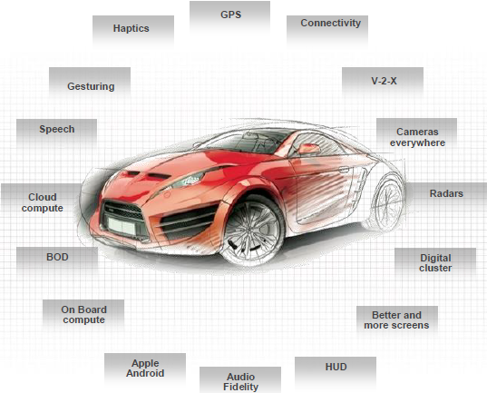
Vehicle CAMCOM Introduction (1)
Automotive Market Trends
Safer – predict and prevent accidents
Greener – more efficient, lighter, aerodynamic
Smarter– use explosion of data to protect, save time and entertain
Cheaper - democratization of technology

Slide 4
Vehicle CAMCOM Introduction (2)
ADAS Applications: Building toward Autonomy
OWC CAMCOM FOR V2V

Slide 5
Vehicle CAMCOM Introduction (3)
V2V CAMCOM for VAT used the Vehicle tail and head lights LEDs
V2I CAMCOM for VAT used the Traffic Lights LEDs and Roadway Signage Systems
Photo Diode(PD) based VAT receiver have limitations
  Can transmit data maximum of 2Mbps in the static environment
  Bit Error Rate(BER) < 10⁻⁶, when the distance between transmitter and receiver is less than 40m
  LEDs in the transmitter is considered as single transmitter
  Small group of LEDs in the transmitter cannot be identified individually, when a PD is used
  Limits the PD usage on VAT and Enable CAMCOM on VAT

Slide 6
Vehicle CAMCOM with High-Speed Camera Receiver (1)
High-speed cameras can capture more information of fast moving objects and changing objects in high frequency, compared to the conventional video cameras
Cameras from companies like Photron and Vision Research can record 800 × 600pixels at 4800fps, or 2.3 giga samples per second

Slide 7
Vehicle CAMCOM with High-Speed Camera Receiver (2)
Needs of High Speed Camera for Receiver
  Vehicle Speeds Varies depends on the driving moment so VAT need to be act faster to support real-time driving assistance to the driver
  Needs to capture the high frequency blinking of LEDs, a camera should have a high frame rate
  Transmitter build-up with Group of LEDs
  LEDs in the transmitter could be recognized individually, it is possible to use each of them as a separate sub-transmitters communicating in parallel at the same time

Slide 8
Vehicle CAMCOM with High-Speed Camera Receiver (3)
Advantages
  Can dramatically increase the communication speed by modulating each LED individually
  Can communicate with several transmitters and receive different information in parallel
To assess the Real-time Processing
  Specific image processing technique to be necessary when these high-speed cameras are used in VAT

Slide 9
Vehicle CAMCOM Image Processing for Receiver
Images taken by high-speed camera should be processed
to capture the lighting pattern of the transmitter
Demodulate the using processed patterns to extract the data
Image processing is required to be used for following purposes
  Transmitter detection
    To Find the transmitter
    To Track the transmitter
  Lighting pattern detection
    To Decode the Data

Slide 10
Vehicle CAMCOM Transmitter Detection Imaging Techniques (1)
Transmitter detection includes two steps,
  Finding and Tracking
  First, transmitter is found from an original image taken by high speed camera
  Track it only processing a defined cut out image area in consecutive frames

Slide 11
Vehicle CAMCOM Transmitter Detection Imaging Techniques (2)
Transmitter Finding
  Absolute differences between current frame and Previous Frame
  Binarization
  Morphology operation
  Candidates selection
  RoI Extraction
  Transmitter confirmation
Transmitter Tracking
  Optical Flow Method based on RoI

Slide 12
Vehicle CAMCOM Data Processing Imaging Techniques
The lighting pattern detection of blinking transmitter which appear on each continuous frame taken by high speed camera to decode the data is important
  Pixel values for lighting LEDs in the images are mainly depended on the distance between the camera and the transmitter
  Pixel values varies duet to the outdoor light sources such as sun light at the day time, outdoor illumination at the night time
  Pixel values varies depends on the whether condition and the affection due to high frame rate image capturing of blinking transmitter
Discriminant analysis (similar as Othsu binarization method) is best apprach to distinguish the pixels belongs to the lighting LEDs and non-lighting LEDs

Slide 13
Conclusion
Presented Image Processing algorithms requirement for V2V OWC for VAT using High Speed Camera Receiver
V2V OWC using CAMCOM System need Efficient Image Processing Techniques are
  Transmitter finding
  Tracking Transmitter
  Lighting Pattern Detection Algorithms to Demodulate the Data.
Presented algorithms include processing time reduction and increase the communication performance

