Slide 1
Project: IEEE P802.15 Working Group for Wireless Personal Area Networks (WPANs)
Submission Title: Color Space Based Modulation and Color-Independent Visual-MIMO
Date Submitted: July 2017
Source: Soo-Young Chang (SYCA), Jaesang Cha (SNUST)
Address:
Contact Information: 530 574 2741 [sychang@ecs.csus.edu], +82-2-970-6431 [chajs@seoultech.ac.kr]
Re:
Abstract: Some system requirements/issues for vehicular OWC applications are identified in this document.
Purpose: To suggest some technical requirements/issues for vehicular applications.
Notice: This document has been prepared to assist the IEEE P802.15. It is offered as a basis for discussion and is not binding on the contributing individual(s) or organization(s). The material in this document is subject to change in form and content after further study. The contributor(s) reserve(s) the right to add, amend or withdraw material contained herein.
Release: The contributor acknowledges and accepts that this contribution becomes the property of IEEE and may be made publicly available by P802.15.
Slide 1

Slide 2
Contents
Color Space Based Modulation
Color-Independent Visual-MIMO
Example Applications

Slide 3
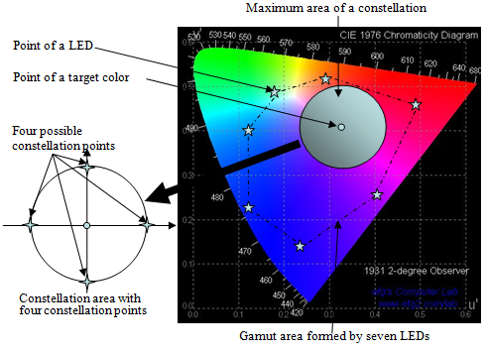
Color-Space Based Modulation

Slide 4
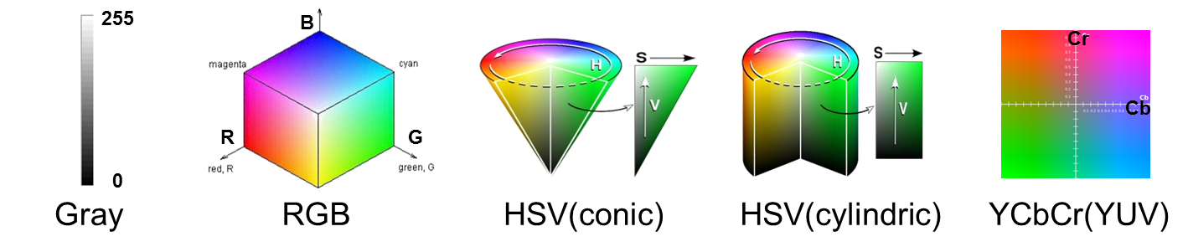
Constellation Diagram and Various Basic Color Models
(a) Circle type (b) Polygon type (c) Line type

Slide 5
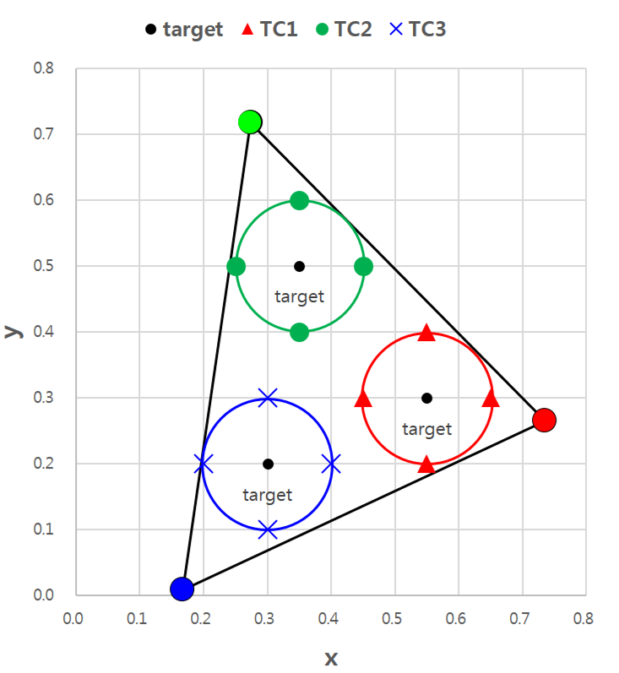
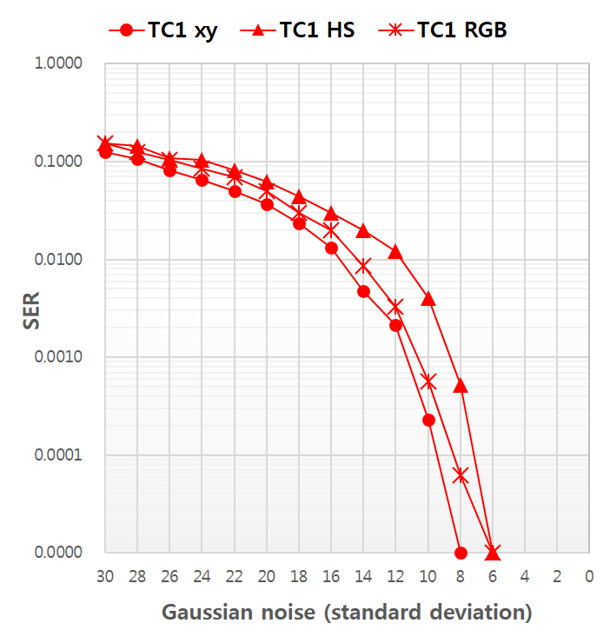
Simulation of SER Comparison under Different Color Models
Symbol decision methods
1.( x,y) based decision in CIE1931
2. (H,S) based decision in HSV model
3. (R,G,B) based decision in RGB model
Constellation diagram and SER graph (TC1 case)

Slide 6
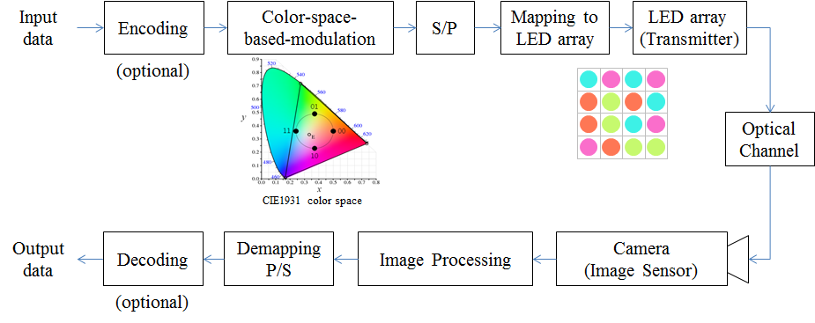
Color-Independent Visual-MIMO
Independent of Color Variation and Intensity Variation

Slide 7
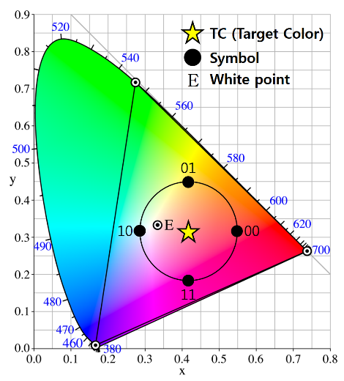
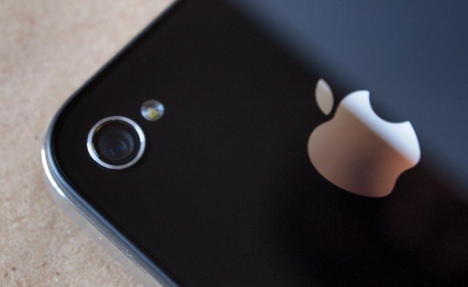
Data Rate in Visual-MIMO
…
…
…
N
N
Encoding
Using m(=2^{n}) symbols
→ n [bits/symbol]
LED Array size
N x N = N² [symbol]
Camera frame rate
F [fps]
Data rate = n x N² x F [bps]

Slide 8
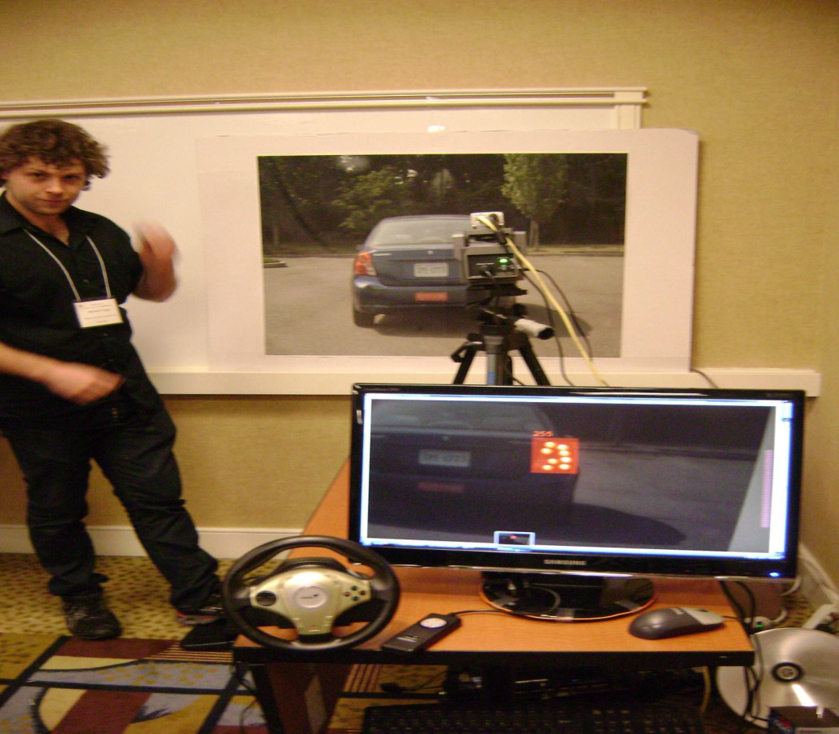
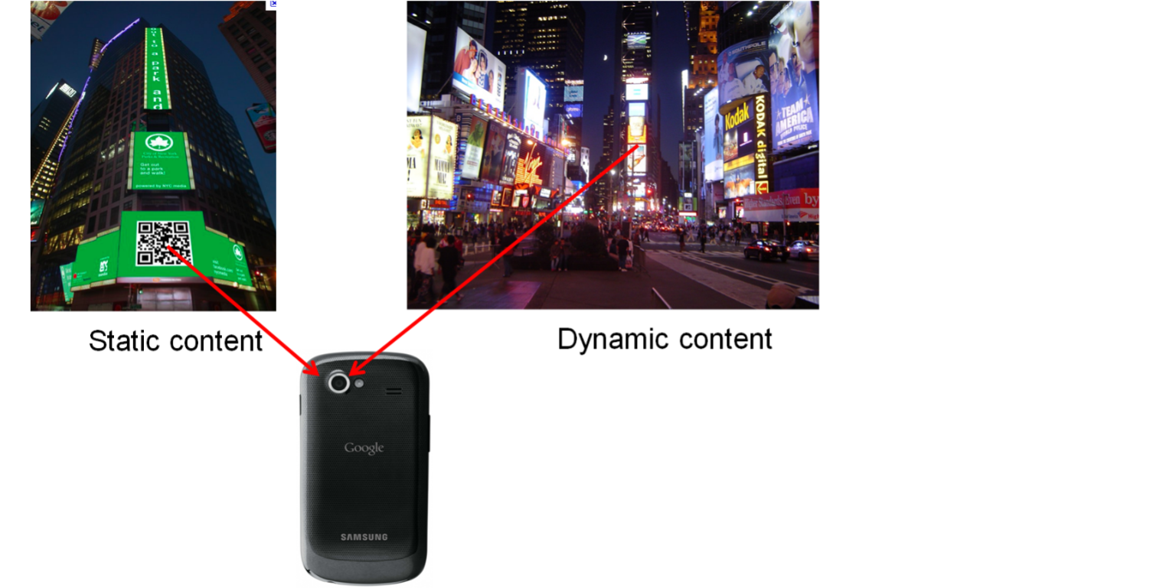
Example Applications
Road side-to-vehicle communication
Vehicle-to-vehicle communication
LEDs for rear and head-lights and Cameras (e.g. parking assistance, rear-view) are getting common in cars
Smartphone-to-electronic billboard communication
Robot-to-robot communication
Hand-held display to fixed surveillance cameras
Visual-MIMO Smartphone – to -electronic billboard comm. examples
Visual-MIMO V2V Demo

