Slide 1
Project: IEEE P802.15 Working Group for Wireless Personal Area Networks (WPANs)
Submission Title: Various Color Spaces for Vehicular Light Communication Modulation
Date Submitted: July 2017
Source: Soo-Young Chang (SYCA), Jaesang Cha (SNUST)
Address:
Contact Information: 530 574 2741 [sychang@ecs.csus.edu], +82-2-970-6431 [chajs@seoultech.ac.kr]
Re:
Abstract: Some system requirements/issues for vehicular OWC applications are identified in this document.
Purpose: To suggest some technical requirements/issues for vehicular applications.
Notice: This document has been prepared to assist the IEEE P802.15. It is offered as a basis for discussion and is not binding on the contributing individual(s) or organization(s). The material in this document is subject to change in form and content after further study. The contributor(s) reserve(s) the right to add, amend or withdraw material contained herein.
Release: The contributor acknowledges and accepts that this contribution becomes the property of IEEE and may be made publicly available by P802.15.
Soo-Young Chang [SYCA]

Slide 2
Various Color Spaces for Vehicular Light
Communication Modulation
Soo-Young Chang [SYCA]
and
Jaesang Cha [SNUST]
Slide 2
Soo-Young Chang [SYCA]
Notes:
doc.: IEEE 802.15-09-0117-00-0007
<month year>

Slide 3
CONSIDERATIONS FOR HIGH EFFICIENT MODULATION FOR LIGHT SIGNALS
Need of brightness control or not
  Need superior brightness for optical wireless communications?
  It is more desirable for performance not to be affected by brightness control.
Dependency of light source characteristics
  Is a modulation technique applied not dependent on technical characteristics of LEDs or other light sources deployed?
Not (or negligibly) affected by background noise or not
  Offsetting the impact of background light sources
  Stable data transmission should be achieved even if the background noise is strong.
  Offers high robustness to background light
Data speed
  Low to high data rates to be realized: adaptive to the amount of information delivered
  Adaptiveness to various data rates is important.
Soo-Young Chang [SYCA]

Slide 4
BASIC CONCEPT: MULTIPLE COORDINATES TO REPRESENT COLORS
A color can be generated by mixing lights from multiple light emitting devices such as LEDs.
  It is not necessary that light of a color can be generated by mixing lights from multiple light emitting devices with a unique set of intensities of lights.
  A multi dimensional space can be considered to represent colors.
  → A multi dimensional light space can be used for color representation, but generally it is not true that there is only one point to represent each color: multiple points can be identified for a color.
In the modulation scheme suggested in this contribution, two coordinates (x and y) for a two dimensional light space are considered.
  x and y are designed to be orthogonal to each other to be applied for the scheme:
    No correlation between these two.
    Any point in a space can be represented by a unique pair of these values.
  Similar to QAM
    Determine points which maximize the minimum distance among distances between any two points.
    Equi-distance strategy is a possible way to assign points.
Soo-Young Chang [SYCA]

Slide 5
VARIOUS LIGHT SPACES
Various light spaces available for color space modulation
So far various light spaces have been suggested for representation of light colors.
  Colors of light signals can be represented by points in a light space.
These light spaces can be defined in various ways.
  Typical examples: CIE1931, CIE1967, and CIE1976 spaces.
Light sources and photo detection devices in a color space
Any light source such as an LED can be represented with a point in a light space for its color.
Any photo detector such as a photo diode can be represented with a point in a light space.
Soo-Young Chang [SYCA]

Slide 6
VARIOUS LIGHT SPACES, CIE 1931 (1)
Tristimulus values of a color
  the amounts of three primary colors in a three-component additive color model needed to match that target color: X, Y, and Z.
Two light sources, appearing to be the same color
  made up of different mixtures of various wavelengths
    this effect is called metamerism.
  Two light sources have the same apparent color to an observer when they have the same tristimulus values, no matter what spectral distributions of light were used to produce them.
Due to the nature of the distribution of cones in the eye, the tristimulus values depend on the observer's field of view.
Soo-Young Chang [SYCA]

Slide 7
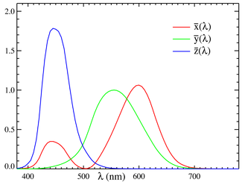



VARIOUS LIGHT SPACES, CIE 1931 (2)
Color matching functions
  a set of three color-matching functions, called , , and
For spectral power distribution, I(λ),
where λ is the wavelength of the equivalent monochromatic light (measured in nanometers).
Other observers, such as for the CIERGB space or other RGB color spaces,
are defined by other sets of three color-matching functions, and lead to
tristimulus values in those other spaces.
Soo-Young Chang [SYCA]

Slide 8
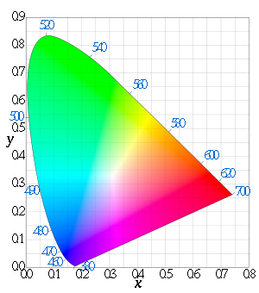





VARIOUS LIGHT SPACES, CIE 1931 (3)
The CIE xy chromaticity diagram and the CIE xyY color space
The outer curved boundary is the spectral (or monochromatic) locus, with wavelengths shown in nanometers.
The concept of color can be divided into two parts: brightness and chromaticity.
The Y parameter is a measure of the brightness or luminance of a color.
Soo-Young Chang [SYCA]

Slide 9
VARIOUS LIGHT SPACES, CIE 1976 (1)
CIE 1976 is a strong candidate for CSM color space
The CIE 1960, CIE 1964, and CIE 1976 color spaces were developed, with the goal of achieving perceptual uniformity
  to have an equal distance in the color space correspond to equal differences in color).
Although they were a distinct improvement over the CIE 1931 system, they were not completely free of distortion.
To utilize better perceptual uniformity, the CIE 1976 can be considered.
And also it has less area that can not be covered by a triangle made with any three point colors.
Soo-Young Chang [SYCA]

Slide 10
VARIOUS LIGHT SPACES, CIE 1976 (2)
Perceptual uniformity of the CIE XYZ and CIE RGB color spaces
The 1931 CIE chromaticity diagram is not perceptually uniform.
  The area of any region of the plot does not correlate at all well with the number of perceptually-distinguishable colors in that region.
Other colour-space coordinate systems and plots exist; examples include CIE 1976 uv, also CIELUV, CIELAB...
  In general, by means of fairly abstract transforms these attempt to be more perceptually-uniform (with only limited success).
Other more perceptually uniform spaces are more desirable.
CIE1976 is a possibility.
Which uniformity is more important, perceptual or detection:
  if perceptual uniformity is more important, more natural colors may be more easily realized;
  on the contrary, if detection uniformity is emphasized, lower BER may be achieved due to equal distances between two points.
For both light emitting devices at transmitters and photo detectors at receivers, the same light space is applied. Therefore the same uniformity is applied with no distortion due to different light spaces.
Soo-Young Chang [SYCA]

Slide 11
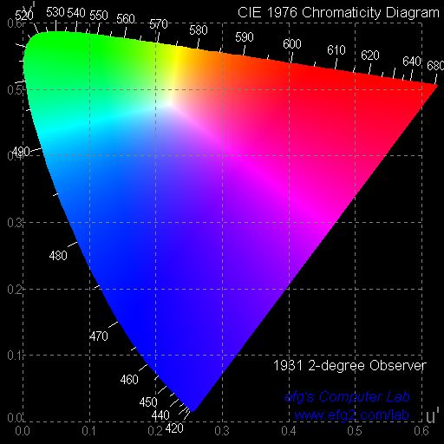
VARIOUS LIGHT SPACES, CIE 1976 (3)
1976 CIE u'v' (or CIE LUV) Chromaticity Diagram (1)
The advantage of the 1976 diagram is that the distance between points is now approximately proportional to the perceived color difference, something definitely not true in the 1931 diagram.
attempted perceptual uniformity
additive mixtures of different colored lights will fall on a line in CIELUV's uniform chromaticity diagram with a condition that the mixtures are constant in lightness.
Historical inertia has won out over technical superiority: the 1976 diagram is not used as much as the original 1931 diagram.
Soo-Young Chang [SYCA]

Slide 12
VARIOUS LIGHT SPACES, CIE 1976 (4)
1976 CIE u'v' Chromaticity Diagram (2)
For conversion from 1976 CIE to 1931 CIE xy coordinates:
x = 9u' / (6u' - 16v' + 12)
y = 4v' / (6u' - 16v' + 12)
z = (-3u' - 20v' + 12) / (6u' - 16v' + 12)
For conversion from 1960 CIE uv to 1976 coordinates:
u' = u
u' = 4x / (-2x + 12y + 3)
u' = 4X / (X + 15Y +3Z)
v' = 3v/2
v' = 9Y / (X + 15Y + 3Z)
v' = 9y / (-2x + 12y + 3)
w' = (-6x + 3y + 3) / (-2x + 12y + 3)
Soo-Young Chang [SYCA]

Slide 13
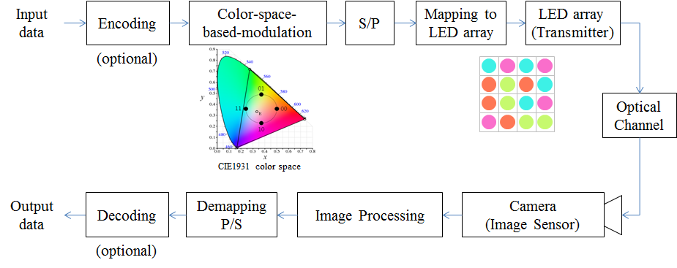
SYSTEM DIAGRAM USING COLOR SPACE MODULATION
Color independent Visual-MIMO tranceiving procedure
Soo-Young Chang [SYCA]

Slide 14
KEY PART FOR COLOR SPACE MOD: MAPPING
Data-to-modulation mapping (transmitter)
Modulation-to-data demapping (receiver)
b₁
mapper
c₁
b₂
c₂
b_{m}
c_{n}
c’_{1’}
demapper
b’₁
c’₂
b’₂
c’_{k}
b’_{m}
Soo-Young Chang [SYCA]

Slide 15
COLOR SPACES UTILIZED FOR VEHICULAR COMMUNICATION MODULATION
Light color spaces
  Light color spaces can be defined.
    A point in a color space represents a color of light.
    Linearity and uniformity work in the space for mixing multiple light signals to generate a light signal having a specific color.
1931 CIE xy
Color space
1976 CIE u'v'
Color space
Soo-Young Chang [SYCA]

Slide 16
UTILIZATION OF CONSTELLATION
ON A COLOR SPACE
Point of
target color
Maximum area of constellation is determined by two factors:
  Point of a target color visible to human eyes: this point becomes the origin of constellation.
  Gamut formed by primary color points which represent points of light emitting devices used.
  → Maximum constellation area determined
Point of a
light emitting
device
Max area of
constellation
r_{c}
Constellation
area with radius r_{c}
Gamut formed by seven
light emitting devices
Soo-Young Chang [SYCA]

Slide 17
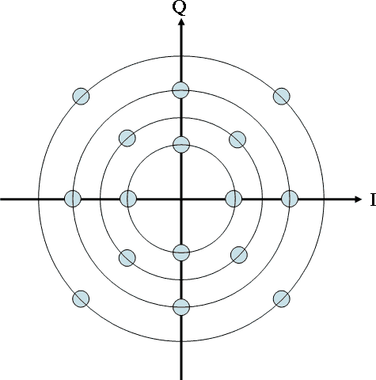
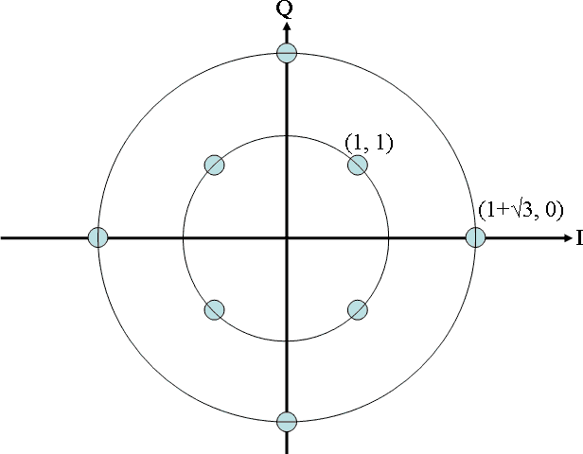
GENERATION OF CONSTELLATION
y
Normalized constellation
Inside a unit circle centered at the original, 2^{m} points are assigned so that the minimum distance between any two points be maximized.
Examples of constellation
x
y
y
m=4
2^{m}=16 points
x
x
m=3
2^{m}=8 points
m=2
2^{m}=4 points
Soo-Young Chang [SYCA]

Slide 18
CONCLUSIONS
Color space modulation scheme has some advantages over conventional schemes
  Independent of brightness control
    Not to be affected by brightness control.
  Dependency of light source (such as LEDs) characteristics
    Modulation technique applied is not directly dependent on technical characteristics of LEDs or other light sources deployed.
  Not (or negligibly) affected by background noise
  Adaptiveness to various data rates
  Simple implementation
Fore this scheme, color spaces with better perceptual uniformity are more desirable
  So far, CIE 1976 is a strong candidate.
This modulation scheme can be applied to vehicular light communication areas.
Soo-Young Chang [SYCA]

