Slide 1
Project: IEEE P802.15 Working Group for Wireless Personal Area Networks (WPANs)
Submission Title: Demand of Highly Reliable Wireless Network and Future Vision for Car Manufacturing Line in Factory
Date Submitted: July 11, 2017
Source: Hiroshi Kobayashi(Nissan Motors, Co.)
Voice: :+81-50-2029-4907, E-Mail: h-kobayashi@mail.nissan.co.jp
Re: IG DEP 15-15-0221-00-Development of Wireless Sensing System for Factory
IG DEP 15-17-0077-00-Updated Development of Wireless Sensing System for Factory
Abstract Update of previous presentation of Nissan Automotive representative
Development of Wireless Sensing System for Factory
Purpose: This document is presented to support promotion of a new standard making by IG-DEP(Dependability) as a representative of association of factory facilities.
Notice: This document has been prepared to assist the IEEE P802.15. It is offered as a basis for discussion and is not binding on the contributing individual(s) or organization(s). The material in this document is subject to change in form and content after further study. The contributor(s) reserve(s) the right to add, amend or withdraw material contained herein.
Release: The contributor acknowledges and accepts that this contribution becomes the property of IEEE and may be made publicly available by P802.15.
Slide 1
Notes:
Jul 12, 2010
Page 1

Slide 2
A Response to Call for Interest(CFI) of IEEE 802.15 IG DEP
Demand of Highly Reliable Wireless Network and Future Vision for Car Manufacturing Line in Factory
Ref. 15-15-0221-00-IG-DEP-Development-of- Wireless-Sensing-System-for-Factory & 15-17-0077-00-its updated version
Berlin, Germany
July, 2017
Hiroshi Kobayashi, Nissan Motors, Co.

Slide 3
Agenda
Background
Updated New Type of Equipment Diagnosis System by using wireless sensor devices
Required specification
Future Activity

Slide 4
Agenda
Background
Updated New Type of Equipment Diagnosis System by using wireless sensor devices
Required specification
Future Activity

Slide 5



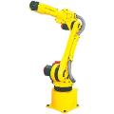


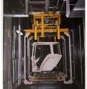
Background
Reduce Cost
Improve OEE
MBD
Reliability

Slide 6
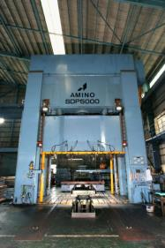
1) Example of Major Breakdown
Crack

Slide 7


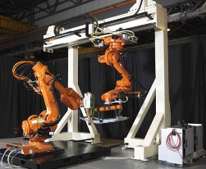
2) Example of Major Breakdown
Cable
Disconnection
Cable
Disconnection

Slide 8
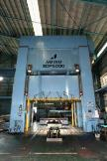


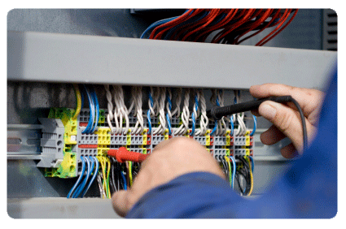
TBM: Time Based Maintenance
Reactive Maintenance
MBD
Occurred Failures
Chronic Failures
Sporadic Failures
Preventive Maint.
Potential Failures
Deterioration
Manual Inspection
Proactive Maintenance
Stress!
Factors to deteriorate
Periodical check
New Equipment
We need a lot of man power of maintenance.
Slide 8

Slide 9
Other reasons why we need to improve “Equipment Reliability” a) Equipment automation rate is increasing.
=> No operator and More maint. tech. b) Production volume is increasing
=> No or less maintenance window & maintenance time ( 2shift => 3 shift) c) Lack of skill for maintenance
=> We need new equipment diagnosis system that does not require us new skill.

Slide 10
Agenda
Background
Updated New Type of Equipment Diagnosis System by using wireless sensor devices
Required specification
Future Activity

Slide 11





Concept for Equipment Diagnosis System
< Periodical Manual Inspection >
< Condition Monitoring System >
Ex. Cable deterioration
Failure
Intranet
OA－LAN
Disconnection Ratio
Monitor of Cable Resistance
Alarm
CBM Server
FA-LAN
Cable Tester
＋
Sensor to detect cable deterioration
Ｕ
－
＋
＋
Ｕ
Ｕ
－
－
Notes:
•a diameter

Slide 12




Concept for Equipment Diagnosis System
< Condition Monitoring System for Cable Disconnection >
Parts Life Time
Failure
Extend Life Time
Real-time CBM
TBM
Time Based Maintenance
Real –Time Diagnosis
Cable Disconnection Ratio
Condition Based Maintenance
CBM
Maintenance Worker’s job
Very sensitive
Good Reliability to detect potential failure
＋
Ｕ
－
Time Axis
Cost Minimum and High Reliability
We need Good Real-Time Diagnosis System

Slide 13


Ordinary approach to develop “Diagnosis system”
< Conventional Development Procedure >
Cable Disconnection
Deteriorated Reducers
Deteriorated Power Supply
Breakdown time
Failure mode, Failure type
Data Logger
Diagnosis
Logic
Sensor
This method requires us a lot of
time and cost to develop.
Individual system

Slide 14
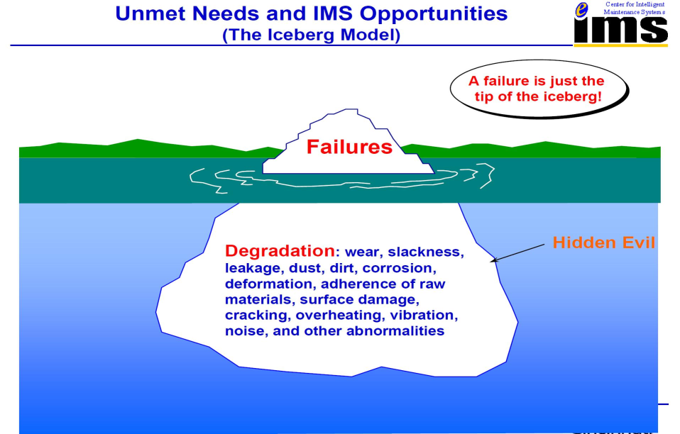
To accelerate Development Speed
We have to consider a new approach to develop!
Courtesy of Prof. Jay Lee, NSF I/UCRC on Intelligent Maintenance Systems (IMS),
Univ, of Cincinnati

Slide 15






New approach to develop “Diagnosis system”
< Conventional Development Procedure >
Cable Disconnection
Deteriorated Reducers
Deteriorated Power Supply
Breakdown time
To cover whole area！
Failure mode, Failure type
Data Logger
Diagnosis
Logic
PC
Sensor
Multi-sensor
Sensor
Storage & Logic
①AE
②Vibration
③Thermal
④Current
⑤ Voltage
・・・・
Individual system
Receiver
Rooter

Slide 16





Comparison between “wired system”and “wireless system”
< Conventional Development Procedure >
Installation Issues
Installation Cost
PC
Restriction of installation
Reliability of wires
< New Development Procedure >
Data Logger
Diagnosis
Logic
Multi-sensor
PC
Sensor
Sensor
Storage & Logic
Individual system
Receiver

Slide 17
Agenda
Background
Updated New Type of Equipment Diagnosis System by using wireless sensor devices
Required specification
Future Activity

Slide 18
Required specification
3 type of Diagnosis System
  Equipment Diagnosis System in Real-time with rea-time feedback
    Real-time measuring
    Judge immediately with a certain threshold level
  Equipment Diagnosis System in Real-time (1)
    Real-time measuring and sending data in real-time
    Judge based on the comparison with the past data
  Equipment Diagnosis System in Real-time (2)
    Real-time measuring and sending data intermittently
    Judge based on the comparison with the past data
A
B
C

Slide 19
Required specification
3 type of Diagnosis System
  Equipment Diagnosis System in Real-time with rea-time feedback
    Real-time measuring
    Judge immediately with a certain threshold level
  Equipment Diagnosis System in Real-time (1)
    Real-time measuring and sending data in real-time
    Judge based on the comparison with the past data
  Equipment Diagnosis System in Real-time (2)
    Real-time measuring and sending data intermittently
    Judge based on the comparison with the past data
A
B
C

Slide 20
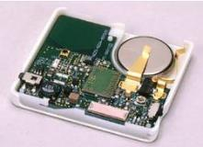



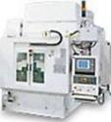
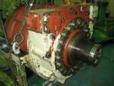
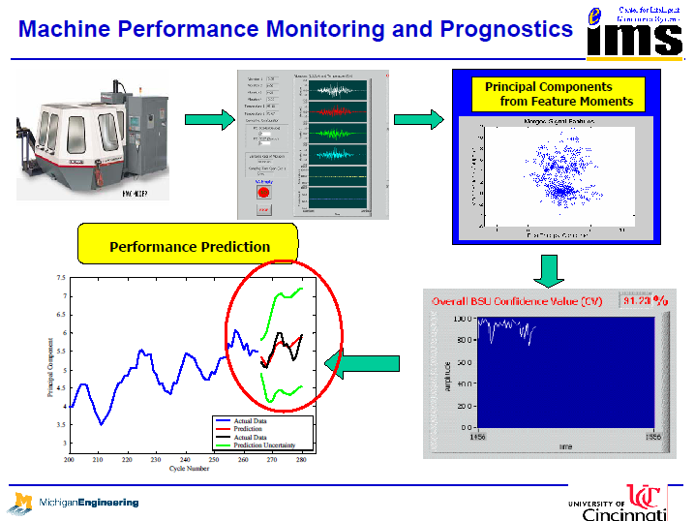
A
C
Versatile Sensor
CBM Server
１： Historical data analysis
２：
Cloud Server
B
AP
AP
Monitor of Cable Resistance
Alarm
20

Slide 21
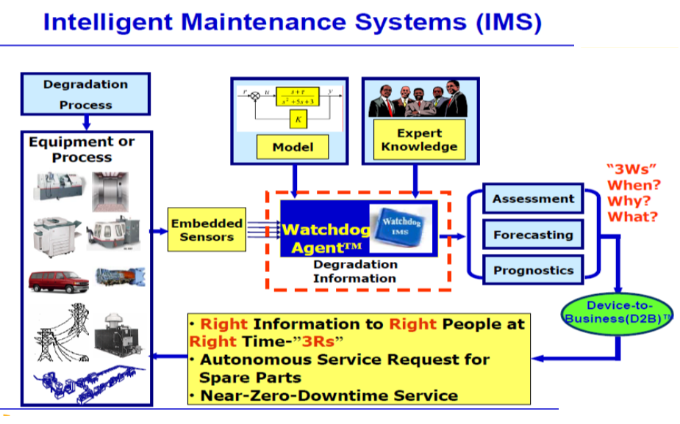
A
IMS Sensor
Alarm

Slide 22
Required specification
3 type of Diagnosis System
  Equipment Diagnosis System in Real-time with rea-time feedback
    Real-time measuring
    Judge immediately with a certain threshold level
    Send alarm
  Equipment Diagnosis System in Real-time (1)
    Real-time measuring and sending data in real-time
    Judge based on the comparison with the past data
  Equipment Diagnosis System in Real-time (2)
    Real-time measuring and sending data intermittently
    Judge based on the comparison with the past data
A
B
C

Slide 23
A
C
Versatile Sensor
CBM Server
１： Historical data analysis
２：
Cloud Server
B
Alarm
AP
AP
Monitor of Cable Resistance
Alarm
23

Slide 24
Required specification
3 type of Diagnosis System
  Equipment Diagnosis System in Real-time with rea-time feedback
    Real-time measuring
    Judge immediately with a certain threshold level
    Send alarm
  Equipment Diagnosis System in Real-time (1)
    Real-time measuring and sending data in real-time
    Judge based on the comparison with the past data
  Equipment Diagnosis System in Real-time (2)
    Real-time measuring and sending data intermittently
    Judge based on the comparison with the past data
A
B
C

Slide 25
A
C
CBM Server
１： Historical data analysis
２：
Versatile Sensor
Cloud Server
B
Alarm
AP
AP
Monitor of Cable Resistance
Alarm
25

Slide 26








New approach to develop “Diagnosis system”
< Conventional Development Procedure >
Cable Disconnection
Deteriorated Reducers
Deteriorated Power Supply
Breakdown time
To cover whole area！
Failure mode, Failure type
Data Logger
Diagnosis
Logic
Multi-sensor
Cloud Server
Sensor
AP
Individual system
Alarm

Slide 27
Required specification
Specification for Equipment Diagnosis System
  Response
    Real-time measuring function to communicate with receiver in real-time
    Judge immediately with a certain threshold level
  Energy consumption
    In order to prolong a life time of measuring device save energy and have good efficiency regarding communication power * At least 1 year or more
  Bilateral communication ability
    In order to change some parameters and firmware in the device
    and give some triggers to start and end measuring from outside
Notes:
Intermittent 間欠な

Slide 28
Required specification
Specification for Equipment Diagnosis System
  4. Distance to communicate with devices
    In order to reduce the number of receivers, device have to have some distance to communicate. At least 20m or more
  5. Data transfer speed
    This sensor will have multi-sensors. So data transfer speed is very important.
  6. Communication capability with many sensors
    How many sensors can communicate at the same time
  7. Kinds of Sensors
  ① Vibration sensor ② Thermal sensor
  ③ Voltage ④ Current
  ⑤ AE （Acoustic Emission）
Notes:
Intermittent 間欠な

Slide 29
Agenda
Background
New Type of Equipment Diagnosis System by using wireless sensor devices
Required specification
Future Activity

Slide 30
Future Activity
  Prototyping Equipment Diagnosis System in Real-time with rea-time feedback with Dependable Short Range Wireless Networks
    Highly reliable real-time measuring with short range radio sensor network
    Highly secure decision immediately with measured data by wireless network of various sensors and past recorded data
    Strongly protected alarm and commands to equipment in a line for dependable remote monitoring and maintenance
  IoT/Big Data/Mining through Cloud Network Using Equipment Diagnosis System in Real-time with rea-time feedback
    Build up Nissan in-house equipment diagnosis system in real-time sensing and controlling with dependable wireless feedback network
    Entire remote sensing and controlling FA equipment diagnosis system with IoT/Data Mining server through cloud network
  International Standard Establishment with All other Institutes and Companies
    Though associations of automotive industries and other manufactures, common standard equipment diagnosis system using wireless dependable short range sensing and controlling will be established.
    IEEE802.15 may be the best venue of establishing a standard of dependable wireless feedback network for global common equipment diagnosis system.

Slide 31
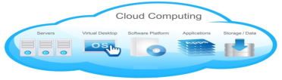











Future Activity
Issues of traditional method
Versatile Sensor （Standardized Diagnosis System）
1) Takes a lot of time to develop
1) Multi-sensor Wire-less ⇒ Shorten Dvpmt. time
2) Difficult to deploy
2) Easy to deploy because of same structure
3) Cost issue
3) Cost minimum and reduce developing cost
4) Some special person just use
4) Everybody can create a diagnosis logic
Data Logger
Diagnosis
Logic
Sensor
Versatile Sensor
Storage & Logic
Sensor
①AE
②Vibration
③Thermal
④Current
⑤ Voltage
Individual system
Versatile
Sensor
Cloud
31
31

