Slide 1
Project: IEEE P802.15 Working Group for Wireless Personal Area Networks (WPANs)
Submission Title: [Comment Resolutions for #309, #310, and #314]
Date Submitted: [July 2017]
Source: [Huan-Bang Li [NICT], Marco Hernandez [Consultant], and Fumihide Kojima [NICT] ]
Address [3-4 Hikarino-oka, Yokosuka, Kanagawa, Japan]
Voice:[+81 468475104], FAX: [:[+81 468475431], E-Mail:[lee@nict.go.jp]
Re: [Contribution to 15.8 PAC draft]
Abstract: [Comment Resolutions for #309, #310, and #314]
Purpose: [This document is to provide comment resolution in Sponsor Ballot]
Notice: This document has been prepared to assist the IEEE P802.15. It is offered as a basis for discussion and is not binding on the contributing individual(s) or organization(s). The material in this document is subject to change in form and content after further study. The contributor(s) reserve(s) the right to add, amend or withdraw material contained herein.
Release: The contributor acknowledges and accepts that this contribution becomes the property of IEEE and may be made publicly available by P802.15.

Slide 2
Comment Resolutions for
#309, #310, and #314
July, 2017

Slide 3
    Comment #309 : Page 52, Line 4
      Comment
      Steps e, f, g could be replaced by a single step as per proposed change using a simple acknowledged frame transmission (i.e. these steps don't need to be separately stated since this is the standard operation of the MAC as specified by clause 6.3.3. Also this doesn't need to say "in the CAP" since that should be obvious.
Suggestion
Upon reception of the MLME-DISCOVERY.response primitive, the R-PD's MAC layer shall send the Discovery Response command frame to the I-PD using acknowledged transmission. ALSO: Review similar cases where acknowledgement steps can be similarly simplified/removed

Slide 4
    Proposed Solutions for #309
e) Upon reception of the MLME-DISCOVERY.response primitive, the R-PD’s MAC layer shall send the Discovery Response command frame to the I-PD during the CAP.
f) Upon reception of the Discovery Response command frame, the I-PD shall send an Immediate Ack frame.
g) If the Immediate Ack frame is not received, the R-PD shall notify the next higher layer by issuing the MLME-COMM-STATUS.indication primitive with the status parameter set to NO_ACK.
e) Upon reception of the MLME-DISCOVERY.response primitive, the R-PD's MAC layer shall send the Discovery Response command frame to the I-PD using acknowledged transmission.

Slide 5
    Comment #310 : Page 52, Line 34
      Comment
      How does the next higher layer obtain the list? (I know it has it from the previous step. Since this is not an actual step with any action.... See proposed change.
Suggestion
Remove step (o) and add new sentence at end of (n): ", and the next higher layer of the I-PD will then have a complete list of PDs qualified for the many-to-many group.

Slide 6
    Proposed Solutions for #310
n) The steps from i) to m) are iterated until Discovery Request command frame has been sent to all R-PDs in the initial R-PDs list.
o) The next higher layer of the I-PD obtains a list of PDs qualified for the many-to-many group.
n) The steps from g) to k) are iterated until Discovery Request command frame has been sent to all R-PDs in the initial R-PDs list, and the next higher layer of the I-PD will then have a complete list of PDs qualified for the many-to-many group.

Slide 7
    Comment #314 : Page 53, Line 34
      Comment
      Figure 29 is using colored boxes.
Suggestion
Change to black dashed boxes.

Slide 8
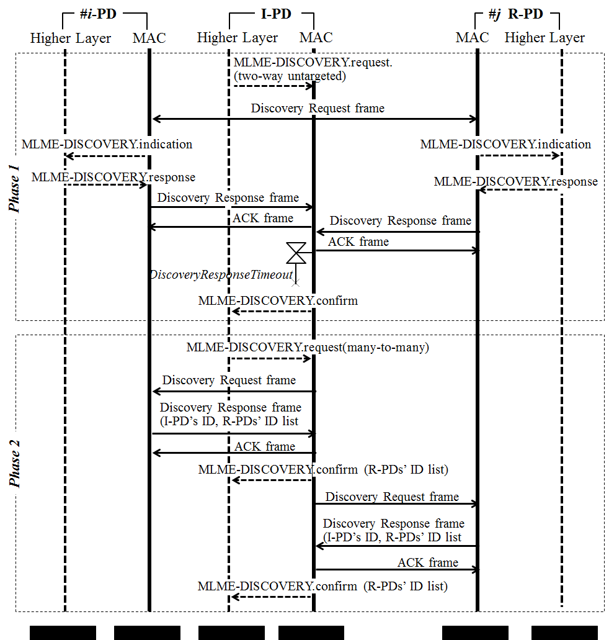
    Proposed Solutions for #314

Slide 9
    Corresponding Bullet Number Changes
old | new
e), f), and g) | e)
h) | f)
i) | g)
j) | h)
k) | i)
l) | j)
m) | k)
n) | l)
o)
p) | m)

Slide 10
6.8.3.4 Discovery procedure for many-to-many group
Many-to-many discovery is specified for a group of PDs in communication range. That is, all intended PDs participating in the many-to-many discovery procedure shall be able to communicate with each other.
The procedure for many-to-many discovery follows the steps illustrated in Figure 31.
Phase 1
a) The higher layer of an Initiator PD (I-PD) triggers the two-way discovery procedure by issuing the MLME-DISCOVERY.request with the parameter Discovery Type set to TWO-WAY-UNTARGETED.
b) Upon reception of the MLME-DISCOVERY.request primitive, the I-PD’s MAC layer broadcasts the Discovery Request command frame.
c) Each of the other PDs that captured the Discovery request sends an MLME-DISCOVERY.indication to its higher layer indicating two-way untargeted discovery request with the Discovery Type parameter.
d) The next higher layer of each Responder PD (R-PD) shall issue a MLME-DISCOVERY.response primitive to its MAC layer, if the PD agreed to send the Discovery Response command frame to the I-PD.
e) Upon reception of the MLME-DISCOVERY.response primitive, the R-PD's MAC layer shall send the Discovery Response command frame to the I-PD using acknowledged transmission.Upon reception of the Discovery Response command frame, the I-PD shall send an Immediate Ack frameIf the Immediate Ack frame is not received, the R-PD shall notify the next higher layer by issuing the MLME-COMM-STATUS.indication primitive with the status parameter set to NO_ACK.
f) As soon as the I-PD broadcasts the Discovery Request command frame, the I-PD shall monitor the CAP for possible Discovery Response command frames. The I–PD collects a list of initial responded R-PDs and reports the initial R-PDs’ list to the next high layer using MLME-DISCOVERY.confirm primitive.

Slide 11
Phase 2
g) The I-PD’s next higher layer issues the MLME-DISCOVERY.request with the parameter Discovery Type set to MANY2MANY, the parameter Address Mode parameter set to Group, and the parameter Multicast Address set to the MAC addresses of initial R-PDs Destination Address parameter set to the MAC address of one of the initial R-PDs in the list obtained at step h).f)
h) Upon reception of the MLME-DISCOVERY.request primitive, the I-PD’s MAC layer sends the Discovery Request command frame.
i) Upon reception of the Discovery Request command frame, the R-PD’s MAC layer shall broadcast the Discovery Response command frame during the CAP with a PDs list starting from the I-PD followed by R-PDs in the received initial R-PDs’ list, whose Discovery Response command frames were captured by the current R-PD.
j) The I-PD re-sends Discovery Request command frame if the I-PD does not receive the Discovery Response command frame from the R-PD until reaching the macMaxFrameRetries.
k) The I-PD’s MAC layer shall issue the MLME-Discovery.confirm primitive with the corresponding list of captured R-PDs of the current R-PD or status of Failure depending on whether the Discovery Response command frame is received or not.
l) The steps from i) to m)g) to k) are iterated until Discovery Request command frame has been sent to all R-PDs in the initial R-PDs list, and the next higher layer of the I-PD will then have a complete list of PDs qualified for the many-to-many group.
m) The next higher layer of the I-PD may form a many-to-many group following the procedure as specified in clause 6.9.2.3, many-to-many peering procedure.

Slide 12
    Questions?

