Slide 1
Project: IEEE P802.15 Working Group for Wireless Personal Area Networks (WPANs)
Submission Title: [Comment Resolutions for #309, #310, and #314]
Date Submitted: [July 2017]
Source: [Huan-Bang Li [NICT], Marco Hernandez [Consultant], and Fumihide Kojima [NICT] ]
Address [3-4 Hikarino-oka, Yokosuka, Kanagawa, Japan]
Voice:[+81 468475104], FAX: [:[+81 468475431], E-Mail:[lee@nict.go.jp]
Re: [Contribution to 15.8 PAC draft]
Abstract: [Comment Resolutions for #309, #310, and #314]
Purpose: [This document is to provide comment resolution in Sponsor Ballot]
Notice: This document has been prepared to assist the IEEE P802.15. It is offered as a basis for discussion and is not binding on the contributing individual(s) or organization(s). The material in this document is subject to change in form and content after further study. The contributor(s) reserve(s) the right to add, amend or withdraw material contained herein.
Release: The contributor acknowledges and accepts that this contribution becomes the property of IEEE and may be made publicly available by P802.15.

Slide 2
Comment Resolutions for #309, #310, and #314
July, 2017

Slide 3
Comment #309 : Page 52, Line 4
Comment
Steps e, f, g could be replaced by a single step as per proposed change using a simple acknowledged frame transmission (i.e. these steps don't need to be separately stated since this is the standard operation of the MAC as specified by clause 6.3.3. Also this doesn't need to say "in the CAP" since that should be obvious.
Suggestion
Upon reception of the MLME-DISCOVERY.response primitive, the R-PD's MAC layer shall send the Discovery Response command frame to the I-PD using acknowledged transmission. ALSO: Review similar cases where acknowledgement steps can be similarly simplified/removed

Slide 4
Proposed Solutions for #309
e) Upon reception of the MLME-DISCOVERY.response primitive, the R-PD’s MAC layer shall send the Discovery Response command frame to the I-PD during the CAP.
f) Upon reception of the Discovery Response command frame, the I-PD shall send an Immediate Ack frame.
g) If the Immediate Ack frame is not received, the R-PD shall notify the next higher layer by issuing the MLME-COMM-STATUS.indication primitive with the status parameter set to NO_ACK.
e) Upon reception of the MLME-DISCOVERY.response primitive, the R-PD's MAC layer shall send the Discovery Response command frame to the I-PD using acknowledged transmission.

Slide 5
Comment #310 : Page 52, Line 34
Comment
How does the next higher layer obtain the list? (I know it has it from the previous step. Since this is not an actual step with any action.... See proposed change.
Suggestion
Remove step (o) and add new sentence at end of (n): ", and the next higher layer of the I-PD will then have a complete list of PDs qualified for the many-to-many group.

Slide 6
Proposed Solutions for #310
n) The steps from i) to m) are iterated until Discovery Request command frame has been sent to all R-PDs in the initial R-PDs list.
o) The next higher layer of the I-PD obtains a list of PDs qualified for the many-to-many group.
n) The steps from g) to k) are iterated until Discovery Request command frame has been sent to all R-PDs in the initial R-PDs list, and the next higher layer of the I-PD will then have a complete list of PDs qualified for the many-to-many group.

Slide 7
Comment #314 : Page 53, Line 34
Comment
Figure 29 is using colored boxes.
Suggestion
Change to black dashed boxes.

Slide 8
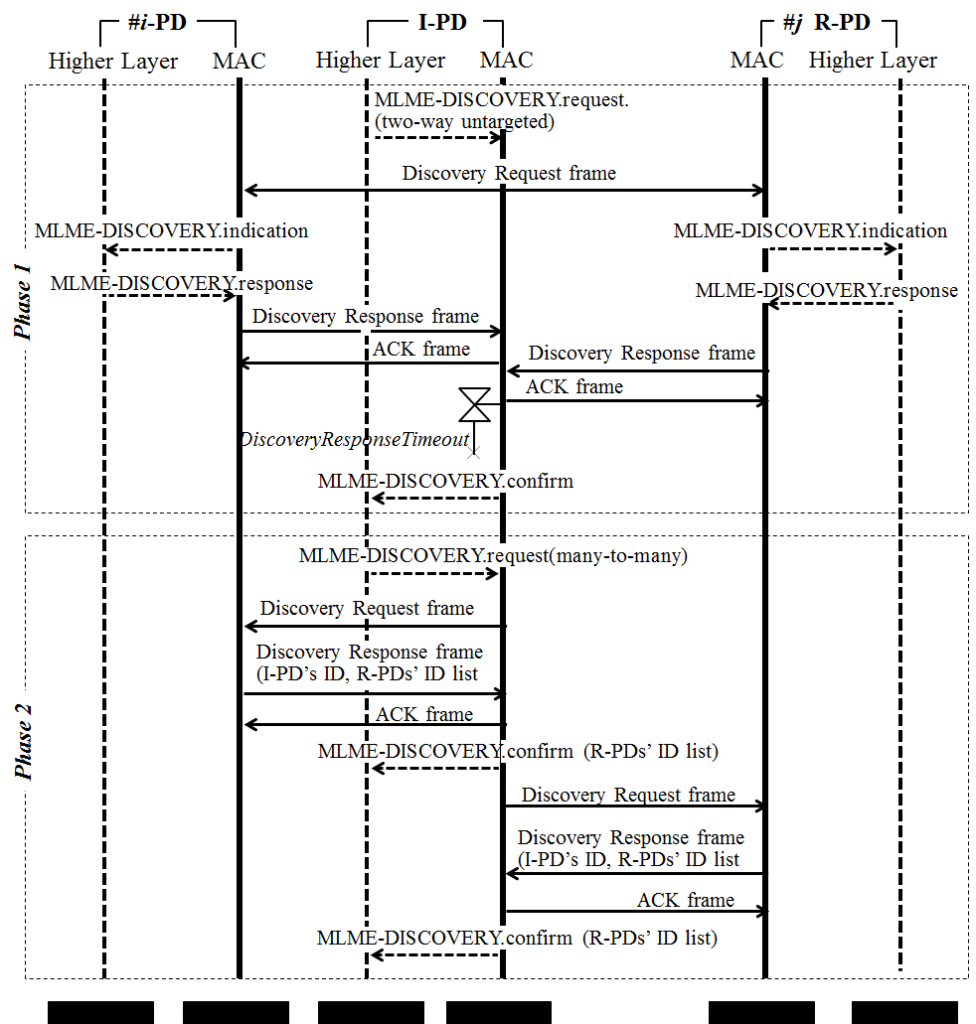
Proposed Solutions for #314

Slide 9
Corresponding Bullet Number Changes
old | new
e), f), and g) | e)
h) | f)
i) | g)
j) | h)
k) | i)
l) | j)
m) | k)
n) | l)
o)
p) | m)

Slide 10
Questions?

