Slide 1
Project: IEEE P802.15 Working Group for Wireless Personal Area Networks (WPANs)
Submission Title: [Research Project BATS]
Date Submitted: [10 July 2017]
Source: [Joerg ROBERT] Company [Friedrich-Alexander University Erlangen-Nuernberg]
Address [Am Wolfsmantel 33, 91058 Erlangen, Germany]
Voice:[+49 9131 8525373], FAX: [+49 9131 8525102], E-Mail:[joerg.robert@fau.de]
Re: []
Abstract: [Introduction to use of LPWAN in research project BATS]
Purpose: [Presentation within IG LPWA]
Notice: This document has been prepared to assist the IEEE P802.15. It is offered as a basis for discussion and is not binding on the contributing individual(s) or organization(s). The material in this document is subject to change in form and content after further study. The contributor(s) reserve(s) the right to add, amend or withdraw material contained herein.
Release: The contributor acknowledges and accepts that this contribution becomes the property of IEEE and may be made publicly available by P802.15.

Slide 2
Research Project “BATS”
Joerg Robert, FAU Erlangen-Nuernberg

Slide 3
Research Project ”BATS“
BATS: Betriebsadaptive Tracking Sensorsysteme (German) – Operation Adaptive Tracking Sensor Systems
Project funded by the Deutsche Forschungsgemeinschaft (DFG, FOR 1508) (German Science Fundation)
More information on http://www.for-bats.de/

Slide 4


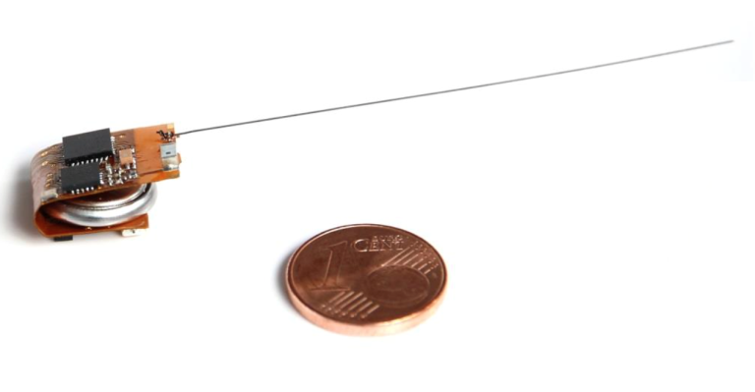
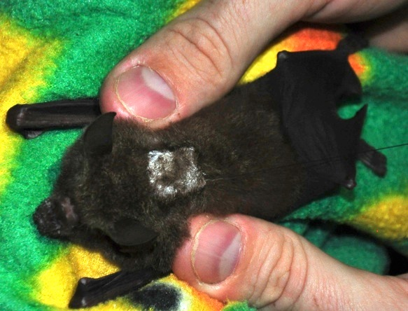
“Facebook” for BATS
Bats are equipped with tiny sensors
to track their social behavior
Wake-Up receivers are used for
encounter detection
2g bat transmitter

Slide 5
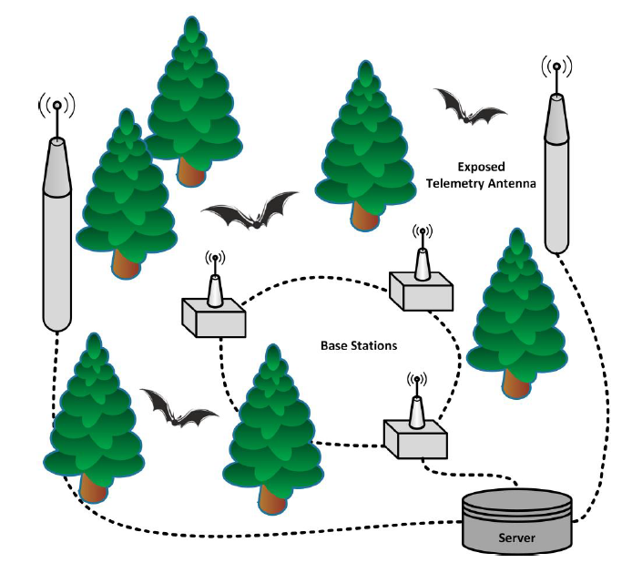
Basic System Setup
Inner base-stations are many used for the localization (field strength, time difference of arrival)
The exposed telemetry antennas are used as LPWAN receive antennas to transmit uplink data from the bats

Slide 6
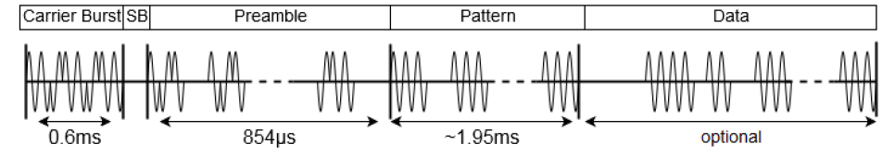
High-Jacking of the Wake-Up Signals for Encounter Detection
The bats transmit wake-up signals every 2s for encounter detection
Wake-up receivers only use the amplitude of the signals (on/off keying)
The phase can be high-jacked for LPWAN transmission

Slide 7
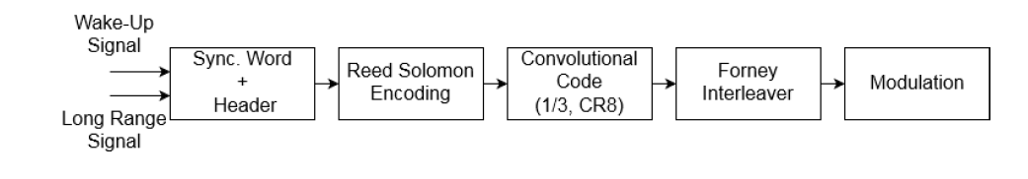
Basic Structure of LPWAN Encoding
Data is protected by Reed Solomon Block Code (instead of CRC-16) and 1/3 convolutional code
Forney interleaver used to spread data over multiple wake-up bursts
Each bursts is then able to transmit 32 bits → 8 payload bits per burst
Final bit-rate of 4 bit/s
On-air rate is 11kbit/s

Slide 8
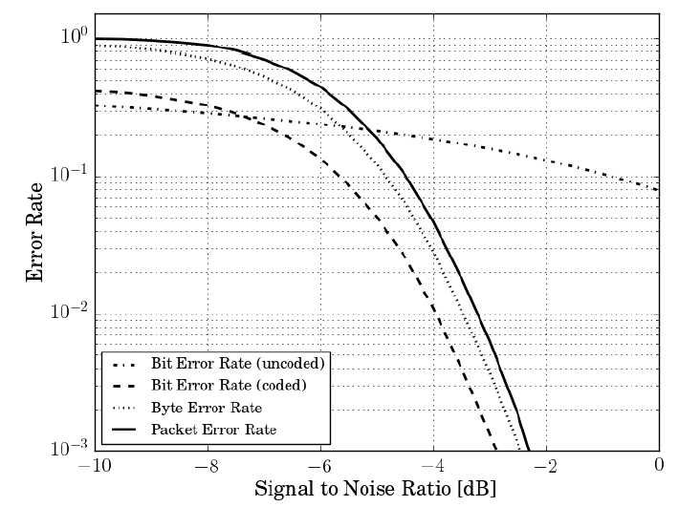
Simulated Performance of LPWAN Encoding
Approx. -5dB SNR required for PER of 10%
Un-coded transmission would not work

Slide 9
System Characteristics
Bat:
  Transmit power P_{TX}=5dBm
  Antenna gain 0dBi
Receiver Station:
  Antenna gain 17dBi
  Noise figure 6dB
  Min. required reception level: P_{RX,min}=-129.4dBm
  ➔ Max. pathloss of L=150dB

Slide 10
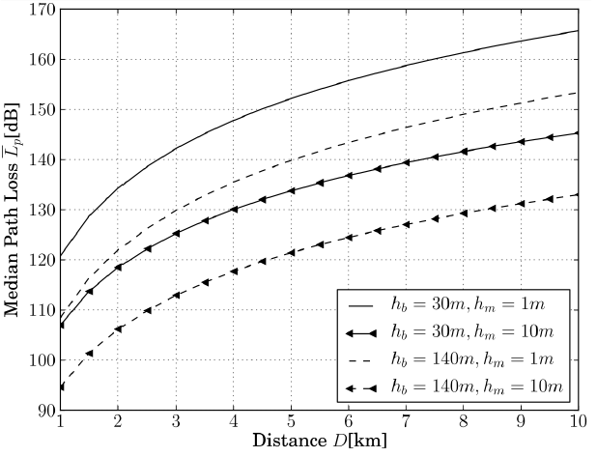
Predicted Media Path Loss for Different Antenna Configurations
Predicted median path loss for different base-station antenna heights h_{b} and bat altitudes h_{m}
Antenna height during trial ≈30m

Slide 11
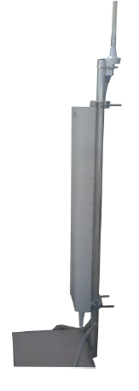
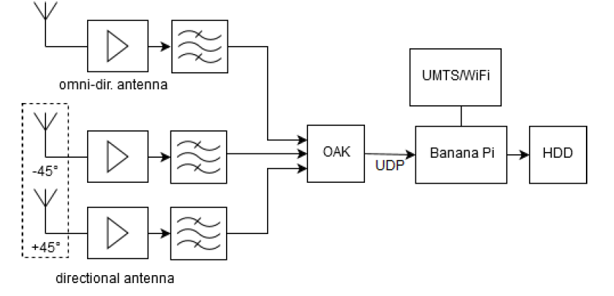
Long Range Base-Station ( I / II )
Data is received using multiple antennas and then stored on a HDD for offline decoding

Slide 12
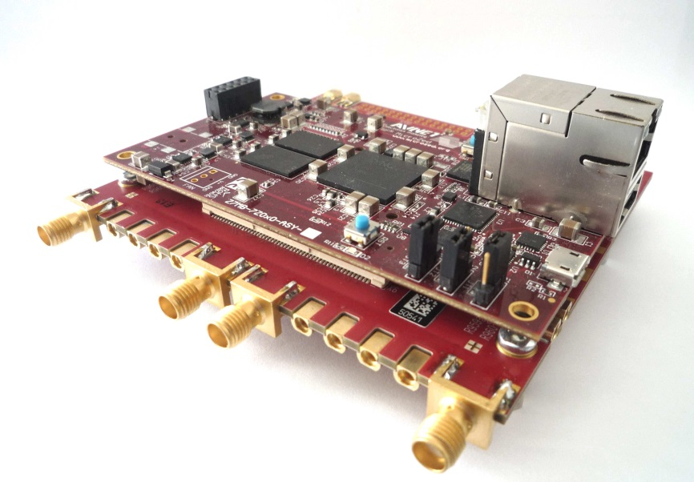
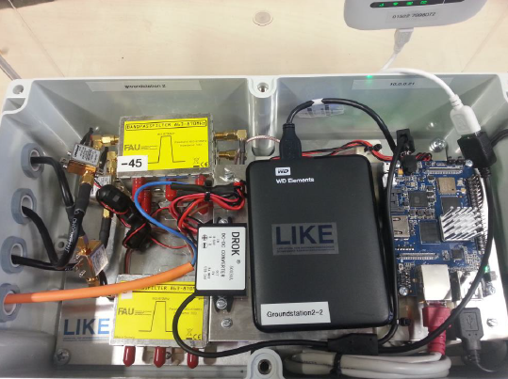
Long Range Base-Station ( II / II )
Hardware is based on self-developed software-defined radio board
System is powered by battery and has to operate with low power hardware (e.g. ARM processor)

Slide 13
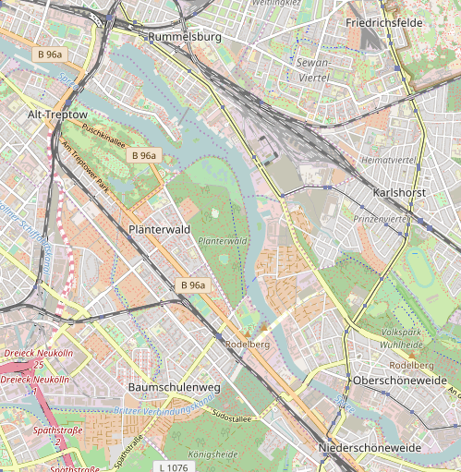
Berlin Field Trial
Area of 2016 and 2017 field trials
Station 1
Main bat area
ca. 5km
Hotel Estrel
Station 2
(c) Openstreetmap Contributors

Slide 14
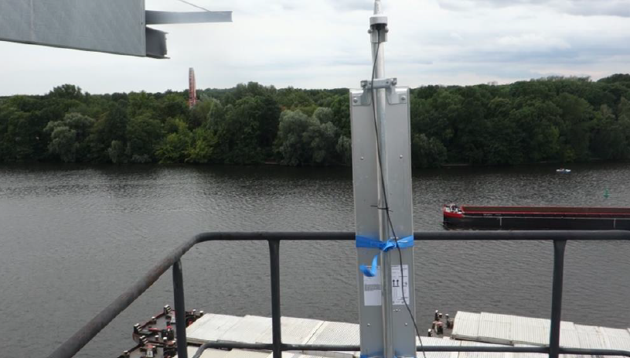
Base Station 1

Slide 15
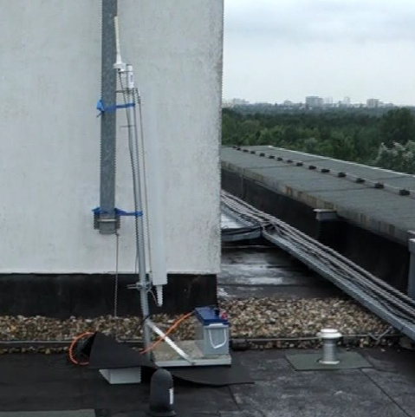
Base Station II

Slide 16
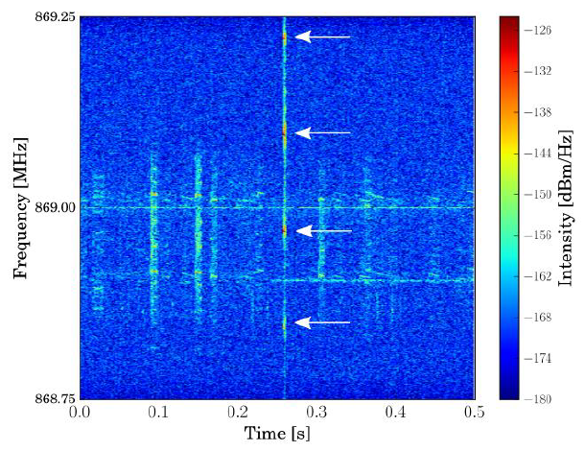
Example of Received Signal
Bat signal is typically received with level much weaker than the shown
System is suffering strong interference from other systems

Slide 17
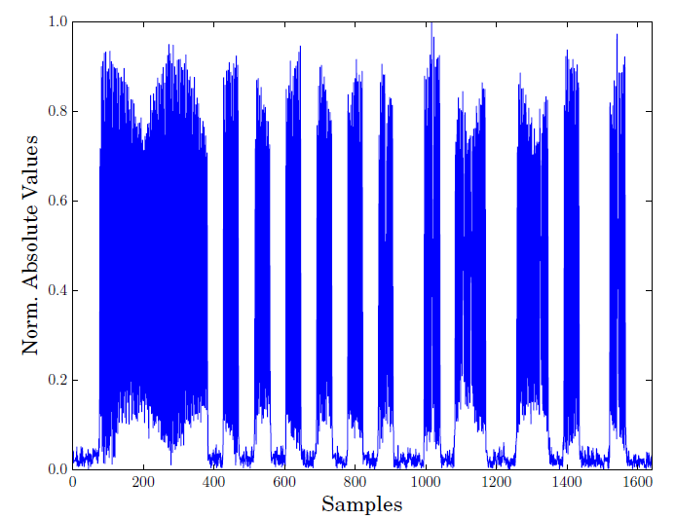
Example of Very Strong Signal

Slide 18
Results of 2016 Field Trial
Communication works
Bats were received up to distances of several km
Received signal strength of the bats was highly fluctuating over time (e.g. 20dB within 2s)
Interference required strong FEC and signal processing in the base-stations
Use of multiple antennas helps to reduce interference
Identification of signals on the PHY level was sub-optimal

Slide 19
2017 Field Trial
Field trial will most likely start on July 17th
Improved scheme on PHY for improved identification of individual bats on the PHY
Solar panels for autonomous operation

Slide 20
Summary and Conclusions
the BATS project is aiming on tracking the social behavior of bats in their natural habitats
Bats are equipped with tiny sensors that have a maximum weight of 2g
The communication from the bats to the network is based on LPWAN
System shows good performance even in difficult channels with strong interference

Slide 21
Thank Your for Your Interest!
Questions?

