Slide 1
Project: IEEE P802.15 Working Group for Wireless Personal Area Networks (WPANs)
Submission Title: [Suitability of 802.15.4k]
Date Submitted: [2 August, 2017]
Source: [Joerg ROBERT] Company [Friedrich-Alexander University Erlangen-Nuernberg]
Address [Am Wolfsmantel 33, 91058 Erlangen, Germany]
Voice:[+49 9131 8525373], FAX: [+49 9131 8525102], E-Mail:[joerg.robert@fau.de]
Re: [Updated numbers]
Abstract: [Suitability of IEEE 802.15.4k]
Purpose: [Presentation in IG LPWA telco]
Notice: This document has been prepared to assist the IEEE P802.15. It is offered as a basis for discussion and is not binding on the contributing individual(s) or organization(s). The material in this document is subject to change in form and content after further study. The contributor(s) reserve(s) the right to add, amend or withdraw material contained herein.
Release: The contributor acknowledges and accepts that this contribution becomes the property of IEEE and may be made publicly available by P802.15.

Slide 2
Suitability of IEEE 802.15.4k

Slide 3
Background
Pat presented a white paper on the suitability of IEEE 802.15.4 for LPWAN applications (15-17/248r0) (https://mentor.ieee.org/802.15/dcn/17/15-17-0248-00-lpwa-summary-of-ieee-std-802-15-4-lecim.docx)
Existing IEEI 802.15.4 technologies already fulfill many requirements of LPWAN
Open questions remained on the applied fragmentation approach in order to fulfill the 0.4s FCC requirement

Slide 4
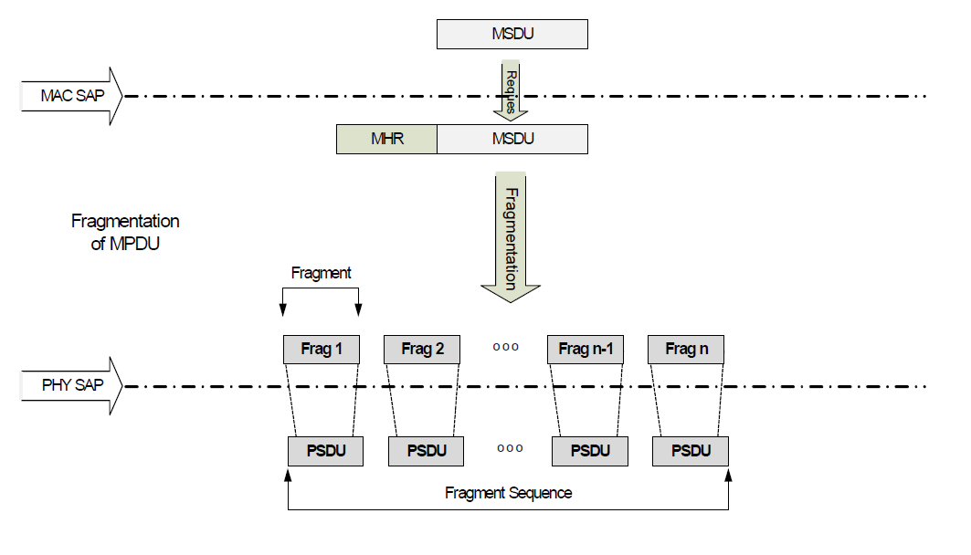
Fragmentation in 802.15.4k
802.15.4k allows the efficient fragmentation of the MPDU into multiple PSDU
If FEC is used each PSDU uses a separate FEC encoding
The fragmentation approach uses compression techniques to minimize the additional fragmentation overhead

Slide 5
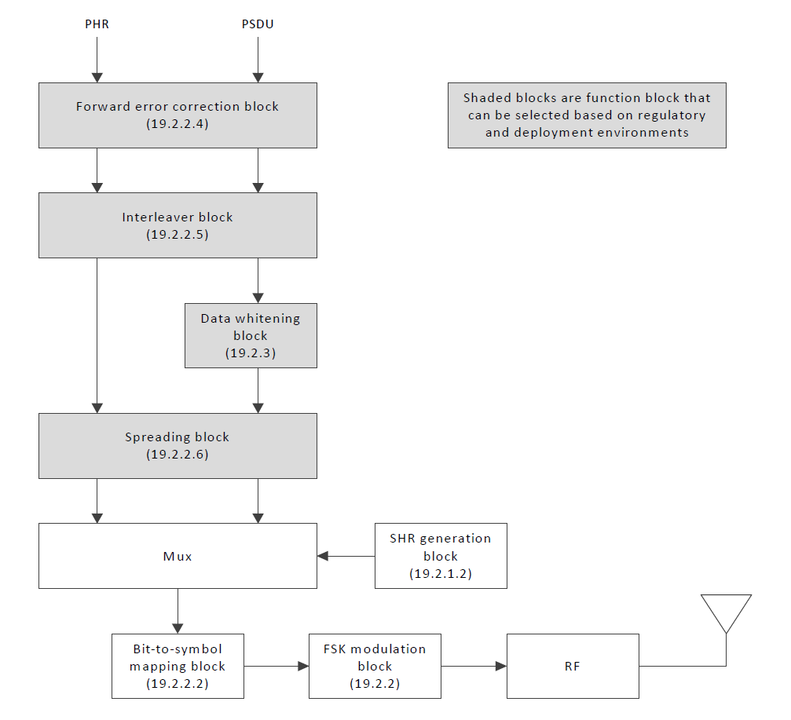
PSDU PHY Modulation
IEEE 802.15.4k FSK PHY Modulation Block Diagram
The PHY Modulation treats every PSDU separately
Separate FEC encoding, separate sync, ...
Reassembly is achieved after FEC decoding in the receiver

Slide 6
Pros and Cons of the Current Approach
Pros:
PHY Modulation wrt. other 802.15.4 systems is kept unchanged
Simple decoding and re-assembly
Frequency hopping possible to achieve 0.4s FCC limitation
Cons:
Significant loss wrt. theoretical performance
The lowest possible data-rate is limited due to the overhead
Additional signaling overhead gets very significant for low data-rates

Slide 7
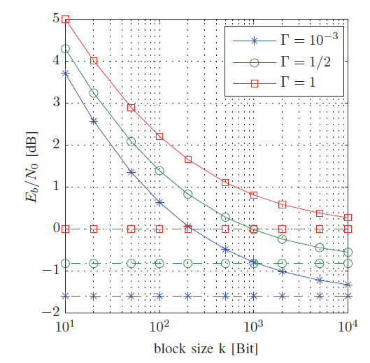
Loss wrt. Theoretical Performance
Loss of performance in case of limited payload block sizes k of the code
➔ Short code words lead to reduces performance
Γ denotes the spectral efficiency
Vertical lines are the Shannon Capacity

Slide 8
PSDU Length ( I / II )
Format of the 802.15.4k FSK PHY
Each fragment has at least 5 bytes overhead due to SFD (3 bytes) and PHR (2 bytes)

Slide 9
PSDU Length ( II / II )
The depicted structure forms the PSDU (see previous slide)
The fragment format adds 4 or 6 additional bytes overhead
This results in the following overhead:
3 bytes (SFD) + 2 bytes (PHR) + 2 bytes (Fragment Header) + 2/4 bytes FVS (16 or 32 bit)
➔ Each fragment contains at 9 / 11 byte of overhead

Slide 10
Most Robust Transmission
Most robust transmission is achieved with lowest possible bit-rate
Minimum bit-rate is limited due to maximum transmit duration of 0.4s (FCC regulation), and each PSDU has to transmit the overhead
We will consider max. robust transmission with only 1 payload byte per fragment → results in 90% overhead
Furthermore we will consider 9 payload byte per fragment → results in more realistic 50% overhead
Additional overhead due to the MPDU fragment sequence context description (802.15.4k-2013, 5.2.4.25) is not considered

Slide 11
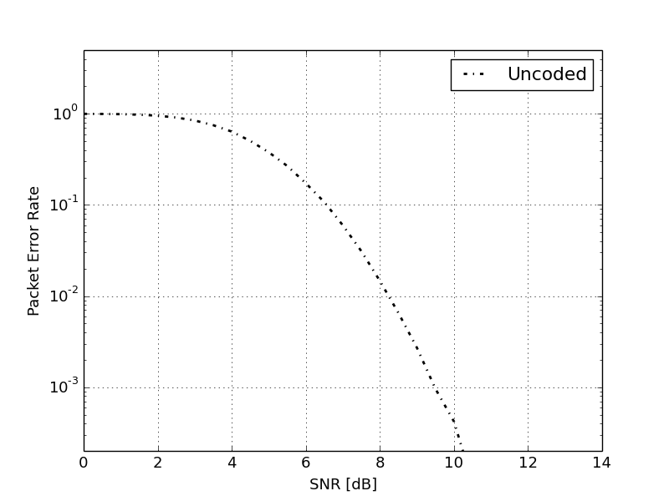
90% Overhead Case ( I / II )
We now assume that each fragment contains only 1 byte payload data, FEC is not used
➔ Fragment size of 10 byte = 80 bits
Lowest bit-rate without coding: 200 bit/s with 90% overhead to meet FCC 0.4s requirement
1% packet error rate (PER) for the PSDU requires E_{b}/N₀= SNR=8dB (coherent decoder, MSK)
Perfect decoder would require E_{b}/N₀=-1.59dB → loss of 9.56dB wrt. theoretical bound
Packet Error Rate vs. SNR for uncoded MSK with coherent demodulation and packet length 80 bit

Slide 12
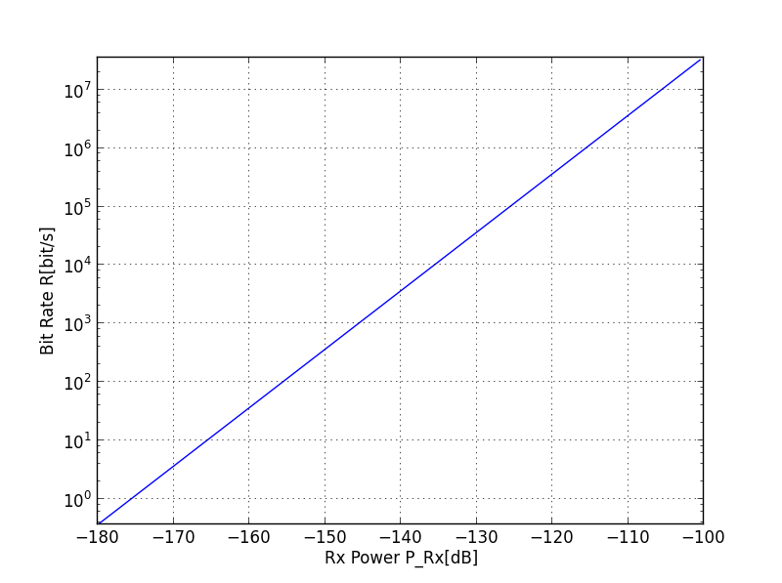
90% Overhead Case ( II / II )
90% overhead case would allow for minimum reception level of -142dBm
Calculation does not take implementation losses into account
Calculation assumes uncoded (i.e. no FEC) transmission
200bit/s
9.56dB loss
-142dBm

Slide 13
50% Overhead Case
We now assume that each fragment contains 9 byte payload data, FEC is not used
➔ Fragment size of 18 byte = 144 bits
Lowest bit-rate without coding: 360 bit/s with 50% overhead
1% PER requires E_{b}/N₀= 8.5dB → loss of 10dB wrt. theoretical bound
Results in minimum reception level of -139dBm
Does not fulfill LPWAN requirement of min. sensitivity of -140dBm

Slide 14
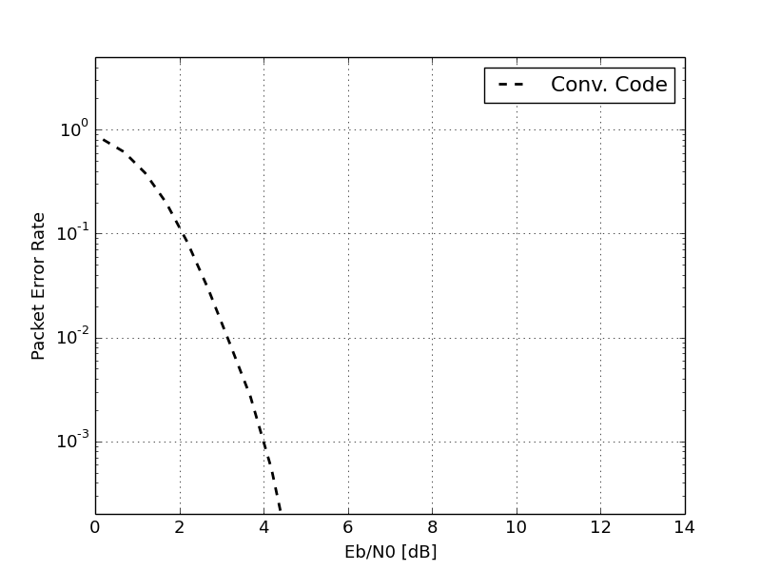
Calculations with Coding
The bit-rate vs. RX power curves only consider the payload bit-rate as they are normalized to E_{b}/N₀
200 bit/s and 360 bit/s are still valid
1% PER requires E_{b}/N₀ of approx. 3dB for 80 and 144 bit
Loss of 5.6dB wrt. theoretical bound
-146dBm for 90% overhead
-143dBm for 50% overhead
FEC significantly improves the performance
Packet Error Rate vs. E_{b}/N₀ for coded (802.15.4k conv. code) MSK with coherent demodulation and payload packet length 144 bit

Slide 15
Loss due to Overhead
Additional overhead reduces payload bit-rate (50% assumption)
13...20dB loss wrt. theoretical limits
20 ... 100 times the energy of a perfect system → battery lifetime
Worse than competitors (15-16-0486r0)
w/ coding
w/o coding

Slide 16
Conclusions
Fragmentation is one mean in 802.15.4k to reduce the transmit duration to meet FCC regulation
However, the employed MAC fragmentation shows significant gaps wrt. the theoretical limits
Using 802.15.4 with lower PHY fragmentation could significantly improve the results
>20 dB more sensitivity
More than 20 time less energy
The calculations did not take the additional signaling into account
Further improvements wrt. interference are not considered here

Slide 17
Thank You for Your Interest!

