Slide 1
Project: IEEE P802.15 Working Group for Wireless Personal Area Networks (WPANs)
Submission Title: [Joerg Robert]
Date Submitted: [22 June, 2017”
Source: [Joerg ROBERT] Company [Friedrich-Alexander University Erlangen-Nuernberg]
Address [Am Wolfsmantel 33, 91058 Erlangen, Germany]
Voice:[+49 9131 8525373], FAX: [+49 9131 8525102], E-Mail:[joerg.robert@fau.de]
Re: []
Abstract: [Suitability of IEEE 802.15.4k]
Purpose: [Presentation in IG LPWA telco]
Notice: This document has been prepared to assist the IEEE P802.15. It is offered as a basis for discussion and is not binding on the contributing individual(s) or organization(s). The material in this document is subject to change in form and content after further study. The contributor(s) reserve(s) the right to add, amend or withdraw material contained herein.
Release: The contributor acknowledges and accepts that this contribution becomes the property of IEEE and may be made publicly available by P802.15.

Slide 2
Suitability of IEEE 802.15.4k

Slide 3
Background
Pat presented a white paper on the suitability of IEEE 802.15.4 for LPWAN applications (15-17/248r0) (https://mentor.ieee.org/802.15/dcn/17/15-17-0248-00-lpwa-summary-of-ieee-std-802-15-4-lecim.docx)
Existing IEEI 802.15.4 technologies already fulfill many requirements of LPWAN
Open questions remained on the applied fragmentation approach in order to fulfill the 0.4s FCC requirement

Slide 4
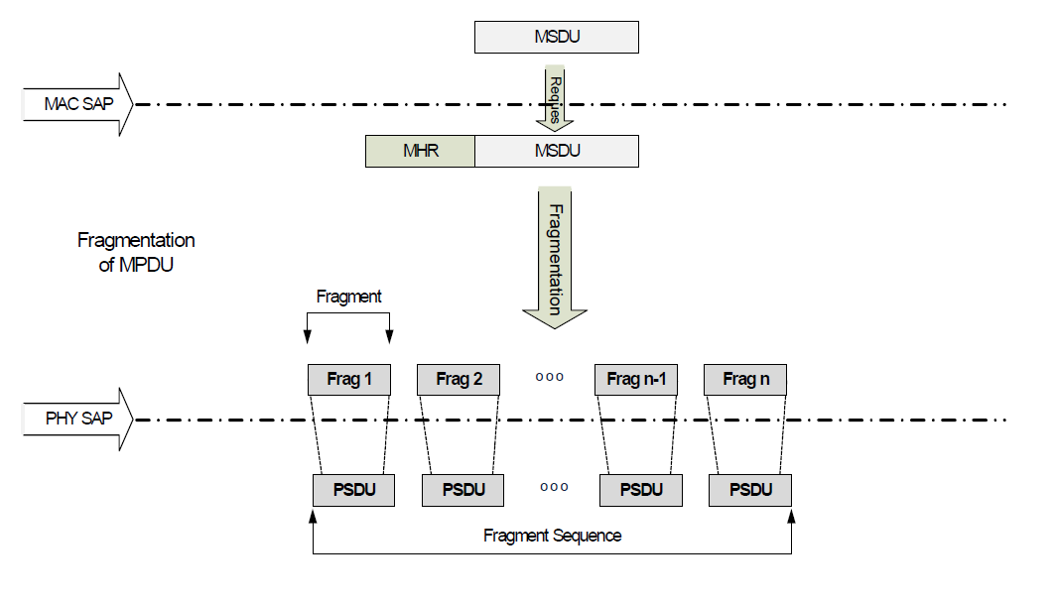
Fragmentation in 802.15.4k
802.15.4k allows the efficient fragmentation of the MPDU into multiple fragments that are passed to the PHY
The PHY then treats every fragment as a separate PSDU
The fragmentation approach uses compression techniques to minimize the additional fragmentation overhead

Slide 5
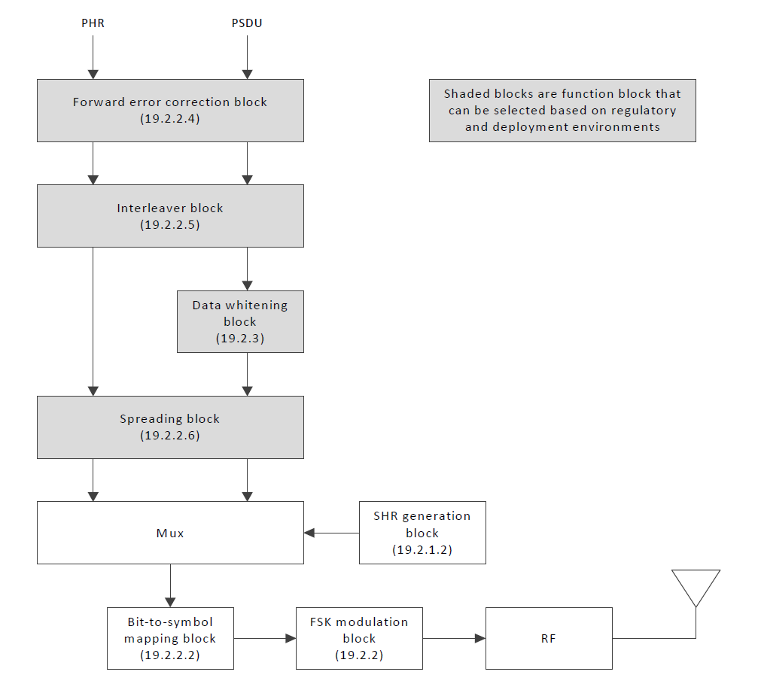
PSDU PHY Modulation
IEEE 802.15.4k FSK PHY Modulation Block Diagram
The PHY Modulation treats every PSDU separately
Separate FEC encoding, separate sync, ...
Reassembly is achieved on MAC layer

Slide 6
Pros and Cons of the Current Approach
Pros:
  PHY Modulation wrt. other 802.15.4 systems is kept unchanged
  Simple decoding and re-assembly on the MAC layer
  Frequency hopping possible to achieve 0.4s FCC limitation
Cons:
  Significant loss wrt. theoretical performance
  The lowest possible data-rate is limited due to the overhead
  Additional signaling overhead gets very significant for low data-rates

Slide 7
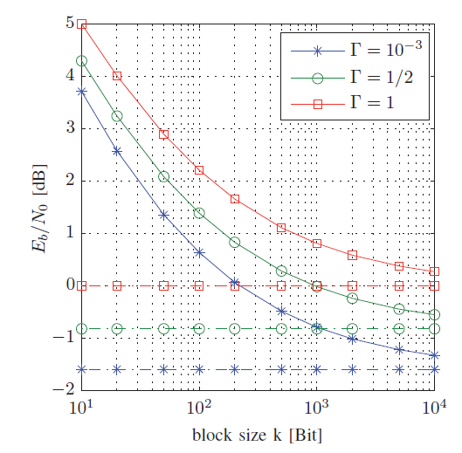
Loss wrt. Theoretical Performance
Loss of performance in case of limited payload block sizes k of the code
➔ Short code words lead to reduces performance
Γ denotes the spectral efficiency
Vertical lines are the Shannon Capacity

Slide 8
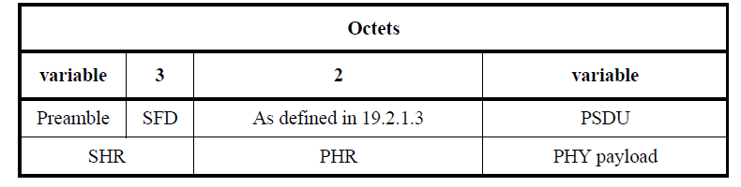
Lowest Possible Rate ( I / IV )
Format of the 802.15.4k FSK PHY
Each fragment has at least 5 bytes overhead

Slide 9
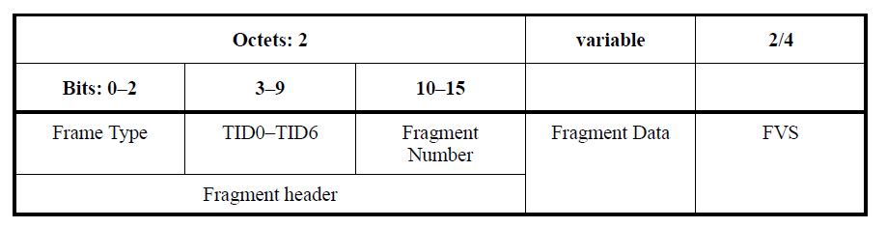
Lowest Possible Rate ( II / IV )
The fragment format adds 4 or 6 additional bytes overhead
➔ Each fragment contains at least 9 bytes of overhead

Slide 10
Lowest Possible Rate ( III / IV )
We now assume that each fragment contains only
1 byte payload data
➔ Fragment size of 10 bytes = 80 bits
Lowest bit-rate without coding: 200 bit/s with 90% overhead
We now assume that each fragment contains
9 byte payload data
➔ Fragment size of 18 bytes = 144 bits
Lowest bit-rate without coding: 360bit/s with 50% overhead

Slide 11
Lowest Possible Rate ( IV / IV )
Use of FEC with code-rate ½ would approx. require doubling the symbol rate
~500bit/s (lowest rate supported by 802.15.4k FSK PHY)

Slide 12
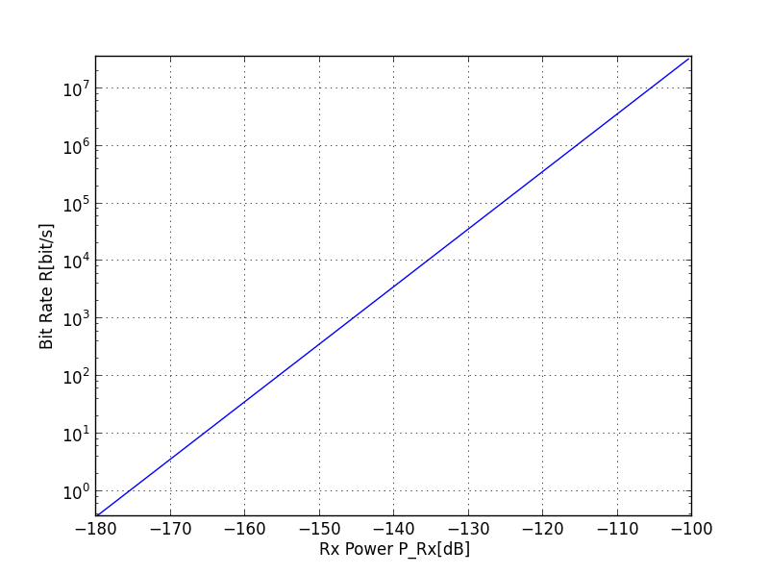
Minimum RX-Level
Eb/N0=20dB without coding (PER ~1%)
Eb/N0=10dB with coding (PER ~1%)
Min. RX level in the order of -135dB with coding and
-130dBm with coding
Definition of LPWAN < -140dBm
w/ coding
w/o coding

Slide 13
Loss due to Overhead
Additional overhead reduces payload bit-rate (50% assumption)
25...30dB loss wrt. theoretical limits
316 ... 1000 times the energy of a perfect system → battery lifetime
Worse than competitors
(15-16-0486r0)
w/ coding
w/o coding

Slide 14
Conclusions
Fragmentation is one mean in 802.15.4k to reduce the transmit duration to meet FCC regulation
However, the employed MAC fragmentation shows significant gaps wrt. the theoretical limits
Using 802.15.4 with PHY fragmentation could significantly improve the results
  >20 dB more sensitivity
  More than 100 time less energy

Slide 15
Thank You for Your Interest!

