Slide 1
Project: IEEE P802.15 Working Group for Wireless Personal Area Networks (WPANs)
Submission Title: [Packet Splitting for Improved Robustness]
Date Submitted: [21 June, 2017]
Source: [Joerg ROBERT] Company [Friedrich-Alexander University Erlangen-Nuernberg]
Address [Am Wolfsmantel 33, 91058 Erlangen, Germany]
Voice:[+49 9131 8525373], FAX: [+49 9131 8525102], E-Mail:[joerg.robert@fau.de]
Re: []
Abstract: [This contribution presents the packet splitting concept]
Purpose: [Presentation within IEEE 802.15 IG LPWA Telco]
Notice: This document has been prepared to assist the IEEE P802.15. It is offered as a basis for discussion and is not binding on the contributing individual(s) or organization(s). The material in this document is subject to change in form and content after further study. The contributor(s) reserve(s) the right to add, amend or withdraw material contained herein.
Release: The contributor acknowledges and accepts that this contribution becomes the property of IEEE and may be made publicly available by P802.15.

Slide 2
Packet Splitting for Improved Robustness

Slide 3
Literature to Packet Splitting
[1] G. Kilian et al., "Improved Coverage for Low-Power Telemetry Systems using Telegram Splitting," Smart SysTech 2013; European Conference on Smart Objects, Systems and Technologies, Erlangen/Nuremberg, Germany, 2013, pp. 1-6.
[2] G. Kilian et al., "Increasing Transmission Reliability for Telemetry Systems Using Telegram Splitting," in IEEE Transactions on Communications, vol. 63, no. 3, pp. 949-961, March 2015.
[3] H. Lieske, J. Robert and A. Heuberger, "Improving Medium Access in Single-Destination Networks with Heterogeneous Propagation Channels," 2015 IEEE Global Communications Conference (GLOBECOM), San Diego, CA, 2015, pp. 1-6.
[4] H. Lieske, G. Kilian, M. Breiling, S. Rauh, J. Robert and A. Heuberger, "Decoding Performance in Low-Power Wide Area Networks With Packet Collisions," in IEEE Transactions on Wireless Communications, vol. 15, no. 12, pp. 8195-8208, Dec. 2016.
[5] M. Hartmann, H. M. Tröger, G. Kilian, J. Robert, T. Nowak and A. Heuberger, "Broadcast of things — A thought experiment," 2014 IEEE Topical Conference on Wireless Sensors and Sensor Networks (WiSNet), Newport Beach, CA, USA, 2014, pp. 46-48.

Slide 4
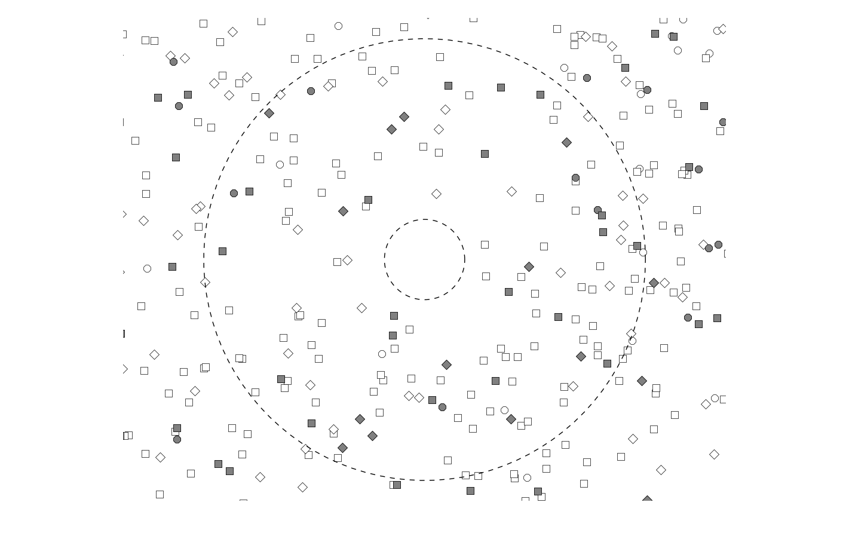
Single Destination Network with ALOHA
$$r_{max}$$
$$r_{min}$$
Problem: Many devices try to access the channel, but coordination is not useful or even possible, e.g. hidden nodes, other transmission systems, ...

Slide 5
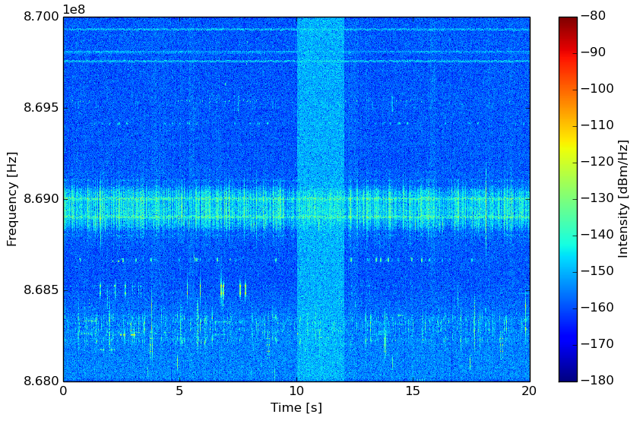
Interference in License-Exempt Bands
Figure shows spectrogram of measured channel
Interference cannot be controlled and listen before talk does not really work for LPWAN

Slide 6
Problems for LPWANs
Low-payload bit-rates lead to long transmit durations → high probability of collisions
Listen before talk does not work in case of exposed base-stations → further increased probability of collisions
Spreading only offers limited gain as it arterially increases the bandwidth of the signal → even further increased collisions probability with limited processing gain in case of linear receivers , i.e. $10⋅\log_{10}{SF}$
➔ Alternative solutions may offer higher robustness

Slide 7
Use of Frequency Hopping Spread Spectrum (FHSS)
FHSS increases the robustness wrt. interferers as only few sub-packets are normally affected
Each sub-packet typically includes only few bits

Slide 8
Benefits of FHSS
Improved robustness wrt. interference in license-exempt bands due to simple non-linear processing
Compliant with FCC regulation (FCC limits TX time without frequency hopping to 0.4s)
Reduced peak currents
Improved frequency diversity
Ultra low payload bit-rate reachable → ultra-long range
FHSS splits packet in many sub-packets → Packet Splitting

Slide 9
Requirements
Each sub-packet must only contain few bits for optimum efficiency
A powerful forward error correction is mandatory (e.g. convolutional K=7 code)
The hopping pattern must be known to the receiver
Synchronization gets more complex

Slide 10
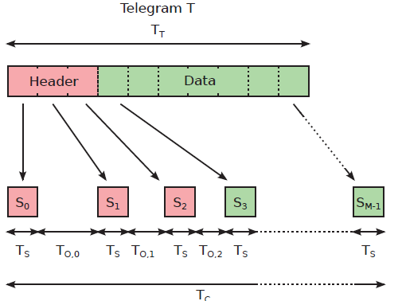
FHSS/Packet Splitting Principle
Telegram is divided into M_{S} sub-packets
Header is not copied → fixed time and frequency pattern to reassemble telegram

Slide 11
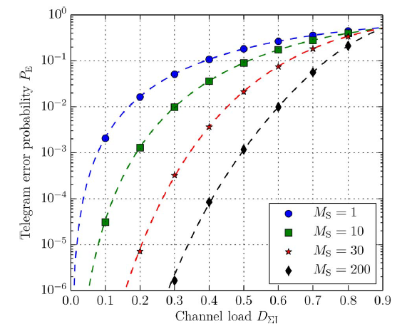
Telegram Probability vs. # Sub-Packets
Assumption of collision channel
Max. theor. channel load for error-free reception is $\frac{1}{e}≈0.367$
Large MS approaches capacity
ALOHA only offers $\frac{1}{2e}≈0.184$
➔ Doubled capacity

Slide 12
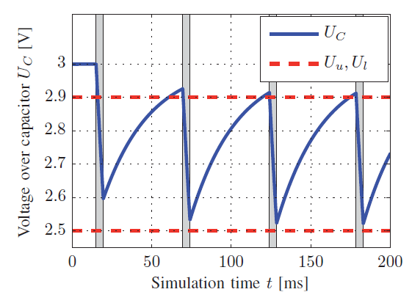
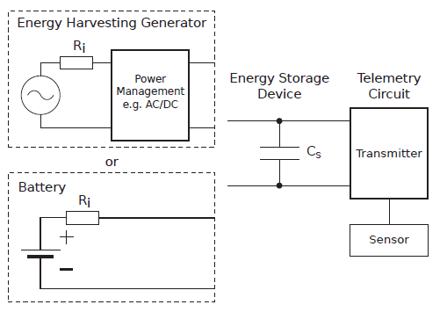
Reduced Peak Current
The time between two sub-packets can be used to re-charge a capacitor
➔ “High” transmit powers even with tiny batteries

Slide 13
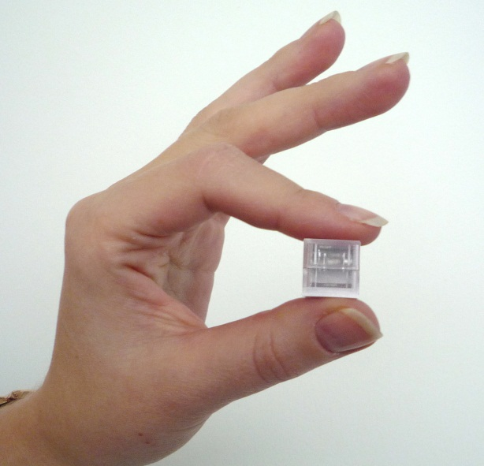
Telemetry Cube Demonstrator
Frequency
Time ~3s
Telemetry Cube Demonstrator and transmitted FHSS signal
Reached transmit range of 10km with <1mW ERP (no line of sight)
Transmitter based on IEEE 802.15.4 compliant Texas Instruments CC1125

Slide 14
Conclusions
FHSS is a suitable candidate for LPWAN with ultra-long range
Improved robustness wrt. interference
Improved frequency diversity
No violation of FCC regulation
Ultra-low bit-rate reachable for ultra-long range
Approaches theoretical bound in single destination networks
Standard IEEE 802.15.4 compliant chips can be used for the transmission
Receiver gets more complex as powerful forward error correction is required and synchronization gets more complex

Slide 15
Thank You for Your Attention!

