Slide 1
Fast-Spot-Channel Analysis and Demonstration at 200 GHz for Extremely High Data Rates in Ultra Dense Environments
Date: 2017-07-10
Authors:
Name | Affiliation | Address | Phone | Email
Robert Müller, Diego Dupleich, Sergii Skoblikov, Giovanni Del Galdo, Reiner Thomä, | Technische Universität Ilmenau |  |  | Mueller.Robert@tu-Ilmenau.de Reiner.thomae@tu-ilmrnau.de

Slide 2
Abstract
In this presentation, we summarize the activities for the terahertz project “fast Spot”. Also we like to presented our current activities in THz channel measurements and channel modeling for 200 GHz indoor scenarios. To find a useful model for small and medium size indoor scenarios, it is necessary to find out which approach is the best to combine the measurements and exiting THz models for multi path propagation communication system.

Slide 3
Outline
The THz project “fast Spot”
200 GHz channel sounder
Multi-Band from microwave to terahertz
Planned indoor measurements and modelling activities at 200 GHz
200 GHz system developments in the frame of “fast Spot”
Conclusion

Slide 4
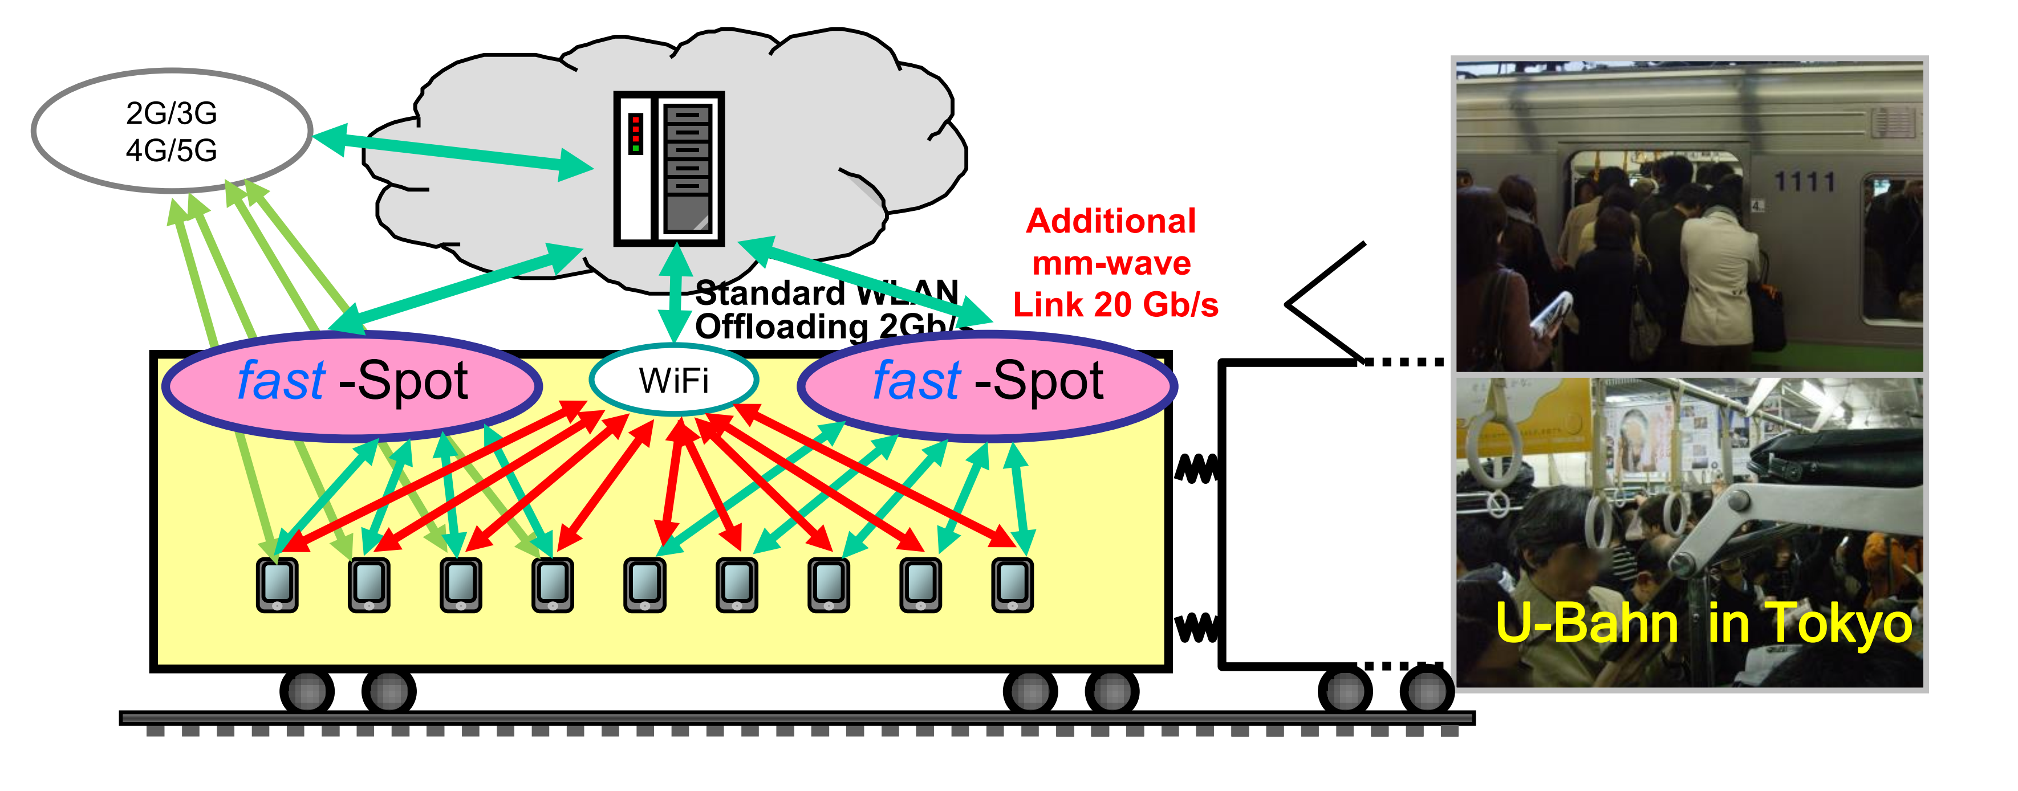
The THz project “fast Spot”

Slide 5
Overview BMBF Project “fast Spot “
Development of ultra-fast access points at around 200 GHz with a BW > 20 GHz
Channel characterization + modeling at 200 GHz for small/medium size Indoor scenarios
Dynamic real-time antenna control using analogue vector modulators with high directivity (> 30dBi) and integrated beamforming antennas
Location of the participants by radar / ranging technology
Spacemultiplex technology (BDMA) with multiple beam (up to 5 beams simultaneously)
latency <1ms by real-time multiplexing (SDM + TDM + FDM)
Modular baseband technology based on multi-core baseband processor
28 nm (or 40 nm) GF-CMOS technology (supplied by fast-access)
1-5 Gb / s / subscriber (20 * 1 Gb / s to 4 * 5 Gb / s) can be cascaded
Standard conform IEEE802.2 LLC technology allows direct integration into any HotSpot configuration

Slide 6
200 GHz Channel Sounder

Slide 7
200 GHz Channel Sounder
TX Module
PA min. 5 dBm
RX Module
LNA
Gain : 20 dB
CH 1
H Pol.
IF-LNA
UWB Sounder TX
0 – 10 GHz
P_{TX} = 0dBm
H Pol.
UWB Sounder RX
0 – 10 GHz
Switch
180 - 220 GHz
180-220 GHz
V Pol.
LNA
Gain : 20 dB
V Pol.
CH 2
PA.
5 dBm
Multiplier
28
Antennen Gain
25 dBi
Multiplier
28
Cable link
6.75 GHz up to 7.5 GHz
Oscillator
Cable link
The green parts show the already order commercial components
Red part is now under development in cooperation with IHP and TU Dresden
PAs will be packaged in LTCC with a waveguide connection
Dual polarized channel sounder system
Clock Frequency can be locaded between 6.5 GHz to 7.5 GHz → 180-210 GHz

Slide 8
Multi-Band Channel Sounder
from
Microwave to Terahertz

Slide 9
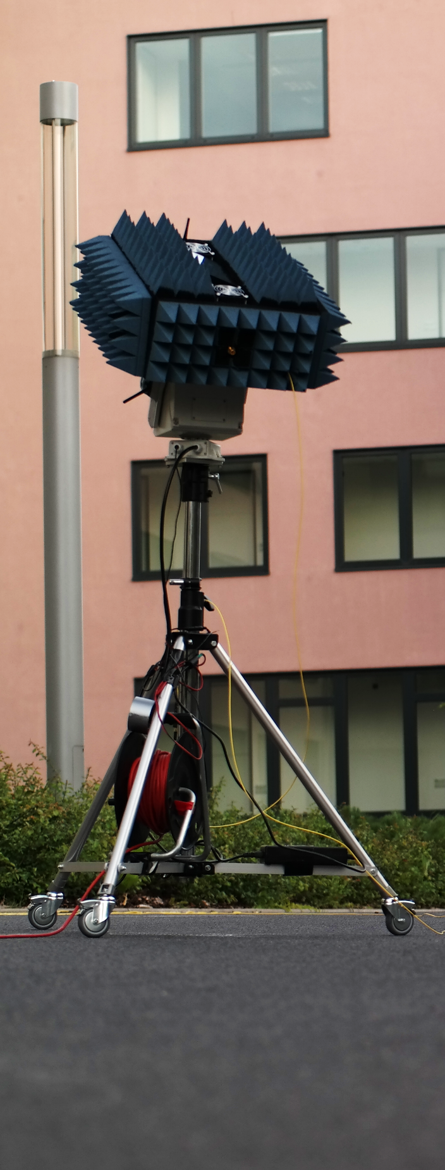
Multi-Band Measurement Setup
Three of the follow bands can be combined as desired (3-10 GHz, 30-37 GHz, 60-67 GHz, 71-78 GHz and 180-210 GHz)
Antennas can occupy exactly the same position (only for two frequency bands at the same setup)
Comparison of the propagation characteristics at different frequencies with the exactly same conditions
The only Channel Sounder with this feature
Reduce of the measurement time
Phases coherent and phase stable measurements
calculation of synthetic aperture
After Calibration HRPE is possible

Slide 10
Planned
Indoor Measurements and Modelling
activities at 200 GHz

Slide 11
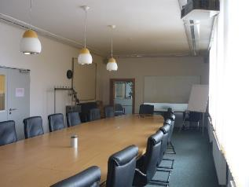
Class room / Meeting room scenario
Dimensions:
4m x 12m x 3m
Part disguised wood
Charateristics:
Provide access to students / users with tablets, notebooks, electronic devices, etc.
Wireless office

Slide 12
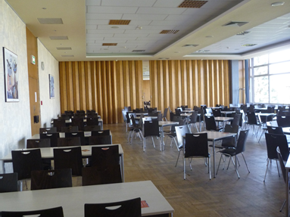
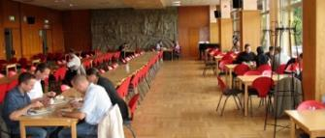
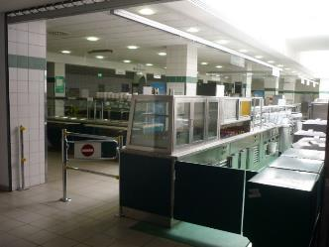
Dinning Hall
Dimensions:
9m x 20 m x 3m
Part disguised wood
Charateristics:
Provide video distribution
Provide access to students / users with tablets, notebooks, electronic devices, etc

Slide 13
Entrance Hall
Dimensions:
7 x 25m x 9m
Glass and metal
3 different floors
Charatersitics:
Provide access to a large number users
Modern buildings full of metal and glass

Slide 14
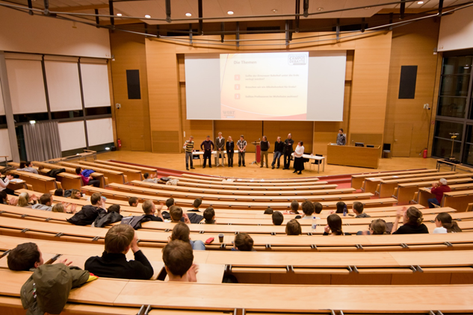
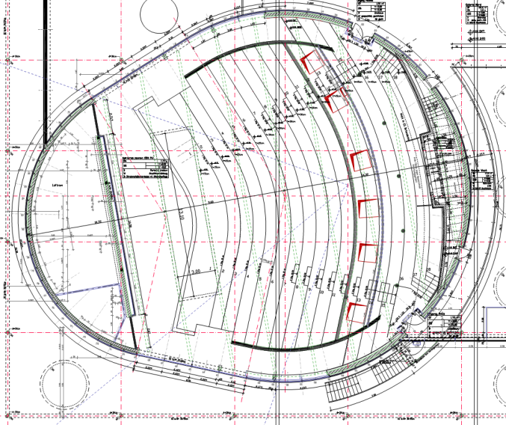
Lecture Hall
Dimensions:
22m x 36m x 7m
Chamfered
Part disguised wood
Charateristics:
Provide access to a large number users
Provide access to users with tablets, notebooks, electronic devices, etc.

Slide 15
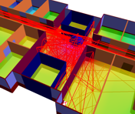
Ray Tracing (RT) in the Entrance Hall at 200 GHz
First wave propagation analyzes are to be carried out using AWE RT (WinProp) in the entrance hall scenario
Later comparison of RT results with measurements
Reduction of measuring time possible for data fusing of measurements and RT
Simple extension to additional scenarios possible by RT simulation

Slide 16
200 GHz
system developments in the frame of
“fast Spot”

Slide 17
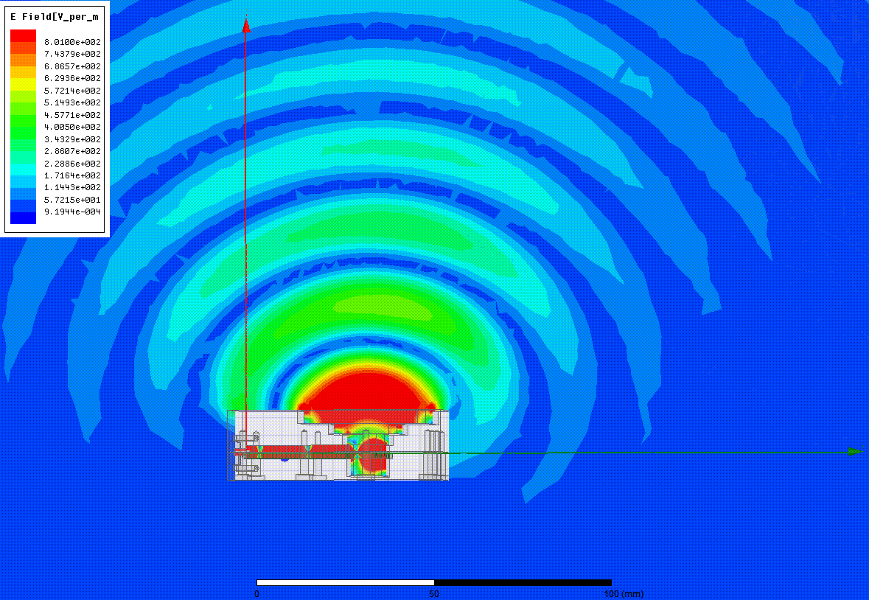
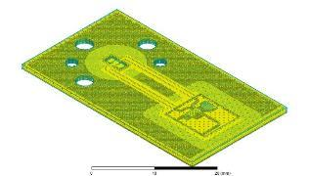
200 GHz PAs for Channel Sounding
Construction of a WR4 / WR5 to chip to WR4 / WR5 LTCC as carrier
Metal housing with WR4 / 5 connection
Test of bond connections and flip chip at 200 GHz
As simple as possible with IHP / TUD chips
Expansion of the commercially purchased CS system to approx. 0 dBm to 5 dBm output power
Active antenna (optional with successful PA implementation)
Implementation of an antenna array structure with PAs

Slide 18
Conclusions
Development of an 200 GHz Channel Sounder
Dual polarized capability at TX (switched) and RX (parallel)
Multi-Band measurements allow the direct comparison of propagation effects from millimetre waves to terahertz
Integration of a wave guide PAs with 5 dBm outpower
Min. two measurement campaigns in small and medium size indoor scenarios are planned

