Slide 1
Project: IEEE P802.15 Working Group for Wireless Personal Area Networks (WPANs)
Submission Title: Wireless 100 Gb/s and beyond: Actual research approaches within a DFG special priority program (SPP1655)
Date Submitted: 10 July 2017
Source: Kraemer, Rolf
Address Im Technologiepark 25; 15236 Frankfurt (Oder); Germany
Voice: +49 335 5625 342, FAX: +49 335 5625 671, E-Mail: kraemer@ihp-microelectronics.com
Re: n/a
Abstract: The talk will give an introduction and overview of the SPP1655 challenges and the projects. Especially bandwidth efficiency as a trade-off for technology selection will be discussed. Moreover, a discussion of analog versus digital signal processing will be conducted. Some information about protocol engines for the MAC and LLC layers will be provided.
Purpose: Information of IEEE 802.15 IG THz
Notice: This document has been prepared to assist the IEEE P802.15. It is offered as a basis for discussion and is not binding on the contributing individual(s) or organization(s). The material in this document is subject to change in form and content after further study. The contributor(s) reserve(s) the right to add, amend or withdraw material contained herein.
Release: The contributor acknowledges and accepts that this contribution becomes the property of IEEE and may be made publicly available by P802.15.

Slide 2
“Wireless 100 Gb/s and beyond”: Actual research approaches within a DFG special priority program (SPP1655)
Rolf Kraemer kraemer@ihp-microelctronics.com

Slide 3
Outline
What is a DFG-SPP?
SPP1655: „Drahtlose Ultrahochgeschwindigkeitskommunikation für den mobilen Internetzugriff :„Wireless 100 Gb/s and beyond“
Problem Statement and Challenges
  “Bandwidth Efficiency” versus “Bandwidth”
  “Digital Signal Processing” versus “Analog Signal Processing”
  “Protocol Design Challenges”
Projects within SPP1655
  Example Projects
  Real 100G.COM
  maximumMIMO
  End2End100
Conclusion

Slide 4

What is a DFG SPP (Special Priority Program)
Purpose:
  advance knowledge in an emerging field of research through collaborative networked support
  enhanced quality of research through the use of new methods for basic research
  added value through interdisciplinary cooperation
  collaborative networked support over several locations national wide
  Researchers prepared call approved by the DFG-senate
Eligibility:
  Researchers at universities research
  institutions in Germany
Funding period: 6 (3 + 3 or 3*2) years
Funding: individual grants + coordination (~ 30 projects)
7.5% of budget for SPPs
Slide borrowed from Dr. Dudek DFG

Slide 5
SPP1655: Facts and Figures
Facts and figures:
  64 applicants
  submitted 27 joint projects with one or more PIs
  with a total applied sum of 15.9M€
  coming from 24 different German universities
Approved
  10+1 research projects and 1 coordination project were approved
  with a total amount of 6.5MEuro for the first 3 years
  Covering the whole range of the topics within “Wireless
  100Gb/s and beyond”
First Funding of the projects started in June 2013
Second phase started in September 2016 with 5,8 Mio€ funding
11+ 1 Projects have been selected
Slide borrowed from Dr. Dudek DFG

Slide 6
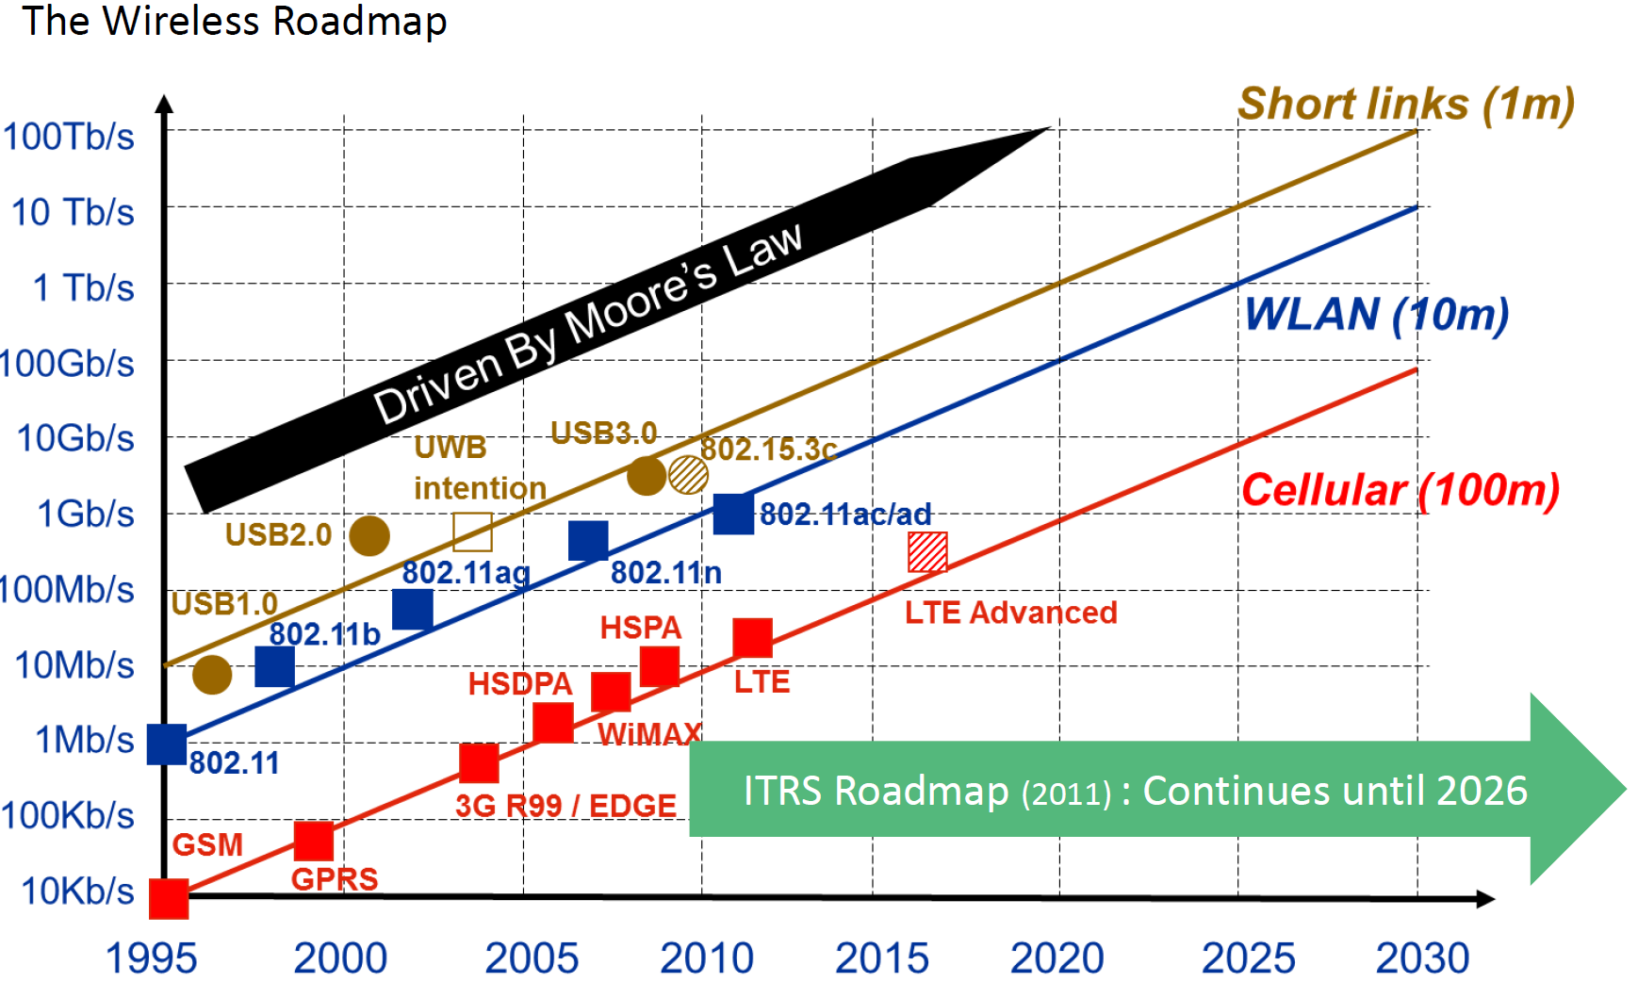
Wireless Roadmap (Fettweis 2012)

Slide 7
Objectives of „Wireless 100Gb/s and beyond“
Investigation of paradigms for effective reduction of complexity and energy consumption of ultra-high speed wireless communication systems
  We need to come close to 1-10 pW/b for the end-2-end communication
Comparison of baseband algorithms with respect to bandwidth efficiency and energy efficiency
Investigation of the boundary between digital and analog signal processing
Investigation of medium access protocols for systems with ultra-high speed, significant error handling and low energy
Investigation of Silicon based transistors with cut-off frequencies of 700 GHz and higher
Investigation of system architectures (including protocols) for extreme high data throughput

Slide 8
Bandwidth Efficiency versus Bandwidth
Basically 2 cases are discussed:
  Use a huge bandwidth at a very high frequency with a small bandwidth efficiency (50GHz, 250GHz, 2 (b/s/Hz) or
  Use a small bandwidth with a huge bandwidth efficiency at a moderate frequency (3GHz, 7GHz, 33(b/s/Hz)
What SNR do we need in different cases of bandwidth efficiency to achieve 100Gb/s
According to Shannon S/N₀= 2^{η}-1 with η=C/B we need as a minimum:
  For System 1: f=250GHz B=50GHz η=2 (b/s/Hz).
  i.e. for S/N₀ we need a minimum of 4.7 dB with
  N₀=4kTB=4*300*50*10⁹*1,38*10⁻²³J/s=0,83*10⁻⁹W
  For System 2: f=7GHz, B=3GHz η= 33 (b/s/Hz)
  i.e. for S/N₀ we need a minimum of 2³³-1= 8*10⁹ or 108 dB
  N₀=4kTB=4*300*2*10⁹*1,38*10⁻²³J/s=0,03*10⁻⁹W

Slide 9
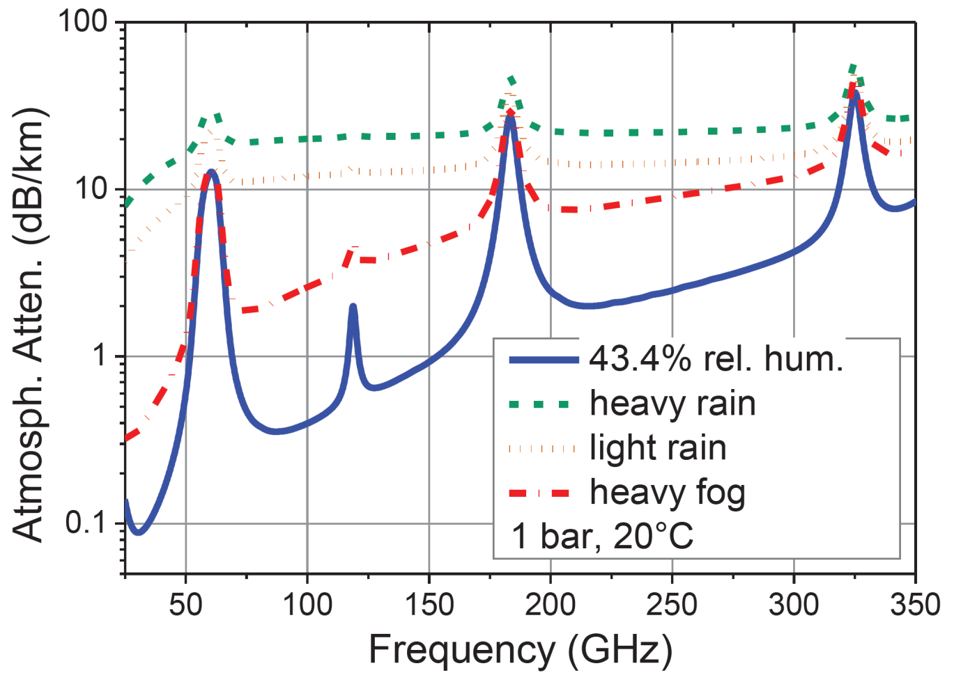
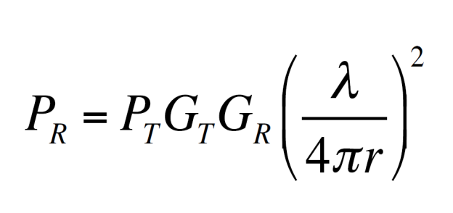
Ultra high frequency challenges
Free space losses grow with the square of the frequency
Atmospheric losses limit the transmission distance significantly

Slide 10
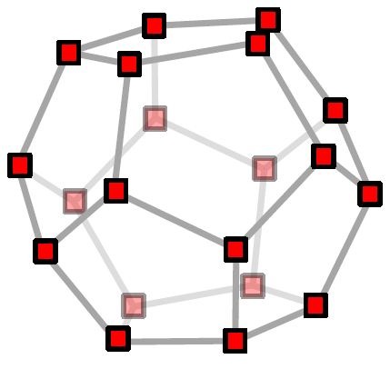
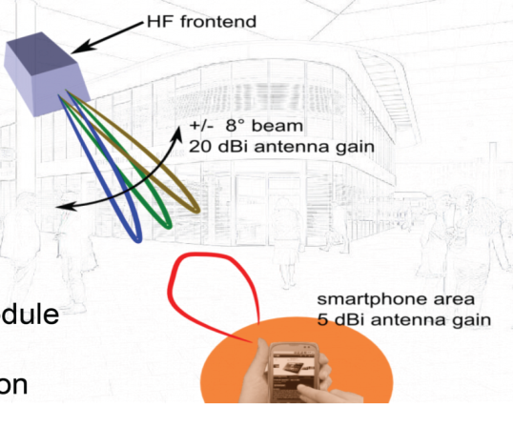
Bandwidth Efficiency versus Bandwidth
We cannot achieve such a high bandwidth efficiency using just one channel
Thus parallelization (e.g. MIMO) is absolutely necessary
For ultra high frequencies the free propagation loss is huge
Thus we need highly directed antennas with gains
of >30dBi

Slide 11
  Digital Signal Processing” versus “Analog Signal Processing
Digital Case:
For a normal IEEE802.11n system (300Mb/s) we need a DSP performance of approximately 2 GFLOPS (mainly for Scrambling, FEC and MIMO).
The bandwidth efficiency of IEEE802.11n is at maximum η=15 b/s/Hz.
The energy consumption per MFLOP at a 40nm Technology is approximately 500nW/MFLOP resulting in 1 W power consumption
If we linearly scale to 100 Gb/s we need 300W. We have not calculated that higher bandwidth efficiency requires higher computing performance!
But we expect higher energy efficiency if we go to higher scaling
Thus we need new algorithms that significantly reduce the complexity and increase the power efficiency

Slide 12
  Digital Signal Processing” versus “Analog Signal Processing
Analog Case:
Mörz et.al. published 2007 results of an analog Viterbi Decoder for FEC with 800Mb/s @120mW in a 0.25μm SiGe technology i.e. 160 pW/b/s
They predicted that 60 pW/b/s can be achieve using that approach using 130 nm technologies.
The energy efficiency is 50 times higher than the digital solution at 40nm
Taking scaling into account the energy efficiency of the analog solution is at least 100 times higher than the equivalent digital one
The complexity of the circuit becomes much smaller (factor 100)
Not all algorithms that work for DSP also work for analog signal processing
Thus we have to search for waveforms, “natural processors” and algorithms that fit to analog realization

Slide 13
Paradigm shift towards analog signal processing
  The use of the natural high speed of the analog domain should be
  used to reduce complexity, power consumption and to avoid the use of data converters.
  The digital domain should be used to correct imperfect results
Problems:
  Analog processing works with non ideal components and yields imperfect results
  The current design flow yield in dramatically lower design performance
It has already been shown that:
  Complex signal processing can be realized completely in the analog domain
  Mathias Mörz: Analog Signal Processing in Forward Error Correction (FEC) Decoders, Diss. TUM 2007
  Josep Vicent Soler: Analogue VLSI Architectures for Multiantenna Wireless Systems, Dissertation 2009 Bristol University
Both investigations showed an increase in performance by 2 orders of magnitude and a reduction of power consumption by 50-100 times

Slide 14
Analog Mimo Detector ASIC
Detection algorithm: Mean Field Annealing:
MIMO configuration: Space Time Block Code
Transmit antennas: nt=4.
Modulation: QPSK
Maximum rate: 50 Mbps:
Power consumption: 223 mW
Analogue core area: 2.75 mm2:
Total area: 5.2 mm2 (including pad ring)
Total transistor count: 1509 HBT, 2437 MOS:
Technology: IHP 0.25 m
SiGe BiCMOS 4M/1P
Source: Josep Vicent Soler: Analogue VLSI Architectures for Multiantenna Wireless Systems,
Dissertation 2009 Bristol University

Slide 15
Analog decoder Designs in BiCMOS and SiGe technology
Source: Mathias Mörz: Analog Signal Processing in Forward Error Correction (FEC) Decoders, Diss. TUM 2007

Slide 16
  Protocol Design Challenges
To achieve 100Gb/s with a MAC processor for a wireless system we need to go to very long data packets to reduce overheads
Long data packets need interim re-synchronization
Since the residual error rate of a wireless system is at least 10⁻⁵ higher than that of a wired system most effort need to be spend in a balance between FEC and ARQ (Automatic Repeat Request).
ARQ need to store the packets thus the memory requirement to store not acknowledged packet will be huge
The transmission bandwidth of current computers (PCIe 2.0) is for all 16 lane approximately 120 Gb/s. With PCIe 3.0 it will be 180-200 Gb/s
Even if this is going to much higher in the future we need to find new trade-offs between the network processor, other processor like the GPU the memory access and the main processor to balance the bus load

Slide 17
List of SPP1655 Projects
LP100 – Optimizing 100Gb/s short range radio systems under energy constraints
Tera50 – A Radio measurement system for frequencies of 10 GHz to 1000 GHz with 50 GHz bandwidth
maximumMIMO – Maximal spectral efficiency by parallel MIMO transmission using 3D antenna topologies
Ultra Wideband Communications based on Massive MIMO and Multi-mode Antennas Suitable for Mobile Handheld Devices
Real100G.COM - Mixed-Mode Baseband for 100 Gbit/s Wireless Communication
Real100G.RF –Integrated Radio-Frontend module for wireless 100Gbps communications
End2End100 – Network interface card for protocol processing of wireless 100 Gbps communication systems
Development of Novel System and Component Architectures for Future Innovative 100 GBit/s Communication Systems
On-Chip Integrated Distributed Amplifier and Antenna Systems in Locally-Backside-Etched SiGe BiCMOS for Receivers with Ultra-Large Bandwidth
Integrated active group antenna including polarization multiplexing for broadband communication in W-Band

Slide 18
Example Cluster: Real100G.com, Real100G.rf, End-2-End100
Both projects in common address the frequency range 250-300 GHz with 50 GHz bandwidth
Real100G.rf will address the RF-Frontend and the directive antenna structure
Real100G.com will address the carrier/phase recovery, the coding and modulation as well as the baseband processing
End-2-End100 will organize the data communication as well as the medium access. Additionally it will arrange for all error handling like FEC and ARQ
The communication will be coherent
The modulation will use a 16 ASK scheme on top of the PSSS structure
There will be 15 channels of 6.7 Gb/s each which can be joined to virtual channel-structures of higher data rates
The baseband shall be mainly in the analog domain
Partners: Prof. Peiffer (Wuppertal); Prof. Zwick (Karlsruhe), Prof. Kallfass (Stuttgart), Prof. Scheytt (Paderborn), Prof. Nolte (Cottbus), Prof. Kraemer (IHP)

Slide 19
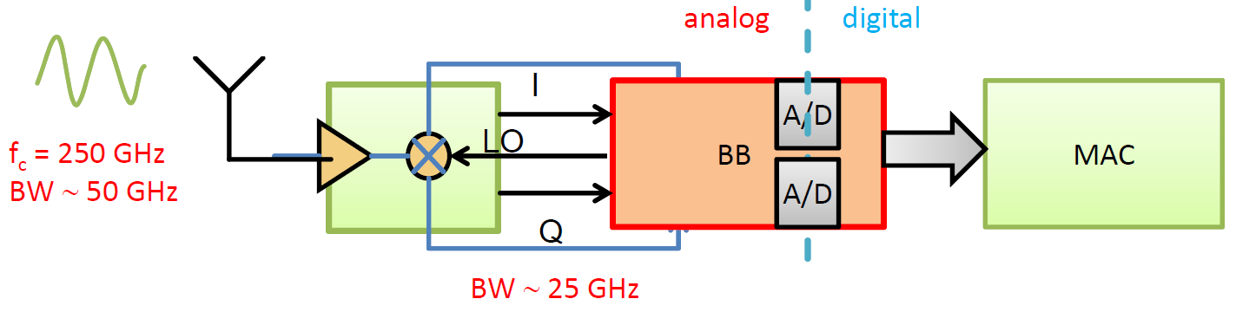
Real100Gb.com: f_{c}=250GHz, B=50GHz, η=2-3
Most of the signal processing will be in the analog domain
The selected modulation and transmission scheme is “analog” friendly
Only the channel de-convolution will be in the digital domain assume a very long channel coherence time
Digital carrier recovery and synchronization at 100 Gb/s will be power‐hungry
Synchronous detection in RF domain comes at little extra hardware effort and power

Slide 20
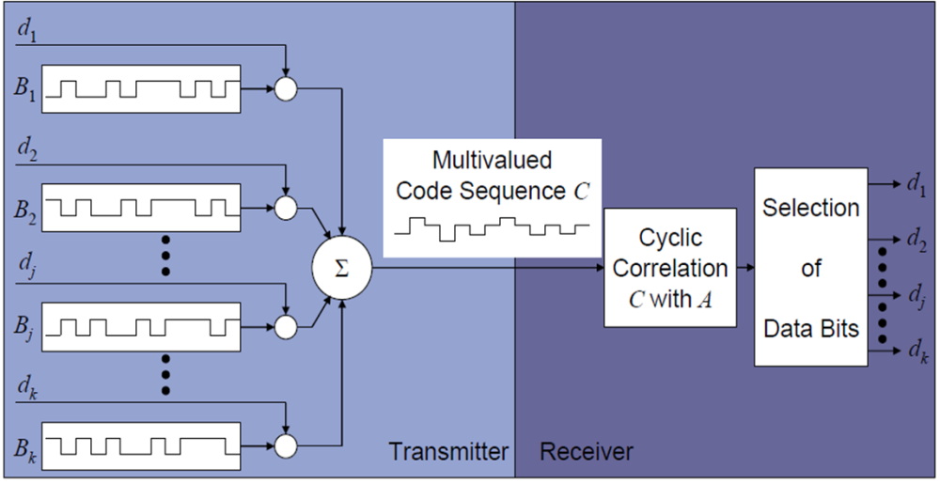
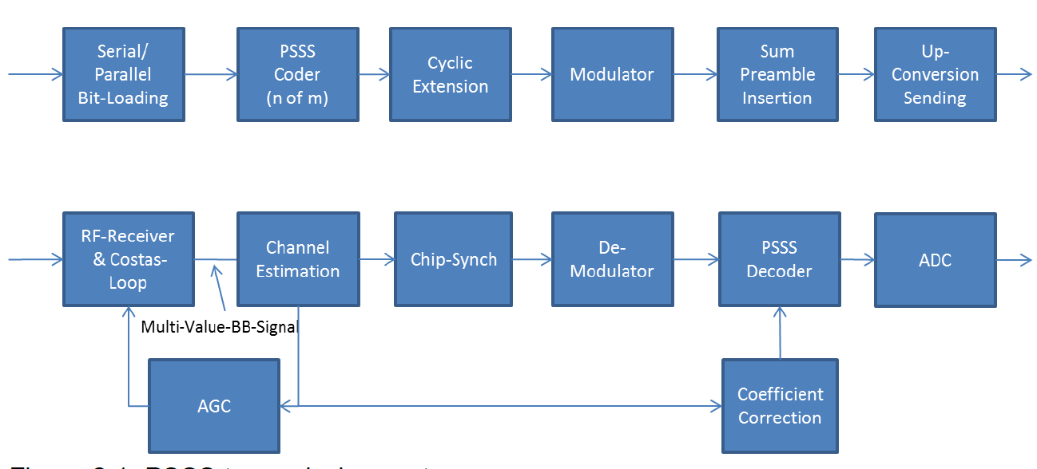
PSSS System approach
Transmitter Receiver
PSSS uses orthogonal m-sequences
The signal can be further modulated
e.g. using PAM
The receiver correlates, integrates and de-modulates the signal

Slide 21
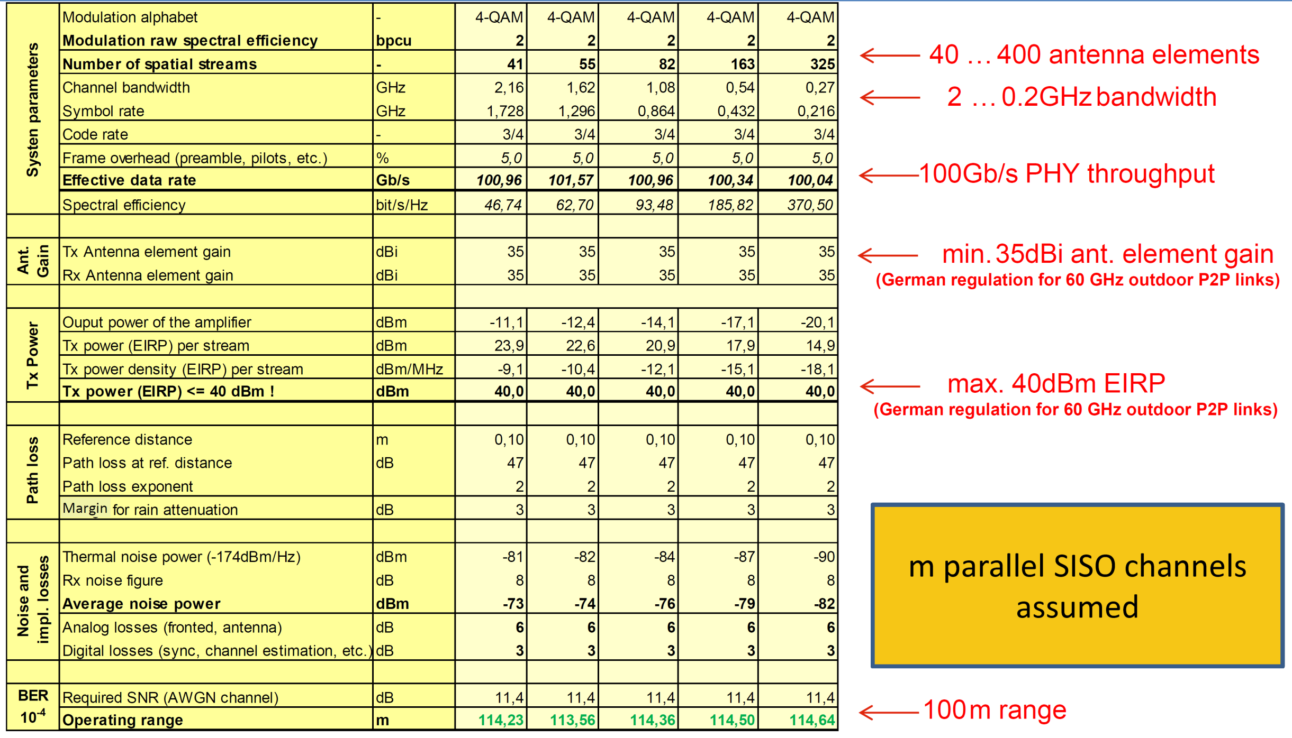
MaximumMIMO: Alternatives to achieve 100Gb/s
Partners: Prof. Lankl (München), Prof. Fettweis (Dresden), Prof. Grass (IHP, Berlin)

Slide 22
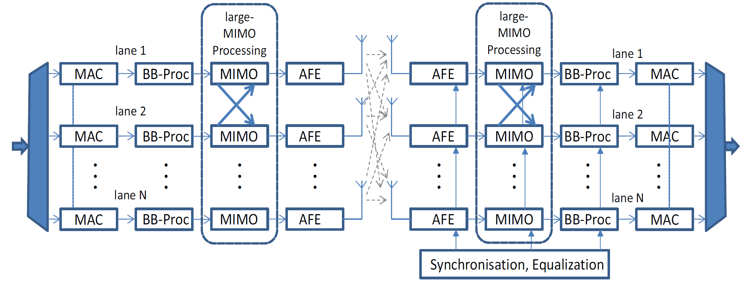
MaximumMIMO: System Approach
Challenges:
  Antenna design and optimization (partitioning)
  Channel characterization (for LOS-MIMO + 3D Antennas)
  massive MIMO processing (algorithms + implementation)
  Dirty RF frontend and related signal processing algorithms
  Synchronization concepts
  Optimized low effort MIMO processing
  Scalable parallel implementation of BB-processor and MAC,…

Slide 23
End-2-End100: NIC conceptual model
The NIC will process individual communications using the lane concept
The many-core processor has to parallelize the protocol calculation
Depending on the lane speed we need different schedules for the processor use
A zero copy approach for the interaction between NIC and main memory has to be applied. Only the protocol header will be processed by the many-core processor
100 Gb/s Parallel NIC System
Multi-Channel-Parallel Processor (MCPP)
MAC-SW-Core
State Machines
Core 1
MAC HW-
Accelerator
Multi-PHY
Parallel-Processor
m-Lanes
to Application Processor
Core 2
n physical
Channel
...
ARQ REMUX FEC
...
Distributed
Operating System
Core k
Many-Core
Processor
k Lanes

Slide 24
Conclusion
Wireless 100Gb/s is still a challenge
Several different approaches can be chosen for different scenarios of application
The power consumption caused by system inefficiencies needs to be solved
There seems to be a chance for a reconsideration of doing signal processing for certain forms of calculation in the analog domain due to extreme high power-efficiency
The project started in 2013 and will provide first result within 2014-2015
The second phase started in September 2016 and will run until August 2019
Acknowledgement:
Thanks to DFG for supporting the activities in SPP1655
Thanks to all colleagues working within SPP1655 for leaving me several slides and pictures for use in this talk

