Slide 1
IEEE 15-17-0322-00-007a
Project: IEEE P802.15 Working Group for Wireless Personal Area Networks (WPANs)
Submission Title: 15.7m OWC TG Closing Report May 2017
Date Submitted: May 2017
Source: Yeong Min Jang Company: Kookmin University
Address
Voice:, FAX:, E-Mail: yjang@kookmin.ac.kr
Re:
Abstract:
Purpose:
Notice: This document has been prepared to assist the IEEE P802.15. It is offered as a basis for discussion and is not binding on the contributing individual(s) or organization(s). The material in this document is subject to change in form and content after further study. The contributor(s) reserve(s) the right to add, amend or withdraw material contained herein.
Release: The contributor acknowledges and accepts that this contribution becomes the property of IEEE and may be made publicly available by P802.15.

Slide 2
IEEE 15-17-0322-00-007a
Background
TG7m conducted a task group letter ballot review of draft D2
Draft D1 was issued at the end of October, 2016.
The comment period closed prior to the January meeting.
There were 826 technical comments submitted and 251 editorial comments.
2/3th of the comments were resolved in January and it was planned to resolve the rest in March, 2017.
Draft D2 was issued at end of March, 2017.
For D2, there were 362 technical comments submitted and 36 editorial comments.

Slide 3
IEEE 15-17-0322-00-007a
Status of OCC comments at the end of May Meeting
Resolved technical comments carried over from March meeting
Resolved comments resolution for D2 document
Discussion about MAC frame structure
Discussion about dimming issue for PHY IV, PHY V and PHY VI.
Discussion about the reference on QR code specification
Discussion about the merging text for PHY VI

Slide 4
IEEE 15-17-0322-00-007a
Plans for July meeting
June 2st : Deadline for modified text/figures/tables based on the comment resolution against D2
Missing deadline of acceptable input may result in the committee imposing a penalty or removing text during the July meeting.
16 June : Release Draft D3
07 July : Deadline for comments against D3
Comments against draft D3 will be resolved during the July meeting. The text is maturing so we expect fewer comments and hopefully we can get them all resolved during the July meeting.
Requesting 10 sessions

Slide 5
IEEE 15-17-0322-00-007a
Updated Milestone and Schedule
2017
Q1 | January | February | March
 | Continue comment resolution against D1 Prepare draft D2 | Comment resolution to delete against unnecessary parts of D1 | Finish comment resolution against D1 Prepare draft D2
Q2 | April | May | June
 | Release Draft D2 | D2 comment resolution Prepare D3 | Release D3
Q3 | July | August | September
 | D3 comment resolution Request conditional approval for Letter Ballot | Release D4 Letter Ballot 1 for D4 | LB1 comment resolution Request conditional approval for Letter Ballot
Q4 | October | November | December
 | Release D5 Letter Ballot 2 for D5 | LB2 comment resolution | Release D6

Slide 6
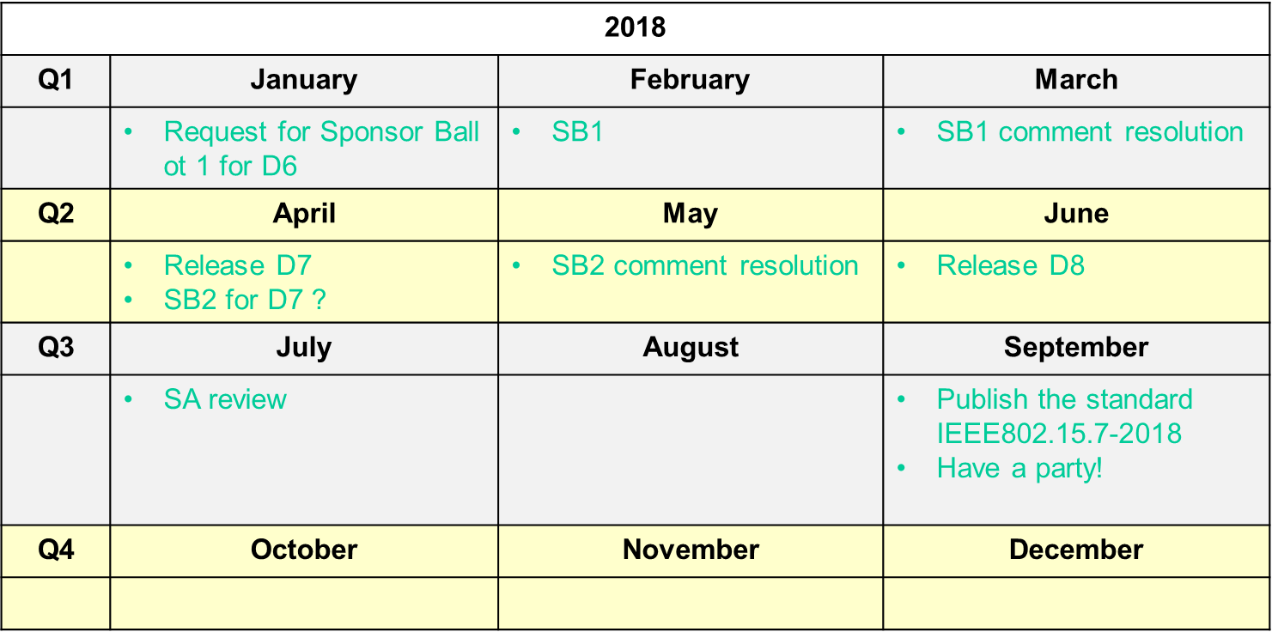
IEEE 15-17-0322-00-007a
Updated Milestone and Schedule

