Slide 1
Project: IEEE P802.15 Working Group for Wireless Personal Area Networks (WPANs)
Submission Title: TG3d Atlanta January 2017 Closing Plenary Slides
Date Submitted: 11 May 2017
Source: Thomas Kürner Company TU Braunschweig
Address Schleinitzstr. 22, D-38092 Braunschweig, Germany
Voice:+495313912416, FAX: +495313915192, E-Mail: t.kuerner@tu-bs.de
Re: n/a
Abstract: TG3d November 2016 Closing Plenary Slides
Purpose: Closing report to WG 15 at closing plenary
Notice: This document has been prepared to assist the IEEE P802.15. It is offered as a basis for discussion and is not binding on the contributing individual(s) or organization(s). The material in this document is subject to change in form and content after further study. The contributor(s) reserve(s) the right to add, amend or withdraw material contained herein.
Release: The contributor acknowledges and accepts that this contribution becomes the property of IEEE and may be made publicly available by P802.15.

Slide 2
TG 3d May 2017 Closing Report

Slide 3
Meetings/Contributions
4 meetings (including 1 joint meeting with IG THz)
Contributions (from Joint meeting with TG3d):
15-16-0269-01: A Japanese Activity on 300-GHz CMOS Transmitters
15-16-0268-00: Study on Statistical Characteristics of Human Blockage Effects in Future Indoor Millimeter Wave and THz Wireless Communications

Slide 4
Tasks Completed
Completion of comments resolution for Sponsor Ballot initial circulation
Motion to start SB recirculation
Review of Time Planning

Slide 5
Plans for Berlin July 2017
Comment resolution from SB (if any)
Prepare submission to RevCom

Slide 6
TG Motion
May 2017
Move that 802.15 TG3d approves TG3d sponsor ballot comment resolutions in doc. 15-17-0250-02-003d and to put them forward to 802.15 WG to approve the start of recirculation ballot of the revised draft D3. Comment resolution on recirculation ballots between sessions will be conducted via reflector email and via teleconferences announced to the reflector as per the LMSC 802 WG P&P.
Moved By: Iwao Hosako
Seconded By: Jay Holcomb
y/a/n = 3/0/0

Slide 7
WG Motion
May 2017
Move that 802.15 WG approves TG3d sponsor ballot comment resolutions in doc. 15-17-0250-00-003d and to start the recirculation ballot of the revised draft D3. Comment resolution on recirculation ballots between sessions will be conducted via reflector email and via teleconferences announced to the reflector as per the LMSC 802 WG P&P.
Moved By: Thomas Kürner
Seconded By
y/a/n =

Slide 8
TG Motion
May 2017
Move that 802.15.3d TG approve the renewal of the Ballot Resolution Committee (BRC) for the Sponsor balloting of the P802.15.3d_D03 or current version with the following membership: Thomas Kürner (Chair), Iwao Hosako, Monique Brown and Ken Hiraga and put this forward to the 802.15 WG for approval. The 802.15.3d BRC is authorized to approve comment resolutions and to approve the start of recirculation ballots of the revised draft on behalf of the 802.15 WG. Comment resolution on recirculation ballots between sessions will be conducted via reflector email and via teleconferences announced to the reflector as per the LMSC 802 WG P&P.
Moved By: Iwao Hosako
Seconded By: Jay Holcomb
y/a/n = 3/0/0

Slide 9
WG Motion
May 2017
Move that 802.15 WG approves the renewal of the Ballot Resolution Committee (BRC) for the Sponsor balloting of the P802.15.3d_D03 or current version with the following membership: Thomas Kürner (Chair), Iwao Hosako, Monique Brown and Ken Hiraga. The 802.15.3d BRC is authorized to approve comment resolutions and to approve the start of recirculation ballots of the revised draft on behalf of the 802.15 WG. Comment resolution on recirculation ballots between sessions will be conducted via reflector email and via teleconferences announced to the reflector as per the LMSC 802 WG P&P.
Moved By: Thomas Kürner
Seconded By
y/a/n =

Slide 10
BRC Calls
24.05.17, 6am-7am, (CET), 2pm-3pm (JST) / 23.05.17, 9pm-10pm (PST)
26.05.17, 6am-8am, (CET), 2pm-4pm (JST) / 25.05.17, 9pm-11pm (PST)
29.05.17, 6am-8am, (CET), 2pm-4pm (JST) / 28.05.17, 9pm-11pm (PST)
06.06.17, 6am-8am, (CET), 2pm-4pm (JST) / 05.06.17, 9pm-11pm (PST)
09.06.17, 6am-8am, (CET), 2pm-4pm (JST) / 08.06.17, 9pm-11pm (PST)
20.06.17, 8am-10am, (CET), 4pm-6pm (JST) / 19.06.17, 11pm- 20.06.17 1am (PST)
22.06.17, 8am-10am, (CET), 4pm-6pm (JST) / 21.06.17, 11pm- 22.06.17 1am (PST)

Slide 11
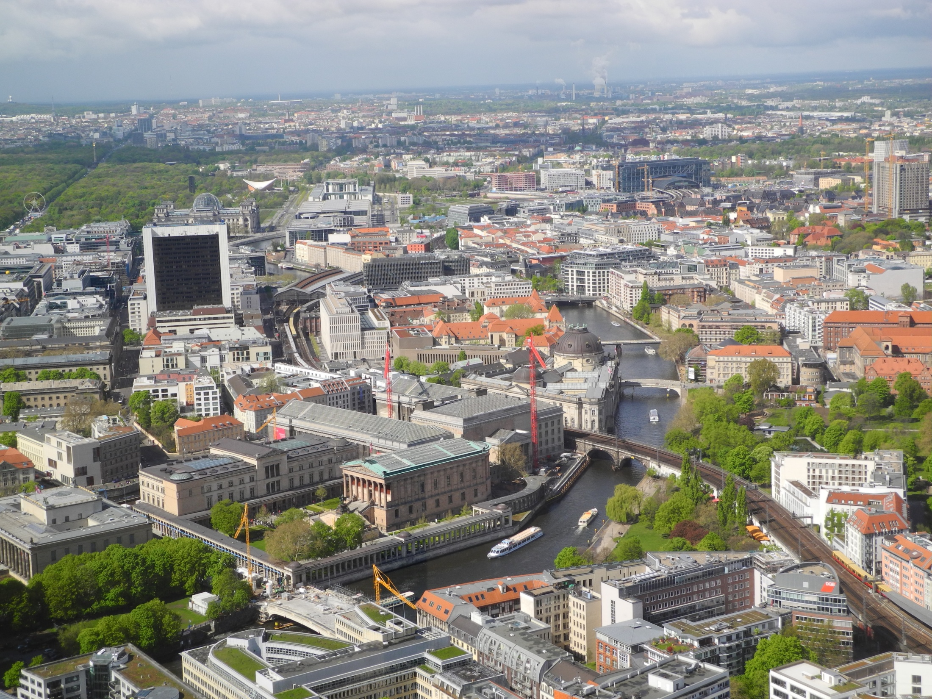
See you in Berlin

