Slide 1
doc.: IEEE 802.15-17- 0287 -00-007a
Project: IEEE P802.15 Working Group for Wireless Personal Area Networks (WPANs)
Submission Title: Explanation on PHY configuration related comments
Date Submitted: May 2017
Source: Trang Nguyen, and Yeong Min Jang
(Kookmin University)
Contact: +82-2-910-5068 E-Mail: yjang@kookmin.ac.kr
Re:
Abstract: D2 comments and resolutions
Purpose: To explain the related comments on configuration of PHYs and MACs.
Notice: This document has been prepared to assist the IEEE P802.15. It is offered as a basis for discussion and is not binding on the contributing individual(s) or organization(s). The material in this document is subject to change in form and content after further study. The contributor(s) reserve(s) the right to add, amend or withdraw material contained herein.
Release: The contributor acknowledges and accepts that this contribution becomes the property of IEEE and may be made publicly available by P802.15.
Submission

Slide 2
doc.: IEEE 802.15-17- 0287 -00-007a
Problem of Sequence number
in PHY (SEQ)
Submission

Slide 3
doc.: IEEE 802.15-17- 0287 -00-007a
Problems of Sequence Number (SEQ)
Kookmin and NTU implement SEQ in the physical layer to support Asynchronous Communication
  NTU’s term
    Sequence number (SEQ)
  Kookmin’s equivalent term
    Asynchronous bit (Ab)
Panasonic implements SEQ in the MAC layer to support what?
  In summary of the related sequence number in 802.15.7 std., for a beacon frame, the Sequence Number field shall specify a BSN. For a data, acknowledgment, or MAC command frame, the Sequence Number field shall specify a DSN that is used to match an acknowledgment frame to the data or MAC command frame.
Several terms that are related to the "sequence number" should be considered throughout this standard:
  1- beacon-sequence number (BSN). This belongs to MAC
  2- data-sequence number (DSN). This belongs to MAC
  3- Sequence number (SEQ). This belongs to PHY
Submission

Slide 4
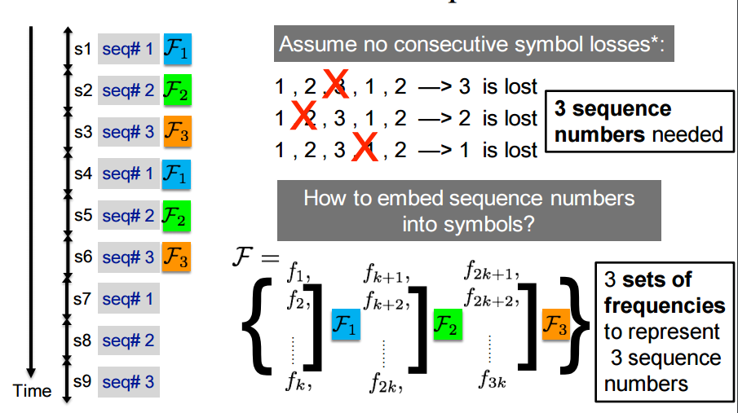
doc.: IEEE 802.15-17- 0287 -00-007a
NTU’s Sequence Number (SEQ)
Sequence Number (SEQ) serves the purpose in the physical layer:
To mark numbering for a group of data frames => Support error detection (due to frame lost)
Submission

Slide 5
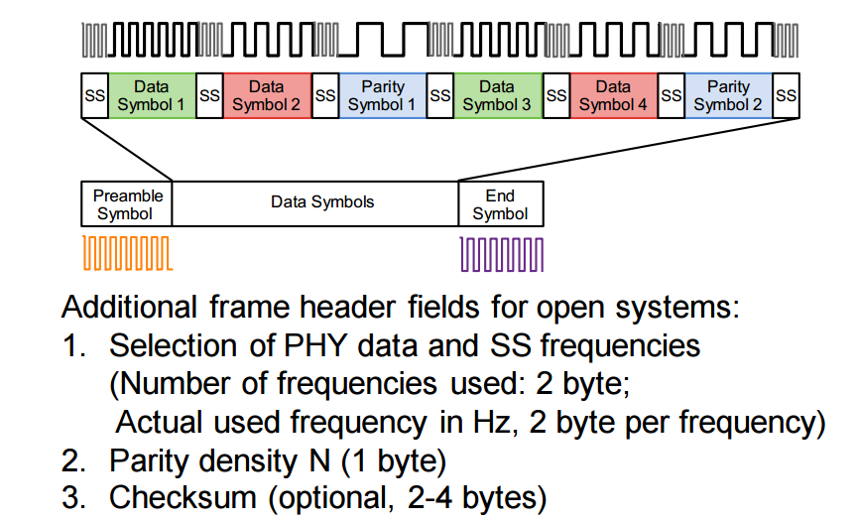
doc.: IEEE 802.15-17- 0287 -00-007a
NTU’s Sequence Number (SEQ)
Sequence Number (SEQ) serves the purpose in the physical layer:
To mark numbering for a group of data frames (i.e. data symbols) => Support error detection (due to frame lost)
Submission

Slide 6
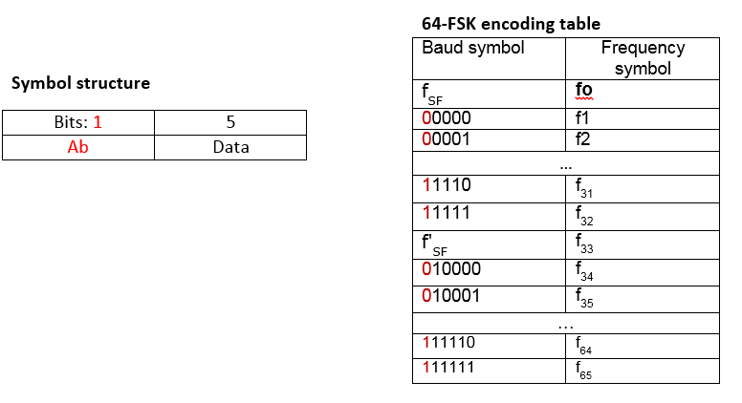
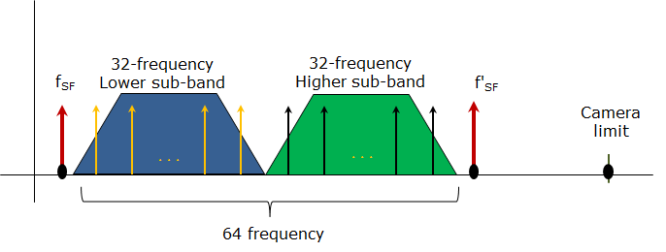
doc.: IEEE 802.15-17- 0287 -00-007a
Kookmin’s Asynchronous bit (Ab) in M-FSK mode
Figure 297– Symbol structure and 64-FSK encoding table (doc 16-0460r0)
The purpose of Asynchronous bit
To support Asynchronous communication (Rx downsampling under the variation of frame rate)
Submission

Slide 7
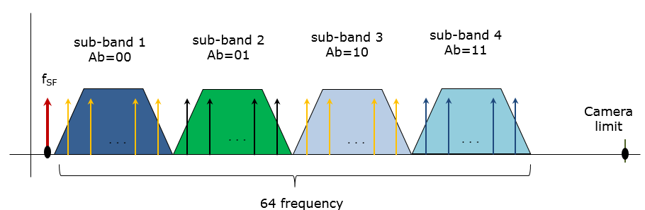
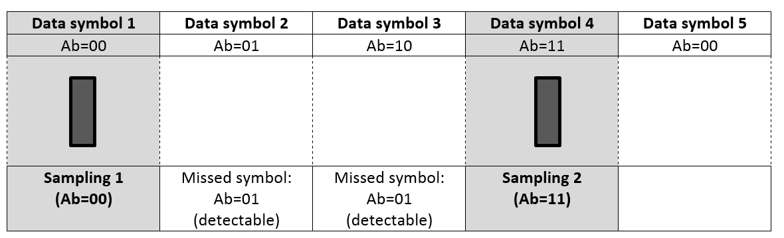
doc.: IEEE 802.15-17- 0287 -00-007a
Kookmin’s Asynchronous bit (Ab) in M-FSK mode
Asynchronous bits
To support error detection caused by frame rate drop.
Submission

Slide 8
Sequence number in M-FSK mdoes
May 2017
doc.: IEEE 802.15-17- 0287 -00-007a
Kookmin
  Asynchronous bit (Ab)
NTU
  Sequence number (SEQ) along with parity coding
During the meeting between Kookmin, Intel, and NTU, we have agreed that
  These two concept is equivalent. Seperating the frequency symbols into groups (using SEQ) equals to the insertion of bit (Ab) into every data subpacket.
  Kookmin implements bit-level based SEQ
  NTU implements 0.5 bit-level based SEQ
SEQ or Asynchronous bits, both serve two purposes of the PHY layer
To support Asynchronous communication
To support error detection caused by frame rate drop.
Submission
Kookmin University

Slide 9
doc.: IEEE 802.15-17- 0287 -00-007a
Kookmin’s Asynchronous bit (Ab) in OOK modes
Asynchronous bits serve two purposes of the PHY layer
To support Asynchronous communication, allow Rx to merge incomplete data parts of a packet from different images into a complete packet. This helps to extend the maximum distance of communication.
To support error detection caused by frame rate drop.
packet (i-1)
packet i
packet (i+1)
DS i ⁽¹⁾
DS i ⁽²⁾
DS i ^{(N)}
Preamble
Ab⁽¹⁾
Ab⁽²⁾
Payload
Ab⁽¹⁾
Ab⁽²⁾
How many missing symbols can be detected?
1 Asynchronous bit : None
2 Asynchronous bits : 3 continuous missed symbols can be detected
3 Asynchronous bits : 2³ -1= 7 continuous missed symbols can be detected
Submission

Slide 10
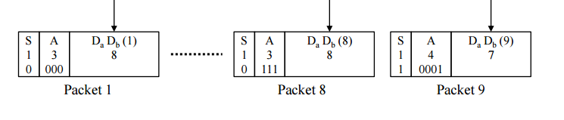
doc.: IEEE 802.15-17- 0287 -00-007a
Summary of Panasonic’s previous PPDU format
Figure: Panasonic’s Packet division – slide 16 – doc. 16/027r1
S (1 bit): major classification of PPDU types
A (1/2/3/4 bit): Specific type of the PPDU
S = 1 | S=0
4 bit A | 1 bit A 2 bit A 3 bit A 4 bit A (reserved)
This is equivalent to MCS-ID subfield of PPDU: to identify packet types
Panasonic introduces multiple packet formats (multiple types of PPDU)
To identify the format of a particular packet, Panasonic implements “addressing bits” that is a part of PHY header, being equivalent to MCS ID subfield.
Submission

Slide 11
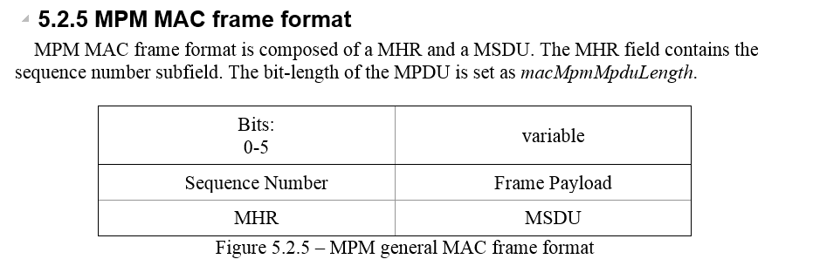
doc.: IEEE 802.15-17- 0287 -00-007a
Panasonic’s PHY header subfield was moved to MAC layer
(16-365r1)
8.6.7.4.2 Packet PWM/PPM PSDU PHY Payload field
PSDU PHY Payload field contains packet address bits, data bits, and a stop bit.
Nov-2016
(17-022r1)
March-2017
From our understanding, current “sequence number” serves the same purpose as the previous “packet header”
This confuses me, because the MHR subfield (belonging to MAC layer) is used for the purpose that should be done in the PHY layer!
Submission

Slide 12
doc.: IEEE 802.15-17- 0287 -00-007a
Suggesting A solution…
Submission

Slide 13
doc.: IEEE 802.15-17- 0287 -00-007a
We suggest that Sequence Number should be a subfield of PHR
variable
Frame Payload
MSDU
Panasonic’s
MAC frame format
macMpmMpduLength
Bits: 0-5 | variable
Sequence Number | Frame Payload
PHR | PPDU
Panasonic’s
PHY frame format
phyMpmSnLength
Panasonic’s MHR should be PHR instead.
The flowchart to determine bit-length of the sequence number subfield does not change. Just replace the prefix mac to phy.
for example: macMpmSnLength -> phyMpmSnLength
Submission

Slide 14
doc.: IEEE 802.15-17- 0287 -00-007a
More description of Sequence Number needed
The proposal from Panasonic lacks the details on how “sequence number” works. This is the reason why it confuses us between PHY and MAC frame format.
From my understanding, it is clear that Panasonic’s “sequence number” should belong to PHY.
Submission

Slide 15
Submission

Slide 16
doc.: IEEE 802.15-17- 0287 -00-007a
Appendix:
Kookmin’s PHY configurations
Submission

Slide 17
doc.: IEEE 802.15-17- 0287 -00-007a
PHY modes Configuration
  Different OCC PHY operating modes shall be configured via PHY PIB attributes
Attribute | Identifier | Type | Range | Description
phyOccMcsID | - | Int. | 0-TBD | This attribute specifies the OCC modulation. 0: S2-PSK 1: S8-PSK 2: HS-PSK 3: C-OOK 4: CM-FSK 5: A-QL 6: Hidden A-QL (HA-QL) 7-TBD: Reserved
phyOccOpticalClockRate | - | Int. | 0-15 | The optical clock rate (or symbol rate) applied for S2-PSK, S8-PSK, CM-FSK, and screen modulations (A-QL, and HA-QL); C-OOK; and DSM-PSK modulations respectively. 0-3: 5 Hz/10 Hz/15 Hz/20 Hz 4-5: 2.2 kHz/ 4.4 kHz 6-7: 10 kHz/ 50 kHz 8-15: Reserved
phyOccDim | - | Int. | 0-1000 | Refer to phyDim (0x02 Identifier), IEEE 802.15.7-2011 std. OCC dimming is configured in steps of TBD %.
Submission

Slide 18
doc.: IEEE 802.15-17- 0287 -00-007a
PHY modes Configuration
Attribute | Identifier | Type | Range | Description
phyOccRLLCode | - | Int. | 0-7 | This specifies the RLL coding corresponding to the specific OCC modulation: In case of S2-PSK modulation, the RLL coding is 0: None 1: Differential code ½ rate In case of S8-PSK modulation, the RLL coding is 0: None 1: 3 bits Grey code In case of HS-PSK, the RLL coding is 0: None 1: 1/2 code rate for S2-PSK and none for DS8-PSK In case of C-OOK modulation, the RLL coding is 0: Manchester 1: 4B6B coding In case of CM-FSK modulation, the RLL coding is 0: None In case of A-QL modulation, the RLL coding is 0: None In case of HA-QL modulation, the RLL coding is 0: None 1: Differential ½ code Other values: Reserved
Submission

Slide 19
doc.: IEEE 802.15-17- 0287 -00-007a
PHY modes Configuration
Attribute | Identifier | Type | Range | Description
phyOccFec | - | Int. | 0-7 | This attribute specifies FEC corresponding to the specific OCC modulation: In case of S2-PSK modulation, 0: None In case of S8-PSK modulation, 0: None In case of HS-PSK modulation, 0: None for both S2-PSK and DS8-PSK 1: None for S2-PSK and RS (15, 11) for DS8-PSK In case of C-OOK modulation, 0: Temporal repeating code DS rate=100 1: Temporal repeating code DS rate=60 In case of CM-FSK modulation, 0: None In case of A-QL modulation, 0: None 1: Hamming (11,15) In case of HA-QL modulation, 0: None 1: Hamming (11,15) Other values: Reserved
Submission

Slide 20
doc.: IEEE 802.15-17- 0287 -00-007a
C-OOK Configuration
Attribute | Identifier | Type | Range | Description
phyCookDSrate | - | Int. | 0-7 | This attribute specifies the data sub-frame rate (DS rate) of C-OOK. 0: 60 DS/sec 1: 100 DS/sec 2-7: Reserved
phyCookSFsymbol | - | Int. | 0-7 | This attribute specifies the SF symbol of PSDU of C-OOK. 0: 6B symbol 1: 10B symbol 2-3: Reserved
phyCookAb | - | Int. | 0-3 | This attribute specifies the amount of Asynchronous bit (Ab) per data sub-frame of C-OOK. 0: 1 bit 1: 2 bit 2-3: Reserved
The length of PSDU for C-OOK and CM-FSK is variable that is determined from a preamble to the next preamble. Thus no configuration is needed for PSDU length.
Submission

Slide 21
doc.: IEEE 802.15-17- 0287 -00-007a
CM-FSK Configuration
Attribute | Identifier | Type | Range | Description
phyCmfskNoFrequency | - | Int. | 0-3 | This attribute specifies the number of frequencies used to modulate data in CM-FSK. 0: 32-FSK 1: 64-FSK 2-3: Reserved
phyCmfskFrequencySeparation | - | Int. | 0-7 | This attribute specifies the frequency separation in CM-FSK. 0: 50 Hz 1: 100 Hz 2-7: Reserved
phyCmfskNoPhase | - | Int. | 0-3 | This attribute specifies the number of phases used to modulate data in CM-FSK. 0: None 1: 2-PSK 2-3: Reserved
phyCmfskPreamble1 | - | Int. | 0-3 | This attribute specifies the frequency value of the first preamble in CM-FSK. 0: 200Hz 1-3: Reserved
phyCmfskSplitterEnable | - | Boolean | T/F | This attribute enables whether the splitter usage in between frequency symbols in CM-FSK. FALSE: Disable TRUE: Enable
phyCmfskAb | - | Int. | 0-3 | This attribute specifies the amount of Asynchronous bit (Ab) per data sub-frame of CM-FSK. 0: 1 bit 1-3: Reserved
Submission

