Slide 1
Project: IEEE P802.15 Working Group for Wireless Personal Area Networks (WPANs)
Submission Title: [Random access and mobility procedure for high-speed train communication systems]
Date Submitted: [10 May, 2017]
Source: [Bing Hui, Junhyeong Kim, Gosan Noh, Hee-Sang Chung, and IlGyu Kim] Company [ETRI]
Address [218 Gajeong-ro, Yuseong-gu, Daejeon, 34129, KOREA]
Voice:[+82-42-860-5324], FAX: [+82-42-860-6732], E-Mail:[huibing@etri.re.kr]
Abstract: []
Purpose: [For discussion]
Notice: This document has been prepared to assist the IEEE P802.15. It is offered as a basis for discussion and is not binding on the contributing individual(s) or organization(s). The material in this document is subject to change in form and content after further study. The contributor(s) reserve(s) the right to add, amend or withdraw material contained herein.
Release: The contributor acknowledges and accepts that this contribution becomes the property of IEEE and may be made publicly available by P802.15.

Slide 2
Random Access and Mobility Procedure for High-Speed Train Communication Systems

Slide 3
Outline
HST Network Deployment & Observations
Random Access Procedure for HST Communications
Mobility Measurement for HST Communications
Handover Strategies
Discussions

Slide 4
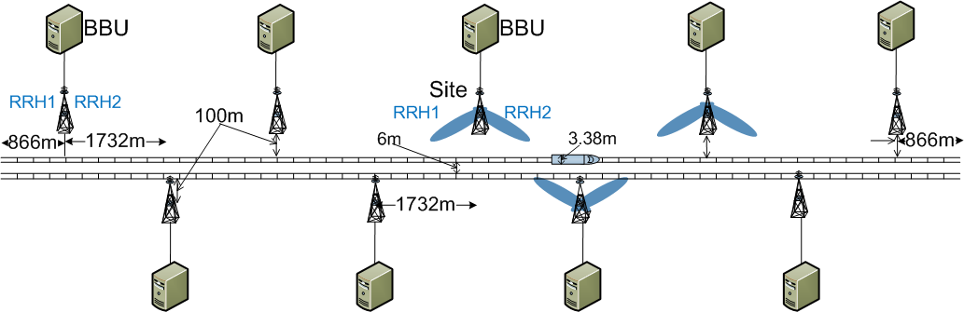
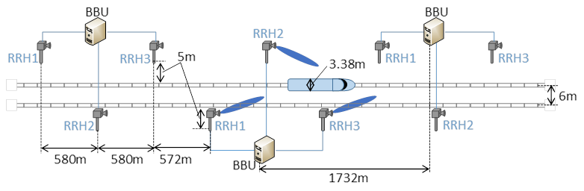
HST Network Deployment & Observations
HST Network Deployment
  Up to 500 km/h mobility is included in eMBB use case for 5G.
  NR employs both below 6 GHz and above 6 GHz frequency band
  Directional network deployment with onboard relay has been approved.
Fig. Cell layout for High Speed Train (4GHz)
Fig. Cell layout for High Speed Train (30GHz)

Slide 5
HST Network Deployment & Observations
Observations
  Severe radio link failure (RLF) rate in directional network deployment
    UE (onboard relay) is always attempting to handover from a source cell with strong received power to a target cell with weak received power
    UE (onboard relay) cannot report the target cell to the source cell or receive a handover command

Slide 6
HST Network Deployment & Observations
Handover Zone by Huawei
Figure A.1-1: Handover zone created by overlapping coverage between SFN cell group C1 and SFN cell group C2. Note that the RRHs can be co-located although illustrated as separate sites.1

Slide 7
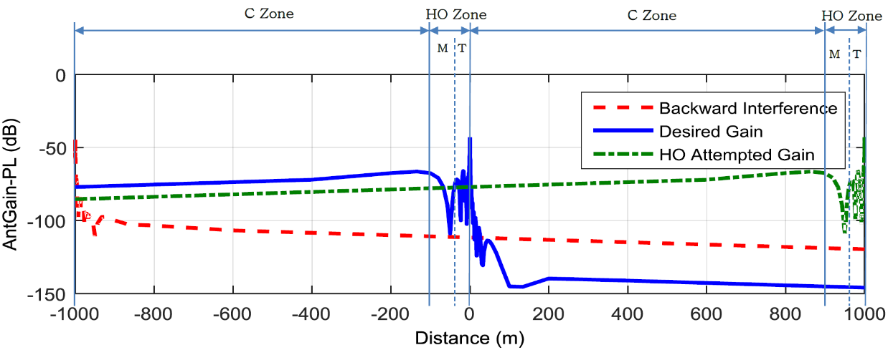
HST Network Deployment & Observations
Handover Zone by ETRI
  Without artificially created handover zone (overlapped area), the nature of antenna pattern can be used as handover zone.
    Directional antenna & free space path loss model [ITU-R]

Slide 8
RA Procedure for HST Communications
Observations
  Contention-free RA in most of the cases
  Conventional HO cannot work efficiently
  1 active onboard relay mostly during communication
    No need of timing advance (TA)
Proposal
  2-step RA procedure for both IDLE & CONNECTED Modes
    Msg 1: request to send + relay ID
    Msg 2: RA response
    Msg. 3 & 4: Omitted since no need for contention resolution

Slide 9
Mobility Measurement for HST Communications
IDLE Mode Measurement
  Synchronization signal (SS)
  Demodulation reference signal (DMRS) for physical broadcast channel (PBCH)
CONNECTED Mode Measurement
  Wideband channel state information reference signal (CSI-RS)

Slide 10
Handover Strategies
Handover Triggers
  Option 1: Network makes handover decision (conventional hard handover)
  Option 2: Onboard relay makes network access decision based on DL measurement (instead of handover)

Slide 11
Handover Strategies
Handover Strategies
  Strategy 1: conventional hard handover
    CONNECTED mode mobility measurement
    Information exchange within handover zone
  Strategy 2: network re-access instead of handover
    IDLE mode mobility measurement

Slide 12
Discussions
Current discussions within the scope of single-beam system
How about multi-beam system?

