Slide 1
Project: IEEE P802.15 Working Group for Wireless Personal Area Networks (WPANs)
Submission Title: Vehicle HUD-Signage based CamCom application
Date Submitted: May 2017
Source: Jaesang Cha, Vinayagam Mariappan(SNUST), Sinyou Hong(SNUST), Jong Hyeok Lee (SNUST), Byungjun Min (Head IT Co.,Ltd.),Juphil Cho (Kunsan Nat’ Univ.), Daehyun Kim (Namuga Co., Ltd), Jaekwon Shin, Jintae Kim (Fivetek Co., Ltd)
Address: Contact Information: +82-2-970-6431, FAX: +82-2-970-6123, E-Mail: chajs@seoultech.ac.kr Re:
Abstract: This documents introduce the Vehicle HUD-Signage based CamCom application for Vehicular Assistant Technology (VAT). This proposed VAT using Image Sensor Communication to operate on the application services like ITS, HUD Signage, ADAS, IoT/IoL, LED IT, Smart Signage with Advertisement Information etc.
Purpose: To Provided Concept models of Vehicle CamCom for Vehicular Assistant Technology (VAT) Interest Group
Notice: This document has been prepared to assist the IEEE P802.15. It is offered as a basis for discussion and is not binding on the contributing individual(s) or organization(s). The material in this document is subject to change in form and content after further study. The contributor(s) reserve(s) the right to add, amend or withdraw material contained herein.
Release: The contributor acknowledges and accepts that this contribution becomes the property of IEEE and may be made publicly available by P802.15.
Slide 1

Slide 2
Contents
Vehicle HUD-Signage based CamCom application
Conclusion

Slide 3
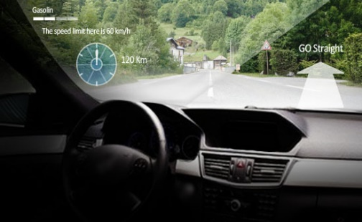
Vehicle HUD-Signage based CamCom application
Vehicle HUD, Appearance Signage– CamCom Link
Vehicle HUD Signage based CamCom application
  Vehicle HUD (+ AR / MR, etc.)
  Real-time HUD signage installed on the exterior of vehicle
  Window signage uses Visible or Invisible mode of data transmission
  Signage Tx Transmits
    Vehicle Speed, Location to Travel, and Vehicle Specific Informations
    Location and Route Informations
    Real-Time Traffic Informations
    Digital Advertisement
Advantages
  Safety Travelers Informative Assistance
  Real-time Information Sharing
  Guides to easy ITS Integration and Connectivity
  Provides Mobile Network Connectivity Infrastructure

Slide 4
Conclusion
Proposed the Vehicle HUD-Signage Signage For CamCom System Link Technology Application Use Case Model
User Assistive use of HUD display to CamCom Technology
CamCom guarantees data communication from Mobile Infrastructure-to-Vehicle, broadcasting many traveling related information, hence suitable for traveler safety applications.

