Slide 1
Project: IEEE P802.15 Working Group for Wireless Personal Area Networks (WPANs)
Submission Title: Tollgates FrontVIEW Smart Signage For Advanced Driver Assistance CamCom System
Date Submitted: May 2017
Source: Jaesang Cha(SNUST), Vinayagam Mariappan(SNUST), Sinyou Hong(SNUST), Jong Hyeok Lee (SNUST), Daehyun Kim (Namuga Co., Ltd), Jaekwon Shin, Jintae Kim (Fivetek Co., Ltd)
Address: Contact Information: +82-2-970-6431, FAX: +82-2-970-6123, E-Mail: chajs@seoultech.ac.kr Re:
Abstract: This documents introduce the Advanced Driver Assistance System (ADAS) using FrontVIEW Smart Signage System with Vehicle CamCom Concept models. This proposed VAT using Image Sensor Communication to operate on the application services like ITS, ADAS, IoT/IoL, LED IT, Digital Signage with Advertisement Information etc.
Purpose: To Provided Concept models of Vehicle CamCom for Vehicular Assistant Technology (VAT) Interest Group
Notice: This document has been prepared to assist the IEEE P802.15. It is offered as a basis for discussion and is not binding on the contributing individual(s) or organization(s). The material in this document is subject to change in form and content after further study. The contributor(s) reserve(s) the right to add, amend or withdraw material contained herein.
Release: The contributor acknowledges and accepts that this contribution becomes the property of IEEE and may be made publicly available by P802.15.
Slide 1

Slide 2
Contents
Tollgate Signage Display
FrontVIEW Signage-CamCom Link for Tollgates
Conclusion

Slide 3
Tollgate Signage Display
Tollgates Signage and Heavy Vehicles on tollgates obscure the frontal view for followed Vehicles
Leads to crashes when drivers attempt to pass the automatic tollgate when overtake long heavy vehicles
Tollgate FrontVIEW Signage Display
FrontVIEW Signage Display surface in the entry point of the Tollgate
FrontVIEW Signage Display the Forward View of Road Condition from tollgate front side installed Camera
Instead of obscuring most of the view, it actually shows the driver what’s going on ahead of the forward direction in the tollgate
Aims to reduce crashes when drivers attempt to pass automatic tollgates on roadways
Integrated With:
Day/Night Clear Forward View of tollgates
Wireless Video Feeds to Display Screens
High Resolution Display Screens
HD, Full HD, UHD
Dual Mode Use
Digital Signage Advertisement
Road Safety – Driver Assistance

Slide 4
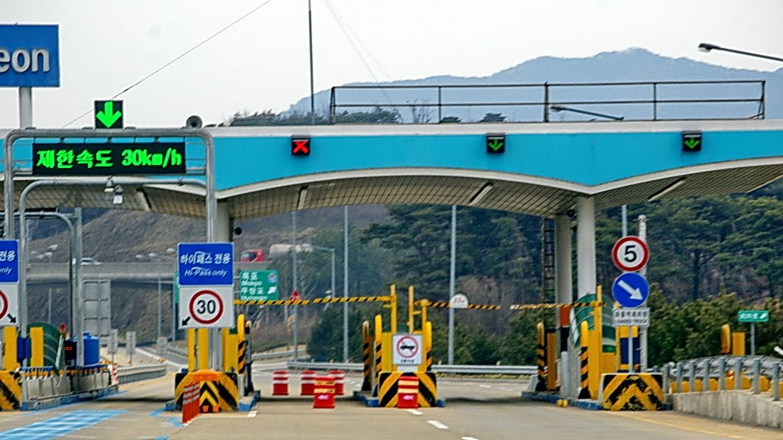
FrontVIEW Signage-CamCom Link for Tollgates
V2I FrontVIEW Signage Display – CamCom Link
V2I CamCom Link between FrontVIEW Signage Display and Tollgate entry Vehicle Front View Camera
FrontVIEW Signage display used to display the tollgate entry vehicle front roadway view as well as display based CamCom Tx
FrontVIEW Signage uses Visible or Invisible mode of data transmission
Tollgate Entry Vehicle Front view camera work as Rx
Signage Tx Transmits
Vehicle Speed, Location to Travel, and Vehicle Specific Informations
Location Informations
Real-Time Traffic Informations
Digital Advertisement
Provide high end driving assistance to the following vehicle and ensures roadway safety
Provides Mobile Network Connectivity Infrastructure
Advantages
Safety Driver Assistance
Real-time Information Sharing
Guides to easy ITS Integration and Connectivity

Slide 5
Conclusion
Proposed the Tollgate FrontVIEW Signage-CamCom Link Technology
Driver Assistive Safety Drive use of Signage to CamCom Technology
CamCom guarantees data communication from Mobile Infrastructure-to-Vehicle, broadcasting many safety related information, hence suitable for road safety applications.
Easy Integration support with ITS using Mobile Infrastructure Technology
Novel road safety system and directly related to human and material safety

