Slide 1
Project: IEEE P802.15 Working Group for Wireless Personal Area Networks (WPANs)
Submission Title: Smart Vehicle Informative Window Signage based CamCom Application
Date Submitted: May 2017
Source: Jaesang Cha, Vinayagam Mariappan(SNUST), Sinyou Hong(SNUST), Jong Hyeok Lee (SNUST), Byungjun Min (Head IT Co.,Ltd.), Juphil Cho (Kunsan Nat’ Univ.), Daehyun Kim (Namuga Co., Ltd), Jaekwon Shin, Jintae Kim (Fivetek Co., Ltd)
Address: Contact Information: +82-2-970-6431, FAX: +82-2-970-6123, E-Mail: chajs@seoultech.ac.kr Re:
Abstract: This documents introduce the Advanced Travelers Assistive Smart Vehicle Informative Signage CamCom Concept models for Vehicular Assistant Technology (VAT). This proposed VAT using Image Sensor Communication to operate on the application services like ITS, ADAS, IoT/IoL, LED IT, Digital Signage with Advertisement Information etc.
Purpose: To Provided Concept models of Vehicle CamCom for Vehicular Assistant Technology (VAT) Interest Group
Notice: This document has been prepared to assist the IEEE P802.15. It is offered as a basis for discussion and is not binding on the contributing individual(s) or organization(s). The material in this document is subject to change in form and content after further study. The contributor(s) reserve(s) the right to add, amend or withdraw material contained herein.
Release: The contributor acknowledges and accepts that this contribution becomes the property of IEEE and may be made publicly available by P802.15.
Slide 1

Slide 2
Contents
Smart Vehicle Informative Window Signage based CamCom Application
Conclusion

Slide 3
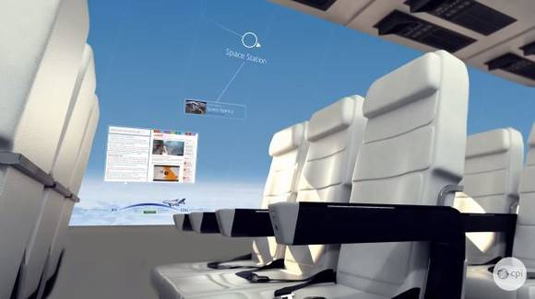
Smart Vehicle Informative Window Signage based CamCom Application
Vehicle Window Smart Appearance Signage– CamCom Link
Smart Vehicle Informative Window Signage
Vehicle Window Smart Signage
Real-time signage installed on the exterior of vehicle
Window signage uses Visible or Invisible mode of data transmission
Following Vehicle Front view camera or User Smart device work as Rx
Signage Tx Transmits
Vehicle Speed, Location to Travel, and Vehicle Specific Informations
Location and Route Informations
Real-Time Traffic Informations
Digital Advertisement
Advantages
Safety Travelers Informative Assistance
Real-time Information Sharing
Guides to easy ITS Integration and Connectivity
Provides Mobile Network Connectivity Infrastructure

Slide 4
Conclusion
Proposed the Smart Vehicle Informative Window Signage For Advanced Travelers Assistive CamCom System Link Technology
Traveler Assistive use of display to CamCom Technology

