Slide 1
Project: IEEE P802.15 Working Group for Wireless Personal Area Networks (WPANs)
Submission Title: Onroad Heavy Vehicle based Rear Signage-CamCom Application
Date Submitted: May 2017
Source: Jaesang Cha(SNUST), Vinayagam Mariappan (SNUST), Sinyou Hong(SNUST), Jong Hyeok Lee (SNUST), Chunseop Kim (QUBER Co.,Ltd), Jaekwon Shin, Jintae Kim (Fivetek Co., Ltd), Daehyun Kim, Dongwoo Lee (Namuga Co., Ltd), JinYoung Kim(Kwangwoon Univ.), SangWoon Lee(Nam Seoul Univ.)
Address: Contact Information: +82-2-970-6431, FAX: +82-2-970-6123, E-Mail: chajs@seoultech.ac.kr Re:
Abstract: This documents introduce the Advanced Driver Assistance System (ADAS) using V Onroad Heavy Vehicle Rear Signage-CamCom Links for Vehicular Assistant Technology (VAT). This proposed VAT using Image Sensor Communication to operate on the application services like ITS, ADAS, IoT/IoL, LED IT, Digital Signage with Advertisement Information etc.
Purpose: To Provided Concept models of Vehicle CamCom for Vehicular Assistant Technology (VAT) Interest Group
Notice: This document has been prepared to assist the IEEE P802.15. It is offered as a basis for discussion and is not binding on the contributing individual(s) or organization(s). The material in this document is subject to change in form and content after further study. The contributor(s) reserve(s) the right to add, amend or withdraw material contained herein.
Release: The contributor acknowledges and accepts that this contribution becomes the property of IEEE and may be made publicly available by P802.15.
Slide 1

Slide 2
Contents
Heavy Vehicle based Smart Signage Application
Vehicle Rear Signage-CamCom Link for Driving Assistance
Vehicle Rear Signage-CamCom Link Implementation
Conclusion

Slide 3
Heavy Vehicle based Smart Signage Application
Onroad Heavy Vehicle obscure the frontal view for followed Vehicles
Leads to crashes when drivers attempt to overtake long heavy vehicles
Onroad Rear Signage Display
Signage Display back surface of the Heavy Vehicle
Display the Forward Camera View of Road Condition
Instead of obscuring most of the view, it actually shows the driver what’s going on ahead of the forward driving Heavy Vehicle
Aims to reduce crashes when drivers attempt to overtake long vehicles on one-way roads
Integrated With:
Day/Night Forward/Front View Camera
Wireless Video Feeds to Display Screens
High Resolution Display Screens
HD, Full HD, UHD
Dual Mode Use
Smart Signage Advertisement
Road Safety – Driver Assistance
Note : Modified from https://news.samsung.com/global/the-safety-truck-could-revolutionize-road-safety

Slide 4
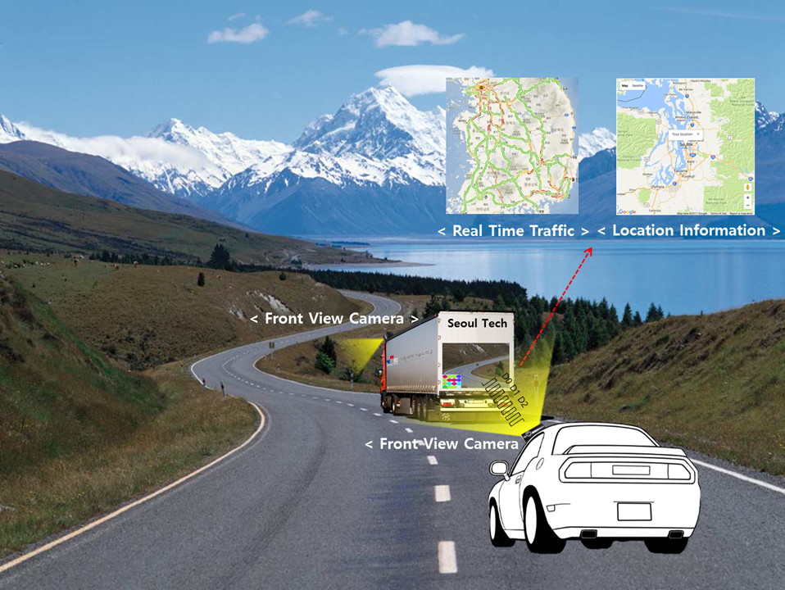
Vehicle Rear Signage-CamCom Link for Driving Assistance
V2V Signage – CamCom Link
V2V CamCom Link between Heavy Vehicle Rear Signage Display and Following Vehicle Front View Camera
Rear signage display used for leading vehicle front roadway view as well as display based CamCom Tx
Following Vehicle Front view camera work as Rx
Signage Tx Transmits
Vehicle Speed, Location to Travel, and Vehicle Specific Informations
Location Informations
Real-Time Traffic Informations
Digital Advertisement
Advantages
Safety Driver Assistance
Real-time Information Sharing
Guides to easy ITS Integration and Connectivity

Slide 5
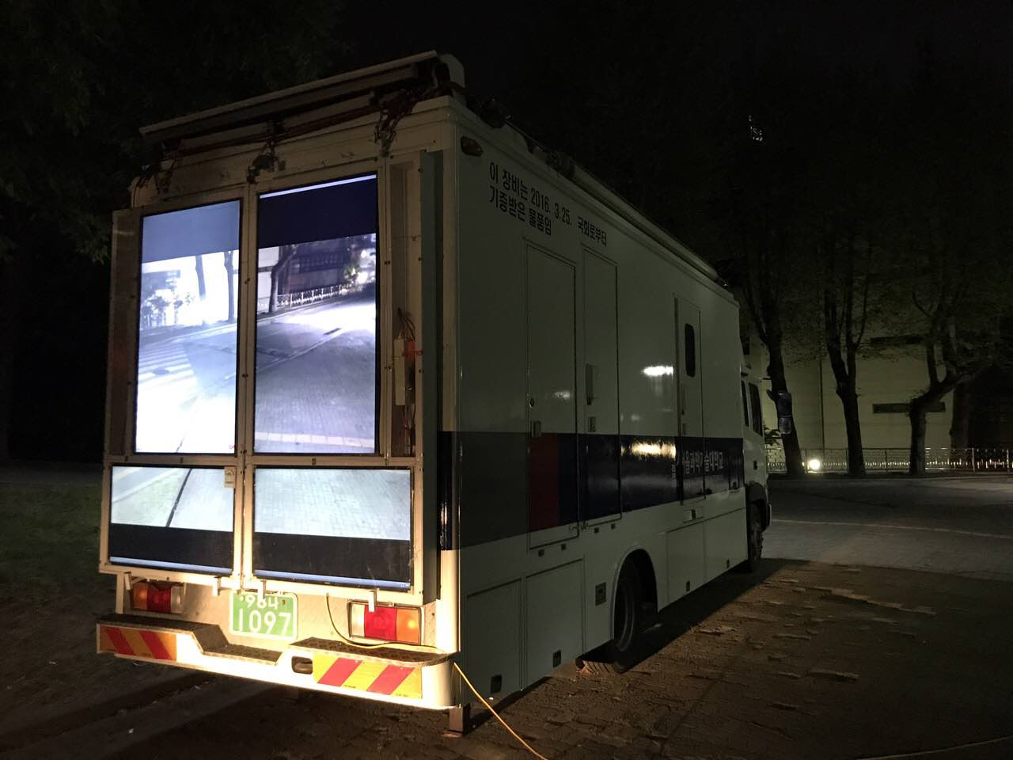
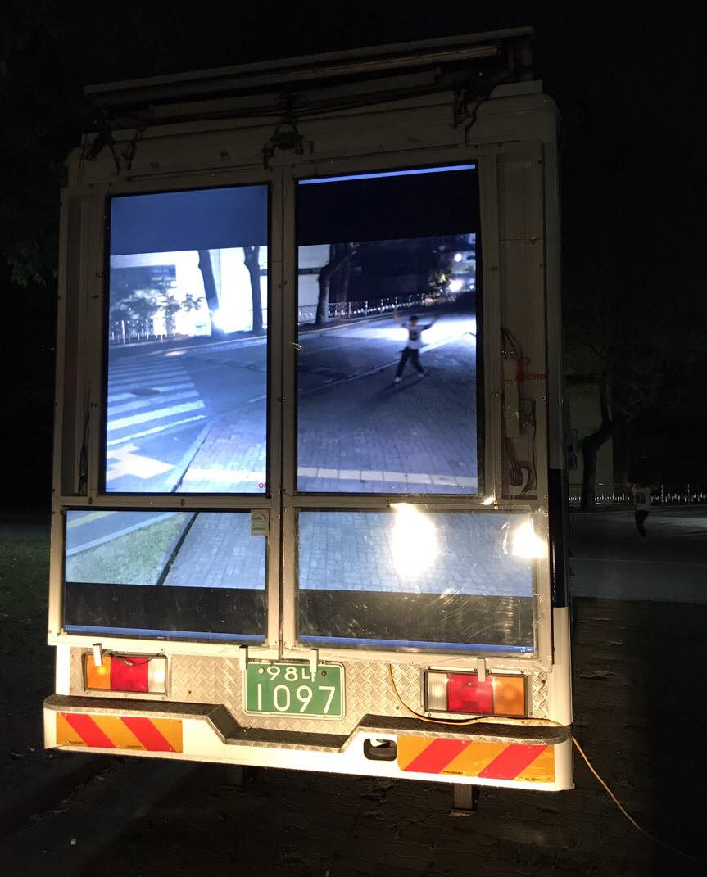
Vehicle Rear Signage-CamCom Link Implementation
V2V 4xUHD Signage – CamCom Link
V2V CamCom Link between Heavy Vehicle Rear Smart Signage-CamCom designed
Using 4 X UHD Signage Panel and Flexible IoT (F-IoT) Module Interface with HD/4K Camera
Rear signage uses Visible or Invisible mode of data transmission
Provide high end driving assistance to the following vehicle and ensures roadway safety
Provides Mobile Network Connectivity Infrastructure

Slide 6
Conclusion
Proposed the Heavy Vehicle Smart Signage-CamCom Technology Use Case Model
Designed with 4xUHD Signage Panel and F-IoT Modules
Driver Assistive Safety Drive use of display to CamCom Technology
Easy Integration support with ITS using Mobile Infrastructure Technology
Novel road safety system which is directly related to human and material safety

