Slide 1
Project: IEEE P802.15 Working Group for Wireless Personal Area Networks (WPANs)
Submission Title: CamCom and Control Box solutions with Metro/Subway facility Signage
Date Submitted: May 2017
Source: Jaesang Cha(SNUST), Vinayagam Mariappan(SNUST), Sinyou Hong(SNUST), Jong Hyeok Lee (SNUST), Daehyun Kim (Namuga Co., Ltd), Jaekwon Shin, Jintae Kim (Fivetek Co., Ltd)
Address: Contact Information: +82-2-970-6431, FAX: +82-2-970-6123, E-Mail: chajs@seoultech.ac.kr Re:
Abstract: This documents introduce the CamCom and Control Box solutions with Metro/Subway facility Signage for Vehicular Assistant Technology (VAT). This proposed VAT using Image Sensor Communication to operate on the application services like ITS, ADAS, IoT/IoL, LED IT, Digital Signage with Advertisement Information etc.
Purpose: To Provided Concept models of Vehicle CamCom for Vehicular Assistant Technology (VAT) Interest Group
Notice: This document has been prepared to assist the IEEE P802.15. It is offered as a basis for discussion and is not binding on the contributing individual(s) or organization(s). The material in this document is subject to change in form and content after further study. The contributor(s) reserve(s) the right to add, amend or withdraw material contained herein.
Release: The contributor acknowledges and accepts that this contribution becomes the property of IEEE and may be made publicly available by P802.15.
Slide 1

Slide 2
Contents
CamCom and Control Box solutions with Metro/Subway facility Signage
Conclusion

Slide 3
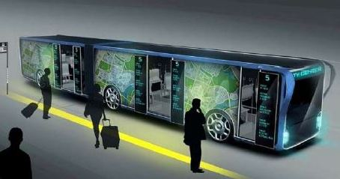
CamCom and Control Box solutions with Metro/Subway facility Signage
Metro/Subway facility Signage – CamCom Link
Metro/Subway facility Signage
  Metro/Subway Vehicle Smart Signage
  Real-time signage installed on the exterior of vehicle
  Metro/Subway Window signage uses Visible or Invisible mode of data transmission
  User Smart device work as Rx
  Signage Tx Transmits
    Vehicle Speed, Location to Travel, and Vehicle Specific Informations
    Location and Route Informations
    Real-Time Traffic Informations
    Digital Advertisement
Advantages
  Safety Travelers Informative Assistance
  Real-time Information Sharing
  Guides to easy ITS Integration and Connectivity
  Provides Mobile Network Connectivity Infrastructure

Slide 4
Conclusion
Proposed the CamCom and Control Box solutions with Metro/Subway facility Signage For Advanced Travelers Assistive CamCom System Link Technology
Traveler Assistive use of display to CamCom Technology

