Slide 1
doc.: IEEE 15-17-0276-00-0vat
Project: IEEE P802.15 Working Group for Wireless Personal Area Networks (WPANs)
Submission Title: Interference Characterization of Artificial Light Sources for long range OCC
Date Submitted: May 2017
Source: Amirul Islam, Md. Tanvir Hossan, and Yeong Min Jang [Kookmin University].
Contact: +82-2-910-5068 E-Mail: yjang@kookmin.ac.kr
Re:
Abstract: Application of optical wireless communication for long range V2X communication with the characterization of the artificial light sources.
Purpose: To characterize the ambient or artificial light sources for long range vehicular communication technologies
Notice: This document has been prepared to assist the IEEE P802.15. It is offered as a basis for discussion and is not binding on the contributing individual(s) or organization(s). The material in this document is subject to change in form and content after further study. The contributor(s) reserve(s) the right to add, amend or withdraw material contained herein.
Release: The contributor acknowledges and accepts that this contribution becomes the property of IEEE and may be made publicly available by P802.15.
Submission

Slide 2
Interference Characterization of Artificial Light Sources for long range OCC
doc.: IEEE 15-17-0276-00-0vat

Slide 3
Introduction
doc.: IEEE 15-17-0276-00-0vat
Expanding the ecosystem by bringing the components together from ITS, IoT, edge & cloud computing, big data and connected vehicles for cooperative ITS and cooperative mobility management.)
Camera, lasers (LIDAR), GPS for safety and innovations in advanced driver assistance systems with a connection to the cloud platform.
Mobile (smart) device integration in vehicle and transport systems can pave way for collecting the data about the vehicular environment.
Submission

Slide 4
Introduction (2)
doc.: IEEE 15-17-0276-00-0vat
Uniform mechanism for data fusion and analytics and integrating all heterogeneous elements into a standard IoT architecture for connected vehicles.
Challenges to enable an intelligent transportation system to address issues facing the transportation such as high fuel prices, high levels of CO2 emissions, increasing traffic congestion, and improved road safety, avoid accident/collision.
We may use vehicular OWC (Optical Wireless Communications) including Near IR technology for transmitting data between front or rear automotive LED light and camera such as black-box and vision camera.
Submission

Slide 5
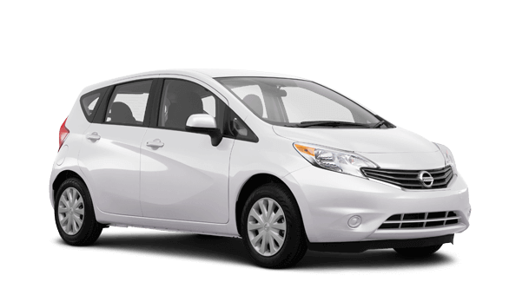
Current and future impact of emerging technologies on ITS
doc.: IEEE 15-17-0276-00-0vat
(a) Future trends of intelligent transportation systems
(b) Impact of emerging technologies on ITS
Submission

Slide 6
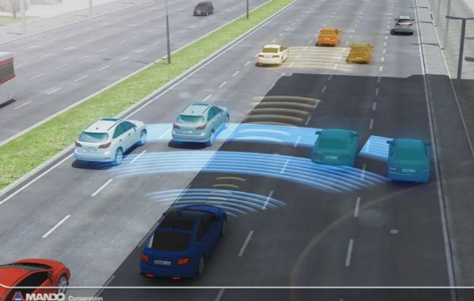
Long range OCC
doc.: IEEE 15-17-0276-00-0vat
Long range V2X communication (>100m)
precise localization to avoid accident in critical condition (1cm level)
Mobility support (e.g., >60km/h) and multiple objects detection capability
Short processing time to support real time communication and services
Affordable price to reach all customers
Submission

Slide 7
Interference Characterization of Artificial Light Sources
doc.: IEEE 15-17-0276-00-0vat
Artificial light sources such as; street lights, traffic lights, and advertising boards
lighting purposes (e.g., decoration lights, street lights, supportive light for advertising billboards)
light sources for static advertising purposes generally neon sign board (i.e., neon light)
advertising and signaling, such as e.g. LED screens, are usually driven by sophisticated controlling circuits to display various information on the screen.
Submission

Slide 8
doc.: IEEE 15-17-0276-00-0vat
Providing different device connectivity and new services
Submission

Slide 9
Benefits of the long range OCC technology
doc.: IEEE 15-17-0276-00-0vat
Cost-effective, fixed-beam optical detection with no moving parts
Narrow to wide field-of-view
Multi-segment configurations for precise multi-object detection /localization /classification
Short- to long-range capability
Reliable operation in all lighting and environmental conditions
Secure communication
Can be implemented in existing infrastructures without changing them too much
Submission

Slide 10
Motion to 802.15 Task Group
doc.: IEEE 15-17-0276-00-0vat
Recommendations
Submission

