Slide 1
Project: IEEE P802.15 Interest Group for Wireless Personal Area Networks (WPANs)
Submission Title: [IEEE 802.15 IG VAT: Using rear light for long range OCC to ensure safety issues]
Date Submitted: [May, 2017]
Source: [Md. Tanvir Hossan, Amirul Islam, and Yeong Min Jang]
Company [Kookmin University]
Address [Seoul, Korea]
Voice:[+82-2-910-5068], FAX: [+82-2-910-4449], E-Mail: [yjang@kookmin.ac.kr]
Re: []
Abstract: [Implementation optical camera communication (OCC) in transportation system to ensure the road safety]
Purpose: [Report progress to WG]
Notice: This document has been prepared to assist the IEEE P802.15. It is offered as a basis for discussion and is not binding on the contributing individual(s) or organization(s). The material in this document is subject to change in form and content after further study. The contributor(s) reserve(s) the right to add, amend or withdraw material contained herein.
Release: The contributor acknowledges and accepts that this contribution becomes the property of IEEE and may be made publicly available by P802.15.

Slide 2
IEEE 802.15 IG VAT Using rear light for long range OCC to ensure safety issues

Slide 3
Introduction
Road safety is primarily meant about the protection and security of all those who travel on roads by foot or using vehicle. Currently advanced driver assistance system (ADAS) helps the driver in the diving process and enables safe, relaxed driving. It is designed to increase vehicle safety more generally road safety

Slide 4
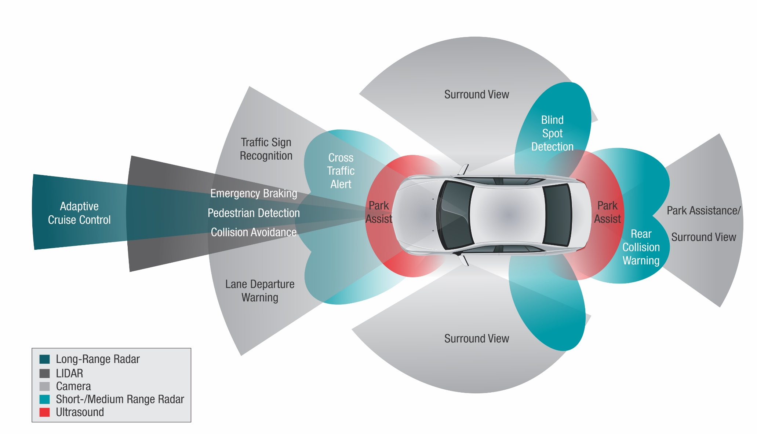
Advanced Driver Assistance Systems
Systems & subsystems on the way to fully automated highway system
Automated Vehicle Guidance

Slide 5
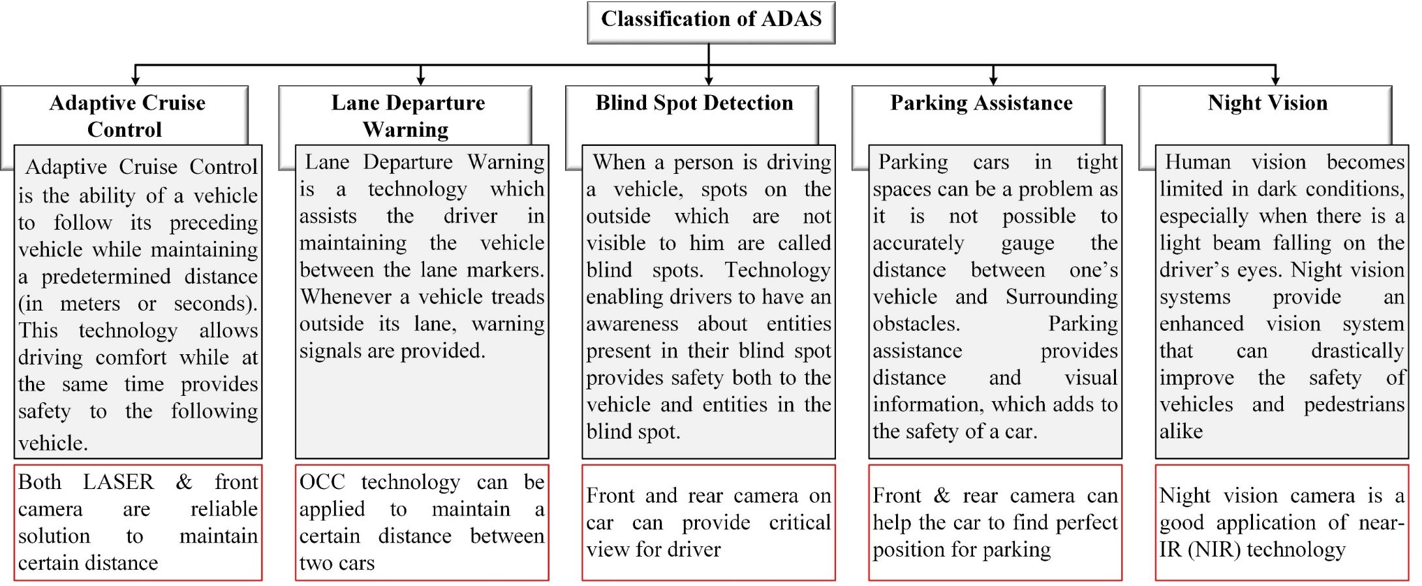
Sub-sections of ADAS

Slide 6
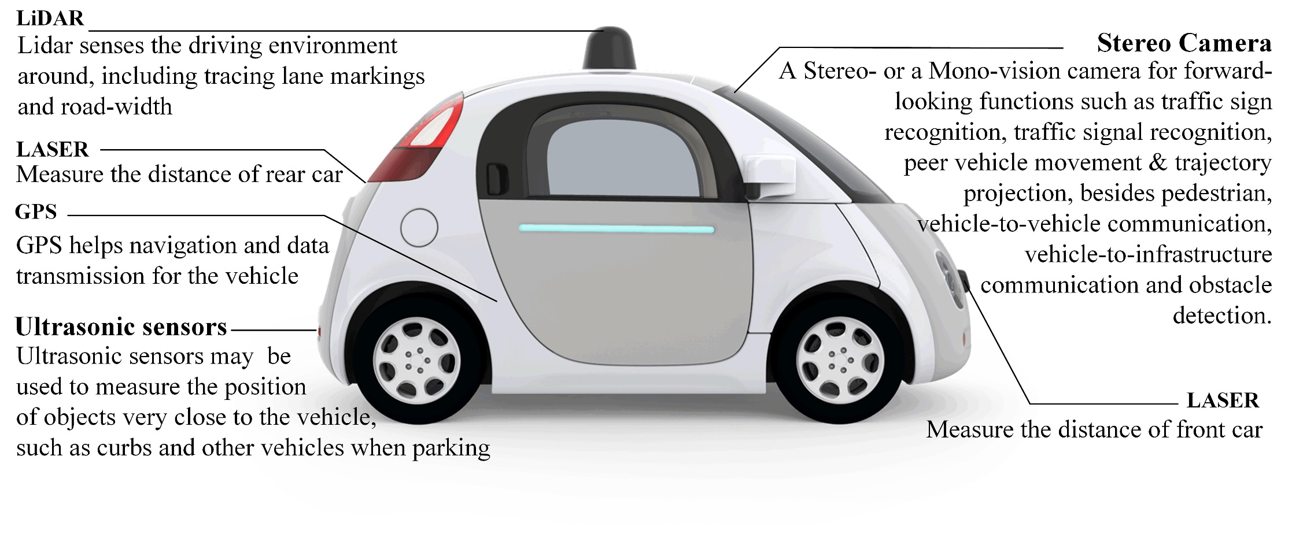
Key Technologies for Autonomous Vehicles
There are existing key technologies enabling autonomous cars

Slide 7
Principles: Control Elements
Normal Driving Situations
The driver should be able to easily and quickly override system actions at any time under normal driving situations and when crashes are avoidable
Critical Driving Situations
When the crash is determined to be unavoidable, the system can take actions to try to mitigate the crash severity
When a loss of control is determined to be unavoidable, the system can take actions to try to regain stability and control
When it determines that driver performance is impaired, the system can take actions to avoid or mitigate collisions

Slide 8
Principles: Operation Elements
For systems that control the vehicle under normal driving situations, the driver should have a means to turn it OFF manually and to keep the system in the OFF state
Drivers should be informed of the conditions that result in system activation and deactivation
Drivers should be informed of the conditions when system operation is different or is not guaranteed

Slide 9
Difference between RADAR & LiDAR
 | RADAR | LiDAR
Abbreviation | Radio detection and ranging | Light detection and ranging
System | The Transmitter of a radar system sends a radio (or microwave) pulse into the air, and part of this pulse is reflected by the objects. | Transmission and reception of a laser signal to determine the time duration
Operational principal | The time duration from transmission to reception of the signal is used to calculate the range (or distance), and the angle of reflected waves gives the altitude of the object. Additionally the speed of the object is calculated using the Doppler Effect. | With the time duration and the speed of light in the medium, an accurate distance to the point of observation can be taken.
Component | transmitter, wave guide, receiver, duplexer | LASER, Scanner and Optics, Photodetector and Receiver electronics, and Position and Navigation systems
Application | Military, marine, meteorologists, geologists, | 3d scanning (agriculture, biology, archaeology, geomatics, geography, geology, geomorphology, seismology, forestry, remote sensing, and atmospheric physics.)

Slide 10
OCC based vehicle-to-infrastructure (V2X) (1/3)
Negligible multipath fading and Doppler effects
Static channel impulse response compared with optical signal frequency
Minimum interference
Spatial separation of multiple light source in receiving plane
Simpler OCC link design than Radio Frequency (RF) channel
Due negligible multipath fading and Doppler effect
Simultaneous data communication without complicated protocol
Spatial separation of multiple light source in receiving plane
Each pixel acts as independent receiver

Slide 11
OCC based V2X (2/3)
Background noise from sun
Pixel could saturate due to high back ground noise from sun
Hence unable to receive signal
Only Line of Sight (LoS) communication is possible for V2V communication
Camera frame rates vs. vehicle speed
Unable to receive data at time interval between two frames
For low frame rate camera, vehicle will travel more distance at that interval
Hence increase tracking complexity
Also increase collision probability
Perspective distortion
Due to viewing angle and distance
Data from multiple LED may not be resolved

Slide 12
OCC based V2X (3/3)
Advantages MIMO OCC
Each pixel is an independent PD, and the sampling frequency (i.e. f_{camera}) is limited to <100 Hz for standard cameras
PD-based receiver cannot be used to separate the mixed signal. This is because a PD capture the sum of all light (i.e. intensity) and it cannot distinguish lights coming from different directions.
Imaging MIMO can be used to increase data rates, and to offer multiple access, as well as reducing the bit error rate (BER).
MIMO can improve received signal-to-noise ratio (SNR).

Slide 13
Conclusion
Automation should provide users with safe, comfortable, convenient and efficient mobility
On that platform ADAS is coming in front us
Long range OCC may provide proper solution for the ADAS system to make more safe and reliable
When the advanced driver assistance systems control or support elements of the driving task, drivers should be fully aware of the performance and limitations of those functions

