Slide 1
doc.: IEEE 15-17-0274-00-0vat
Project: IEEE P802.15 Working Group for Wireless Personal Area Networks (WPANs)
Submission Title: Performance enhancement of OCC using image sensor receiver of Camera for V2X
Date Submitted: May, 2017
Source: Chun Soo Kim [Light Telecom], Eunbi Shin [Light Telecom], Nguyen Van Phuoc [Kookmin University], Yeong Min Jang.
Contact: +82-2-910-5068 E-Mail: yjang@kookmin.ac.kr
Re:
Abstract: This document introduces a method to increase the communication distance for V2X
Purpose: To introduce an enhancement method of vehicular OCC to VAT group
Notice: This document has been prepared to assist the IEEE P802.15. It is offered as a basis for discussion and is not binding on the contributing individual(s) or organization(s). The material in this document is subject to change in form and content after further study. The contributor(s) reserve(s) the right to add, amend or withdraw material contained herein.
Release: The contributor acknowledges and accepts that this contribution becomes the property of IEEE and may be made publicly available by P802.15.
Submission

Slide 2
Contents
doc.: IEEE 15-17-0274-00-0vat
Problems with OCC based rolling shutter image sensor for vehicular
How to solve above problems by configuring parameters of image sensor
Conclusion

Slide 3
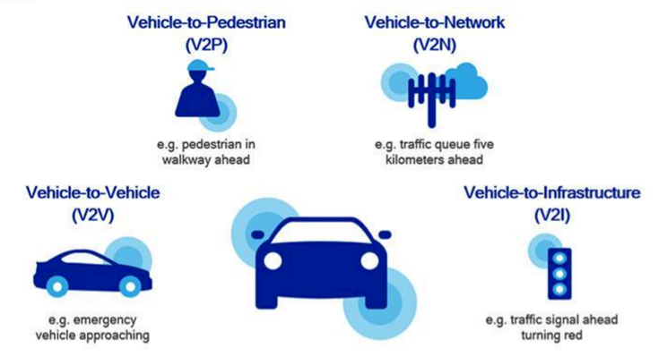
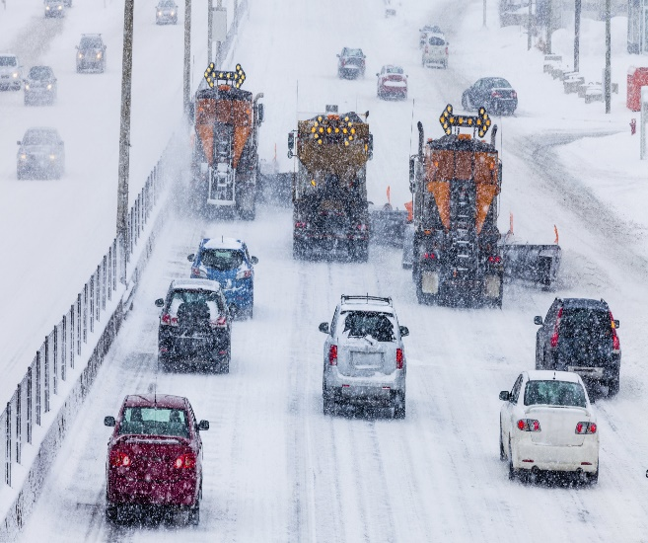
Problems with OCC based rolling shutter image sensor for vehicular
doc.: IEEE 15-17-0274-00-0vat
Vehicle has to detect everything (X) as fast as possible.
Fog, rain, snow, sunny reflection affect to the camera communication efficient so much.

Slide 4
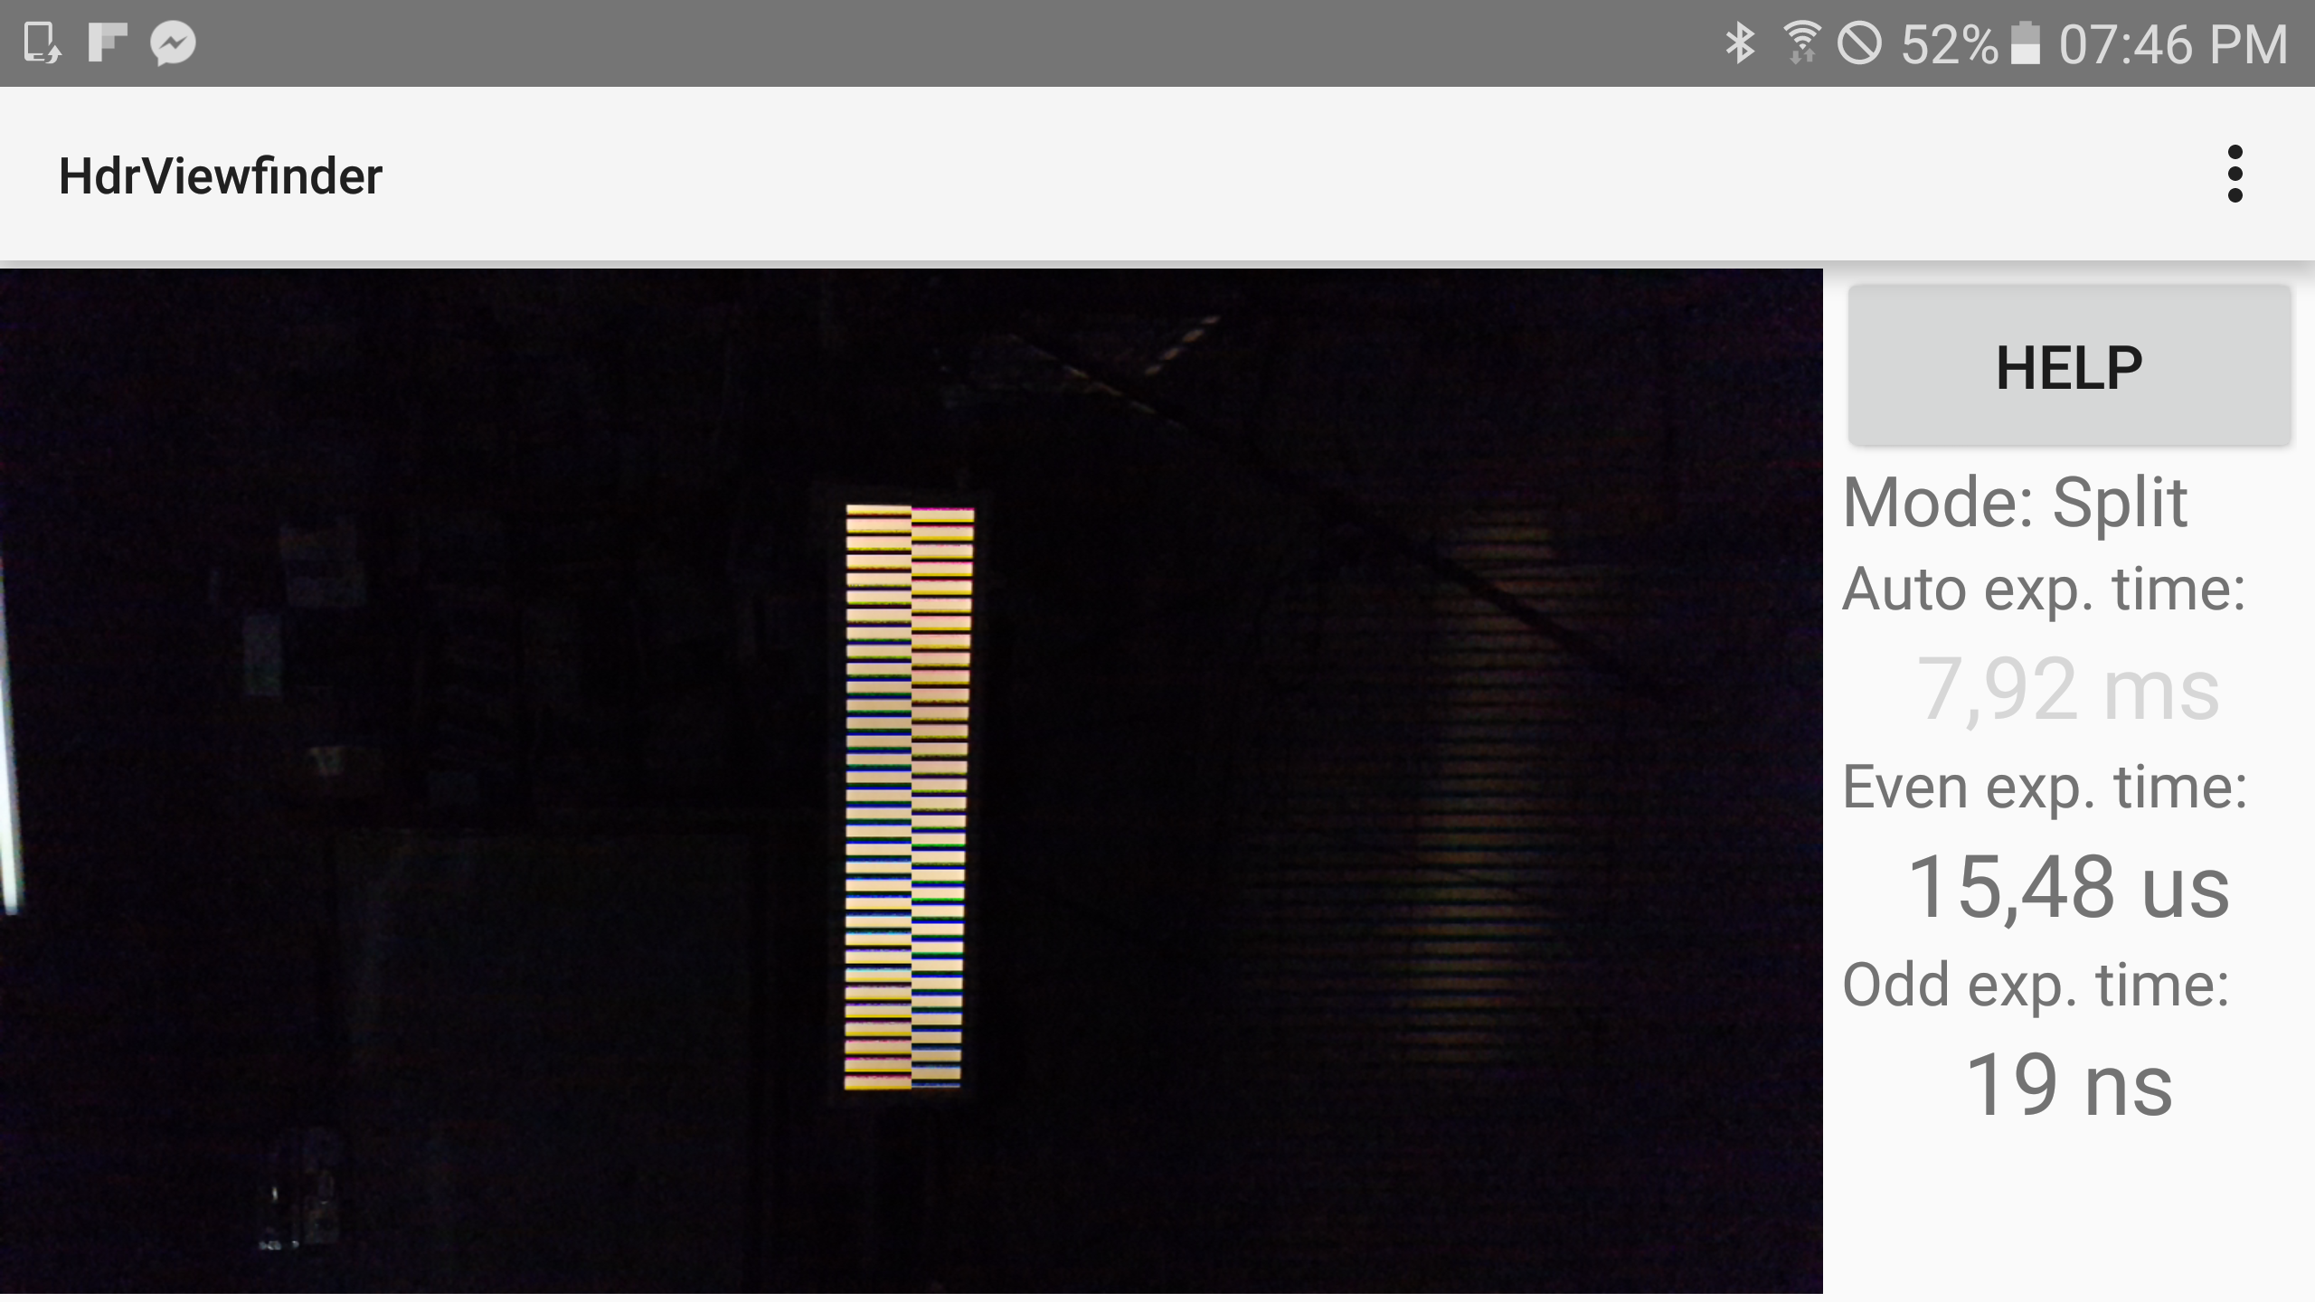
How to solve above problems by configuring parameters of image sensor
doc.: IEEE 15-17-0274-00-0vat
1. Fixed shutter speed
By configuring shutter speed of image sensor, all of the noise will be neglected because with enough small exposure time, background of the image is absolutely black except LED brightness

Slide 5
How to solve above problems by configuring parameters of image sensor
doc.: IEEE 15-17-0274-00-0vat
2. Set up image’s high resolution
In V2X, with the low resolution, we can not get the high accuracy data from X. To guarantee safety for vehicle, it will be better if we capture the image with high resolution level.
3. High frame rate
When we use high frame rate for vehicle communication, it will be so useful because with the powerful processor is embedded inside the car, we can easily get the image data without any delaying or data loss.

Slide 6
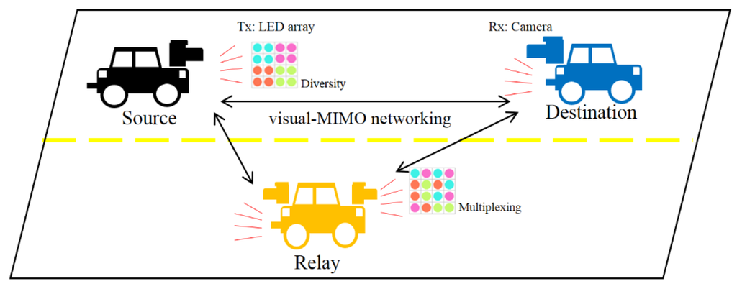
How to solve above problems by configuring parameters of image sensor
doc.: IEEE 15-17-0274-00-0vat
1. Using MIMO concept
To increase data rate, solve the obstacle of OCC and handover link recovery, we should use MIMO.

Slide 7
doc.: IEEE 15-17-0274-00-0vat
Conclusion
With rolling shutter image sensor, we can easily get the data from everything.
It will be so helpful if we set up manually parameters of image sensor because we can increase the data rate, communication distance.

