Slide 1
doc.: IEEE 15-17-0273-00-0vat
Project: IEEE P802.15 Working Group for Wireless Personal Area Networks (WPANs)
Submission Title: Cloud based OCC for long range V2X
Date Submitted: May 2017
Source: Chun Soo Kim [Light Telecom], Eunbi Shin [Light Telecom], ThanhLuan Vu [Kookmin University], Yeong Min Jang.
Contact: +82-2-910-5068 E-Mail: yjang@kookmin.ac.kr
Re:
Abstract: This document contains the output of the Vehicular Assistant Technology (VAT) Interest Group, intended to describe the use cases, requirements, and technical feasibility of Optical Wireless Communications in 802.15.
Purpose: Press release announcing confirmation of VAT IG
Notice: This document has been prepared to assist the IEEE P802.15. It is offered as a basis for discussion and is not binding on the contributing individual(s) or organization(s). The material in this document is subject to change in form and content after further study. The contributor(s) reserve(s) the right to add, amend or withdraw material contained herein.
Release: The contributor acknowledges and accepts that this contribution becomes the property of IEEE and may be made publicly available by P802.15.
Submission

Slide 2
Introduction
doc.: IEEE 15-17-0273-00-0vat
Cloud based OCC for long range V2X offers application developers and providers cloud-computing capabilities and an IT service environments at the edge of the mobile network and OCC.
This environment is characterized by:
Proximity
Ultra-low latency
High bandwidth
Real-time access to radio network information
Location awareness

Slide 3
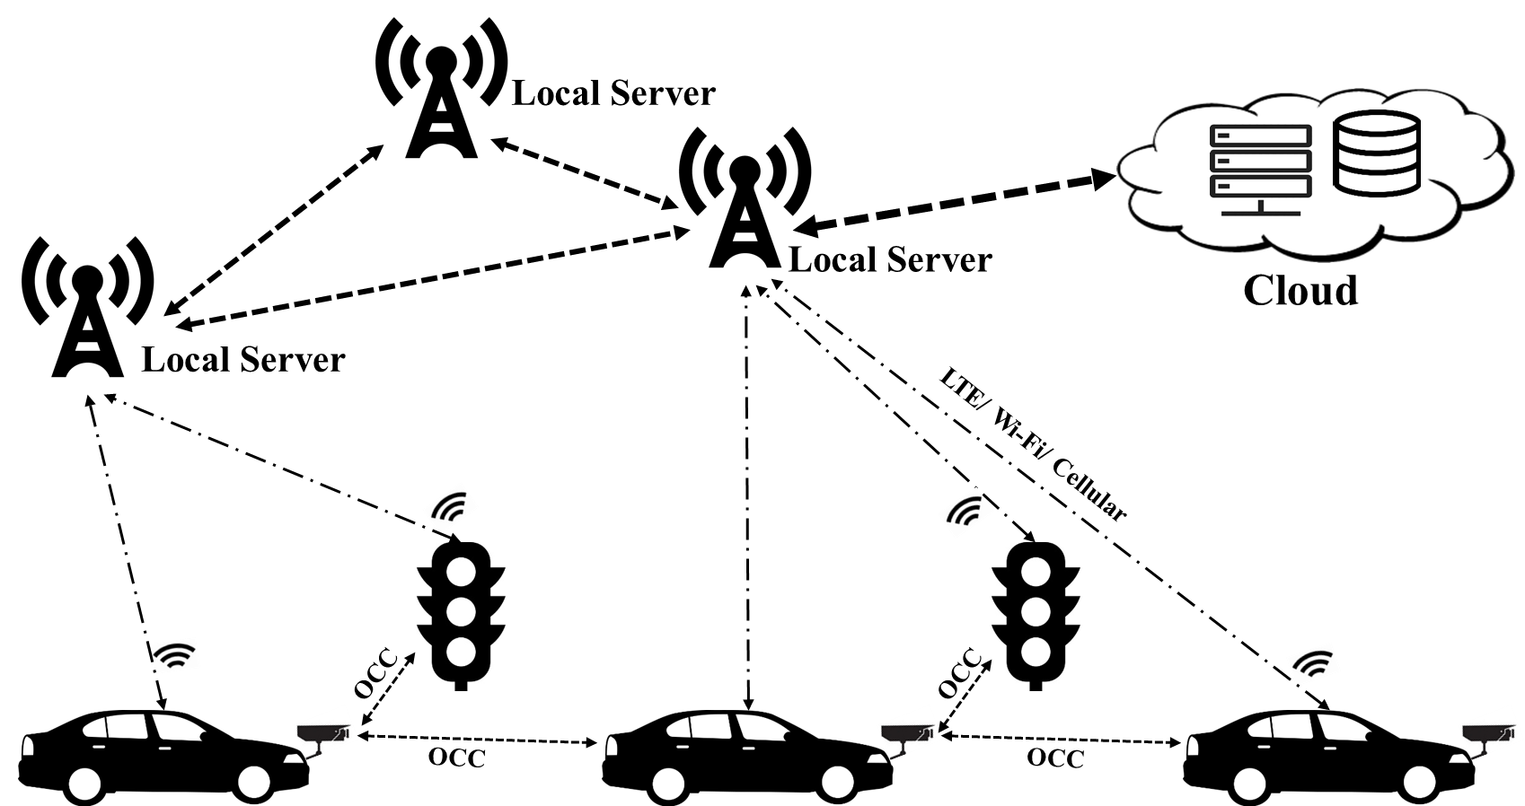
Architecture (1)
doc.: IEEE 15-17-0273-00-0vat
High level architecture of Cloud based OCC for long range V2X

Slide 4
Architecture (1)
doc.: IEEE 15-17-0273-00-0vat
V2V is about proximity, path predictionand collision anticipation/warning:
Intersection & Lane Change
Rear end
V2I is about broader road conditions:
Incidents
Alerts
V2X via location-cast is about Electronic Horizon far ahead of the vehicle:
Weather/road/traffic conditions
Incidents

Slide 5
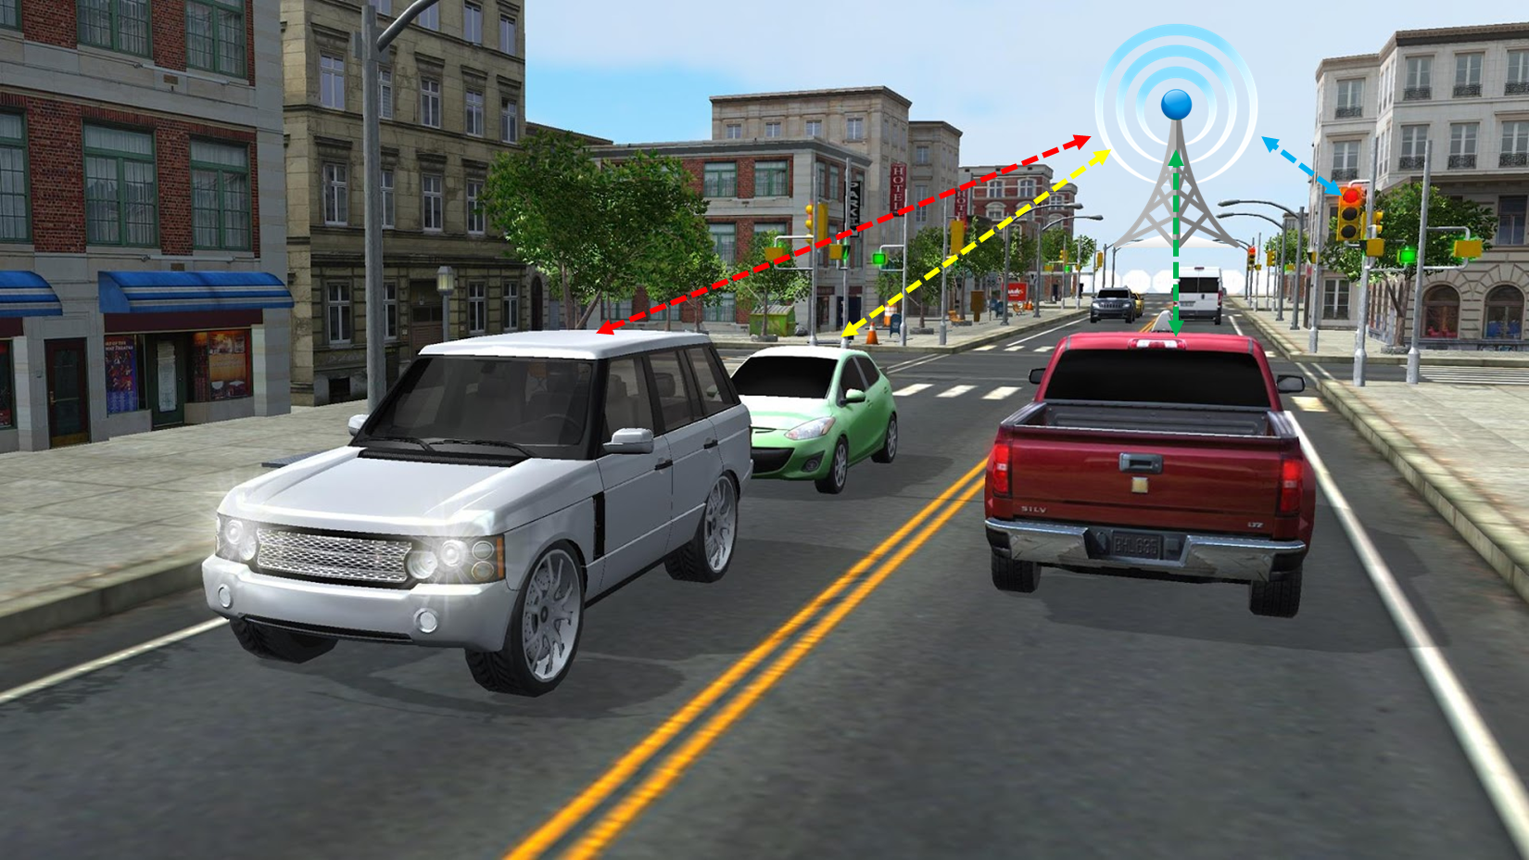
Local Server/ Base Station (1)
doc.: IEEE 15-17-0273-00-0vat
Direct communication between vehicles and as well as between vehicles and Local server over WiFi/ LTE/ Cellular

Slide 6
Local Server/ Base Station (2)
doc.: IEEE 15-17-0273-00-0vat
Mobile Edge Server to support communications between vehicles and vehicles & clouds
Vehicles can communicate with very low latency over long range distance (e.g. used for hazard warnings).

Slide 7
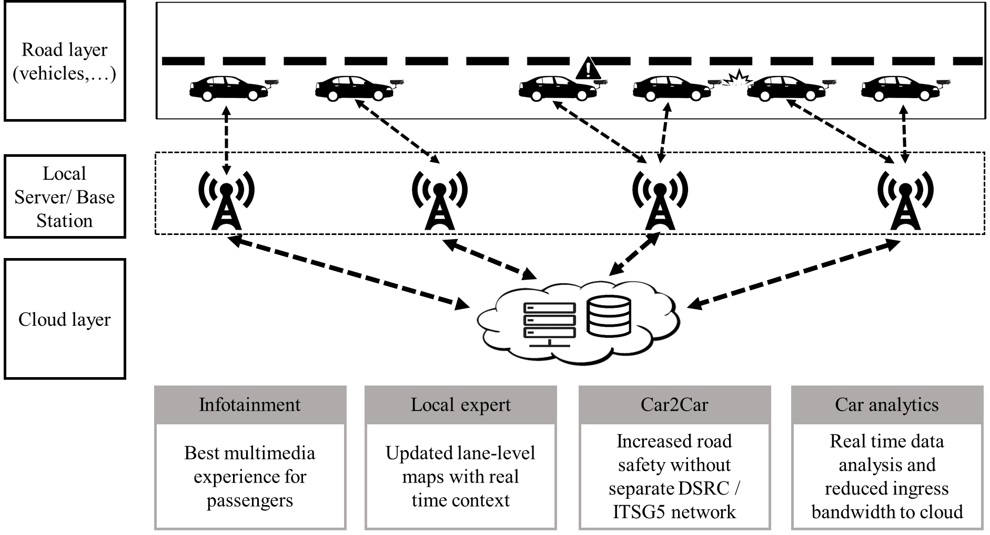
High level use cases
doc.: IEEE 15-17-0273-00-0vat
High level use cases

Slide 8
Notification use cases (1)
doc.: IEEE 15-17-0273-00-0vat
Warning of dangers ahead
Slow or stationary vehicle
Obstacle on the road
Wrong-way driver
Emergency electronic brake lights (EEBL)
Adverse weather condition

Slide 9
Notification use cases (2)
doc.: IEEE 15-17-0273-00-0vat
Monitoring of surrounding vehicles
Intersection collision warning
Longitudinal collision risk warning
Blind spot assistance

Slide 10
Motion to 802.15 Task Group
doc.: IEEE 15-17-0273-00-0vat
Recommendations

