Slide 1
Project: IEEE P802.15 Working Group for Wireless Personal Area Networks (WPANs)
Submission Title: [TG12 ULI Report for May 2017 Session]
Date Submitted: [11 May 2017]
Source: [Patrick Kinney] Company [Kinney Consulting LLC]
Address [Chicago area, IL, USA]
Voice:[+1.847.960.3715], E-Mail:[pat.kinney@ieee.org]
Source: [Charles Perkins] Company [Futurewei]
Address [Santa Clara, CA, USA]
Voice:[+1.408-330-4586], E-Mail:[charlie.perkins@huawei.com]
Re: [TG12 Report for May 2017 Session.]
Abstract: [Report for the May Session]
Purpose: [Planning and status updates for TG 802.15.12 Interim meeting during May, 2017]
Notice: This document has been prepared to assist the IEEE P802.15. It is offered as a basis for discussion and is not binding on the contributing individual(s) or organization(s). The material in this document is subject to change in form and content after further study. The contributor(s) reserve(s) the right to add, amend or withdraw material contained herein.
Release: The contributor acknowledges and accepts that this contribution becomes the property of IEEE and may be made publicly available by P802.15.

Slide 2
Instructions for the WG Chair
The IEEE-SA strongly recommends that at each WG meeting the chair or a designee:
  Show slides #1 through #4 of this presentation
  Advise the WG attendees that:
    The IEEE’s patent policy is described in Clause 6 of the IEEE-SA Standards Board Bylaws;
    Early identification of patent claims which may be essential for the use of standards under development is strongly encouraged;
    There may be Essential Patent Claims of which the IEEE is not aware. Additionally, neither the IEEE, the WG, nor the WG chair can ensure the accuracy or completeness of any assurance or whether any such assurance is, in fact, of a Patent Claim that is essential for the use of the standard under development.
  Instruct the WG Secretary to record in the minutes of the relevant WG meeting:
    That the foregoing information was provided and that slides 1 through 4 (and this slide 0, if applicable) were shown;
    That the chair or designee provided an opportunity for participants to identify patent claim(s)/patent application claim(s) and/or the holder of patent claim(s)/patent application claim(s) of which the participant is personally aware and that may be essential for the use of that standard
    Any responses that were given, specifically the patent claim(s)/patent application claim(s) and/or the holder of the patent claim(s)/patent application claim(s) that were identified (if any) and by whom.
  The WG Chair shall ensure that a request is made to any identified holders of potential essential patent claim(s) to complete and submit a Letter of Assurance.
  It is recommended that the WG chair review the guidance in IEEE-SA Standards Board Operations Manual 6.3.5 and in FAQs 14 and 15 on inclusion of potential Essential Patent Claims by incorporation or by reference.
  Note: WG includes Working Groups, Task Groups, and other standards-developing committees with a PAR approved by the IEEE-SA Standards Board.

Slide 3
Participants, Patents, and Duty to Inform
All participants in this meeting have certain obligations under the IEEE-SA Patent Policy.
  Participants [Note: Quoted text excerpted from IEEE-SA Standards Board Bylaws subclause 6.2]:
    “Shall inform the IEEE (or cause the IEEE to be informed)” of the identity of each “holder of any potential Essential Patent Claims of which they are personally aware” if the claims are owned or controlled by the participant or the entity the participant is from, employed by, or otherwise represents
    “Should inform the IEEE (or cause the IEEE to be informed)” of the identity of “any other holders of potential Essential Patent Claims” (that is, third parties that are not affiliated with the participant, with the participant’s employer, or with anyone else that the participant is from or otherwise represents)
  The above does not apply if the patent claim is already the subject of an Accepted Letter of Assurance that applies to the proposed standard(s) under consideration by this group
  Early identification of holders of potential Essential Patent Claims is strongly encouraged
  No duty to perform a patent search
Slide #1

Slide 4
Patent Related Links
  All participants should be familiar with their obligations under the IEEE-SA Policies & Procedures for standards development.
  Patent Policy is stated in these sources:
  IEEE-SA Standards Boards Bylaws
  http://standards.ieee.org/develop/policies/bylaws/sect6-7.html#6
  IEEE-SA Standards Board Operations Manual
  http://standards.ieee.org/develop/policies/opman/sect6.html#6.3
  Material about the patent policy is available at
  http://standards.ieee.org/about/sasb/patcom/materials.html
If you have questions, contact the IEEE-SA Standards Board Patent Committee Administrator at patcom@ieee.org or visit http://standards.ieee.org/about/sasb/patcom/index.html
This slide set is available at https://development.standards.ieee.org/myproject/Public/mytools/mob/slideset.ppt
Slide #2

Slide 5
Call for Potentially Essential Patents
If anyone in this meeting is personally aware of the holder of any patent claims that are potentially essential to implementation of the proposed standard(s) under consideration by this group and that are not already the subject of an Accepted Letter of Assurance:
  Either speak up now or
  Provide the chair of this group with the identity of the holder(s) of any and all such claims as soon as possible or
  Cause an LOA to be submitted
Slide #3

Slide 6
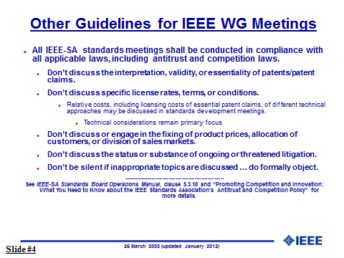

Slide 7
TG12 Officers
Chair Pat Kinney
Vice Chair Charlie Perkins
Slide 7
Notes:
May 17
Page 7

Slide 8
TG 12 Status Update
Discussion on mandatory elements of 802.15.12
  Management Protocol Module
    Presentation: 15-17-0215-00 primitives for handling profiles
      Profile concept is a significant advancement in 802.15.4 configuration, which allows the group to leverage many techniques from IETF’s Netconf protocol
      Commenter asked for inclusion of the ability of a profile to contain wildcard parameters to allow parameter changes to the Profile
      Using GET primitive, profiles could be sent to a device’s Netconf or to other devices, i.e. remote configuration
    Management/Monitor: adopts and extends the OMA LWM2M object definitions for 802.15.4
  PDE
    Will leverage the MMI concepts; accordingly, development will lag the MMI
  MMI
    Will leverage the 802.15.9 multiplex concepts, using MPX IE or ULI-6lo IE
    An additional primitive, management, and access to the MLME-SAP are notable differences
  PassThru
    Discussion on need for PassThru
    Discussion on the use of profiles to allow specific configurations per application call
Slide 8
Notes:
May 17
Page 8

Slide 9
TG 12 Status Update (continued)
Discussion on optional elements of 802.15.12
  6LoWPAN
    No progress in Vancouver
  RLS Protocol Module (Ranging and Location Support)
    During the meeting document 15-17-0220-00-0012 was presented by Billy Verso. This advanced the discussion/development of the ranging and location support (RLS) function by presenting its interactions (with both the upper layer application and the lower layer MMI/MAC) in support of single sided two-way ranging location and time difference of arrival (TDOA) location scenarios. This identified the primitives involved and proposed some ULI information elements to transfer the ranging related information.
    RLS needs support from the PassThru module on packets being sent by non-RLS apps.
  L2R
    No progress in Vancouver
  KMP
    No progress in Vancouver
  6top
    No progress in Vancouver
Slide 9
Notes:
May 17
Page 9

Slide 10
TG12 Session Focus (agenda: 15-17-0262-00)
Define all steps required for a higher layer entity to pass a message to the 802.15.12 SAP, have that message transmitted and received and then submitted to the higher layer entity
Define the process and steps for a higher layer entity to configure the 802.15.4 device
Slide 10
Notes:
May 17
Page 10

Slide 11
TG12 Meeting Goals (agenda: 15-17-0262-00)
Meeting Objectives
Monday 8 May, PM1: Opening report, Discuss Meeting Goals, Agenda, Status and Functional decomposition review
Monday 8 May, PM2: Part 1 of Session Focus #1
Tuesday 9 May, AM1: Part 2 of Session Focus #1
Tuesday 9 May, AM2: Presentations: Management protocol module, Ranging and Location Support (RLS) module
Thursday 11 May, PM1: Part 1 of Session Focus #2
Thursday 11 May, PM2: Part 2 of Session Focus #2, closing report, adjourn
Slide 11
Notes:
May 17
Page 11

Slide 12
TG12 First Meeting
Monday 8 May, PM1: Opening report, Agenda, Status and Functional decomposition review
  Approve Agenda 15-17-0262-00
  Approve Minutes from previous session, 15-17-0222-00
  Status Update (slides 7-8)
  Functional Decomposition Review (15-17-0113-02-0012)
Slide 12
Notes:
May 17
Page 12

Slide 13
TG12 Second Meeting
Monday 8 May, PM2: Part 1 of session focus
  Call meeting to order
  Define and describe part 1 of session focus
  Recess
Slide 13
Notes:
May 17
Page 13

Slide 14
TG12 Third Meeting
Tuesday 9 May, AM1: Part 1 of session focus
  Call meeting to order
  Define and describe part 1 of session focus
  Recess
Slide 14
Notes:
May 17
Page 14

Slide 15
TG12 Fourth Meeting
Tuesday 9 May, AM2: Presentations: L2R functional module, Mgmt Protocol module, Ranging and Location Support (RLS) module
  Call meeting to order
  L2R protocol module
  Presentation: Management Protocol Module
  Presentation: RLS module
  Assignments of unassigned modules
  Recess
Slide 15
Notes:
May 17
Page 15

Slide 16
TG12 Fifth Meeting
Thursday 11 May, PM1: Part 2 of session focus
  Call meeting to order
  Define and describe part 2 of session focus
  Recess
Slide 16
Notes:
May 17
Page 16

Slide 17
TG12 Sixth Meeting
Thursday 11 May, PM2: part 2 of session focus, draft closing report, adjourn
  Call meeting to order
  Define and describe part 2 of session focus
  Draft closing report
  Next steps, phone calls
  Adjourn
Slide 17
Notes:
May 17
Page 17

Slide 18
Meeting Accomplishments
Presentation about L2R
Discussion on data plane operation using 802.15.12
Discussion on management plane operation using 802.15.12
  Discussion about transmission from higher-layer protocol
    xxx
  Discussion about reception from MAC layer and data plane through 802.15.12
    Required to allow 6LoWPAN communications to pass through PDE and MMI to 802.15.4 device
    Required to allow application to directly configure 802.15.4 device
Slide 18
Notes:
May 17
Page 18

Slide 19
Meeting Accomplishments
Discussion on data plane operation using 802.15.12 – in the example of 6lo
  Device driver presents packet to 802.15.12 with EPD=0xA0ED, and layer-2 addresses
  Determine the MAC and PHY layer using source and destination layer-2 addresses.
  We check configuration for MAC & PHY for outgoing
  Upon reception, ULI-6lo ID allows routing to the proper higher-layer device driver.
  Must fully consider forwarding and date concatenation data-plane effects
Progress with optional elements of 802.15.12
  L2R
    Format issues - Dispatch
      Where should L2R IE be inserted?
    Format issues - Discovery
      How is it done with L2R discovery? Answer: they are independent
    Architecture – Where is L2R management situated?
      In Application Layer, and in 802.15.12 Management functional block
    List of management functions
  KMP, 6top, 6LoWPAN, Ranging and Location Support Module:
    No progress this session
Slide 19
Notes:
May 17
Page 19

Slide 20
Meeting Accomplishments
Discussion on management plane operation using 802.15.12
  Discussion about enabling configuration from higher-layer protocol
    Netconf
    CoMI
    Ioctl()
    Need for remote configuration
  Discussion about how to identify profiles
    Could associate some with device drivers in the way that Unix does (e.g., “eth0”)
    Can multiple profiles be associated with a single device driver? For instance, SUN FSK with or without L2R?
Slide 20
Notes:
May 17
Page 20

Slide 21
    Schedule
TASK | Start | Completed
TG12 | May, 2016 | Mar, 2019
Concept and Architecture | May, 2016 | Nov, 2016
Baseline definition | Nov, 2016 | July, 2017
Draft | May, 2017 | Nov, 2017
TG Comment Collection | Sept, 2017 | Jan, 2018
WG Letter Ballot | Dec, 2017 | Mar, 2018
Sponsor Ballot | Aug, 2018 | Jan, 2019
NesCom | Jan, 2019 | Mar, 2019
IEEE-SA Publication | Mar, 2019 | June, 2019
Slide 21
Notes:
May 17
Page 21

Slide 22
Backup Slides

Slide 23
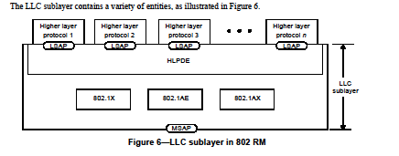
802-2014 Reference Model
Slide 23
Notes:
May 17
Page 23

Slide 24
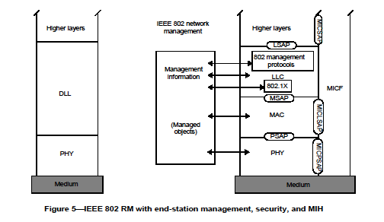
802-2014 Reference Model
Slide 24
Notes:
May 17
Page 24

Slide 25
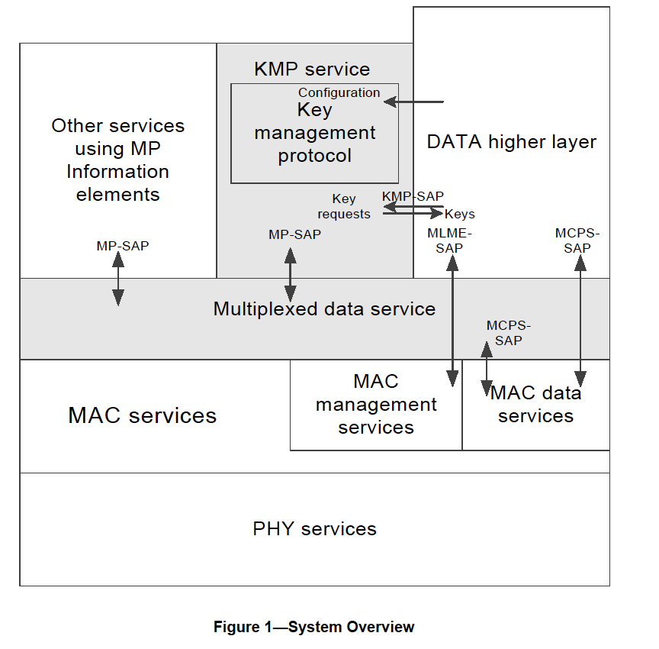
802.15.9 Functional Decomposition

Slide 26
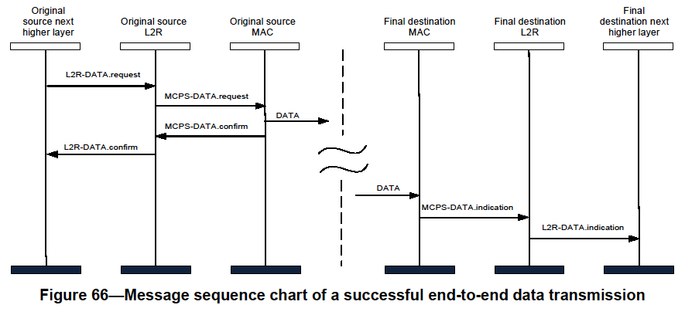
802.15.10 Functional Decomposition
The Data SAP and the MCPS-SAP are used for Multicast as indicated in Figure 19 and Figure 66
The MGMT SAP and the MLME-SAP are used as indicated in Figures 3 through 13

Slide 27
    Deliverables
Deliverables
Management SAP
  Configuration Management
    Dynamic PHY management
      B Rolfe to provide
    Network
      Set-Up
    MAC
      Set-Up
    PHY
      Set-Up
    Security
      Set-Up
    TSCH set-up
      P Kinney to provide
    Channel Hopping
  Yang Modeling
  L2 Routing
    C Perkins to provide
Data SAP
  Protocol Differentiation
    EtherType
  Security
    KMP (802.15.9)
      ETSI TS102887-2
      802.1x
      Internet Key Exchange (IKE)
      Dragonfly
      PANA
      Vendor specific
  MAC Resource Management
    Priority
    GTS management
  TSCH Operation
    P Kinney to provide
  Fragmentation
    Adaptive
    PHY (PSDU)
    UpperLayer
      802.15.9
      6LoWPAN
  Location awareness
    Ranging
    B Verso to provide
Slide 27
Notes:
May 17
Page 27

Slide 28
    Deliverables
Management SAP
  Configuration Management
    PHY
      Set-Up
        Channel
          Center frequency
          Channel number
          Regional band
        Bandwidth
        Modulation
          Channel page
        Preamble
          Code
          Repetition
        FCS size
        Packet Length
        Data Rate
        Transmit Power level
        Data Whitening
        Common Signalling Mode
        ED Threshold
        Spreading Factor
        DSSS code
        CCA
          Mode
          duration
        FEC?
          Rate
          Coding
          Interleaving
        SFD
          Size
          value
Slide 28
Notes:
May 17
Page 28

Slide 29
    Deliverables
Management SAP
  Configuration Management
    MAC
      Set-Up
        FFD?
        Beacon-enabled?
          DSME?
            Seong-Soon Joo to provide
          Superframe parameters
        Low Energy?
          Parameters
        Channel Hopping?
          parameters
        Association?
          Fast?
        Synchronization
          Superframe
          TSCH
        ACK required?
        Promiscuous mode?
          Ask Packet Sniffer vendors or chipset vendors
        Device Announcement
        UL IEs?
          parameters
Slide 29
Notes:
May 17
Page 29

Slide 30
    Deliverables
Management SAP
  Configuration Management
    Network
      Set-Up
        PAN Coordinator?
          Beacon-enabled?
          Low Energy?
          Association?
            Fast?
            Permit to Join?
              Criteria to accept
          Short Address?
            Assignment
        Channel Scan
Slide 30
Notes:
May 17
Page 30

Slide 31
Management Protocol Configuration Parameters via MGMT SAP - MAC
Operational | Op enumerations
Device Type | FFD, RFD, RFD-TX, RFD-RX
PAN | Set-up, discovery
Slide 31
Notes:
May 17
Page 31

Slide 32
Management Protocol Configuration Parameters via MGMT SAP - MAC
Optional Modes | Configuration set-up
Generic (GTS) [beacon-enabled] | Superframe
DSME | Superframe
TSCH | Slotframe
SUN [Nonbeacon-enabled] |  | phyCurrentChannel, ChanCenterFreq0 NumChan, ChanSpacing phyCurrentPage, phyCurrentSUNPageEntry, phyNumSUNPageEntriesSupported phySUNPageEntriesSupported macPanId, macCoordShortAddress phySUNChannelsSupported
TVWS
LECIM (lp-wan)
RFID
RCC
Generic [non-beacon-enabled]
Slide 32
Notes:
May 17
Page 32

Slide 33
Management Protocol Configuration Parameters via MGMT SAP - MAC
Option behaviors | Option details
Association
Security | Integrity, Encryption
Promiscuous
Ranging
Low Energy | CSL, RIT, IRIT
Priority
Metrics | MAC Metrics IE/All MAC Metrics IE
Channel Hopping | Channel hopping IE, macHoppingSequenceLength, macHoppingSequenceList, macHoppingSequenceId, macNumberofChannels, macPhyConfiguration, macExtendedBitmap
IEs | Header, Payload
TRLE
Spectrum Tracking
Slide 33
Notes:
May 17
Page 33

Slide 34
Management Protocol Configuration Parameters via MGMT SAP
PHY Parameters | PHY Parameters - detail
Channel | phyCurrentChannel = Number: phyCurrentPage
Modulation type | O-QPSK, BPSK, FSK, MSK, OFDM, CSS, UWB-HR, UWB-LR, ASK
Preamble | Code/repetition: phyFskPreambleLength, SecondaryFskPreambleLength
FCS size | 2, or 4
Packet Length | aMaxPhyPacketSize = 127, or 2047, or phyLecimDsssPsduSize
Operating Mode
Data Rate (kb/s) | 2.4, 4.8, 6.25, 9.6, 10, 12.5, 16, 19.2, 20, 25, 31.25, 32, 36, 38.4, 40, 50, 100, 110, 150, 156, 200, 234, 250, 300, 312, 468, 600, 624, 800, 850, 936, 1000, 1404, 1562.5, 1638, 2000, 3125, 6250, 6810, 27240
Transmit power level | phyTxPower
CCA | 1, 2, 3, 4, 5, 6, : aCcatime/phyCCADuration
FEC | Off/On, rate, code, interleaving: phyFskFecEnabled, phyFskFecInterleavingRsc, phyFskFecScheme/phyTvwsFskFecScheme, phyLecimFecTailBitingEnabled
SFD | Size/value: phySunFskSfd, phyTvwsSfdLength, phyLecimDsssSfdPresent, SecondaryFskSfd
Slide 34
Notes:
May 17
Page 34

Slide 35
Management Protocol Configuration Parameters via MGMT SAP
PHY Parameters (cont’d) | PHY Parameters - detail
TX<->RX | aTurnaroundTime
ED threshold
Spreading factor
DSSS code
Data whitening
Common signaling mode
Slide 35
Notes:
May 17
Page 35

Slide 36
Example of Options Used for Secured SUN FSK Device
Slide 36
Notes:
May 17
Page 36

Slide 37
Example of Options Used for LECIM O-QPSK Device
Slide 37
Notes:
May 17
Page 37

Slide 38
Example of Options Used for 6tisch O-QPSK Device
Slide 38
Notes:
May 17
Page 38

Slide 39
    Future Efforts
Functional Module Technical Details
PDE P Kinney
MMI P Kinney
Management Protocol H Yokota
6LoWPAN
KMP
802.1X
L2R C Perkins
6tisch
Ranging B Verso
Generic (i.e., template)
Functional Block Overview
How do they work?
What functions do they include?
How do the SAPs work?
What primitives are required?
What parameters are required?
Slide 39
Notes:
May 17
Page 39

Slide 40
    Schedule
TASK | Start | Completed
TG12 | May, 2016 | Mar, 2019
Concept and Architecture | May, 2016 | Nov, 2016
Baseline definition | Nov, 2016 | July, 2017
Draft | May, 2017 | Nov, 2017
TG Comment Collection | Sept, 2017 | Jan, 2018
WG Letter Ballot | Dec, 2017 | Mar, 2018
Sponsor Ballot | Aug, 2018 | Jan, 2019
NesCom | Jan, 2019 | Mar, 2019
IEEE-SA Publication | Mar, 2019 | June, 2019
Slide 40
Notes:
May 17
Page 40

