Slide 1
Project: IEEE P802.15 Working Group for Wireless Personal Area Networks (WPANs)
Submission Title: [15-17-0249-00-lpwa-LPWAN_SLIDES-IEEE_802-15-IG_LPWA]
Date Submitted: [11. Apr. 2017]
Source: [Charlie Perkins] Company [Futurewei]
Voice:[+1-408-330-4586], E-Mail:[charliep@computer.org]
Abstract: [IETF 98 presentation materials for lpwan working group]
Purpose: [Information for telco participants]
Notice: This document has been prepared to assist the IEEE P802.15. It is offered as a basis for discussion and is not binding on the contributing individual(s) or organization(s). The material in this document is subject to change in form and content after further study. The contributor(s) reserve(s) the right to add, amend or withdraw material contained herein.
Release: The contributor acknowledges and accepts that this contribution becomes the property of IEEE and may be made publicly available by P802.15.

Slide 2
An Introduction to IEEE 802 IG LPWA (Low Power Wide Area)
Charlie Perkins <charles.perkins@earthlink.net>
Joerg Robert <joerg.robert@fau.de>
98th IETF, Chicago, March 29th, 2016

Slide 3
Contents
What are LP-WANs?
Typical Applications and Characteristics
Reason for the Low LP-WAN Bit-Rates
Downlink Issues
Costs of using IP Directly
Channel Access
Current Work in IEEE 802.15

Slide 4
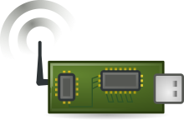
What are LP-WANs?
Base-Station
e.g. 100m
e.g. 40km
Sensor Node
e.g. 10mW
Small and cost-efficient sensor nodes transmit data over long distances with ultra-low power (1/10 of typical Wi-Fi transmit power)
The sensor nodes are powered by tiny batteries (e.g. coin type)
One base-station may serve millions of sensor nodes
Multi-hop transmission is typically not used
Joerg Robert, FAU Erlangen-Nuernberg

Slide 5
Typical Applications
Application | Description
Alarms and Security | Monitoring of doors, windows, etc.
Smoke Detectors | Real time alerts, monitoring battery life, etc.
Cattle Monitoring | Location and health monitoring of cattle
Logistics | Location and monitoring of goods
Smart Parking | Available parking space indication in real-time
Smart Metering | Automatic reading of gas/water meters
Structural Health Monitoring | Monitor structural health of bridges, etc.
LP-WANs mostly address sensor applications
Further use-cases are listed in [1]
Joerg Robert, FAU Erlangen-Nuernberg

Slide 6
Typical LP-WAN Characteristics
 | LP-WAN | Wi-Fi
Bit-Rate | < 1 kBps | >> 1 Mbps
Latency | Up to minutes | << 1 s
Payload length | ~ 16 byte | > 1 kbyte
Max. number of uplink packets / day | ~ 200 | Millions
Max. number of downlink packets / day | < 20 | Millions
Max. distance w/o directive antennas | Up to 40 km | < 100 m
Typical power supply | Coin type / AA | Electrical Outlet / Li-Ion
Battery lifetime | Several years | Hours (laptop/mobile)
Typical frequency bands | < 1 GHz | 2.4 GHz, 5.4 GHz
Joerg Robert, FAU Erlangen-Nuernberg

Slide 7
Reason for Low LP-WAN Bit-Rates
Minimum energy to transmit one bit
Received power P_{Rx} is the transmitted power P_{Tx} minus the path loss from interference (noise)
For a few details, see next three slides
Joerg Robert, FAU Erlangen-Nuernberg

Slide 8
Reason for Low LP-WAN Bit-Rates (I/III)
According to information theory the successful transmission of an information bit requires a certain energy
The energy per bit is given by the reception power P_{Rx} divided by the bit-rate R
The theoretical maximum payload bit-rate is then given by [2]:
Assumptions:
Eb/N0=-1.59dB (information theoretic value for error-free decoding)
Noise figure 0dB
Noise power spectral density -174dBm/Hz
Joerg Robert, FAU Erlangen-Nuernberg

Slide 9
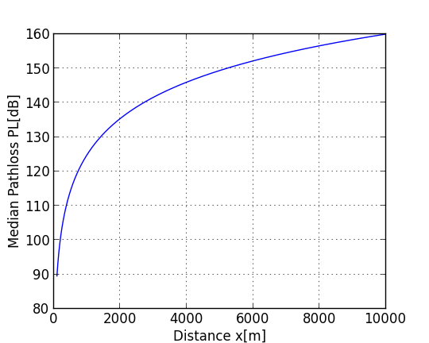
Reason for Low LP-WAN Bit-Rates ( II/III )
Path loss according to channel model
The received power P_{Rx}[dBm] is given by the transmitted power P_{Tx}[dBm] minus the path loss PL[dB] {plus antenna gain, not considered here}
The path loss PL[dB] for the outdoor-rural channel model [3] corresponds to PL=150dB for a distance of x=5000m
So, at x=5000m, P_{Rx} equals 10dBm - 150dB = -140dBm
Base-station antenna height: 30m
Sensor node antenna height: 2m
Joerg Robert, FAU Erlangen-Nuernberg

Slide 10
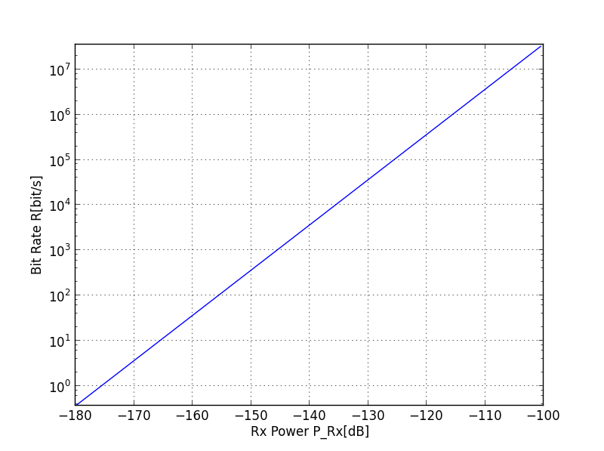
Reason for Low LP-WAN Bit-Rates ( III/III )
Theoretical bit-rate according to slide 8
P_{Rx}[dBm] = -140dBm results in a maximum bit-rate of $R=3⋅\frac{{10}^{3}Bit}{s}=3kBit/s$
Transmitting each bit is expensive!
Packet overhead has significant impact
Joerg Robert, FAU Erlangen-Nuernberg

Slide 11
Downlink-Issues
The uplink and downlink have the same regulatory restrictions, but the base-station is more sensitive [4]
Downlink is more critical than uplink
The base-station may be able to receive from thousands of sensor nodes simultaneously, but it can only transmit to a single downlink node at a time [4]
Only a few packets can be transmitted in the downlink
Acknowledging uplink packets is impractical
Due to downlink, LP-WANs are highly asymmetric
Joerg Robert, FAU Erlangen-Nuernberg

Slide 12
Costs of using IP (and TCP) directly
The typical payload length is only a few bytes. Even a few bytes overhead can significantly impact efficiency.
Reduced battery life, increased channel load and latencies
IP headers (for IPv4 / IPv6) are much longer than a typical LP-WAN payload.
Connection oriented protocols (e.g. TCP) require significant downlink traffic, and further increase overhead.
Gateways are very beneficial (as discussed within IETF [5])
Joerg Robert, FAU Erlangen-Nuernberg

Slide 13
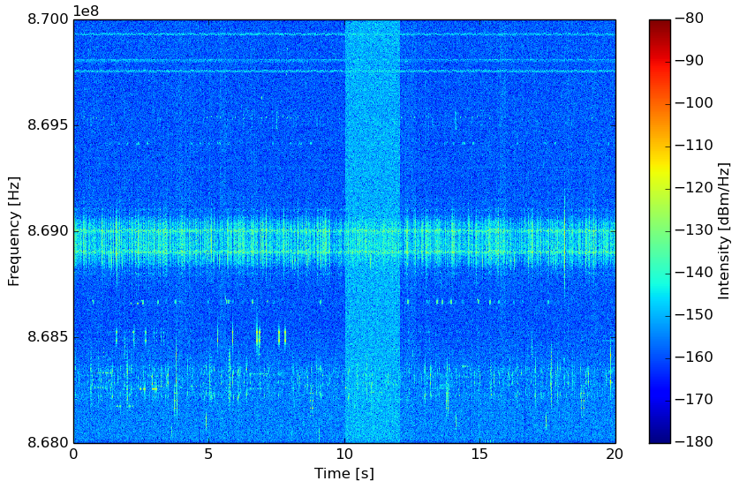
Channel Access
Measured interference (Erlangen/Germany)
Base-stations are often mounted on exposed sites, while sensor nodes are near the ground
Very high uplink traffic [6]
Algorithms such as CSMA have “hidden node” problems
Significant levels of interference from other systems can be expected [7]
Current research for LP-WANs focuses on improved channel access algorithms based on ALOHA, and methods to improve robustness (with respect to interference)
Joerg Robert, FAU Erlangen-Nuernberg

Slide 14
Current Work in IEEE 802.15
Interest Group (IG) LPWA is developing a report on use-cases and potential technologies for LP-WAN [1]
Final IG report is expected end of July 2017
IG LPWA has already defined and analyzed:
Use-cases
Regulatory aspects
Channel / interference models
Current focus of IG LPWA is on analyzing:
Suitability of existing IEEE standards of LP-WAN
Candidate technologies and their suitability for LP-WAN (e.g. modulation, forward error correction, channel access, encryption, privacy, ...) [8]
Joerg Robert, FAU Erlangen-Nuernberg

Slide 15
Procedure for Evaluating a Candidate Technology
Suitability
Analyze the general suitability of a candidate technology
Qualitative Evaluation
Analyze pros and cons, and dependency on other technologies
Quantitative Evaluation
Exact performance (for selected technologies)
Joerg Robert, FAU Erlangen-Nuernberg

Slide 16
Use-Case Parameters for Evaluations
Channel Model
Interference Model
Active Interfering Users
Communication Mode
Data Period
Data Length
Availability
Frequency Regulation
Cell Radius
Data Security
Node Velocity
Latency
Typical Power Supply
LP-WAN Localization
Joerg Robert, FAU Erlangen-Nuernberg

Slide 17
Example of Current Work – Suitability Evaluation
Use-case parameters are matched against the evaluation results. A use-case is not supported if any parameter is not supported (see next slide) [9]
Example:
Modulation DSSS (Direct Sequence Spread Spectrum)
Spreading offers additional robustness, but fails in case of strong interference from other frequency users
Spreading increases the required channel bandwidth and / or the length of the packets, making the data more vulnerable
DSSS is not suitable if large “Cell Radius” is required
Joerg Robert, FAU Erlangen-Nuernberg

Slide 18
Results of the DSSS Suitability Evaluation on the Use-Cases
Access Control | Public Lighting
Alarms and Security | Smart Grid - Fault Monitoring
Asset Tracking | Smart Grid - Load Control
Assisted Living | Smart Metering
Cattle Monitoring | Smart Parking
Field Monitoring | Smoke Detectors
Global Tracking | Structural Health Monitoring
Industrial Plant Condition Monitoring | Vending Machines - general
Industrial Production Monitoring | Vending Machines - privacy
Light Switch | Waste Management
Pet Tracking | Water Pipe Leakage Monitoring
Pipeline Monitoring - Terrestrial
Joerg Robert, FAU Erlangen-Nuernberg

Slide 19
Conclusion
LPWANs are mainly suitable for monitoring applications
Long range communications results in very low payload bit-rates
IP overhead is too large for many applications
Channel access and interference are critical design considerations
IG LPWA (within IEEE 802.15) is currently investigating LPWAN technologies and technical prospects of a new standard.
The IG (Interest Group) report is expected in July 2017. A Study Group or Task Group might be formed as a result.
Joerg Robert, FAU Erlangen-Nuernberg

Slide 20
Thank You for Your Interest!
Joerg Robert, FAU Erlangen-Nuernberg

Slide 21
Literature
[1] IEEE 802.15, IG LPWA, LPWA Use-Cases, https://mentor.ieee.org/802.15/dcn/16/15-16-0770-05-lpwa-lpwa-use-cases.xlsx
[2] Proakis, J. G., Salehi, M.; Digital Communications, McGRAW-Hill, 2008
[3] IEEE 802.15, IG LPWA, Proposal for LPWAN Channel Models, https://mentor.ieee.org/802.15/dcn/17/15-17-0036-01-lpwa-proposal-for-lpwan-channel-models.pptx
[4] IEEE 802.15, IG LPWA, LP-WAN Downlink Issues, https://mentor.ieee.org/802.15/dcn/17/15-17-0164-00-lpwa-lp-wan-downlink-issues.pptx
[5] IETF, LPWAN Overview, https://datatracker.ietf.org/doc/draft-ietf-lpwan-overview/
[6] IEEE 802.15, IG LPWA, Number of Active Interfering Users, https://mentor.ieee.org/802.15/dcn/17/15-17-0035-00-lpwa-number-of-active-interfering-users.pptx
Joerg Robert, FAU Erlangen-Nuernberg

Slide 22
Literature (cont.)
[7] IEEE 802.15, IG LPWA, Proposal for sub-GHz Interference Model, https://mentor.ieee.org/802.15/dcn/17/15-17-0037-01-lpwa-proposal-for-sub-ghz-interference-model.pptx
[8] IEEE 802.15, IG LPWA, Candidate IEEE Standards and Technologies for IG Report, https://mentor.ieee.org/802.15/dcn/17/15-17-0211-01-lpwa-candidate-ieee-standards-and-technologies-for-ig-report.pptx
[9] IEEE 802.15, IG LPWA, Candidate IEEE Standards and Technologies for IG Report , https://mentor.ieee.org/802.15/dcn/17/15-17-0228-00-lpwa-candidate-technology-qualitative-evaluation.pptx
Joerg Robert, FAU Erlangen-Nuernberg

