Slide 1
Project: IEEE P802.15 Working Group for Wireless Personal Area Networks (WPANs)
Submission Title: SG MG OWC Closing Plenary Slides
Date Submitted: 16 March 2017
Source: Volker Jungnickel Fraunhofer HHI
Address Einsteinufer 37, D-10587 Berlin, Germany
Voice:+493031002768, FAX: +49 31002 250, E-Mail: volker.jungnickel@hhi.fraunhofer.de
Re: n/a
Abstract: SG MG OWC Closing Plenary Slides
Purpose: Closing report to WG 15 at closing plenary
Notice: This document has been prepared to assist the IEEE P802.15. It is offered as a basis for discussion and is not binding on the contributing individual(s) or organization(s). The material in this document is subject to change in form and content after further study. The contributor(s) reserve(s) the right to add, amend or withdraw material contained herein.
Release: The contributor acknowledges and accepts that this contribution becomes the property of IEEE and may be made publicly available by P802.15.

Slide 2
SG MG OWC March 2017 Closing Report

Slide 3
Meetings/Contributions
5 meetings
Main task was finish new PAR and CSD for Multi-Gigabit OWC for decision at EC on Friday
Received 37 technical comments (and few editorial ones) from 802, 802.3, 802.11 and individuals
A response to all comments has been developed by the SG and put together in document 0177r4 on Mentor
The accordingly revised CSD and PAR are contained in documents 0075r1 and 076r3, respectively
Thanks to Bob and Rick for guiding us through this whole process during the entire week

Slide 4
Contributions/Discussions
One technical contribution 0146r0 from VLNcomm on Hadamard transformation based modulation for energy-efficient OWC
Preliminary discussions on the way forward in the new TG13
Li-Fi related comments against D1 in TG7r1 will be combined in one document by John (Huawei)
Additional comments to be submitted until April 23

Slide 5
Plans for Daejeon May 2017
Establish the new TG13 if approved
To be clarified
how to handle potential new contributions
what PHY and MAC functions will be taken over from D1 in TG7r1 as a baseline for the work of the new TG13
Comment resolution on Li-Fi comments in TG7r1/D1
First tentative overall schedule for the new TG13 is available in document 0218r1
Any recommendation from WG members to get the work of the TG13 started is welcome

Slide 6
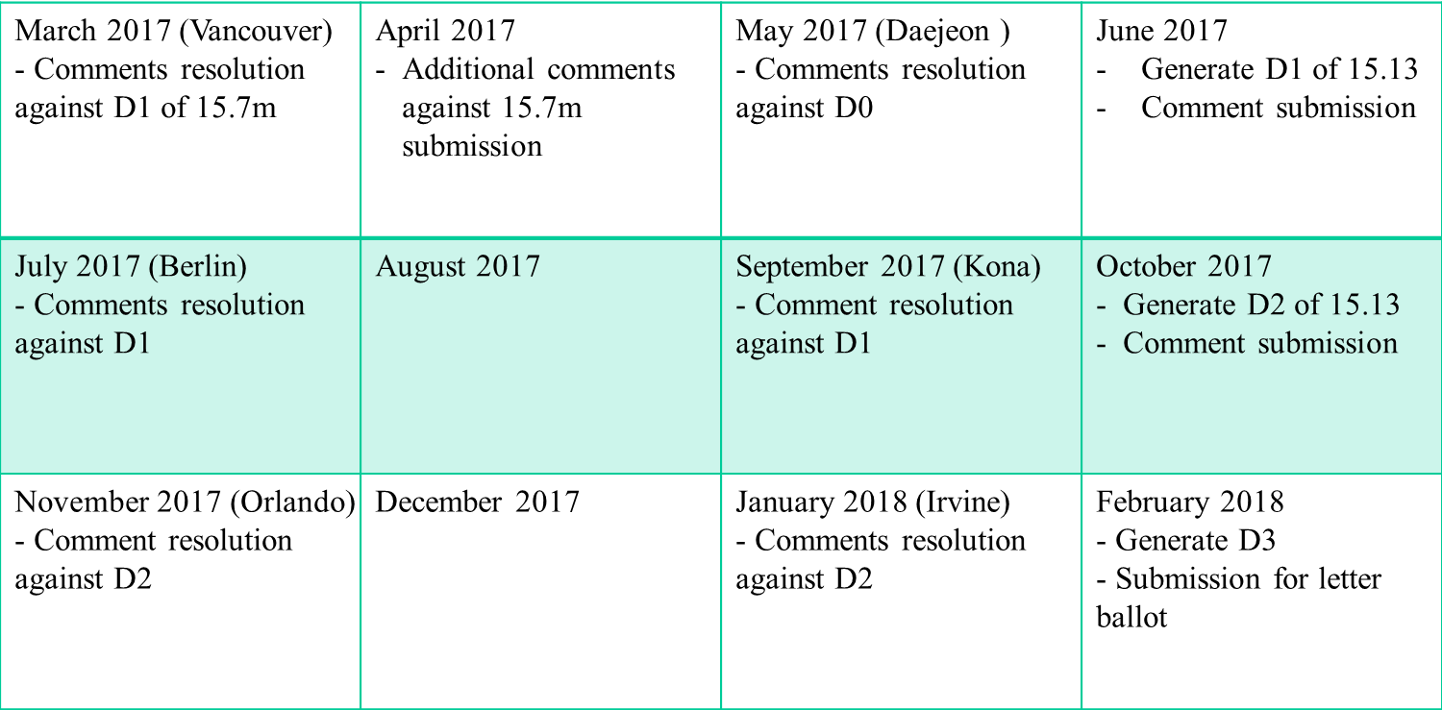
BRC Calls

Slide 7
SG Motion 1
Motion: MG-OWC study group moves to approve the comments resolutions contained in document [177rev4] and approves the revised CSD in document [0075rev1] and revised PAR in document [0076rev3] and requests approval from the working group.
Approved by unanimous consent

Slide 8
SG Motion 2
Motion: MG-OWC moves that the PAR and CSD contained in documents [0076rev3] and [0075rev1], respectively, be approved for submission to the WG for its approval and that the EC be requested to forward the PAR to NesCom.
Approved by unanimous consent

Slide 9
WG Motion 1
Motion: MG-OWC study group requests the working group approve the comments resolutions contained in document [177rev4] and approves the revised CSD in document [0075rev1] and revised PAR in document [0076rev3].
Moved by Volker Jungnickel
Seconded by Mike McInnis
Approved by unanimous consent

Slide 10
WG Motion 2
Motion: The MG-OWC study group requests that the PAR and CSD contained in documents [0076rev3] and [0075rev1], respectively, be approved by the IEEE 802.15 WG and that the EC be requested to forward the PAR to NesCom. The 802.15 working group chair and technical editor are authorized to make additional modifications to the PAR and CSD as needed to reflect EC discussion at its closing meeting.
Moved by Volker Jungnickel
Seconded by Mike McInnis
y/a/n = 28/0/0

