Slide 1
Project: IEEE P802.15 Working Group for Wireless Personal Area Networks (WPANs)
Submission Title: [FHSS Link Performance Evaluation for LPWAN Systems]
Date Submitted: [15 March, 2017]
Source: [Hendrik LIESKE, Joerg ROBERT] Company [Friedrich-Alexander-Universität Erlangen-Nürnberg (FAU)]
Address [Am Wolfsmantel 33, 91058 Erlangen, Germany]
Voice:[+49 9131 8525107], FAX: [+49 9131 8525102], E-Mail:[hendrik.lieske@fau.de]
Abstract: [This document evaluates FHSS as a candidate technology for a LPWAN PHY layer]
Purpose: [Presentation within IEEE802.15 Interest Group LPWA]
Notice: This document has been prepared to assist the IEEE P802.15. It is offered as a basis for discussion and is not binding on the contributing individual(s) or organization(s). The material in this document is subject to change in form and content after further study. The contributor(s) reserve(s) the right to add, amend or withdraw material contained herein.
Release: The contributor acknowledges and accepts that this contribution becomes the property of IEEE and may be made publicly available by P802.15.

Slide 2
FHSS Link Performance Evaluation for LPWAN Systems
Hendrik Lieske, Joerg Robert
FAU Erlangen-Nürnberg

Slide 3
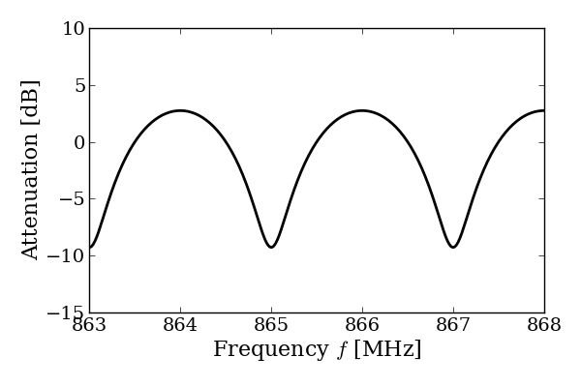

Motivation
Reliable uplink communication is a key requirement for
high coverage and low power consumption
Multipath propagation between TX and base station (BS) potentially decreases the system performance
Diversity by means of Frequency Hopping Spread Spectrum (FHSS) mitigates the effect of frequency selective fading
TX
BS

Slide 4
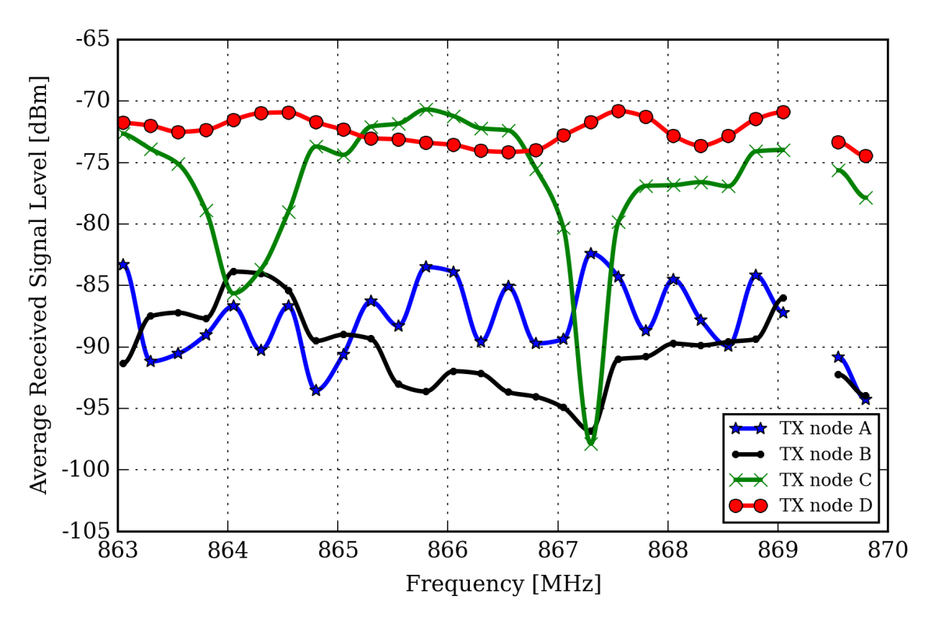
Motivation
Measured signal level spectra of four characteristic TX nodes in
urban field trial setup [1]
Observation time is 6 days
How does FHSS affects the transmission reliability?

Slide 5
Agenda
Motivation
System Model
Information Outage Probability
Decoding Performance in Fading Environments
  Two-Path Fading Model
  Outdoor Rural Model
Conclusions

Slide 6
System Model
We consider a narrowband communication system with
BPSK modulation and forward error correction (FEC)
k information bits are encoded to n code symbols (rate R_{c} = k/n)
A random channel interleaver is applied to reduce burst errors
The discrete time channel model accounts for a flat fading coefficient H( f ) and AWGN n(t)

Slide 7
System Model
The frequency hopping (FH) spreader divides a code word of length n symbols into M_{S} subpackets
Each subpacket is consecutively transmitted on an
individual center frequency f_{c,i} (1 < i < M_{S})
Example for M_{S} = 5:
The despreader joins the subpackets at the receiver
Perfect time and frequency synchronization is assumed at the RX
(e.g. due to the insertion of pilots)

Slide 8
Information Outage Probability
A practical performance metric for the decoding error probability of a (n,k) block code is the information outage probability (IOP) [2]:
where are the channel‘s input and output vectors, the r.v.
denotes the (normalized) information spectrum (rate), and
is the mutual information between the random input symbol X_{j}
and its channel output observation Y_{j}.

Slide 9
Information Outage Probability
In a FHSS scenario, the instantaneous SNR (E_{s}/N₀) for
symbol i (1 ≤ i ≤ n) depends on the fading state of the corresponding subpacket, i.e. on the realization of the
channel transfer function H( f ).
The following results are based on the numerical framework recently proposed in [3] for BPSK channel inputs, because well-known results for complex Gaussian channel inputs would overestimate the achievable performance in typical modulation-constraint LPWA setups.

Slide 10
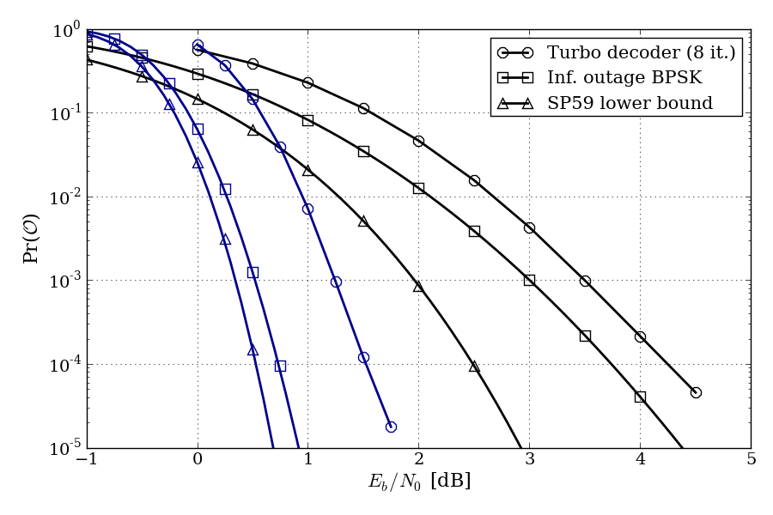
Information Outage Probability
Decoding error probability by means of IOP for information sizes
k = {40, 512}, R_{c} ≈ 1/3 in a stationary AWGN channel (const. E_{b}/N₀):
For comparison, the sphere packing lower bound (SPB) and simulation results of an LTE Turbo decoder are given.
k = 40
k = 512
cf. [3, Fig. 2]

Slide 11
Agenda
Motivation
System Model
Information Outage Probability
Decoding Performance in Fading Environments
  Two-Path Fading Model
  Outdoor Rural Model
Conclusions

Slide 12
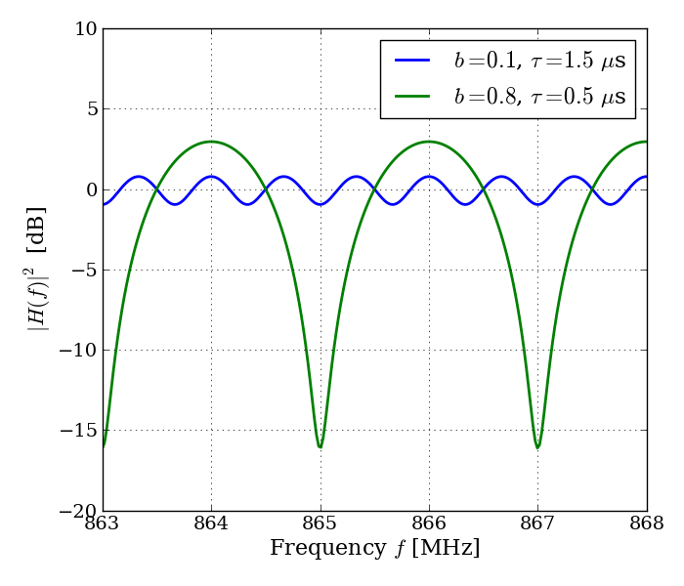
Two-Path Fading Environment
The two-path channel model takes a strong signal reflection between the TX and an exposed base station into account
(e.g. on tall buildings)
Normalized magnitude response
(average gain one) is given by:
τ… relative time delay
b… relative amplitude (0 ≤ b ≤ 1)
2π f₀ τ… relative phase of the 2nd ray
Model is based on field measurements in [1]

Slide 13
Two-Path Fading Environment
Further assumptions:
  During a packet transmission, the channel is assumed to be stationary (i.e. slow fading)
  Signal bandwidth << 1/τ, i.e. a subpacket signal itself
  experiences flat fading
  Available FH bandwidth >> 1/τ, i.e. H( f ) is quasi-periodic and f₀ can be neglected
  Individual center frequencies are randomly chosen from a uniform distribution
  k = 200, n = 612 (R_{c} ≈ 1/3)

Slide 14
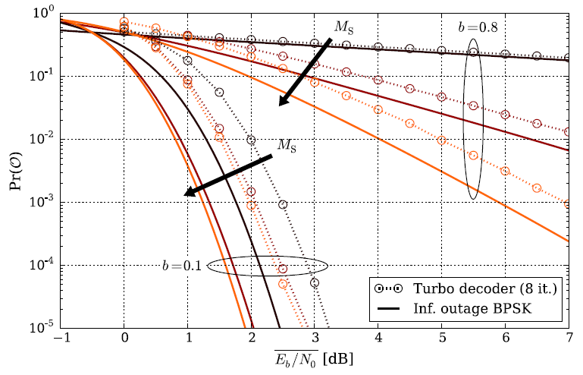
Two-Path Fading Environment
Decoding performance for M_{S} = {1, 5, 10} subpackets in
strong (b = 0.8) and weak (b = 0.1) fading environment [3]:
IOP and Turbo decoder results show similar trend
FHSS significantly improves performance in strong fading scenario

Slide 15
Two-Path Fading Environment
The effect of FHSS on the coverage range of a base station is evaluated as follows:
  A TX node is assumed to be covered if its outage probability is below 10⁻³ (this value is usually application specific)
  For a given average SNR and M_{S}, a channel is generated with b drawn from a uniform distribution [0, 1]
  The performance metric is the fraction of covered channel realizations
N… Number of channel realizations
N’… Number of covered channels

Slide 16
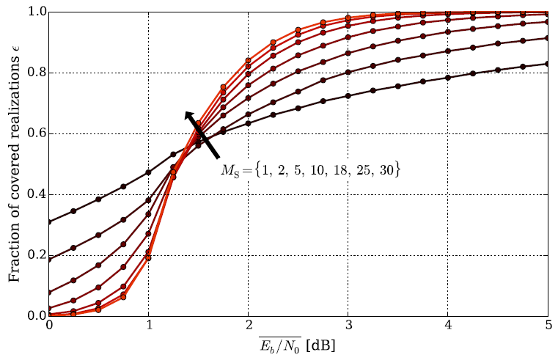
Two-Path Fading Environment
Coverage significantly increases with M_{S} for SNR > − 0.5 dB
Below the critical SNR, FHSS provides no benefit, but such nodes are likely covered by neighbored BS cells
SNR ≈ − 0.5 dB
[3]

Slide 17
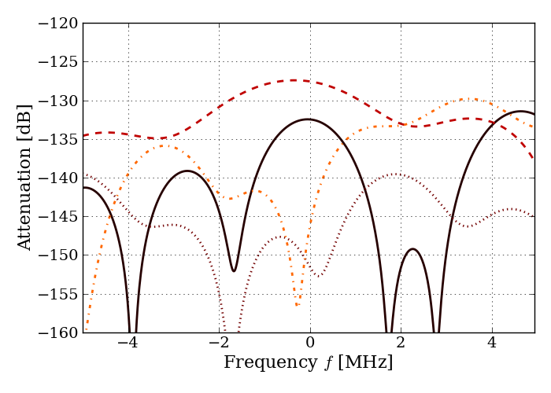
Outdoor Rural Channel Model
The following results consider the Outdoor Rural LPWAN channel model as proposed in DCN 802.15-17-0036-01-lpwa ([4])
For convenience, the channel is assumed to be stationary,
i.e. the results apply for signals whose duration is shorter than
the coherence time of the channel, which is roughly 80 ms
Results considering time-varying
channels can be provided
on request
Exemplary channel realizations
for TX – BS distance of 1.5 km:

Slide 18
Outdoor Rural Channel Model
System assumptions:
  k = 200, n = 612 (R_{c} ≈ 1/3)
  P_{TX} = 25 mW, T_{Symbol} = 100 us (data rate 10 kSymbols/s)
  M_{S} = {1, 5}
  Frequency hopping bandwidth is 6 MHz
  Center frequencies are equally spaced across the bandwidth
  Base station noise figure is 3 dB
  Isotropic antennas (G_{TX} = G_{BS} = 1)
  A node is covered if its outage probability is below 10⁻³

Slide 19
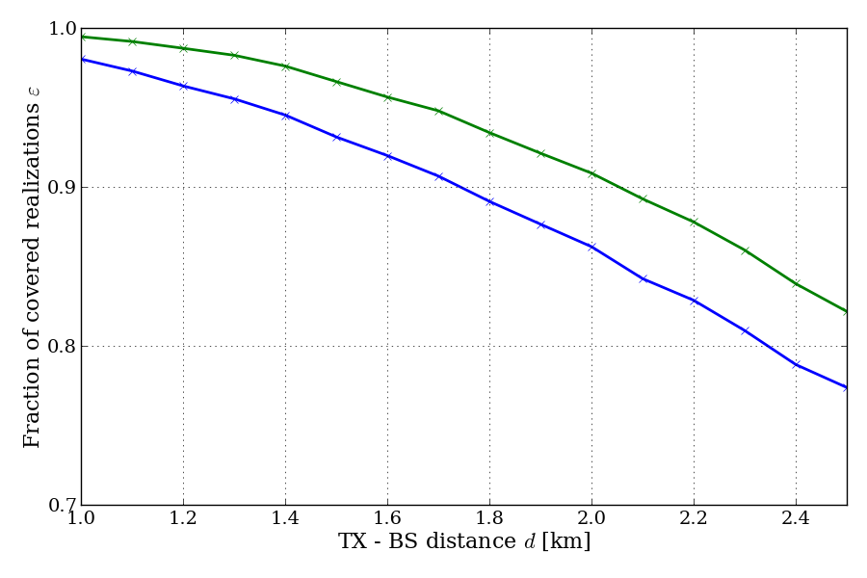
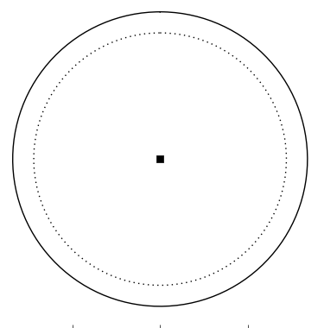

Outdoor Rural Channel Model
If the network operator requires a coverage of e.g. 90 %, the
covered area of the base station is increased from 9.6 km² to 13.2 km² for M_{s} = 5
M_{s} = 5
A = 13.2 km²
M_{s} = 5
M_{s} = 1
M_{s} = 1
BS
A = 9.6 km²

Slide 20
Conclusions
The information outage probability is a practical performance indicator for the packet error rate (PER) of BPSK modulated
packet transmissions
FHSS on a subpacket level can significantly improve the PER in severe multipath environments, and should therefore be considered as a candidate technology for LPWA PHY layer implementations
Additionally, increased robustness towards interference
is expected (requires separate study)
For very low SNR, the best strategy is a single packet transmission, however, the achievable PER misses practical application requirements

Slide 21
References
[1] S. Rauh, T. Lauterbach, H. Lieske, J. Robert, and A. Heuberger,
“Multipath Characteristics of Indoor-to-Outdoor Radio Channels in the 868-MHz Band,” in Smart SysTech 2016; European Conference on Smart Objects, Systems and Technologies, 2016
[2] D. Buckingham und M. C. Valenti,
„The information-outage probability of finite-length codes over AWGN channels“, in Information Sciences and Systems, 2008. CISS 2008. 42nd Annual Conference on, 2008, S. 390–395.H.
[3] H. Lieske, S. Rauh, and A. Heuberger,
„Numerical Evaluation of Information Outage for BPSK FHSS Link Performance Analysis,“
accepted for publication in IEEE Wireless Communications and Networking Conference (WCNC), 2017
[4] Proposal of LPWAN Channel Models, Rev. 1, IEEE 802.15-17-0036-01-lpwa

Slide 22
Thank You!
Discussion?

