Slide 1
Project: IEEE P802.15 Working Group for Wireless Personal Area Networks (WPANs)
Submission Title: Overview Tutorial on IEEE 802.15.10
Date Submitted: March, 2017
Source: Clint Powell (Powell Wireless Commsulting, LLC), Verotiana Rabarijaona (NICT), Charles Perkins (Futurewei), Noriyuki Sato (OKI)
Voice: +1-480-586-8457, E-Mail: cpowell@ieee.org
Re:
Abstract: Overview of IEEE 802.15.10 Recommended Practice
Purpose: Introduction to L2R
Notice: This document has been prepared to assist the IEEE P802.15. It is offered as a basis for discussion and is not binding on the contributing individual(s) or organization(s). The material in this document is subject to change in form and content after further study. The contributor(s) reserve(s) the right to add, amend or withdraw material contained herein.
Release: The contributor acknowledges and accepts that this contribution becomes the property of IEEE and may be made publicly available by P802.15.
Clint Powell, Verotiana Rabarijaona,
Charles Perkins, Noriyuki Sato

Slide 2
Outline
Overview
System Architecture
Topologies
IE's Overview/Use
Routing Types Supported
Addressing Supported
Payload & Address at each Hop
Route Metrics
Security Features
Clint Powell, Verotiana Rabarijaona,
Charles Perkins, Noriyuki Sato

Slide 3
Layer 2 Routing (L2R) Overview
Motivation
  Growing use of 802.15 in large mesh network applications such as Utility and more generally in Field Area Networks
  Need to address general requirements for L2 routing in Field Area Networks utilizing newer 15.4g and 15.4e amendments
  Support and use in higher layer protocols – the Internet of Things
Applications
  Smart Energy/Utilities (Smart Metering, FANs…)
  Smart City (Street Lighting/Parking/Metering…)
  Control and Monitoring (Smart Home, etc.)
  Automation
Clint Powell, Verotiana Rabarijaona,
Charles Perkins, Noriyuki Sato

Slide 4
Layer 2 Routing (L2R) Overview
802.15 TG10 - L2R Purpose
  Defines protocols that route packets in a dynamically changing (order of a minute) 802.15.4 network
  Extends the area of coverage as the number of nodes increase
  Supports Data Concatenation
  Supports small, medium and large scale networks
Anticipated Publication Date
  April 2017
Clint Powell, Verotiana Rabarijaona,
Charles Perkins, Noriyuki Sato

Slide 5
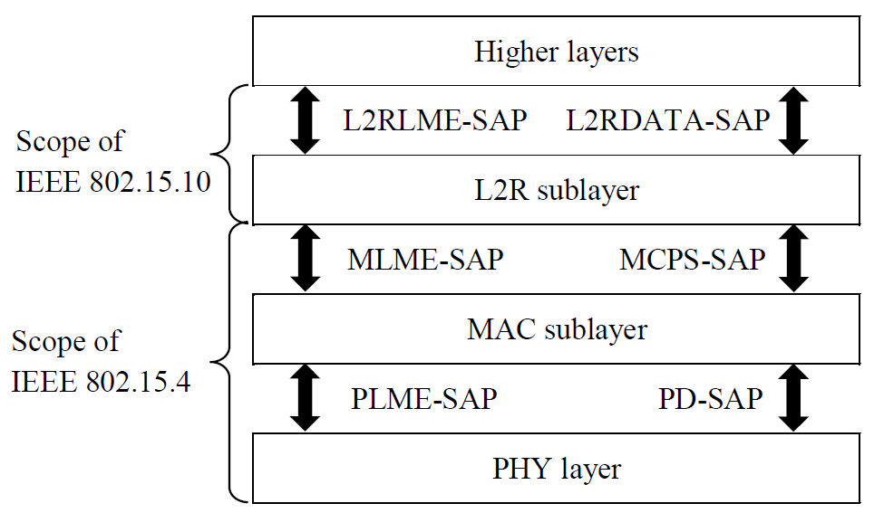
System architecture
L2R management (start, join...)
L2R
Data
PAN management (start, association...)
MAC
Data
PHY settings (frame size, channel...)
PHY
Data
LME: (sub)layer management entity L2RLME: Layer 2 Routing LME
MLME: MAC LME PLME: PHY LME
SAP: service access point PD: PHY layer data
MCPS: MAC common part sublayer
Clint Powell, Verotiana Rabarijaona,
Charles Perkins, Noriyuki Sato

Slide 6
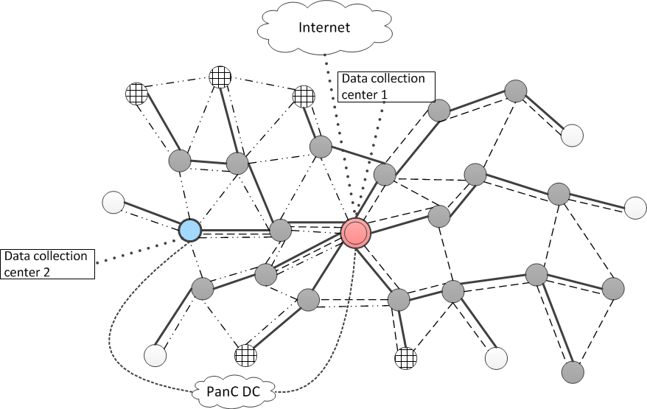
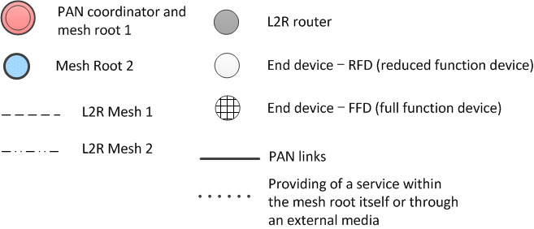
Topologies
Multiple services in one mesh
* The definition of services are out of scope
Same service provided in different meshes
Optional direct connection to the PAN coordinator through an external network (3G, 4G, WiMAX...)
Used for short address assignment, credential verification...
Support for multiple meshes in one PAN
Clint Powell, Verotiana Rabarijaona,
Charles Perkins, Noriyuki Sato

Slide 7
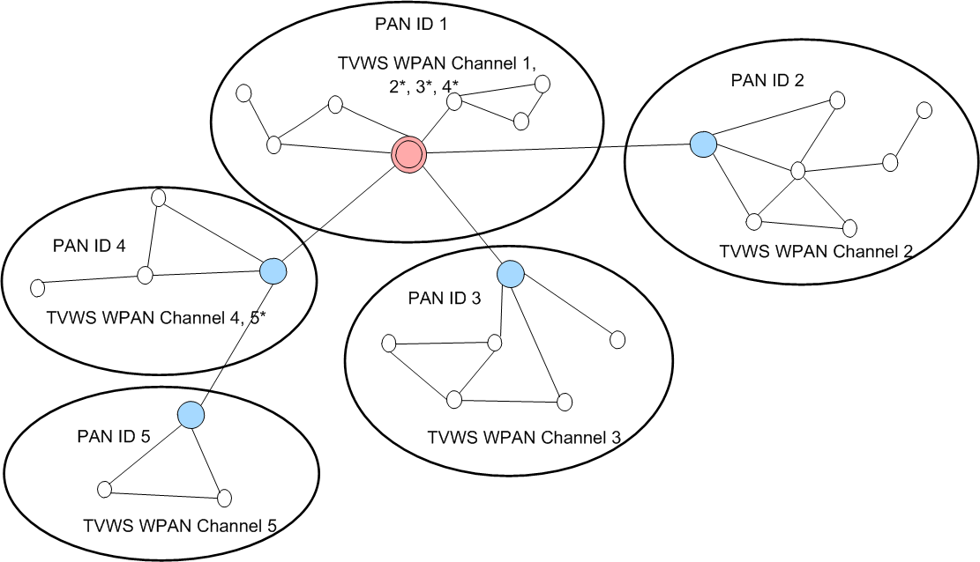



Topologies – Multi-PAN Operation
For TV White space cluster tree PAN (TMCTP - IEEE 802.15.4m)
Operates with
EUI-64 addresses
Single mesh rooted at the super PAN coordinator
Clint Powell, Verotiana Rabarijaona,
Charles Perkins, Noriyuki Sato

Slide 8
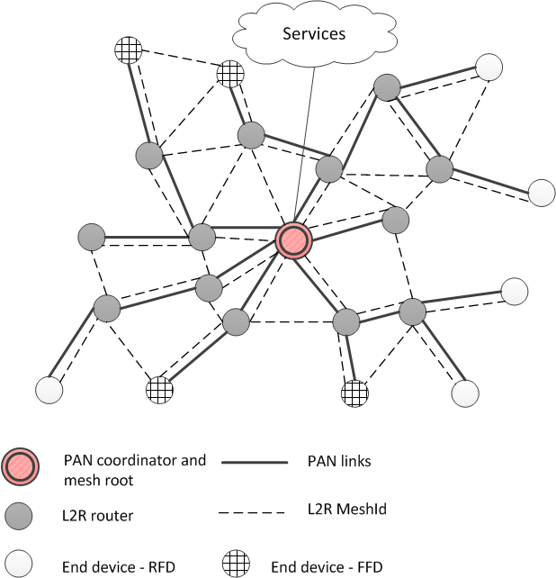
Topologies – Small scale PAN
Single mesh in the PAN
PAN coordinator and mesh root implemented in the same device
Uses short nested IE for downstream route establishment and routing
Clint Powell, Verotiana Rabarijaona,
Charles Perkins, Noriyuki Sato

Slide 9
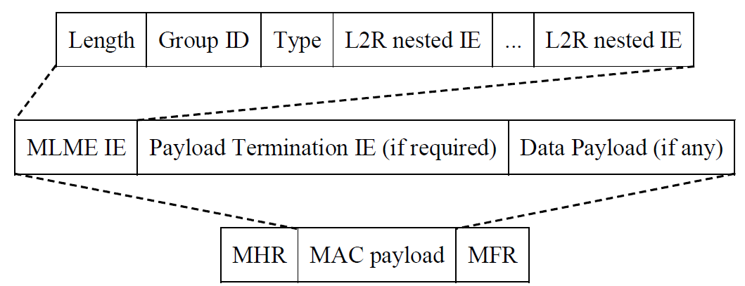
IE Overview
IEEE 802.15.10 uses the frame formats available in IEEE 802.15.4
L2R functions are enabled with nested IEs
The MLME IE is used in an enhanced beacon (EB), enhanced beacon request (EBR) or a data frame
Each nested IE enables one L2R operation
Covered in IEEE 802.15.4
Clint Powell, Verotiana Rabarijaona,
Charles Perkins, Noriyuki Sato

Slide 10
IE’s & Uses
IE name | Description
L2R discovery (L2R-D) IE | Used for L2R mesh management (discovery, join, start...)
Topology construction (TC) IE
Neighbor link metric (NLM) IE
Short route announcement (SRA) IE | Used for establishing downstream routes (unicast and multicast)
Route announcement (RA) IE
Peer-to-peer request (P2P-RQ) IE | Used for establishing P2P routes between two devices
Peer-to-peer reply (P2P-RQ) IE
Short L2R routing (SLR) IE | Used for data routing
L2R Routing IE
Address assignment request (AA-RQ) IE | Used for managing short address assignment
Address assignment reply (AA-RP) IE
Address release (A-RLS) IE
Data concatenation (DCat) IE | Used to when a data frame is the concatenation of several data frames
Clint Powell, Verotiana Rabarijaona,
Charles Perkins, Noriyuki Sato

Slide 11
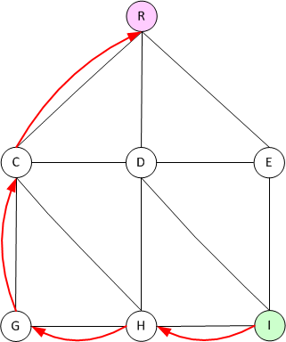

Routing Types Supported - Unicast
Upstream: L2R device to the mesh root
Enabled as soon as a device has joined the mesh
Example use cases:
  Infrastructure monitoring
  Traffic monitoring
  Smart meter reading
  HVAC monitoring
  Environment monitoring
  Agriculture monitoring
  Asset tracking
  Parking monitoring
Clint Powell, Verotiana Rabarijaona,
Charles Perkins, Noriyuki Sato

Slide 12
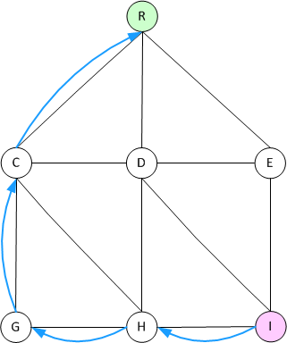
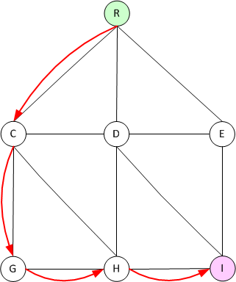
Routing Types Supported - Unicast
Downstream: mesh root to L2R device
Requires route establishment with a (short) route announcement IE ((S)RA IE)
Example use cases:
  HVAC control
  Traffic messaging
  Traffic signal control
  Irrigation
Clint Powell, Verotiana Rabarijaona,
Charles Perkins, Noriyuki Sato

Slide 13
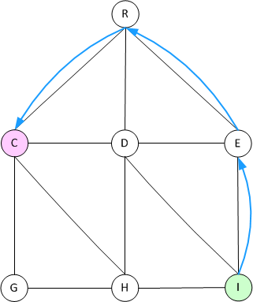
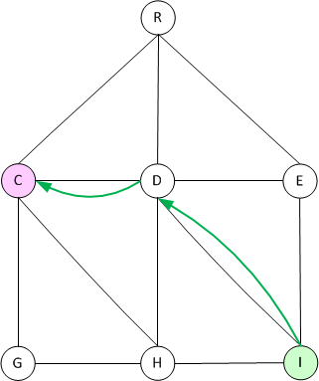
Routing Types Supported - Unicast
Peer-to-peer: L2R device to L2R device
  Combination of US and DS routing or
  Routing on the path established with an exchange of P2P request (P2P-RQ) and P2P reply (P2P-RP) IEs
    Avoid root node congestion
    Minimize #hops, energy consumption
    Minimize end-to-end delay
    Most traffic does not traverse the root
Example use cases:
  Factory automation
  Building automation
Clint Powell, Verotiana Rabarijaona,
Charles Perkins, Noriyuki Sato

Slide 14
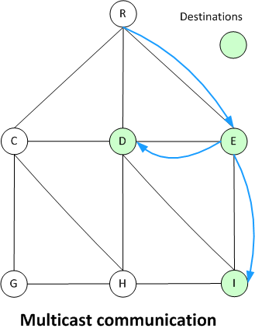
Routing Types Supported – Multicast
L2R device to group of L2R devices based on function (temperature sensor, light...), location (floor, building, district...), or other criteria
Uses flooding with higher layer filtering, or routing on multicast paths established using Multicast Subscription field of the route announcement IE (RA IE)
ACK may not be supported
Example use cases:
  Street lighting
  Building, factory, city energy management systems (BEMS, FEMS, CEMS)
  Sprinkler control
  Entrance/Exit control
Clint Powell, Verotiana Rabarijaona,
Charles Perkins, Noriyuki Sato

Slide 15
Routing Types Supported – Broadcast
Frames sent to all nodes in the mesh.
No route establishment required. An L2R device forwards a frame if it has at least one neighbor other than the L2R device from which the frame was received
Useful for topology building, neighborhood discovery, and route establishment
Care must be used since no acknowledgement
Example use cases:
  Emergency notification
  Outage notification
  Measurement/reading/sensing request
  Ping after disaster
Clint Powell, Verotiana Rabarijaona,
Charles Perkins, Noriyuki Sato

Slide 16
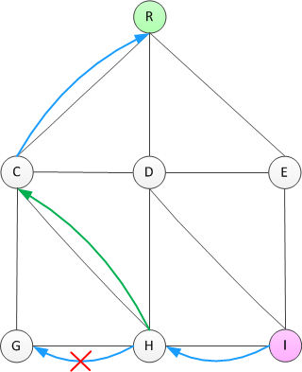
Routing Types Supported - Options
Source routing (DS and P2P)
Hop-by-hop retransmission
  Enabled with the L2R Retransmission
  flag in the L2R Routing IE
  Requires MAC ACK
Octets: ... | 1 | 0/Variable
... | Number of Intermediate Addresses | Intermediate Address List
(S)RA IE, SLR IE, L2R Routing IE, P2P RQ/RP IEs content
Retransmission through a different neighbor
* Not supported with source routing
Failed transmission
Clint Powell, Verotiana Rabarijaona,
Charles Perkins, Noriyuki Sato

Slide 17
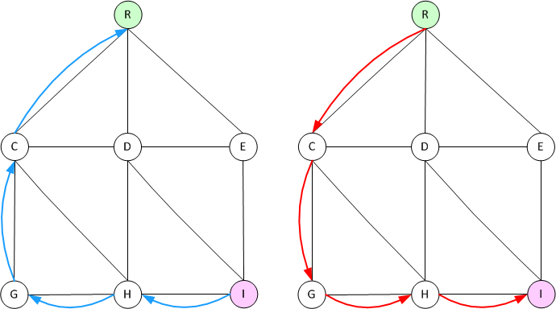
Routing Types Supported - Options
End-to-end acknowledgment
  Enabled with the E2E AR flag in the L2R Routing IE
  Uses the E2E-ACK IE
Clint Powell, Verotiana Rabarijaona,
Charles Perkins, Noriyuki Sato

Slide 18
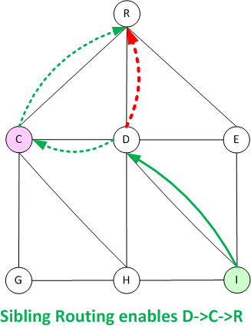
Routing Types Supported – Options
Sibling routing
  When enabled, allows routing through a neighbor of the same depth
  Increases robustness
  Requires resources for loop avoidance
Clint Powell, Verotiana Rabarijaona,
Charles Perkins, Noriyuki Sato

Slide 19
Addressing Supported
All devices in the mesh must use the same address length (either 16-bit or 64-bit)
Unicast, multicast, and broadcast are supported with either address length
PAN coordinator manages address assignment upon request, with signaling mediated by the mesh root
Uses the following short nested IEs for short address assignment:
  AA-RQ IE
  AA-RP IE
  A-RLS IE
Pre-assigned addresses are O.K.
Clint Powell, Verotiana Rabarijaona,
Charles Perkins, Noriyuki Sato

Slide 20
Example for AA-RQ and AA-RP IEs
Node I requests a new address using AA-RQ
Root gets address from PAN coordinator, sends back to I with AA-RP
Clint Powell, Verotiana Rabarijaona,
Charles Perkins, Noriyuki Sato

Slide 21
Payload & Address at each Hop
Time To Live (TTL) is decreased
Each intermediate router sets the transmit address to its own MAC address.
Each intermediate router sets the next hop address appropriately depending on whether US, DS, or P2P routing is in use, possibly modified by sibling routing.
802.15.4 enables per-hop acknowledgement to be requested; 802.15.10 offers in addition end-to-end acknowledgement.
Payload can be increased by data concatenation, and IEs manipulated as shown on the next slide; otherwise the payload remains unchanged.
Clint Powell, Verotiana Rabarijaona,
Charles Perkins, Noriyuki Sato

Slide 22
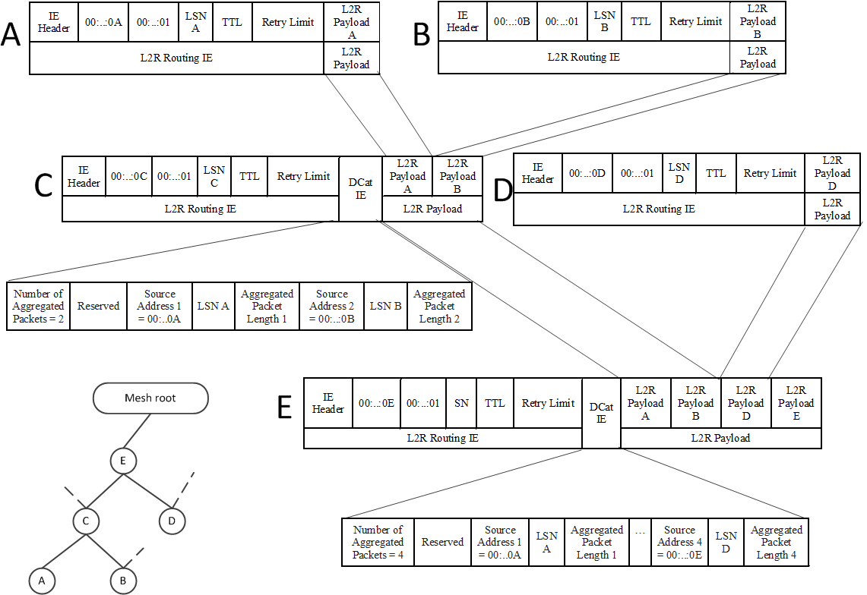
Data Concatenation (DCat)
E transmits concatenation of ((A | B) | D) | E all to same destination
Clint Powell, Verotiana Rabarijaona,
Charles Perkins, Noriyuki Sato

Slide 23
Route Metrics
Metric ID | Metric type name | Description | # of octets
0 | Hop count | # hops source --> destination | 1
1 | RSW | Received Signal Weakness (RSW) | 2
2 | ETX | Estimated # of retransmissions | 2
3 | Expected airtime | time to successfully send a frame | 4
15 | Vendor specific PQM | defined by the implementer.
There are four predefined metrics: Hop Count, RSW, ETX, and Expected Airtime.
RSW is related to “signal strength”
All predefined metrics are integer and additive, monotonically increasing metrics.
Clint Powell, Verotiana Rabarijaona,
Charles Perkins, Noriyuki Sato

Slide 24
Security Features
Security Setting PIBs
  Discovery
    L2R-D IEs are exchanged in an EBR and an EB without security
      Indicates key exchange method - Non secure, Out-of-band, KMP
  Key setting
    Attributes of L2IB are set by higher layer or out-of-band mechanism
    Key exchange can be done by IEEE802.15.9.
  Related L2IB
    L2R Unicast Security attributes
      A key is managed by MAC layer. Key usage is managed by L2R (Key ID mode, Key source, Key index)
      Individual key usage can be set per neighbor (IEEE802.15.4 supports a link key)
      Different key usage for general unicast, RA IE and AA IE specific.
    L2R Broadcast Security attributes
      Different key usages can be set for general BC, TC IE and NLM IE.
Clint Powell, Verotiana Rabarijaona,
Charles Perkins, Noriyuki Sato

Slide 25
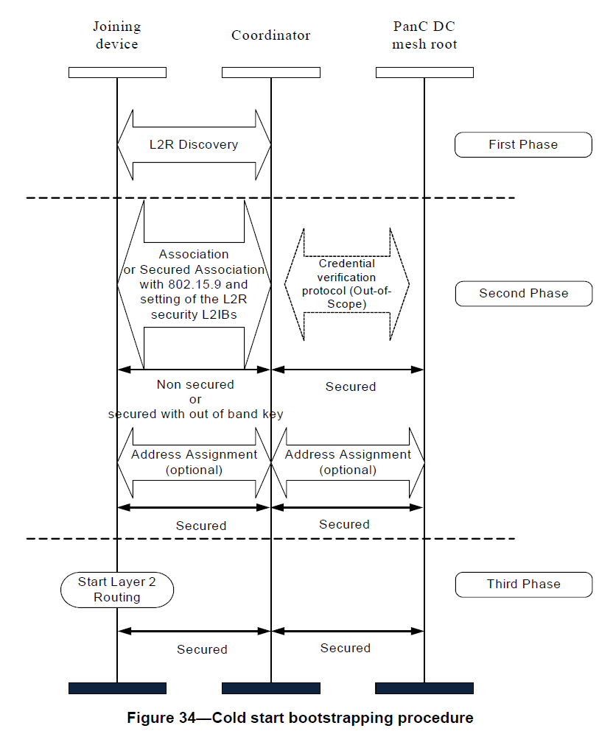
Example bootstrap with IEEE802.15.9
Clint Powell, Verotiana Rabarijaona,
Charles Perkins, Noriyuki Sato

Slide 26
Questions?
Clint Powell, Verotiana Rabarijaona,
Charles Perkins, Noriyuki Sato

