Slide 1
Project: IEEE P802.15 Working Group for Wireless Personal Area Networks (WPANs)
Submission Title: [802.15.4 MAC Addresses]
Date Submitted: [12 March 2017]
Source: [Pat Kinney] Company [Kinney Consulting]
Address [Chicagoland]
Voice:[Add telephone number], FAX: [Add FAX number], E-Mail:[pat.kinney@kinneyconsultingllc.com]
Re: [Concern about transmission order of extended MAC address]
Abstract: [excerpts from 15.4 revisions dealing with address transmission order.]
Purpose: [consider 802.15.4-2015’s declaration of MAC address ordering.]
Notice: This document has been prepared to assist the IEEE P802.15. It is offered as a basis for discussion and is not binding on the contributing individual(s) or organization(s). The material in this document is subject to change in form and content after further study. The contributor(s) reserve(s) the right to add, amend or withdraw material contained herein.
Release: The contributor acknowledges and accepts that this contribution becomes the property of IEEE and may be made publicly available by P802.15.

Slide 2
Transmission order of MAC address
Specifically for 802.15.4

Slide 3
64-bit MAC address through the revisions
802.15.4-2003 6.3 All multiple octet fields shall be transmitted or received least significant octet first and each octet shall be transmitted or received least significant bit (LSB first. The same transmission order should apply to data fields transferred between the PHY and MAC sublayer.
802.15.4-2006 6.3 All multiple octet fields shall be transmitted or received least significant octet first and each octet shall be transmitted or received least significant bit (LSB) first. The same transmission order should apply to data fields transferred between the PHY and MAC sublayer.
802.15.4-2006 C2.2.1 The example below illustrates security processing of a data frame that is transmitted using extended addresses, with PAN identifier compression and acknowledgment enabled. This example uses source address 0xacde480000000001, destination address 0xacde480000000002, PAN identifier 0x4321, and data payload 0x61 0x62 0x63 0x64; the frame counter has integer value 5. The security level is set to 0x04 (ENC, or data confidentiality without data authenticity). For simplicity, all frames in this example are shown without the FCS field (because security processing is independent of it).
Secured data frame:
69 DC 84 21 43 02 00 00 00 00 48 DE AC 01 00 00 00 00 48 DE AC || 04 05 00 00 00 || D4 3E 02 2B.
Corresponding unsecured data frame:
61 CC 84 21 43 02 00 00 00 00 48 DE AC 01 00 00 00 00 48 DE AC || 61 62 63 64.

Slide 4
64-bit MAC address through the revisions
802.15.4-2011 10.1 All multiple octet fields shall be transmitted or received least significant octet first, and each octet shall be transmitted or received least significant bit (LSB) first.
802.15.4-2015 4.3 Numbers of size greater than 1 octet occur with the octet containing the least significant bits first (leftmost) followed by octets containing bits of increasing significance to the right.
802.15.4-2015 4.4 A string of length greater than 1 octet is represented by the octet containing the lowest numbered bits first and leftmost, followed by octets containing increasing bit numbers to the right.
802.15.4-2015 7.1 The EUI-64 shall be sent in the canonical form defined in IEEE Std 802-2014.
802-2014 8.2.2 NOTE—The upper, bit-stream representation of the EUI-48 in Figure 10 and the EUI-64 in Figure 11 shows the LSB of each octet first; this corresponds to the data-communications convention for representing bit-serial transmission in left-to-right order, applied to the model for transmission of EUI-48 fields (see 5.2.3) and EUI-64 fields. See also 8.6 for further discussion of bit-ordering issues. The lower, octet-sequence representation shows the bits within each octet in the usual order for binary numerals; the order of octet transmission is from the top downward.

Slide 5
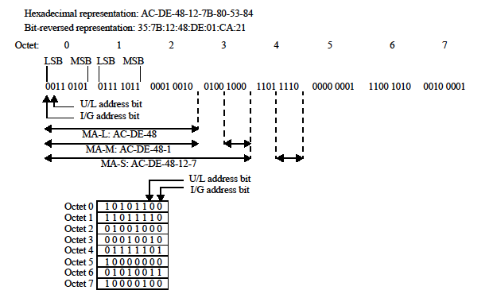
802-2014 (Figure 11)

Slide 6
Resolution
Major uses with compliance concerns: ZigBee, Thread, WiSUN, W-HART, ISA100, 6tisch, 6lo, ETSI (TS 102 887-1), TIA (TR51)
What percentage of deployed 802.15.4 devices use MAC address as per 802-2014?
What percentage of deployed 802.15.4 devices use MAC address as per 802.15.4-2003?
If choose to use 802.15.4-2003 method then
802.15.4 Corrigendum
802 update

