Slide 1
Project: IEEE P802.15 Working Group for Wireless Personal Area Networks (WPANs)
Submission Title: [802.15.4 MAC Addresses]
Date Submitted: [12 March 2017]
Source: [Pat Kinney] Company [Kinney Consulting]
Address [Chicagoland]
Voice:[Add telephone number], FAX: [Add FAX number], E-Mail:[pat.kinney@kinneyconsultingllc.com]
Re: [If this is a proposed revision, cite the original document.]
Abstract: [Description of document contents.]
Purpose: [Description of what the author wants P802.15 to do with the information in the document.]
Notice: This document has been prepared to assist the IEEE P802.15. It is offered as a basis for discussion and is not binding on the contributing individual(s) or organization(s). The material in this document is subject to change in form and content after further study. The contributor(s) reserve(s) the right to add, amend or withdraw material contained herein.
Release: The contributor acknowledges and accepts that this contribution becomes the property of IEEE and may be made publicly available by P802.15.

Slide 2
Transmission order of MAC address
Specifically for 802.15.4

Slide 3
64-bit MAC address through the revisions
802.15.4-2003 6.3 All multiple octet fields shall be transmitted or received least significant octet first and each octet shall be transmitted or received least significant bit (LSB) first. The same transmission order should apply to data fields transferred between the PHY and MAC sublayer.
802.15.4-2006 6.3 All multiple octet fields shall be transmitted or received least significant octet first and each octet shall be transmitted or received least significant bit (LSB) first. The same transmission order should apply to data fields transferred between the PHY and MAC sublayer.
802.15.4-2011 10.1 All multiple octet fields shall be transmitted or received least significant octet first, and each octet shall be transmitted or received least significant bit (LSB) first.
802.15.4-2015 4.3 Numbers of size greater than 1 octet occur with the octet containing the least significant bits first (leftmost) followed by octets containing bits of increasing significance to the right.
4.4 A string of length greater than 1 octet is represented by the octet containing the lowest numbered bits first and leftmost, followed by octets containing increasing bit numbers to the right.
7.1 The EUI-64 shall be sent in the canonical form defined in IEEE Std 802-2014.

Slide 4
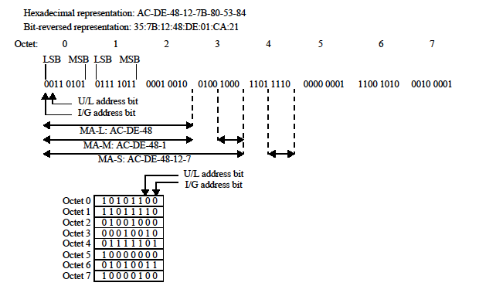
8.2.2 NOTE—The upper, bit-stream representation of the EUI-48 in Figure 10 and the EUI-64 in Figure 11 shows the LSB of each octet first; this corresponds to the data-communications convention for representing bit-serial transmission in left-to-right order, applied to the model for transmission of EUI-48 fields (see 5.2.3) and EUI-64 fields. See also 8.6 for further discussion of bit-ordering issues. The lower, octet-sequence representation shows the bits within each octet in the usual order for binary numerals; the order of octet transmission is from the top downward.
802-2014

Slide 5
Resolution
802.15.4 Corrigendum
802 update

