Slide 1
Project: IEEE P802.15 Working Group for Wireless Personal Area Networks (WPANs)
Submission Title: [LP-WAN Downlink Issues]
Date Submitted: [12 March, 2017]
Source: [Joerg ROBERT] Company [Friedrich-Alexander University Erlangen-Nuernberg]
Address [Am Wolfsmantel 33, 91058 Erlangen, Germany]
Voice:[+49 9131 8525373], FAX: [+49 9131 8525102], E-Mail:[joerg.robert@fau.de]
Re: []
Abstract: [This presentation shows generic problems with the downlink in LPWAN]
Purpose: [Presentation within IG LPWA]
Notice: This document has been prepared to assist the IEEE P802.15. It is offered as a basis for discussion and is not binding on the contributing individual(s) or organization(s). The material in this document is subject to change in form and content after further study. The contributor(s) reserve(s) the right to add, amend or withdraw material contained herein.
Release: The contributor acknowledges and accepts that this contribution becomes the property of IEEE and may be made publicly available by P802.15.

Slide 2
LP-WAN Downlink Issues
Joerg Robert
FAU Erlangen-Nuernberg

Slide 3
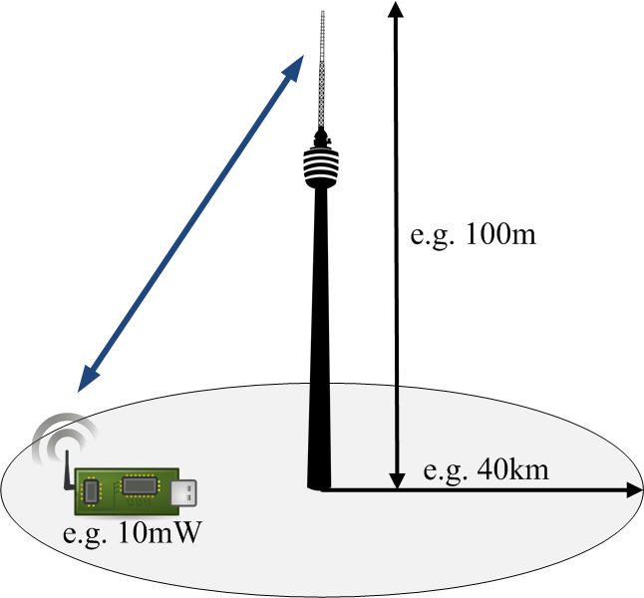
Scenario
Exposed base-station receives data from potentially thousands of devices
Clever channel access schemes allow for the parallel reception of many nodes at the base-station
Base-station wants to ACK each uplink packet it receives

Slide 4
Link Budget Calculations ( I / II )
 | Uplink | Downlink
Receiver Noise Figure F | 3dB | 6dB
Required E_{b}/N₀ | 3dB | 10dB
Elect. P_{TX} | 10dBm | 3dBm/17dBm *)
TX Antenna Gain G_{TX} | 0dBi | 10dBi
RX Antenna Gain G_{RX} | 10dBi | 0dBi
Payload Bit-Rate R | 100bit/s | 100bit/s
*) TX Power limited due to EIRP limitation to 20mW / 500mW (higher
power band in) in Europe
Noise figure assumptions according to 17/36r1
Assumption of powerful forward error correction (FEC) in uplink and simplified FEC in downlink

Slide 5
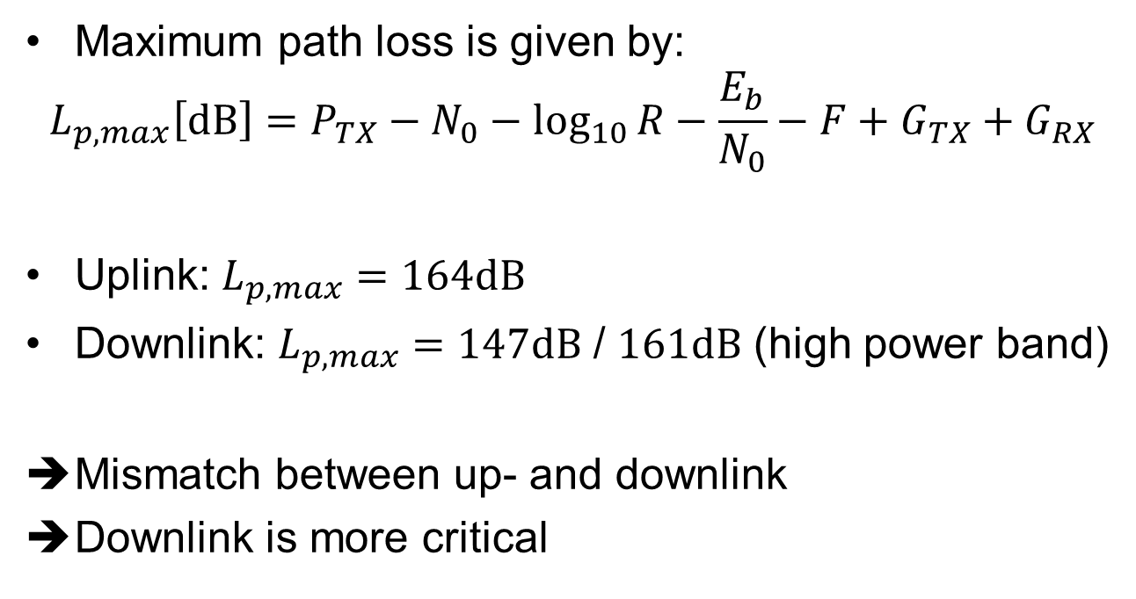
Link Budget Calculations ( II / II )
Maximum path loss is given by:
$$L_{p,max}\left[dB\right]=P_{TX}−N_{0}−\log_{10}{R}−\frac{E_{b}}{N_{0}}−F+G_{TX}+G_{RX}$$
Uplink: $L_{p,max}=164dB$
Downlink: $L_{p,max}=147dB$ / $161dB$ (high power band)
Mismatch between up- and downlink
Downlink is more critical

Slide 6
Solutions for Symmetric Link-Budget
Increasing the transmit power the base-station is not possible due to frequency regulation (same holds for higher gain antennas)
Improved performance of FEC and reduced noise figure in nodes leads to increased power consumption and costs
Reduced payload bit-rate is only remaining solution

Slide 7
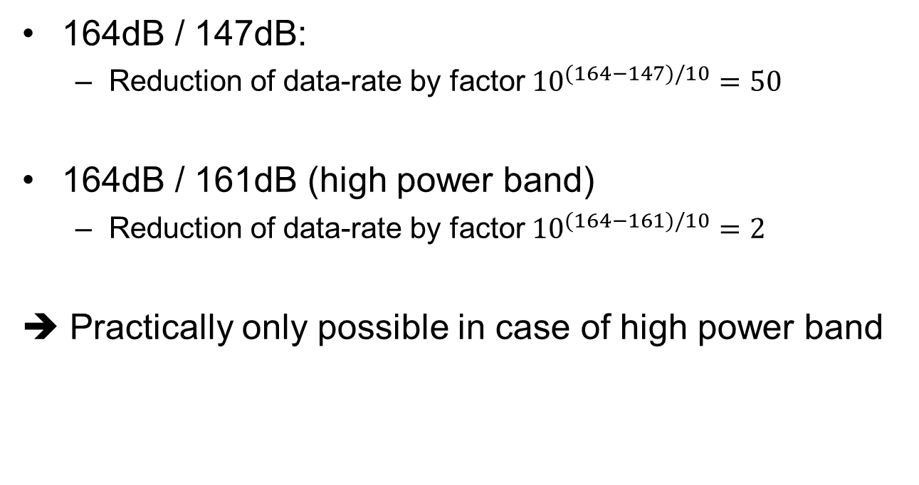
Reduced Payload Bit-Rates
164dB / 147dB:
  Reduction of data-rate by factor ${10}^{(164−147)/10}=50$
164dB / 161dB (high power band)
  Reduction of data-rate by factor ${10}^{(164−161)/10}=2$
➔ Practically only possible in case of high power band

Slide 8
Downlink Limitations: Scenario Definition
One node sends an uplink packet and requests an ACK from the base-station
Uplink data has 200 bit/s with R=100bit/s
→ Packet length of 2s
Downlink ACK packet has 100bit/s with R=50bit/s (high power band, half rate for link budget correction)
→ Packet length of 2s
A base-station can only ACK one packet at a time as otherwise the downlink power for each ACK packet would be halved

Slide 9
Downlink Limitations
A base-station is only able to ACK 0.5 packets/s if it has to generate a separate ACK for each uplink packet in the high power band
A base-station is only able to ACK 0.04 packets/s if it has to generate a separate ACK for each uplink
Impossible to ACK uplink packet separately
Even worse if Duty Cycle considerations have to be taken into account (e.g. 10% for high power band in Europe)

Slide 10
Conclusions
In LPWANs the downlink is more critical than the uplink
A base-station would be only able to ACK few uplink packets if a separate ACK packet for each uplink packet has to be transmitted
Clever schemes for more effective downlink transmission have to be evaluated

Slide 11
Thank You!
Questions / Comments?

